Slide 1


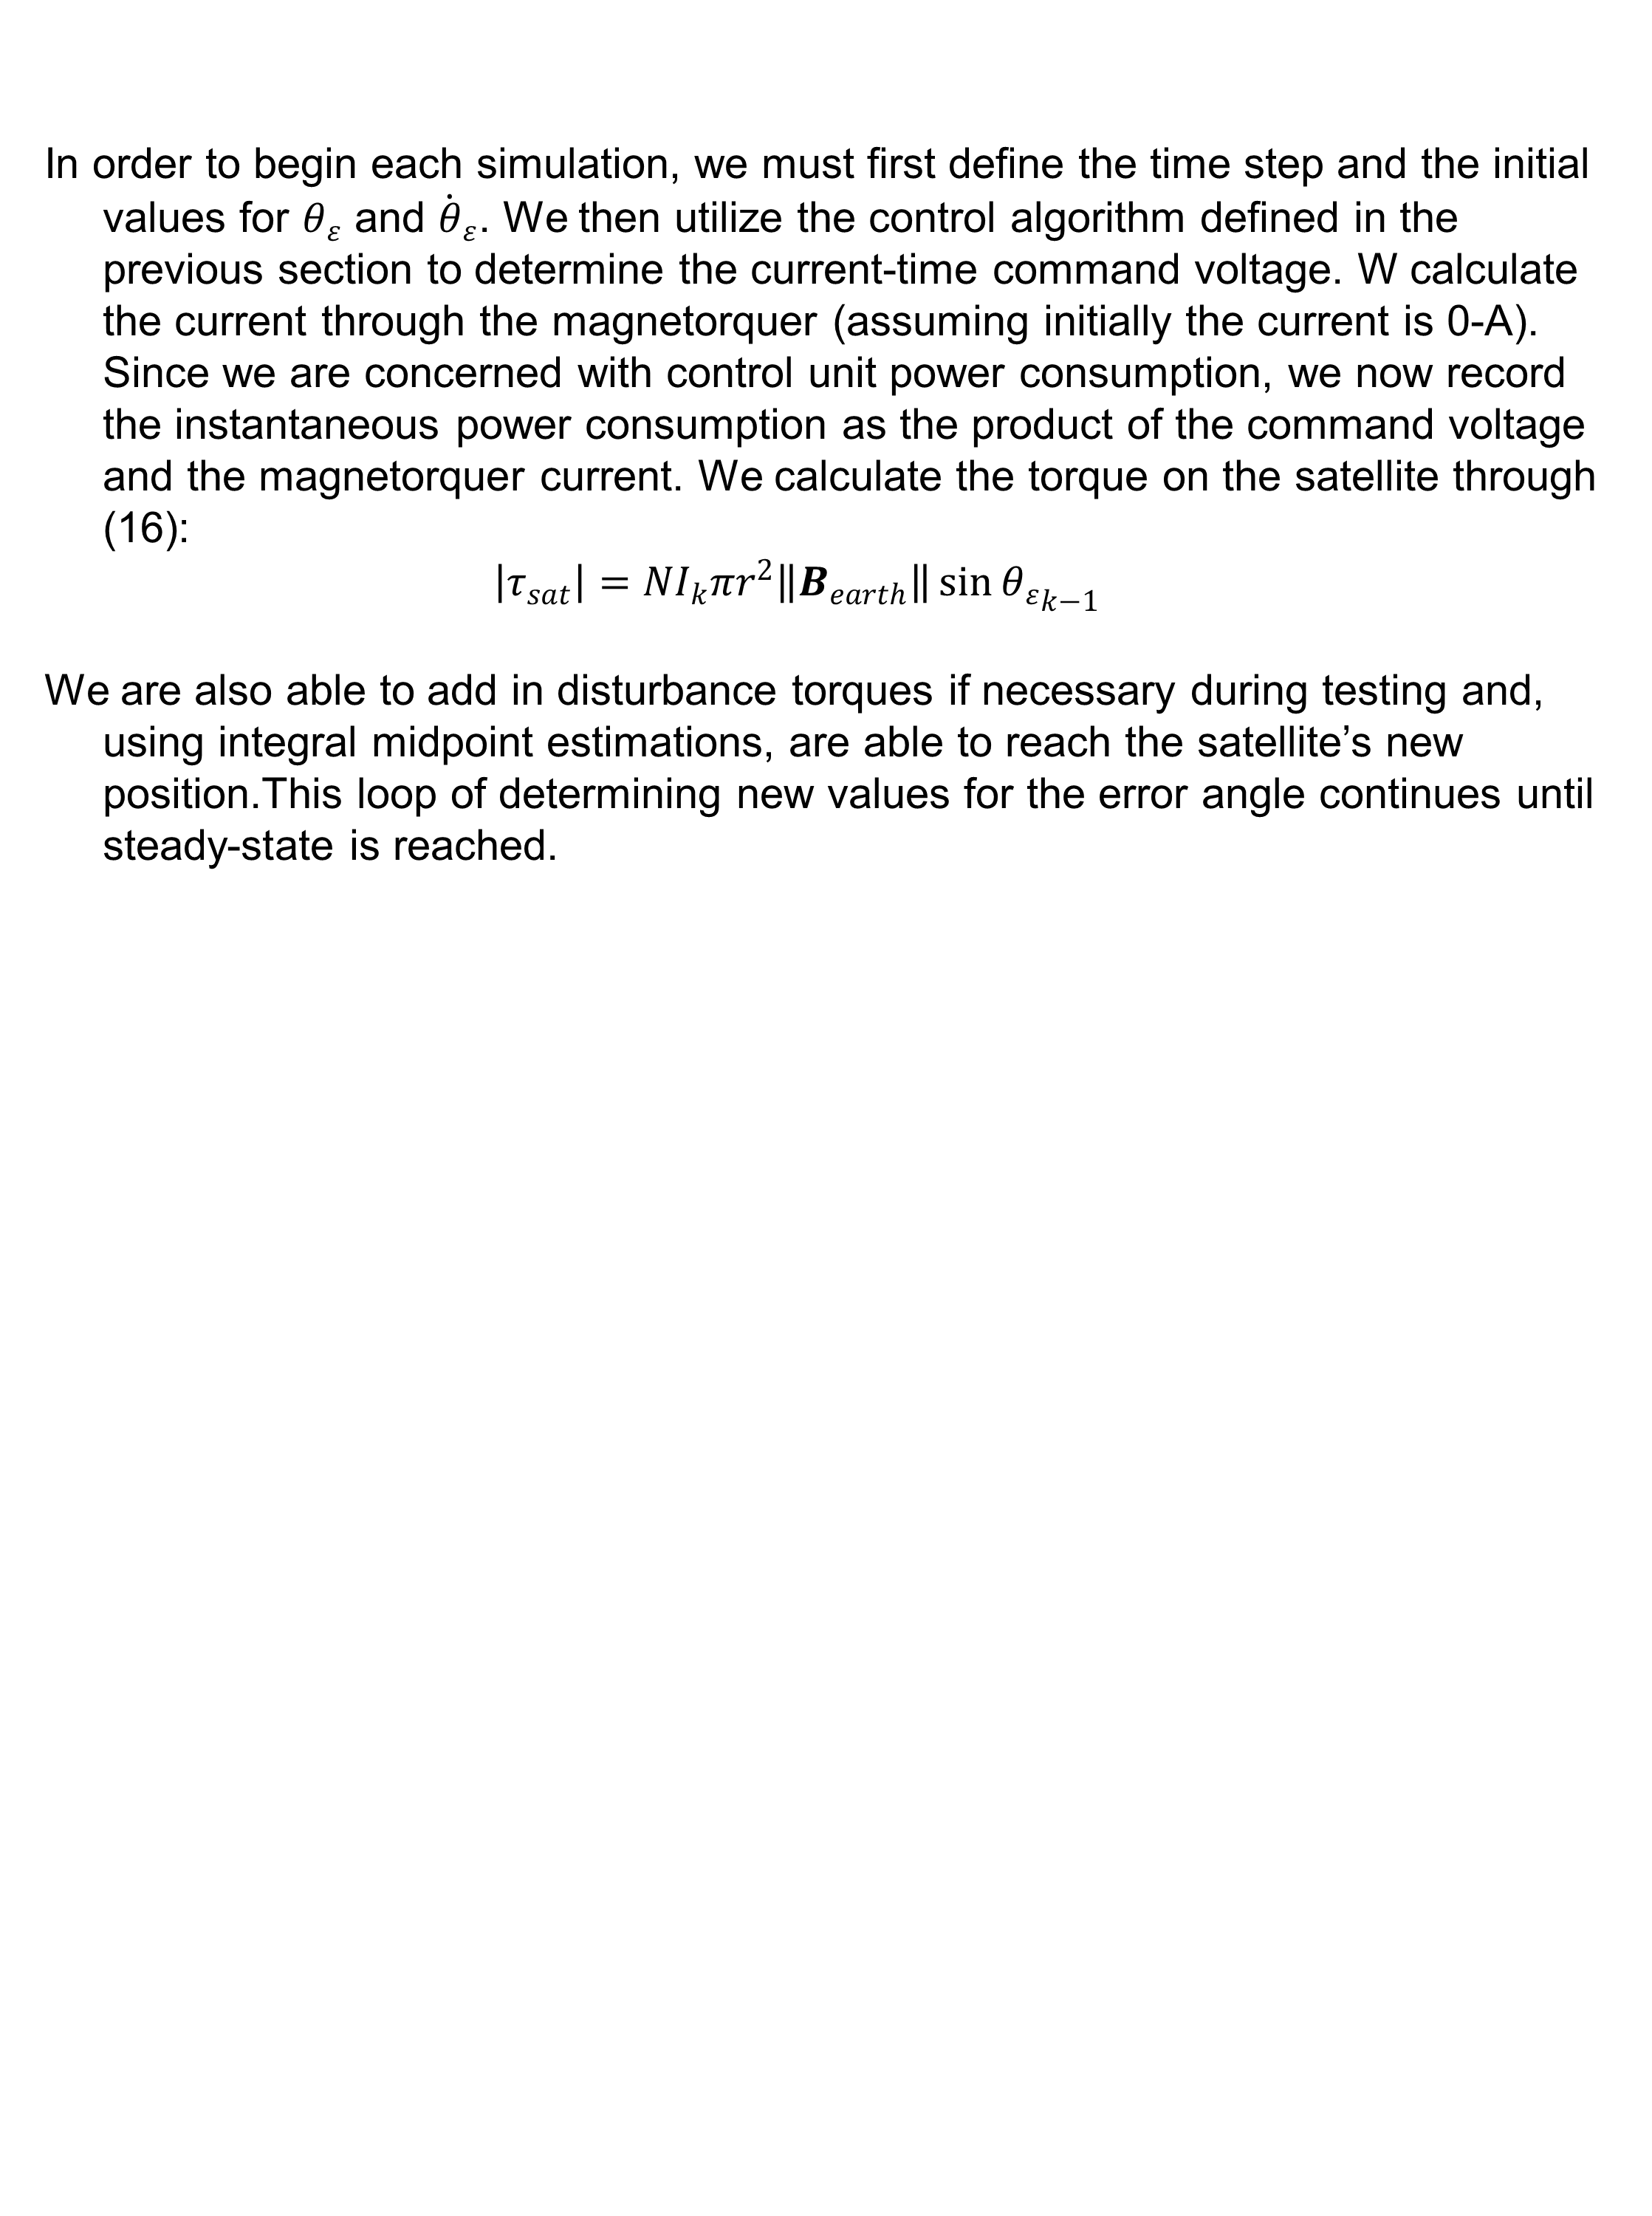
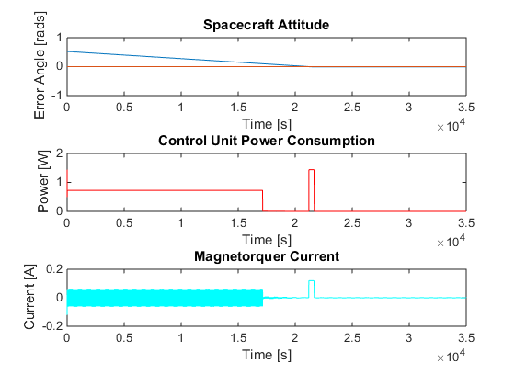
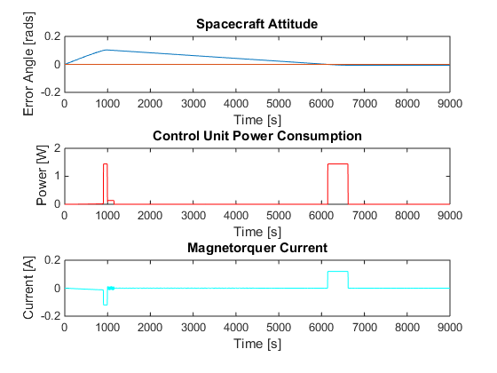
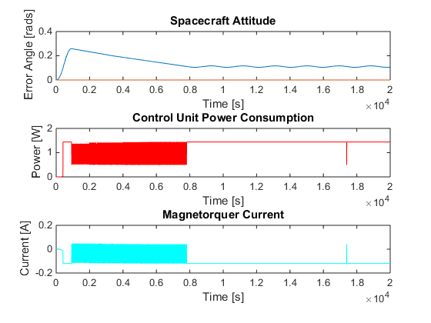
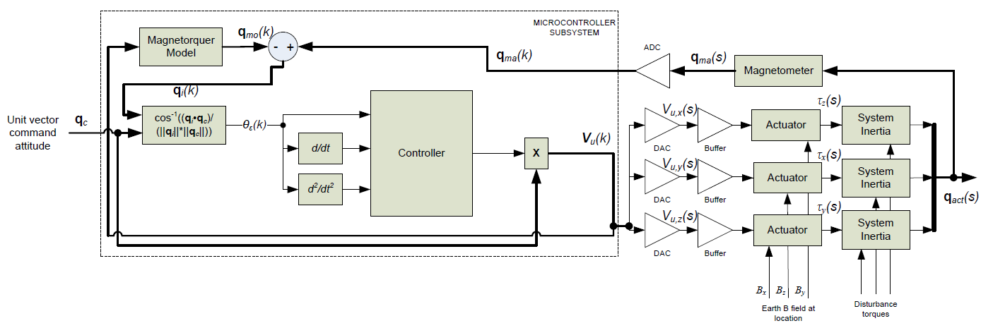
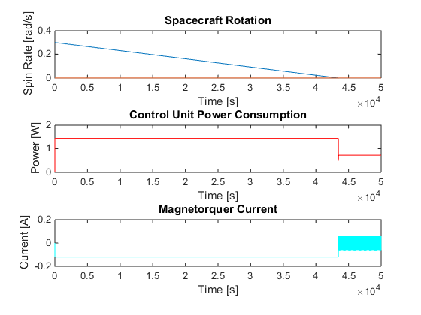
CDT Clayton Jaksha, United States Military Academy
A Modular, Low-Power Cube Satellite Attitude Control System Using Magnetorquers
In this work, we create a modular control system with magnetorquers that provides single-axis attitude and stability and control for a variety of common CubeSat configurations. We achieve this by analyzing the advantages and limitations of magnetorquers for attitude control, simplifying the controller design challenge, determining a low-power control algorithm, and testing the control solution through simulation. In a system that relies solely on magnetorquers for stability and control, the Earth’s magnetic field provides the only stable frame of reference, therefore we are able to take a multi-dimensional control problem that would normally involve greater processing power and reduce it to a simple, one-dimensional control system. Taking also into account a limited power budget, we are able to design a rate-based combinational logic controller that provides attitude control on limited power and static stability with extremely little power. We validate the system with tests for standard attitude commands under different satellite inertial configurations, impulse disturbance torques, constant disturbance torques, and tumble recovery.
Abstract
Methodology
Results
Background
Soaring overhead at thousands of miles per hour, satellites inspire in humanity the awe of space and wonder of discovery. As the cost of launching pico- and nano-satellites into low-Earth orbit decreases and the amount of space-based research and educational payloads increases, the need for modular cube satellite buses becomes more pressing. One must assume the users of these buses are not all aerospace engineers, so the bus subsystems must be straight-forward enough to be configured and troubleshot by anyone with a technical background. The brain of any spacecraft bus is its control system and the value of any modular cube satellite bus relies on the robustness of its control architecture.
Though many cube satellite control systems rely on momentum wheels and magnets for control and stability, the weight and power requirements of those systems can sometimes put excessive design constraints on other bus systems or, worse, limit the payload’s ability to perform its mission. Used creatively, magnetorquers have the ability to provide a low-power stability and control to most general cube satellite configurations. By creating a lighter, more modular control system, cube satellites can become more accessible to the researchers that require them and, in doing so, become a platform to advance the state of human knowledge.
The switching control is performed through combinational logic. We accomplish this by correcting the position concavity so that it is always zero, which produces a constant rate of rotation. We also begin to multiply the output voltage by the current position as a method of power conservation as the satellite reaches steady state. For very small error angles, the controller outputs very small control voltages and consumes very little power to just keep the attitude where it needs to be.
Plot of error angle, power consumption, and magnetorquer current for commanded 30º attitude maneuver for a “high-inertia” cube satellite configuration. Satellite comes to rest near 22,000-s with very little steady-state error.
Plot of error angle, power consumption, and magnetorquer current for for a significant 0.01-s perturbation. Satellite comes to rest near 6700-s with very little steady-state error.
Plot of spin rate, power consumption, and magnetorquer current for a notional tumble recovery scenario. Satellite ceases tumbling near 43,000-s.
Plot of error angle, power consumption, and magnetorquer current for commanded for a small, yet constant disturbance torque. Satellite comes to rest near 8000-s with some steady-state error.
Plot of spin rate, power consumption, and magnetorquer current for a notional tumble recovery scenario. Satellite ceases tumbling near 43,000-s.
Three-dimensional modular control system using magnetorquers. The blocks in this system represent physical systems that would be implemented on the satellite bus as opposed to fig. 4, which shows the simplified mathematical model for the control system.

