Slide 1
A Modular Low-power cube satellite attitude controller with magnetorquers
CDT Clayton Jaksha
Department of Electrical Engineering and Computer Science
United States Military Academy
AUTS 23 | 14 October 2015

Slide 2
Design problem
Cube satellite research platforms becoming more affordable
Attitude stability and control is complicated—requires highly technical, specialized education
How can we make CubeSat ADCS more accessible to research platforms with limited budget and only a basic understanding of astronautics?

Slide 3
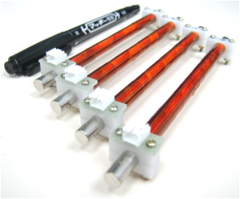
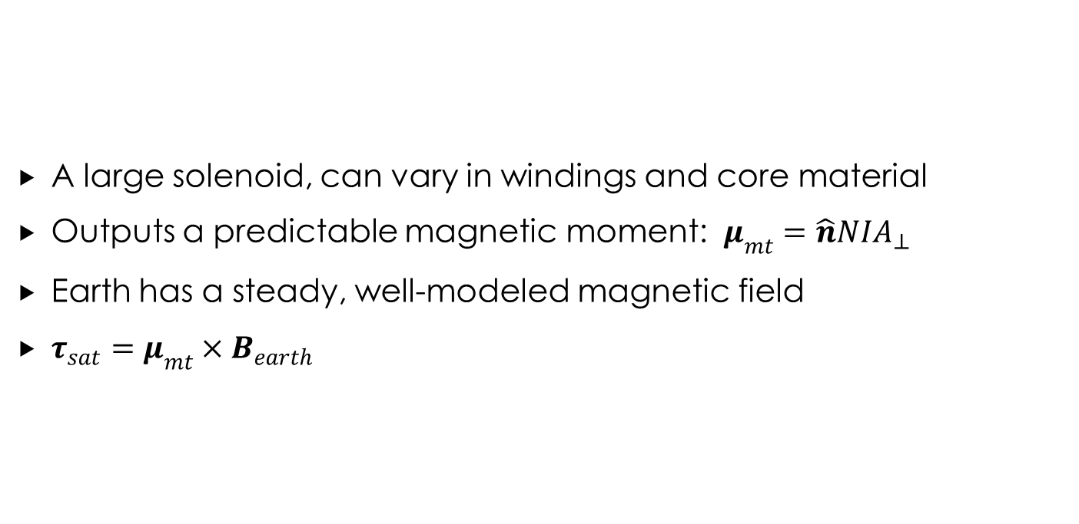
magnetorquers
A large solenoid, can vary in windings and core material
Outputs a predictable magnetic moment: $μ_{mt}=\hat{n}NIA_{⊥}$
Earth has a steady, well-modeled magnetic field
$τ_{sat}=μ_{mt}×B_{earth}$
Source: http://sat.aero.cst.nihon-u.ac.jp/sprout-e/images/SPROUT/ADC5.png

Slide 4

limitations
Power/current budget on satellite EPS
Roll/pitch/yaw movement in space is severely underdamped
Magnetic field only strong enough at low-Earth orbit (LEO)
Orbital inclination low enough to avoid poles
Magnetorquer control/stability leaves one DOF uncontrolled
Source: http://greendustriesblog.com/greendustries/wp-content/uploads/2013/04/EarthMagneticField.jpg

Slide 5
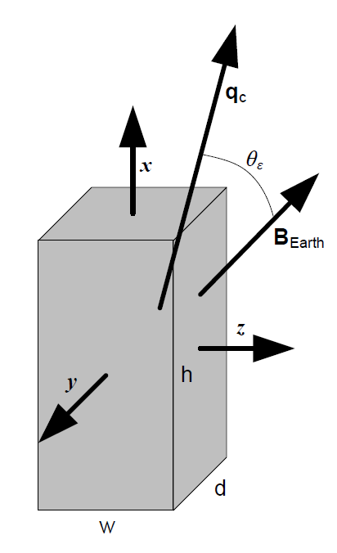
Controller requirements
Account for severe underdamping in space environment
Close control loop by detecting difference between Earth’s magnetic field
Be able to control the axis about which 1-DOF exists

Slide 6
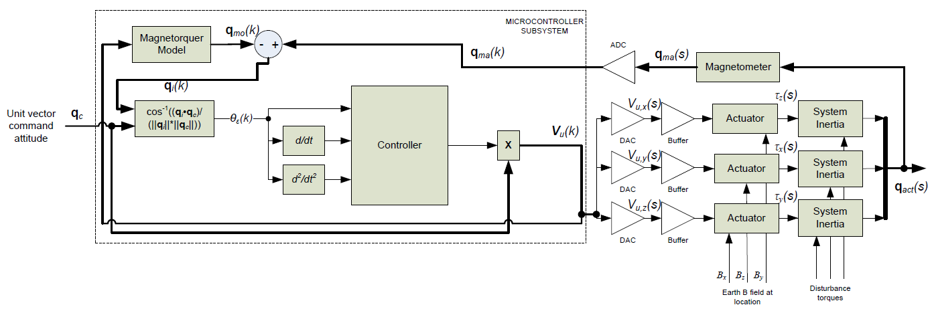
Control block diagram

Slide 7
Control LOGIC
LOOP
IF time derivative of error angle > threshold
Apply V_{cc} to magnetorquer
ELSE IF second time derivative of error angle > 0
Apply V_{cc}•error angle to magnetorquer
ELSE IF second time derivative of error angle < 0
Apply -V_{cc}•error angle to magnetorquer
Threshold changes based on magnitude of error angle

Slide 8
System testing and validation
Fixed-step Euler method discrete system simulation in MATLAB
Assume constant magnitude for Earth’s magnetic field (60-μT)
Assume moment of inertia constant as average of moment of inertia about each satellite rotational DOF
Scenarios to simulate:
30º attitude command, standard inertia
30º attitude command, high inertia
Impulse perturbation response
Constant disturbance torque stability
Tumble recovery

Slide 9
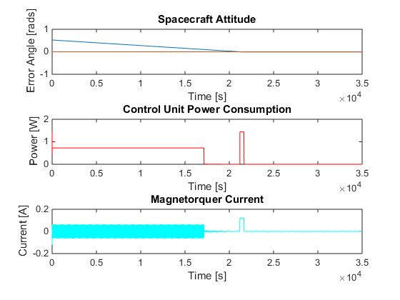
30º attitude command, standard inertia
2-u Cube Satellite (10x10x20-cm)
2-kg gross mass
1.44-W maximum power consumption
Results:
Comes to rest within 7 hours
Median power consumption: <1-W
Stable

Slide 10
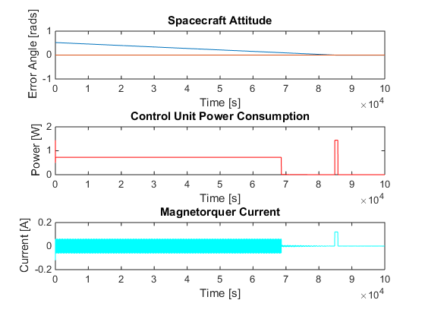
30º attitude command, HIGH inertia
3-u Cube Satellite (10x10x20-cm)
4-kg gross mass
1.44-W maximum power consumption
Results:
Comes to rest within 23 hours (multiple LEOs)
Median power consumption: <1-W
Stable

Slide 11
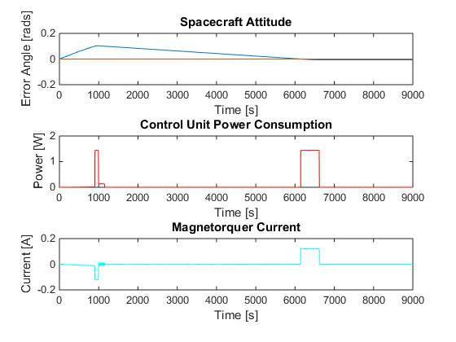
Impulse perturbation response
2-u Cube Satellite (10x10x20-cm)
2-kg gross mass
1.44-W maximum power consumption
0.01-s, 100-mN∙m disturbance torque
Results:
Comes to rest within 2 hours
Very low power
Stable

Slide 12
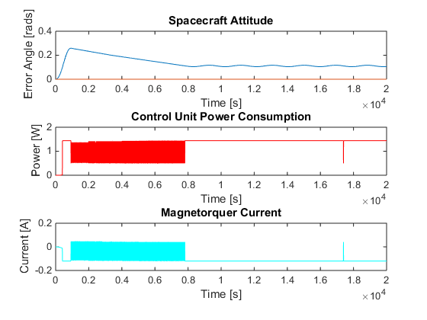
Constant disturbance torque
2-u Cube Satellite (10x10x20-cm)
2-kg gross mass
1.44-W maximum power consumption
Constant 34.5-mN∙m disturbance torque
Results:
Comes to rest within 3 hours
Remains at or below maximum power consumption
Stable
Minimal steady-state error

Slide 13
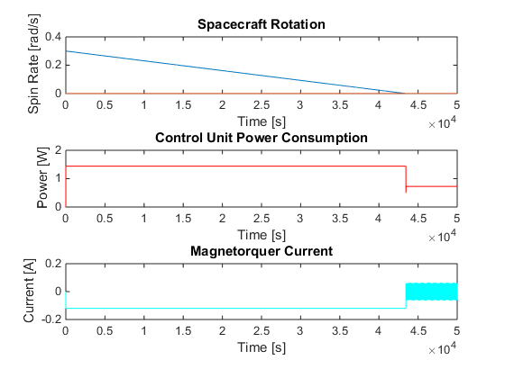
Tumble recovery
Look at controllable spin rate
2-u Cube Satellite (10x10x20-cm)
2-kg gross mass
1.44-W maximum power consumption
Initialize at 0.3 rad/s (~17º/s)
Results:
Comes to rest within 4 hours
Remains at or below maximum power consumption
Spin about controllable axes neutralized
Next step: correct position through attitude command

Slide 14
Conclusions/Way forward
Magnetorquer control should not be implemented on high-inertia cube satellites
Magnetorquer control can be used as an affordable, low-power method of stability and control
ADCS can be achieved in space with little knowledge about astronautics on the user end
Alternative observer loop can be achieved with GPS onboard and high-resolution model of Earth’s magnetic field
More software modeling that can better model space environment helpful to better define threshold tuning
Black Knight II (USMA, D/EECS) cube satellite platform will see implementation of described control system. Engineering unit to be built and tested this FY.

Slide 15
Questions/Contact information
CDT Clayton Jaksha
Department of Electrical Engineering and Computer Science
United States Military Academy
Email: clayton.jaksha@usma.edu

