Slide 1
Title: AutoML with Monte Carlo Tree Search and Neural Network
Author: Shaohang Chen
Supervisor : Yiran Huang

Slide 2
0. Design
AutoML
Monte Carlo Tree Search
MCTML Structure
MCTML Details
Evaluation
Future Work

Slide 3
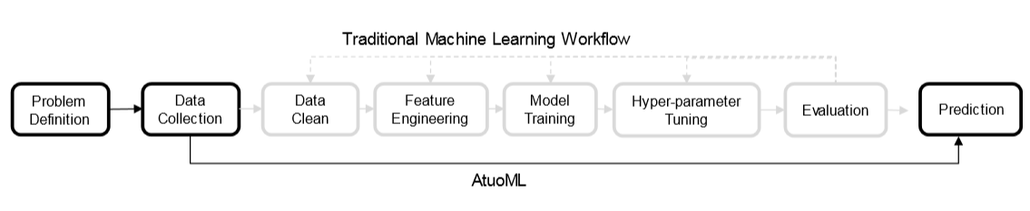
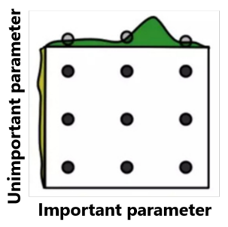
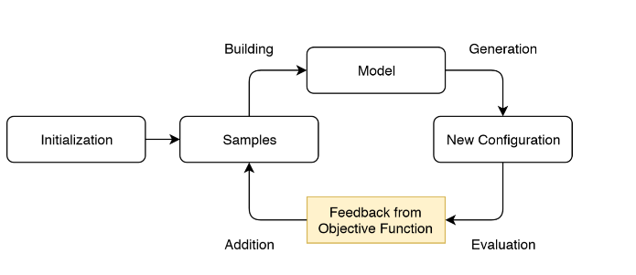
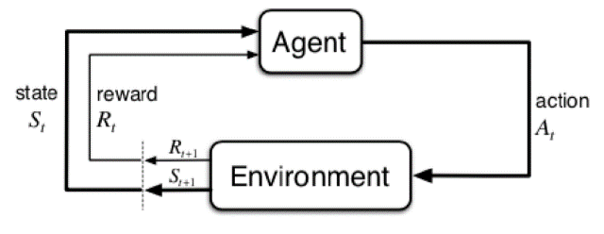
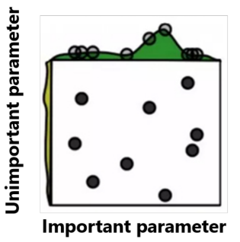
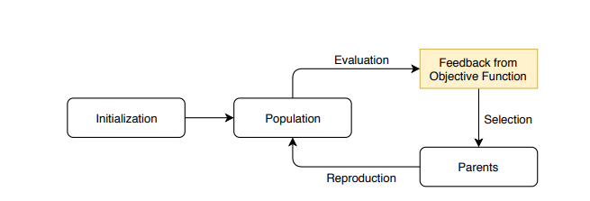
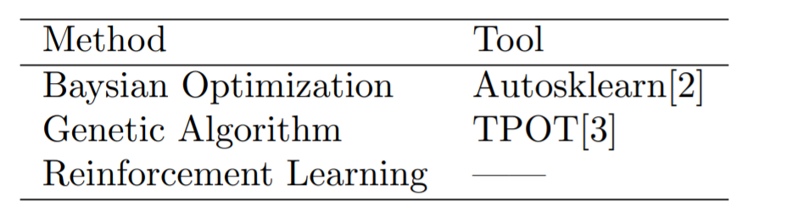
1. AutoML
Task: Algorithm selection and hyperparameter selection --- black box optimization[1]
Figure 1.1: Traditional machine learning workflow and AutoML
Figure 1.2: Grid Search
Figure 1.4: Baysian Optimization
Figure 1.5: Reinforcement Learning
Figure 1.3: Random Search
Figure 1.5: Genetic Algorithm
Table 1: AutoML methods and tools
[1] Automated Machine Learning: Methods, Systems, Challenges, Hutter, Frank, 2018
[2] Efficient and Robust Automated Machine Learning, Matthias Feurer, Aaron Klein, Katharina Eggensperger,2015
[3] TPOT: A Tree-Based Pipeline Optimization Tool for Automating Machine Learning, Randal S. Olson,etc, 2019

Slide 4
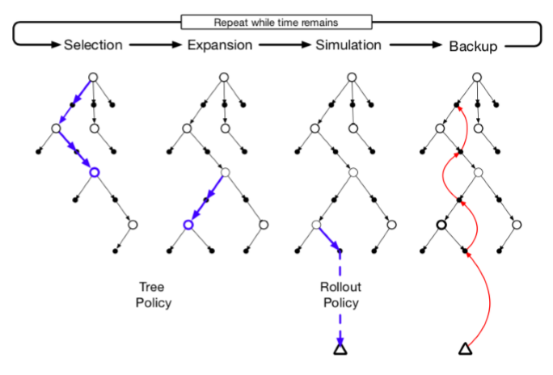

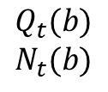
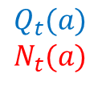

2. Monte Carlo Tree Search
$$Q_{t}$$
$$N_{t}$$
a b
$$Q_{t}(a)$$
$$N_{t}(a)$$
$$Q_{t}(b)$$
$$N_{t}(b)$$
Figure 2.2: Ilussion of parent node and children nodes
$$A_{t}\dot{=}\underset{a}{argmax}{[Q_{t}\left(a\right)+c\sqrt{\frac{N_{t}}{N_{t}(a)}}]}$$
Figure 2.1: Outline of Monte Carlo Tree Search[1]
Equation 1: Upper Confidence Bound Algorithm.
Selection: traverses and selects the best-scored child node(UCB algorithm)
Expansion: a new child node is added to the tree
Simulation: choosing moves until a leaf node is achieved
Backup: backprogress the value to each node in trajectory.
[1] Mastering the game of Go with deep neural networksand tree search, David Silver, Aja Huang, 2016

Slide 5
3.1. MCTML
Structure
Data Cleaning (1)
Expasion:different strategy between algorithm and hyperparameter selection (2,3)
Evaluation: 80% training, 20% validation, 5 fold cross validation (4)
Raw Data
1. Data Cleaner
Data
Processing
RobustScaler
Feature
Engineering
FastICA
Model
Selection
AdaBoostClassifier
Data Hyperparameter
quantile_range = (25.0, 75.0)
Feature
Hyperparameter
n_components =10, algorithm = deflation
2: Initial sampling
3. Expansion method
Model Hyperparameter
n_estimators = 50, learning_rate = 0.01
4. Value network

Slide 6
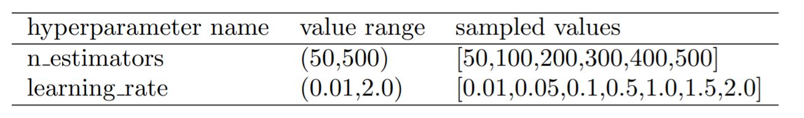
3.2. Detail of MCTML(1)
1. Data cleaner
missing value imputation: NaN, ?, -
conver non-numerical feature to numerical feature
2. Initial sampling
Table 2 : Example of hyper-parameter samples using initial state sampling method

Slide 7
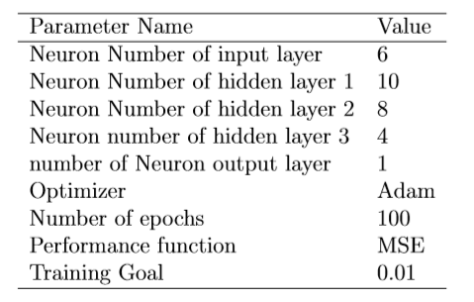
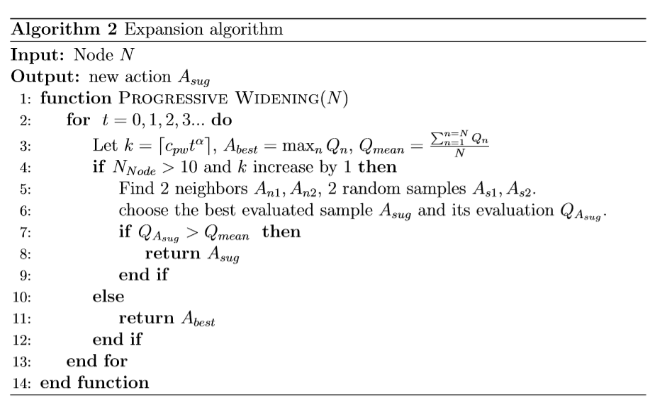
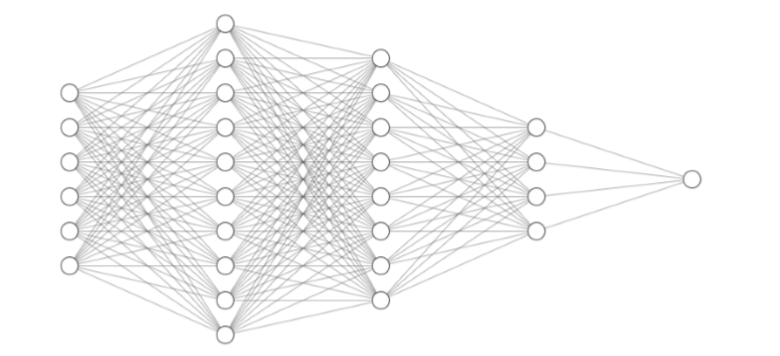

3.3. Detail of MCTML(2)
3. Expansion algorithm
New parameter:
When to expand node? All node visited at least 10, and K increase by one
Which node to expand? Selection between neighbors and random nodes.
4. Value network
$$K=\left\lceil C_{pw} N^{α}\right\rceil$$
Table 3:Value network parameter setting
Figure 3.1: Expansion Algorithm
Figure 3.2: Value network structure

Slide 8
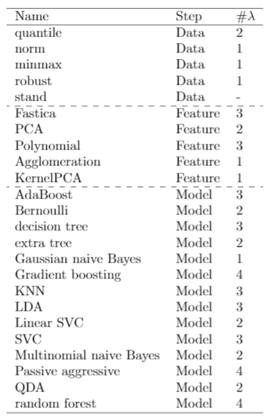
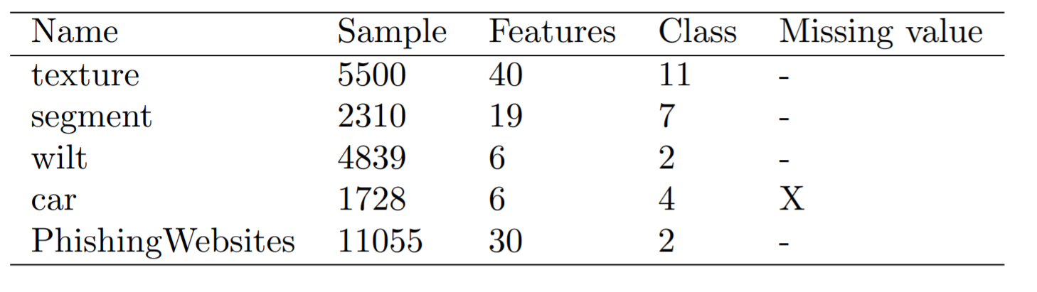
4.1. Evaluation Environment
Smart Data Innovation Lab Platform: 1 core with 4GB RAM.
Search space: 5/5/14 (53)
Data processor: 5
Feature Engineering : 5
Model: 14
Hyperparameter: 53
Dataset: OpenML CC18 suite
Table 3: Example of datasets properties from CC18 suite.
Table 4 : Default search space, # means number of hyperparameters

Slide 9
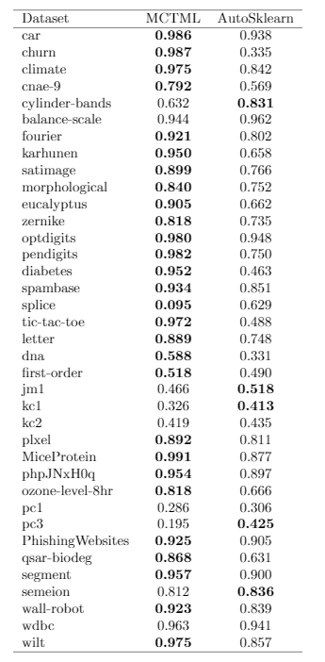
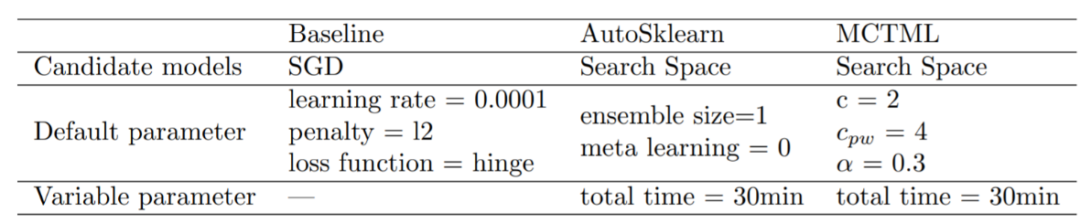
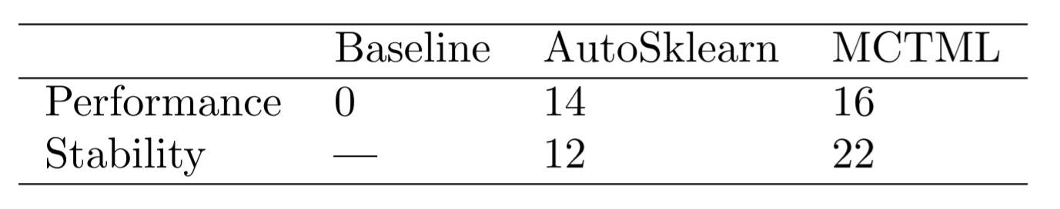

4.2. Evaluation Results
Default setting
Performance:
Stability: 5 runs variance
Evaluation summary
Table 5 : Default setting of methods Baseline, AutoSklearn and MCTML
$$F1=2∗\frac{Precision ∗Recall }{Presion+Recall}$$
Table 6: Statistical summary of performance and stability
Table 7: F1 score on all dataset of methods MCTML and Autosklearn

Slide 10
5. Future Work
Regression tasks --- change task type
Initial state sampling --- meta learning
Value network --- pipeline convertion and structure
More evaluation methods & Bigger search space

Slide 11

Thanks

