Slide 1
Dementia Classification
Clayton Young

Slide 2
TABLE OF CONTENTS
01
BACKGROUND
02
ANALYSIS
03
04
PERFORMANCE
CONCLUSION
Numbers
Early detection
EDA
Baselines
Tuning
Comparisons
Selected model performance
Summary

Slide 3
14,000,000
01
Projected to be living with dementia in the United States by 2060.
Source: https://www.cdc.gov/aging/dementia/index.html
Notes:
Dementia is not a single disease; it’s an overall term — like heart disease — that covers a wide range of specific medical conditions, including Alzheimer’s disease. Disorders grouped under the general term “dementia” are caused by abnormal brain changes. These changes trigger a decline in thinking skills, also known as cognitive abilities, severe enough to impair daily life and independent function. They also affect behavior, feelings and relationships.

Slide 4
Mini Mental Status Exam
01
Domains
Background
Working Memory
Memory Recall
Orientation
Visuospatial
Language
Concentration
10 mins
Assessment based
One of many tests used

Slide 5
02
ANALYSIS
Features:
Age at testing (1)
Education (1)
Gender (1)
Handedness (1)
MMSE Items and total score (28)
Target:
Dementia (CDR >= 0.5)
CDR: 16662, 61
Demographics: 32796, 33
Diagnosis: 32808, 140
Neuropsychological: 17363, 35
Final: 4476, 33

Slide 6
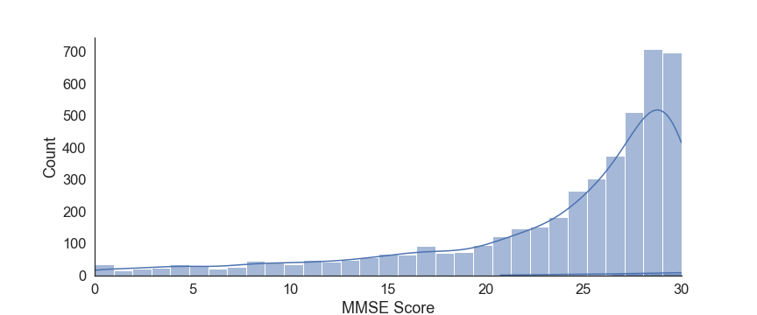
02
EDA-MMSE
Scores above 23 indicates cognitively normal

Slide 7
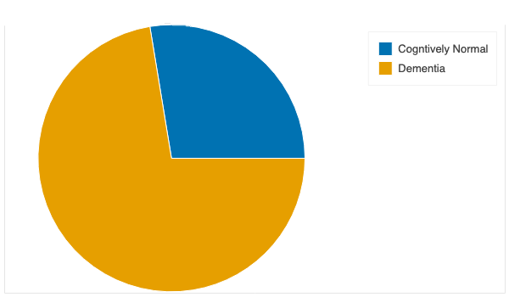
02
EDA
Engineering
Majority have clinical dementia rating of 0.5 or above, indicating dementia
Binarized scores at 0.5 threshold

Slide 8
F2 Baselines
02
Model | F2 Training | F2 Validation | Difference
kNN | 0.883 | 0.823 | 0.060
Logistic Regression | 0.868 | 0.849 | 0.019
Random Forest | 1.000 | 0.866 | 0.134
XGBoost | 0.893 | 0.865 | 0.028
Baseline tests on selected metric

Slide 9
F2 Baselines
02
Model | F2 Training | F2 Validation | Difference
kNN | 0.883 | 0.823 | 0.060
Logistic Regression | 0.868 | 0.849 | 0.019
Random Forest | 1.000 | 0.866 | 0.134
XGBoost | 0.893 | 0.865 | 0.028
Baseline tests on selected metric

Slide 10
F2 Baselines
02
Model | F2 Training | F2 Validation | Difference
kNN | 0.883 | 0.823 | 0.060
Logistic Regression | 0.868 | 0.849 | 0.019
Random Forest | 1.000 | 0.866 | 0.134
XGBoost | 0.893 | 0.865 | 0.028
Baseline tests on selected metric

Slide 11
Tuning
03
Grid/Randomized Hyperparameters | F2 Training | F2 Validation | Difference
kNN | 0.787 | 0.780 | 0.007
Logistic Regression | 0.877 | 0.865 | 0.012
Random Forest | 0.881 | 0.873 | 0.008
XGBoost | 0.868 | 0.859 | 0.009
Voting Ensemble | 0.873 | 0.857 | 0.016
Baseline tests on selected metric
Tuning
Model comparisons

Slide 12
Tuning
03
Grid/Randomized Hyperparameters | F2 Training | F2 Validation | Difference
kNN | 0.787 | 0.780 | 0.007
Logistic Regression | 0.877 | 0.865 | 0.012
Random Forest | 0.881 | 0.873 | 0.008
XGBoost | 0.868 | 0.859 | 0.009
Voting Ensemble | 0.873 | 0.857 | 0.016
Baseline tests on selected metric
Tuning
Model comparisons

Slide 13
Tuning
03
Grid/Randomized Hyperparameters | F2 Training | F2 Validation | Difference
kNN | 0.787 | 0.780 | 0.007
Logistic Regression | 0.877 | 0.865 | 0.012
Random Forest | 0.881 | 0.873 | 0.008
XGBoost | 0.868 | 0.859 | 0.009
Voting Ensemble | 0.873 | 0.857 | 0.016
Baseline tests on selected metric
Tuning
Model comparisons

Slide 14
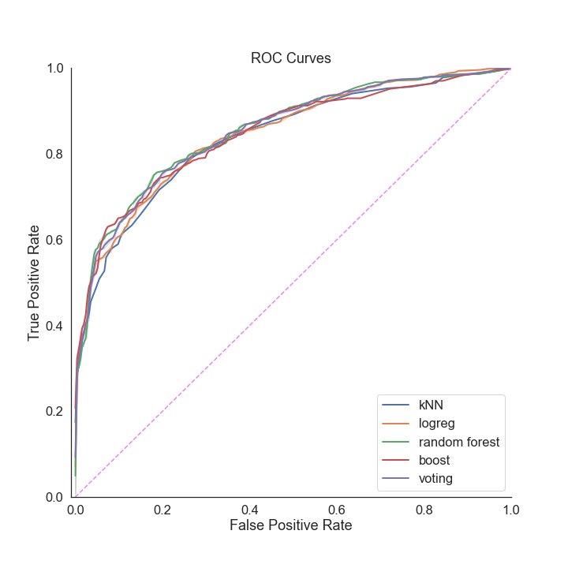
Comparisons
03
Baseline tests on selected metric
Tuning
Model comparisons

Slide 15
Comparisons
03
Baseline tests on selected metric
Tuned Models | ROC AUC Score
kNN | 0.840
Logistic Regression | 0.848
Random Forest | 0.856
XGBoost | 0.848
Voting Ensemble | 0.854
Tuning
Model comparisons

Slide 16
Comparisons
03
Baseline tests on selected metric
Tuned Models | ROC AUC Score
kNN | 0.840
Logistic Regression | 0.848
Random Forest | 0.856
XGBoost | 0.848
Voting Ensemble | 0.854
Tuning
Model comparisons

Slide 17
Comparisons
03
Baseline tests on selected metric
Tuned Models | ROC AUC Score
kNN | 0.840
Logistic Regression | 0.848
Random Forest | 0.856
XGBoost | 0.848
Voting Ensemble | 0.854
Tuning
Model comparisons

Slide 18
Random Forest Performance
04
Data Set | F2 Score
Training | 0.882
Validation | 0.874
Test | 0.872

Slide 19
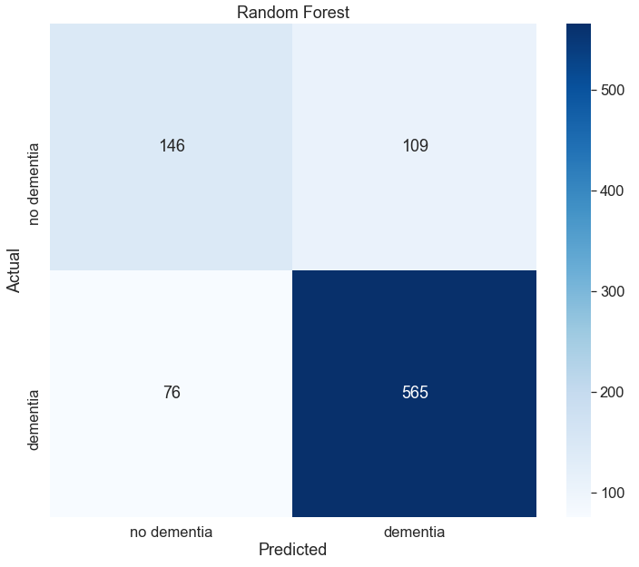
Random Forest Performance
04

Slide 20
Conclusion
Purpose
Untuned
Tuned
04
Quick, objective measure for classifying dementia status
Logistic Regression outperforms
Tuned Random Forest has highest F2 score and greatest ROC AUC score
Conclusion
This model can be used to screen for dementia using MMSE and demographic data

Slide 21




THANKS!
Do you have any questions?
Clayton.Young@ucsf.edu

Slide 22
Supplementary

Slide 23
Tuning
03
Oversampling
Baseline tests on selected metric
kNN | F2 Validation
Oversampling | 0.747
Smote | 0.759
Tuned w/o oversampling | 0.780
Tuning, Oversampling, Feature Selection
Model comparisons

Slide 24
Tuning
03
Oversampling
Baseline tests on selected metric
kNN | F2 Validation
Oversampling | 0.747
Smote | 0.759
Tuned w/o oversampling | 0.780
Tuning, Oversampling, Feature Selection
Feature Selection
XGBoost | F2 Training | F2 Validation
Tuned w/all features | 0.868 | 0.859
Recommended features | 0.818 | 0.807
Model comparisons

Slide 25
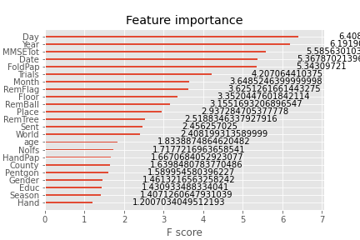
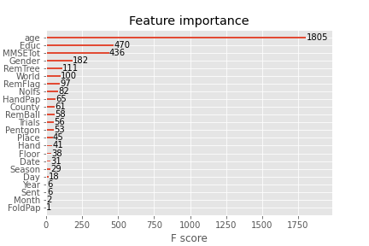

Slide 26
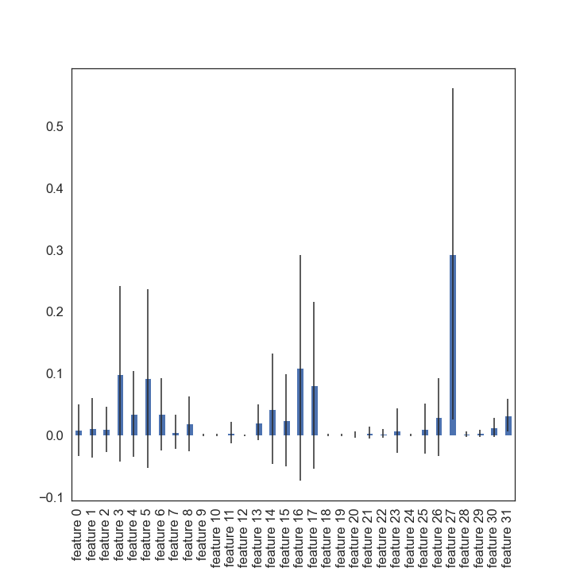
Random Forest Feature importance (mean decrease in impurity)

