Slide 1

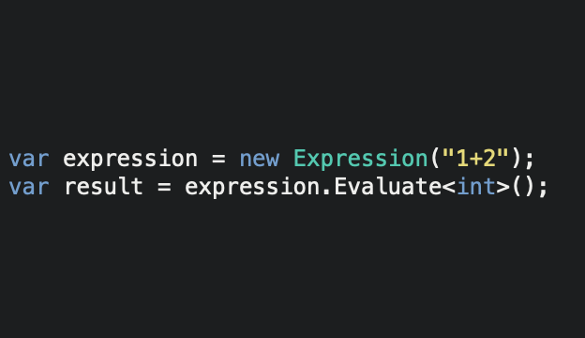
Expressive
.NET Standard expression parsing library
Officially running in:
Xamarin Forms apps
Unity apps
Full .NET framework apps
Comprehensive operator support
Comprehensive function support
Extensible
https://github.com/bijington/expressive

