Slide 1
Movie Recommendation System
Data Mining Project Final Report
Group：郑祎航 董星辰 高天予 王旭 姜邻泉

Slide 2
Content
Introduction
Data
Algorithm
Result

Slide 3
Introduction
Movie Recommendation System:
data - process - recommend
Basic method:
User-based: friends, group…
Item-based: genre, actor…
NLP
Wilson lower bound and EM-test
Final goal:
Recommend 5 movies to user 1

Slide 4
Content
Introduction
Data
Algorithm
Result

Slide 5
Data - Data Source
Data Name: MovieLens
run by GroupLens, a research lab at the University of Minnesota
dataset: ml-latest-small, recommended for education
Basic information:
600 users and 9000 movies
100,000 ratings and 3,000 free-text tags
Last updated 9/2018
Files: links.csv, movies.csv, ratings.csv and tags.csv

Slide 6
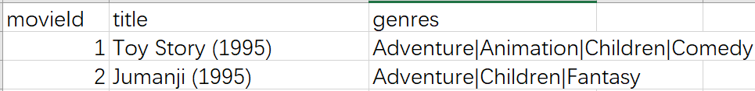
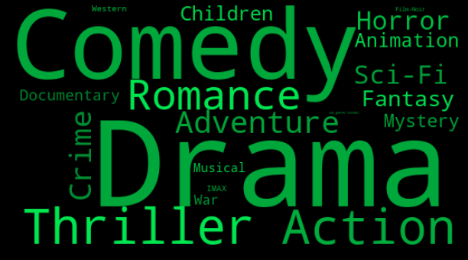
Data - Movies
Movies.csv:
visualization by word cloud as follows:
(all users)

Slide 7
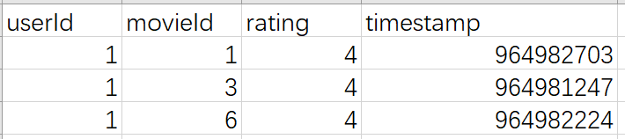
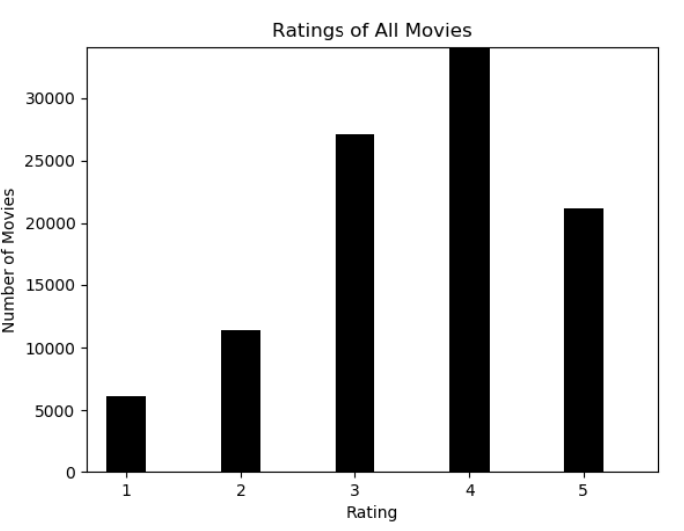
Data - Rating
ratings.csv : userId - movieId - rating – timestamp
rating: 5-star scale, with half-star increments
timestamp: represent seconds since midnight of January 1, 1970

Slide 8
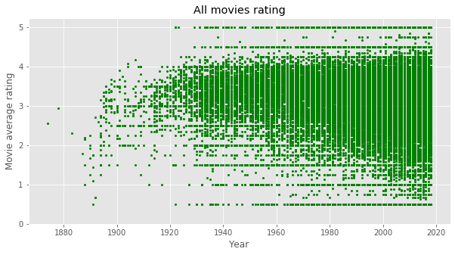
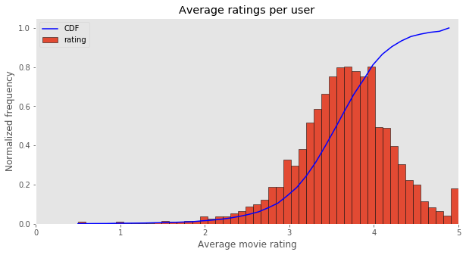
Data - Rating
ratings.csv : distribution of time and user

Slide 9
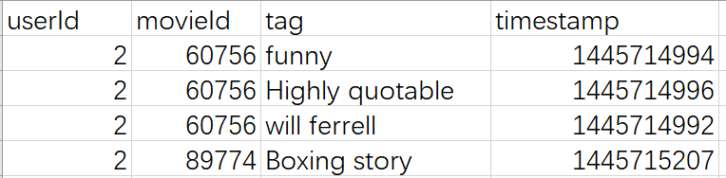
Data - Tag
tags.csv :
user-generated metadata about movies
a single word or short phrase
meaning & value are determined by users

Slide 10
Data - Tag
General Classification:
feeling, name, genre, valuation, prize, company, time …
Problems:
case sensitive
different writing habits
different words, same meaning
same word, different meanings
same information as genre
wrong spelling

Slide 11
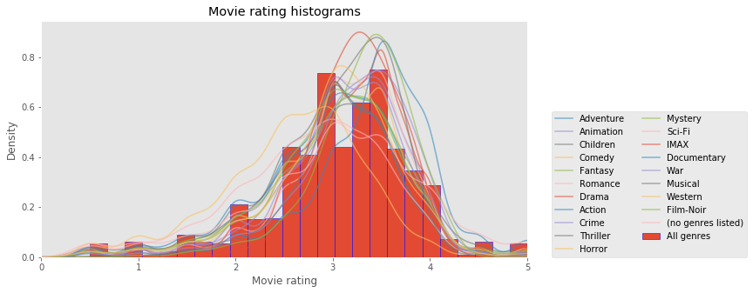
Data - Analysis - Normality Test
preprocessing - merged dataset: genre and rating
Notes:
Merge dataset

Slide 12
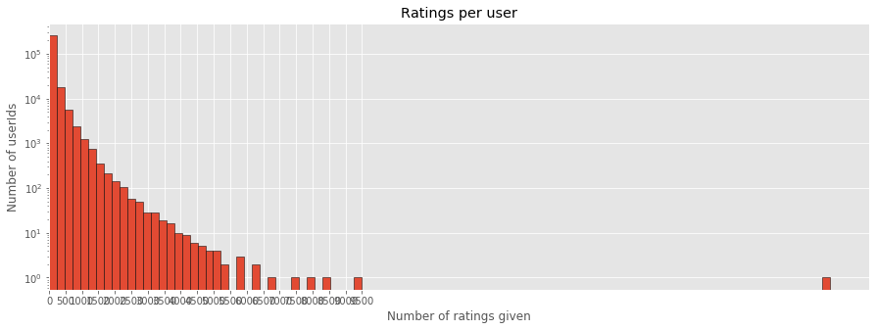
Data - Analysis - Outlier
exponentially decreasing
outlier: 9.2k ratings given = 2-whole-year watching

Slide 13
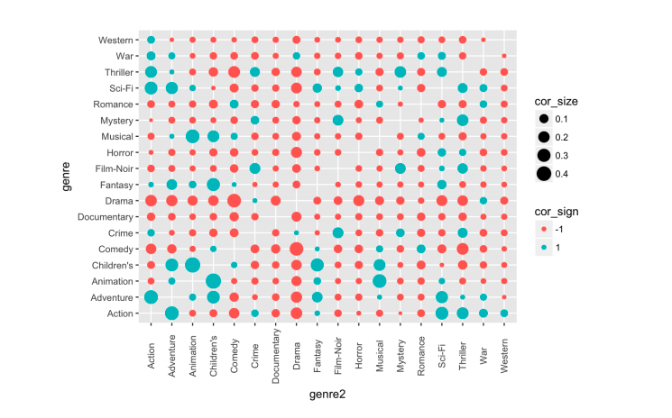
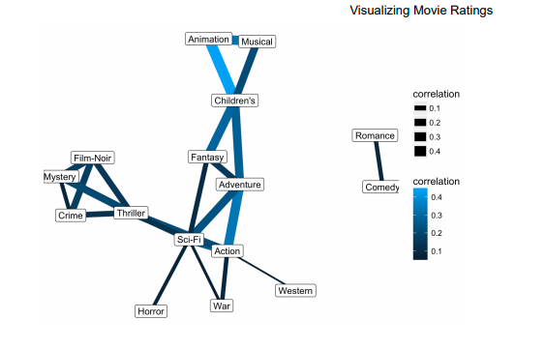
Data - Analysis - Association Rule Discovery
genre covariance matrix (of movie)

Slide 14
Content
Introduction
Data
Algorithm
Result

Slide 15
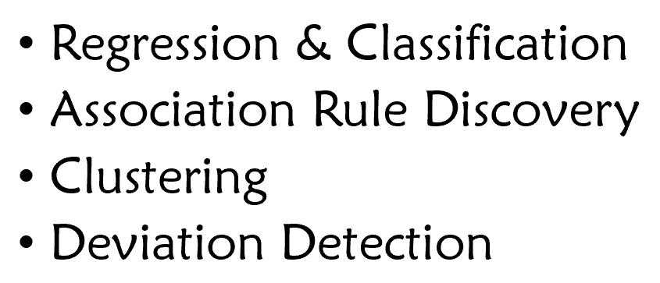
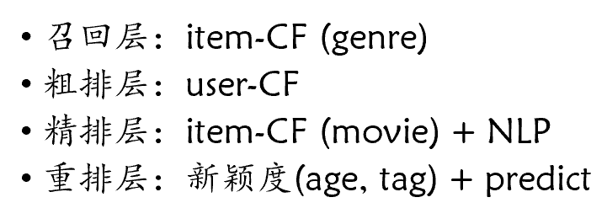
Algorithm - Previous Analysis
Basic Mining
Data
Development

Slide 16
Algorithm - Trade Off
Time Complexity
Performance
Method: Collaborative Filtering
simplest
save little time
Data: 600 users and 9000 movies
relatively small
Notes:
此处最好有操作过程中的例子来解释

Slide 17
Algorithm - Improvement
itemCF(genre)
itemCF or
userCF or
NLP
userCF
itemCF(movie)+NLP
reload
reload

Slide 18
Algorithm - Improvement
itemCF(genre)
Limitation
itemCF: low accuracy
userCF: popular
NLP: low interpretability
itemCF or
userCF or
NLP
userCF
itemCF(movie)+NLP
reload
reload

Slide 19
Algorithm - Improvement
itemCF(genre)
itemCF or
userCF or
NLP
userCF
userCF
itemCF
reload
itemCF(movie)+NLP
NLP
reload
reload

Slide 20
Algorithm - Source Tree
Class RecSystem
#private members
User #推荐对象/目标用户
Wateched_movies #该user的电影评分历史记录
Recommend_movies #给该user推荐的电影列表
#private methods
Itemcf_rec_movie() #调用ItemCF类召回10个推荐的电影
Usercf_rec_movie() #调用UserCF类召回10个推荐的电影
NLP_rec_movie() #调用NLP类召回10个推荐的电影
Reload_rec_movie() #从召回的电影中重排出最佳的5个电影

Slide 21
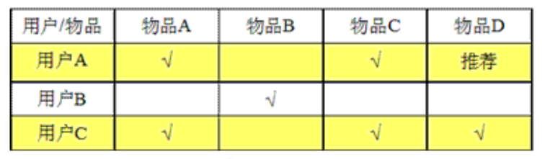
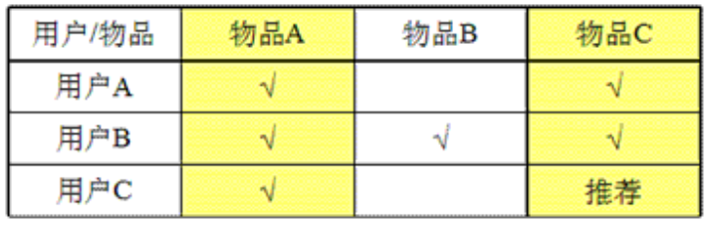
Algorithm - method introduction - CF
Collaborative Filtering (协同过滤)
preference —— similarity —— KNN
user CF: one user, all items
Item CF: all users, one item

Slide 22
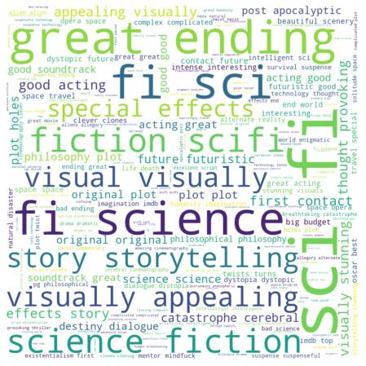
Algorithm - method introduction - NLP
Natural Language Processing
Jaccard Coefficient
nltk: stopwords
doc2vec
Set parameter
Model training
Cosine similarity
save, input and output
e.g. movie: Interstellar

Slide 23
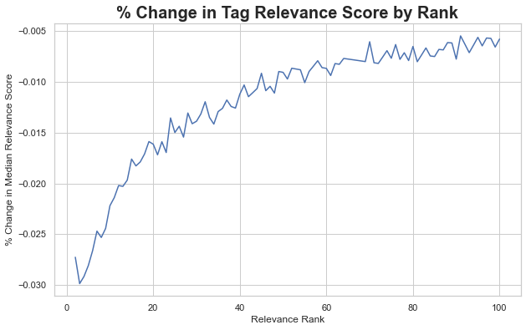
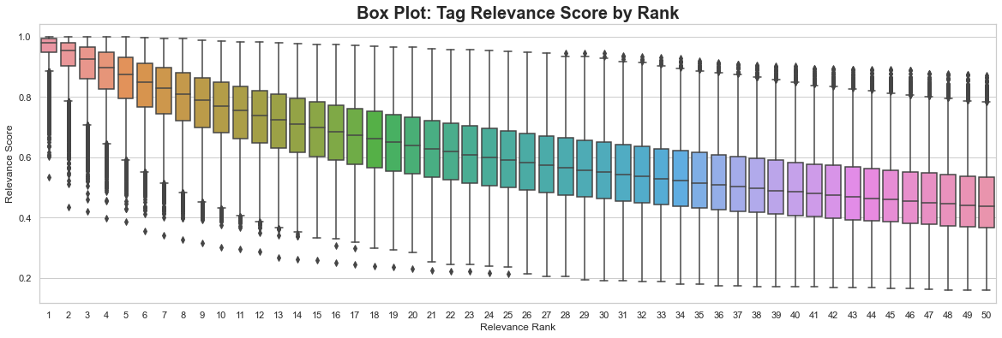
Algorithm - method introduction - NLP
Natural Language Processing - parameter setting

Slide 24
Algorithm - method introduction - NLP
Natural Language Processing - evaluation
Based on natural network
Unsupervised document quantification method
Only consider similarity among movies
Require high quality and quantity data: use ml-20m data in Movielens
Low interpretability

Slide 25
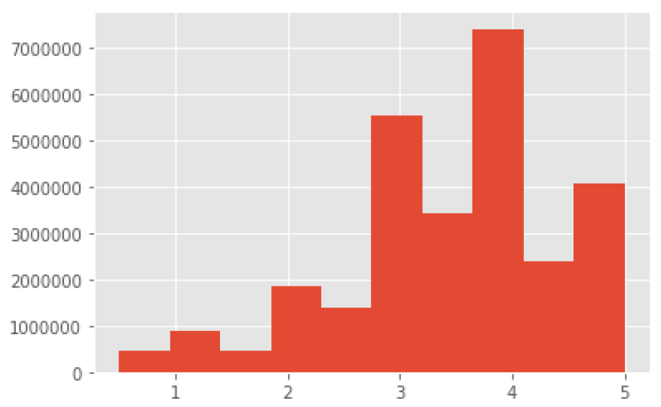
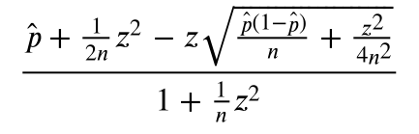
Algorithm - method introduction - Reload
Wilson Section
Confidence interval of rating
Solve the tradeoff of rating vs number
Wilson lower bound defined as:
EM-test & Bayes Rule: control FN and min FP
p: Rate > 3.13
Regular term - Genres - to increase novelty
average cosine similarity: recommend
movies the user watched: penalty term

Slide 26
Content
Problems
Improvement
Realization
Result

Slide 27
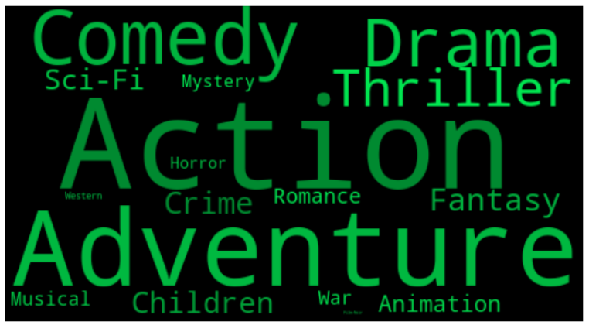
Result
Take user 1 as example
(user 1)
(all users)

Slide 28
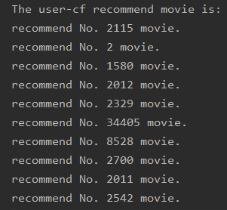
Result - userCF
title | genre
Indiana Jones and the Temple of Doom (1984) | Action|Adventure|Fantasy
Jumanji (1995) | Adventure|Children|Fantasy
Men in Black (a.k.a. MIB) (1997) | Action|Comedy|Sci-Fi
Back to the Future Part III (1990) | Adventure|Comedy|Sci-Fi|Western
American History X (1998) | Crime|Drama
Serenity (2005) | Action|Adventure|Sci-Fi
Dodgeball: A True Underdog Story (2004) | Comedy
South Park: Bigger, Longer and Uncut (1999) | Animation|Comedy|Musical
Back to the Future Part II (1989) | Adventure|Comedy|Sci-Fi
Lock, Stock & Two Smoking Barrels (1998) | Comedy|Crime|Thriller

Slide 29
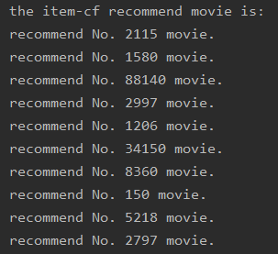
Result - itemCF
title | genre
Indiana Jones and the Temple of Doom (1984) | Action|Adventure|Fantasy
Men in Black (a.k.a. MIB) (1997) | Action|Comedy|Sci-Fi
Captain America: The First Avenger (2011) | Action|Adventure|Sci-Fi|Thriller|War
Being John Malkovich (1999) | Comedy|Drama|Fantasy
Clockwork Orange, A (1971) | Crime|Drama|Sci-Fi|Thriller
Fantastic Four (2005) | Action|Adventure|Sci-Fi
Shrek 2 (2004) | Adventure|Animation|Children|Comedy|Musical|Romance
Apollo 13 (1995) | Adventure|Drama|IMAX
Ice Age (2002) | Adventure|Animation|Children|Comedy
Big (1988) | Comedy|Drama|Fantasy|Romance

Slide 30
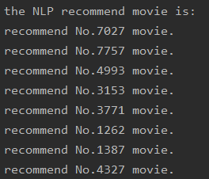
Result - NLP
title | genre
Serenity (2005) | Action|Adventure|Sci-Fi
Silverado (1985) | Action|Western
Jason and the Argonauts (1963) | Action|Adventure|Fantasy
Lord of the Rings: The Fellowship of the Ring, The (2001) | Adventure|Fantasy
Mike's New Car (2002) | Animation|Comedy
7th Voyage of Sinbad, The (1958) | Action|Adventure|Fantasy
Day of the Doctor, The (2013) | Adventure|Drama|Sci-Fi
The Golden Voyage of Sinbad (1973) | Action|Adventure|Fantasy
Great Escape, The (1963) | Action|Adventure|Drama|War
Jaws (1975) | Action|Horror
Approve by Dong Xingchen in XMU

Slide 31
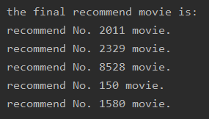
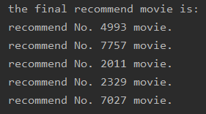
Result - Reload
low punishment
title | genre
Back to the Future Part II (1989) | Adventure|Comedy|Sci-Fi
American History X (1998) | Crime|Drama
Dodgeball: A True Underdog Story (2004) | Comedy
Apollo 13 (1995) | Adventure|Drama|IMAX
Men in Black (a.k.a. MIB) (1997） | Action|Comedy|Sci-Fi
high punishment
title | genre
Jason and the Argonauts (1963) | Action|Adventure|Fantasy
Silverado (1985) | Action|Western
Back to the Future Part II (1989) | Adventure|Comedy|Sci-Fi
American History X (1998) | Crime|Drama
Serenity (2005) | Action|Adventure|Sci-Fi
Approve by Gao Tianyu in XMU

Slide 32
Result - Comparison
title | genre
Back to the Future Part II (1989) | Adventure|Comedy|Sci-Fi
American History X (1998) | Crime|Drama
Dodgeball: A True Underdog Story (2004) | Comedy
Apollo 13 (1995) | Adventure|Drama|IMAX
Men in Black (a.k.a. MIB) (1997） | Action|Comedy|Sci-Fi
title | genre
Jason and the Argonauts (1963) | Action|Adventure|Fantasy
Silverado (1985) | Action|Western
Back to the Future Part II (1989) | Adventure|Comedy|Sci-Fi
American History X (1998) | Crime|Drama
Serenity (2005) | Action|Adventure|Sci-Fi
Approve by Gao Tianyu in XMU

Slide 33
Result - Evaluation
Advantage
Multiple Recall : diversity of recall samples
Reload : statistics meaningful, personality
Time Complexity : simple method -> low time complexity
Shortage
Cold start
Model hot update
Recommend effect

Slide 34
Group Member
郑祎航：协同过滤、展示
董星辰：自然语言处理
高天予：重排
王 旭：报告撰写
姜邻泉：图表、展示文稿

Slide 35
Movie Recommendation System Thanks for Listening

