Slide 1
Quality Assurance
By Gary, Karina, Jordan, Nathan, & Tryston

Slide 2
Outline
Testing Background
What is testing?
Why test?
Types of Testing
Unit Boundary & Stress Testing
Unity Test Framework
Stress Test Demonstration
Design Patterns
What are design Patterns?
Types of Patterns
Pattern Methods
Examples
Deliverables

Slide 3
Testing Background
An introduction to testing motivations & various test types

Slide 4
What is Testing?
Testing is defined by:
Showing a program functions as intended & identifying defects prior to use
Executing a program with artificial data
Uncovering the existence of errors, not absence of
Belonging to the general verification & validation process

Slide 5
Why Test?
Ensure program handles expected & unexpected inputs
Define load constraints to stay within
Verify functioning of code before pushing to GitHub
Identify scenarios where software behaviour is incorrect, undesirable, or non-conforming to specification
Demonstrate to customer & developers software satisfies requirements

Slide 6
Why Test?
Expected to contribute 1 stress test & 2 unit boundary tests by next Tuesday (10 marks)
Expected to provide complete test plan by Oral Exam

Slide 7
Verification vs. Validation
Verification: software conforms to specifications
“Are we building the product right?”
Validation: software does what user needs it to
“Are we building the right product?”

Slide 8

Types of Testing
Testing is divided into several categories based on goals and characteristics.
System Testing
Use-case Testing
Release Testing
User Testing
Alpha Testing
Beta Testing
Acceptance Testing
Requirements-based Testing
Unit Testing
Boundary Testing
Performance Testing
Stress Testing

Slide 9
System Testing
System Testing: testing on a complete, fully-integrated software product to identify defects
Types (of Interest):
Use-case Testing
Release Testing

Slide 10
Use-case Testing
Use-case Testing: testing developed to identify system interactions by simulating typical use
Characteristics:
Involves multiple system components
Forces interactions to occur
Informs system testing test cases
Sequence diagrams document components & interactions

Slide 11
Release Testing
Release Testing: testing on a specific release of a system to validate it satisfies the requirements to be released for external use
Characteristics:
Performed by team external to the system development
Usually black-box testing process
Demonstrate dependability, functionality, & performance under normal conditions
-Switch
Notes:
Define black-box testing process when presenting

Slide 12
user Testing
User Testing: stage of testing in which users provide feedback on system testing
Types (of Interest):
Alpha Testing: users work with development team onsite
Beta Testing: release made available to enable user input
Acceptance Testing: customers test to determine if ready to be accepted
Irreplaceable as the user environment, which guides tuning for reliability, usability, & performance, can not be replicated in a testing environment

Slide 13

Acceptance Testing Process
2) Plan Acceptance Testing
3) Derive Acceptance Tests
4) Run Acceptance Tests
5) Negotiate Test Results
6) Reject (or Accept) System
1) Define Acceptance Criteria

Slide 14
Requirements-based Testing
Requirements-based Testing: testing in which test cases, conditions, & data are derived from customer-determined requirements

Slide 15
Unit Testing
Unit Testing: automated testing of individual components of software to validate each is performing as expected
Types (of Interest):
Boundary testing: validates value lies within, on, or outside of a boundary to ensure proper edge case handling

Slide 16
Performance Testing
Performance Testing: testing emergent properties of a system, e.g., performance & reliability, with incremental load increases
Types (of Interest):
Stress Testing: system intentionally overloaded to determine breakpoint & failure behaviour

Slide 17
Unit Boundary & Stress Testing
An introduction to the Unity Test Framework

Slide 18
Unity Test Framework (UTF)
Unity package offering a standard test framework
Notes:
Offers 2 testing modes
For automated (or not) tests
Not necessary for stress tests
Use guide coming soon to your GitHub

Slide 19
Edit mode VS. Play Mode Tests
Edit Mode Tests:
Only run in Unity Editor
Access to Editor & game code
For code for which game need not be executed
Best suited for testing with automated inputs e.g., unit tests
Faster runtime
Play Mode Tests:
Run as coroutines
Best suited for conditions only met while game running
Better for movement, animations, etc.

Slide 20
UTF Installation
Prerequisite: Unity Editor versions 2019.2 or higher
Open project in Unity Editor
Select Window > Package Manager
Select Packages: Unity Registry from dropdown at top of window
Locate Test Framework by scrolling or entering in search
Select Install at bottom right of window

Slide 21
UTF Boundary Test Creation
Prerequisite: project open in Unity Editor version 2019.2 or higher
Select Window > General > Test Runner
Select EditMode
Select Create EditMode Test Assembly Folder
Select Create Test Script in current folder
Exit Test Runner
Rename created folder (e.g., EditMode_Tests) & script

Slide 22
UTF Test Execution
Prerequisite: preexisting test
Open project in Unity Editor
Select Window > General > Test Runner
Select PlayMode or EditMode
Select Run All or Run Selected

Slide 23
Stress Testing
A Demonstration

Slide 24
What Is stress Testing?
A stress test is a test that puts the application to its limits in order to see what the engine or hardware can support.
Stress Testing requires a metric to be chosen based on the goal of the test (ie. Breaking Physics, CPU Usage, Memory Usage)
Stress Testing is meant to push the application to its limits, so spawning hundreds of enemies or interacting with an object rapidly are good ways to stress a system
Have fun with the stress tests and be creative

Slide 25
Stress Testing basic example
In this basic example, a test will be done to see how many enemies can be spawned in a confined space before physics break
The test will confine enemies in a small space to force collisions
The test will spawn more enemies until an enemy breaks out of the cube
Note: FPS based stress tests only count for 80%

Slide 26
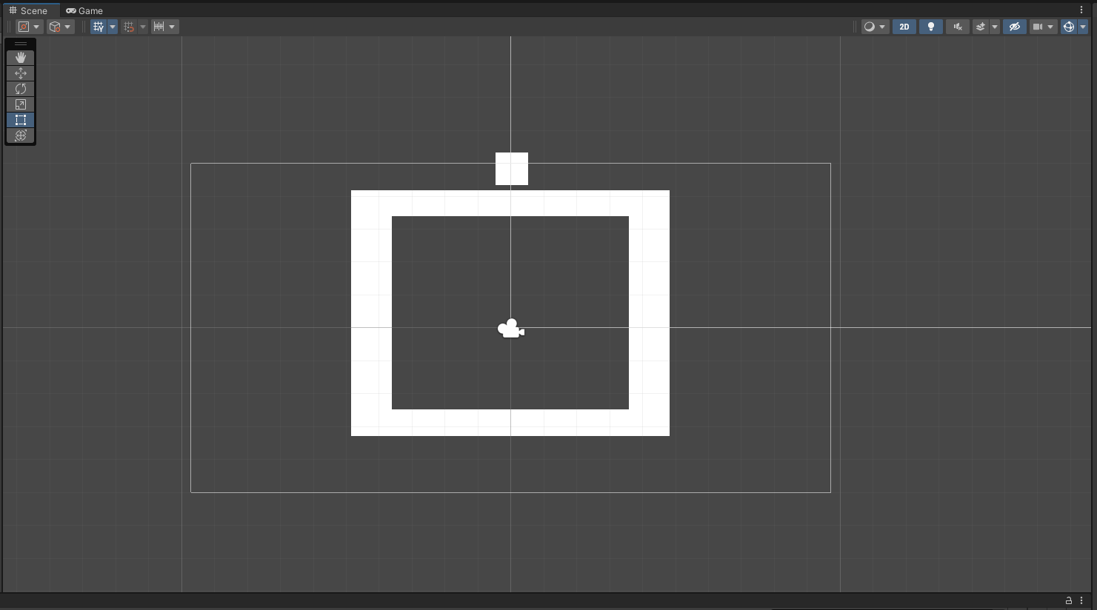
STRESS TESTING BASIC EXAMPLE
Setup
First a separate scene must made to keep production and testing separate
Stress Testing does not require the use of the Unit Testing Framework
This basic scene has a box to confine the enemies and a player on top that they will detect for extra load

Slide 27
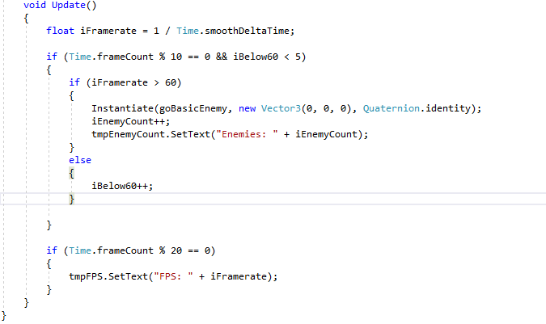
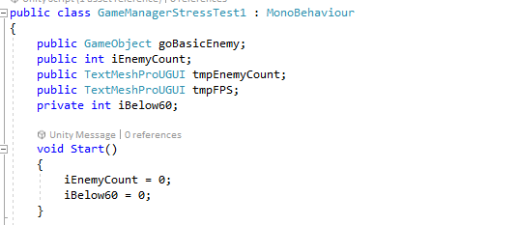
STRESS TESTING BASIC EXAMPLE
Script
In order to run the test a simple game manager script will need to facilitate it

Slide 28
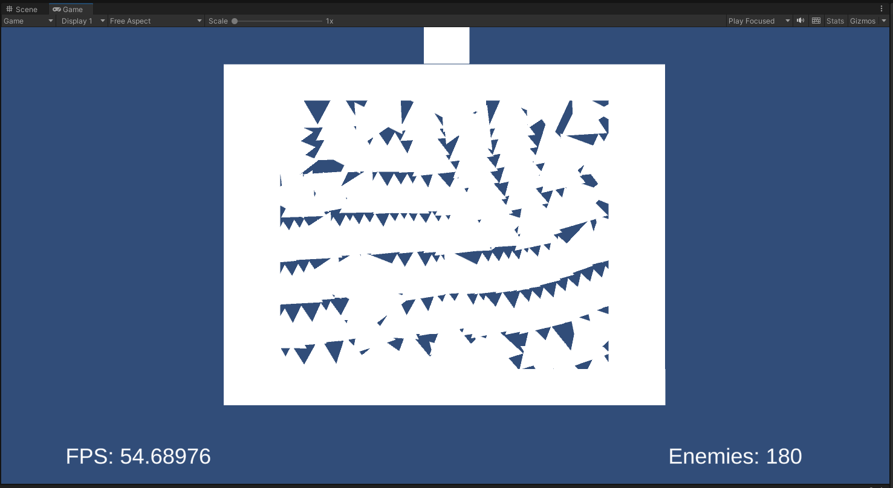
STRESS TESTING BASIC EXAMPLE
Running
Running the test spawns 180 enemies before the threshold of 60 fps is reached
This shows that the game can handle 180 enemies with collision trying to pathfind the player before the performance is severely impacted

Slide 29
Design Patterns
Types of patterns & their methods

Slide 30
What are design patterns?
General repeatable solution for common software design problems
Uses:
Speeds up development process
Prevents subtle issues that cause major problems
Improves code readability for those who use patterns
Provides general solutions in a format that does not require specifics
Allows developers to communicate using known names for software interactions

Slide 31
Types of patterns
Creational Patterns
Class creation patterns use inheritance effectively during instantiation
Object creation patterns use delegation effectively to do the job
Structural Patterns
Uses class inheritance to compose interfaces
Define ways to compose objects to obtain new functionality
Behavioral Patterns
All about class and object communication

Slide 32
Creational patterns
Abstract Factory
Creates an instance of several families of classes
Builder
Separates object construction from its representation
Factory Method
Creates an instance of several derived classes
Object Pool
Avoids expensive acquisition and release of resources by recycling objects that are no longer in use
Prototype
A fully initialized instance to be copied or cloned
Singleton
A class of which only a single instance can exist
https://sourcemaking.com/design_patterns

Slide 33
Structural patterns
Adapter
Match interfaces of different classes
Bridge
Separates an object’s interface from its implementation
Composite
A tree structure of simple and composite objects
Decorator
Add responsibilities to objects dynamically
Façade
A single class that represents an entire subsystem
Flyweight
A fine-grained instance used for efficient sharing
Private class data
Restricts accessor/mutator access
Proxy
An object representing another object
https://sourcemaking.com/design_patterns

Slide 34
Behavioral patterns
Chain of Responsibility
A way of passing a request between a chain of objects
Command
Encapsulate a command request as an object
Interpreter
A way to include language elements in a program
Iterator
Sequentially access the elements of a collection
Mediator
Defines simplified communication between classes
Memento
Capture and restore an object's internal state
https://sourcemaking.com/design_patterns

Slide 35
Behavioral Patterns
Null Object
Designed to act as a default value of an object
Observer
A way of notifying change to a number of classes
State
Alter an object's behavior when its state changes
Strategy
Encapsulates an algorithm inside a class
Template Method
Defer the exact steps of an algorithm to a subclass
Visitor
Defines a new operation to a class without change
https://sourcemaking.com/design_patterns

Slide 36
Design Pattern Examples
A few illustrative pattern examples

Slide 37
Ex1: (Jordan) Singleton
The Singleton pattern is a class that ensures it only ever has one instance at a time.
A singleton should have a private constructor and a public static accessor function.
Upon calling the accessor, it returns the singleton. If it has not been instantiated yet, it first does so before returning it.
Good uses for a singleton include game managers & loggers.

Slide 38
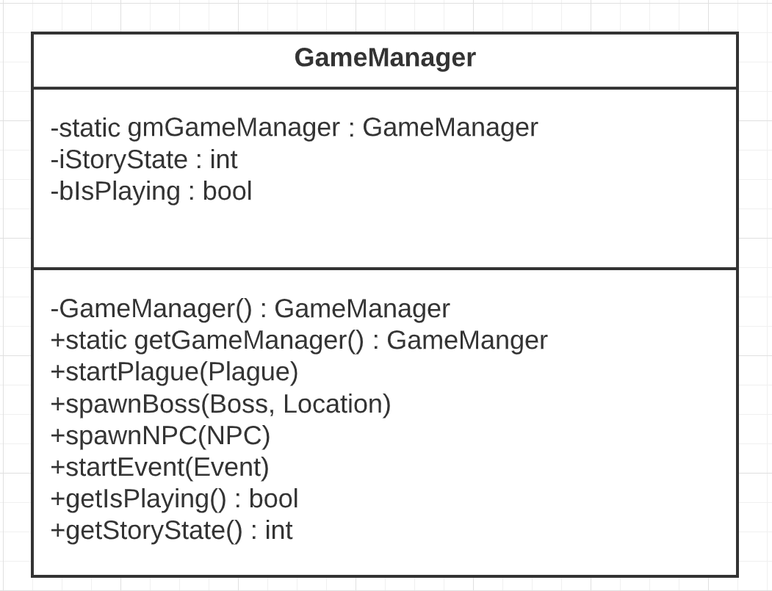
Ex 1: (Jordan) Singleton Class Diagram
Class diagram of a singleton game manager implementation.

Slide 39
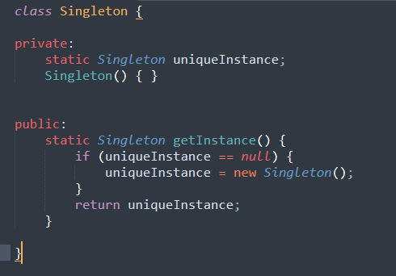
Ex 1: (Jordan) Singleton Implementation
This is a basic singleton class, but it is not made to be threadsafe.

Slide 40
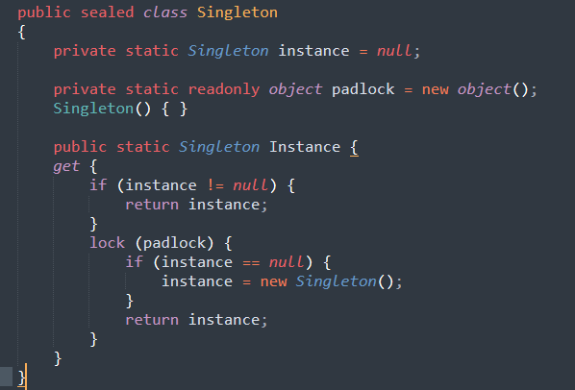
Ex 1: (Jordan) Singleton Implementation Contd.
This singleton class has been modified to make it thread safe using a lock

Slide 41
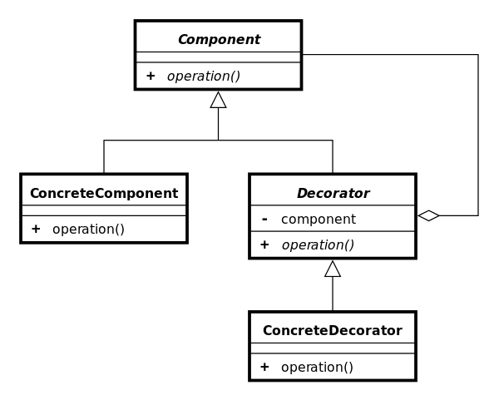
Ex 2: (Nathan) Decorators
A decorator, also called a wrapper, is a structural design pattern that adds optional functionality to a class.
Has an interface, a core component class, a wrapper class, and classes for each decoration.
The wrapper class implements the component and uses an implementation of the component in its constructor.
EX:
Decorator Class Diagram -Wikipedia

Slide 42
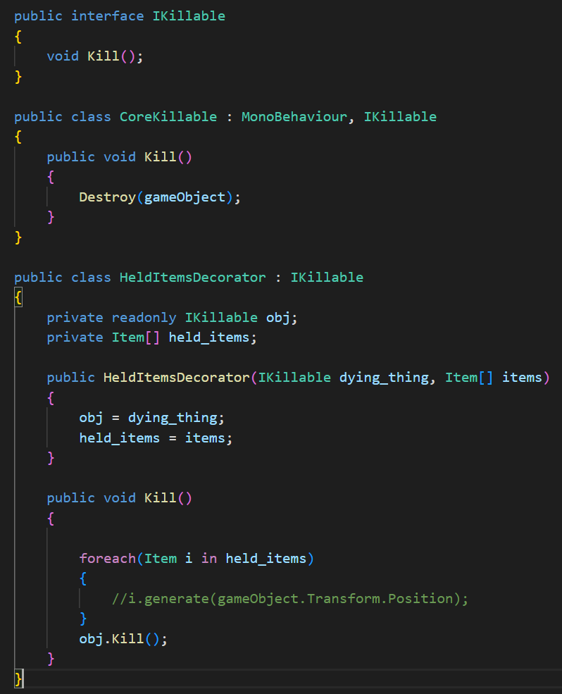
Here is an example of a decorator code.
Objects that are dying can be decorated with dropping items, if they have any items.

Slide 43
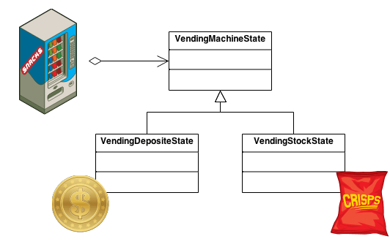
Ex 3: (Tryston) State Patterns
Context Class
Client interaction interface
Contains references to Concrete States
State Class
Interface for declaring what the Concrete Stats should do.
Concrete State Class
Implementation of methods defined in the state.

Slide 44
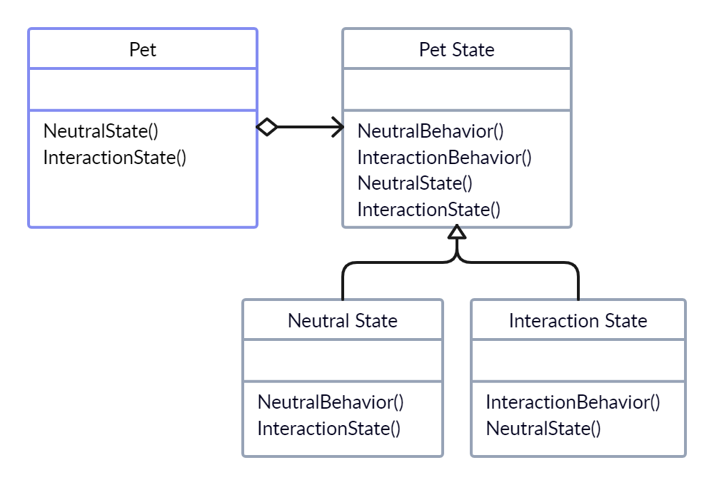
Ex 3: (Tryston) State Pattern Class Diagram
Pet is the Context Class
Pet State is the State Class
Neutral State is a Concrete Class
Interaction State is a Concrete Class

Slide 45
Deliverables
Individual tasks for next Tuesday & Oral Exam

Slide 46
Next Tuesday (07/03/23)
For each member:
Code 1 stress test
Code 2 unit boundary tests
Push tests to test folder in GitHub
Update Gantt chart

Slide 47
Oral Exam (16 - 21/04/23)
Each individual is expected to demonstrate:
2 instances of patterns
Justify choices
Draw class diagram for 1
Complete test plan
Describe
Explain intention
Justify choices

Slide 48

Thank you for your attention.
Refer to your team lead 3 for questions throughout the week.

