Slide 1
Coupling, Cohesion, & GRASP
Hunter Squires, Jenna-Luz Pura, & Alphonse Crittenden

Slide 2
General Outline
Introductions
Coupling -- Hunter
Cohesion -- Al
Visibility – Jenna pura0273@vandals.
GRASP
Critique Gantt charts
Overview of how our Master Gantt charts work (if there's time)

Slide 3
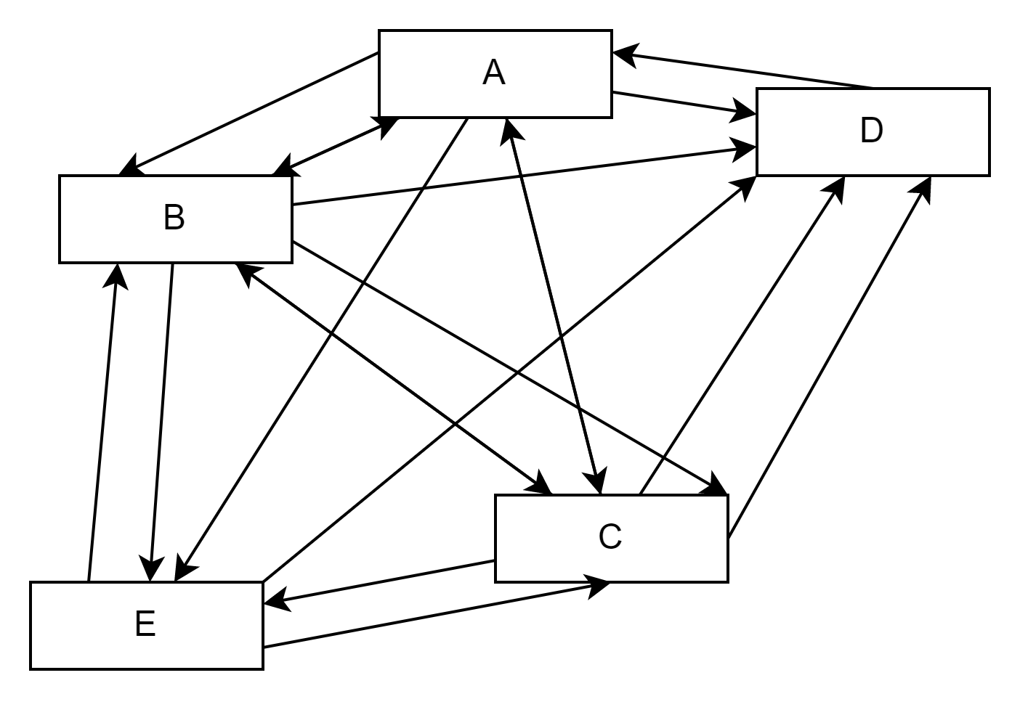
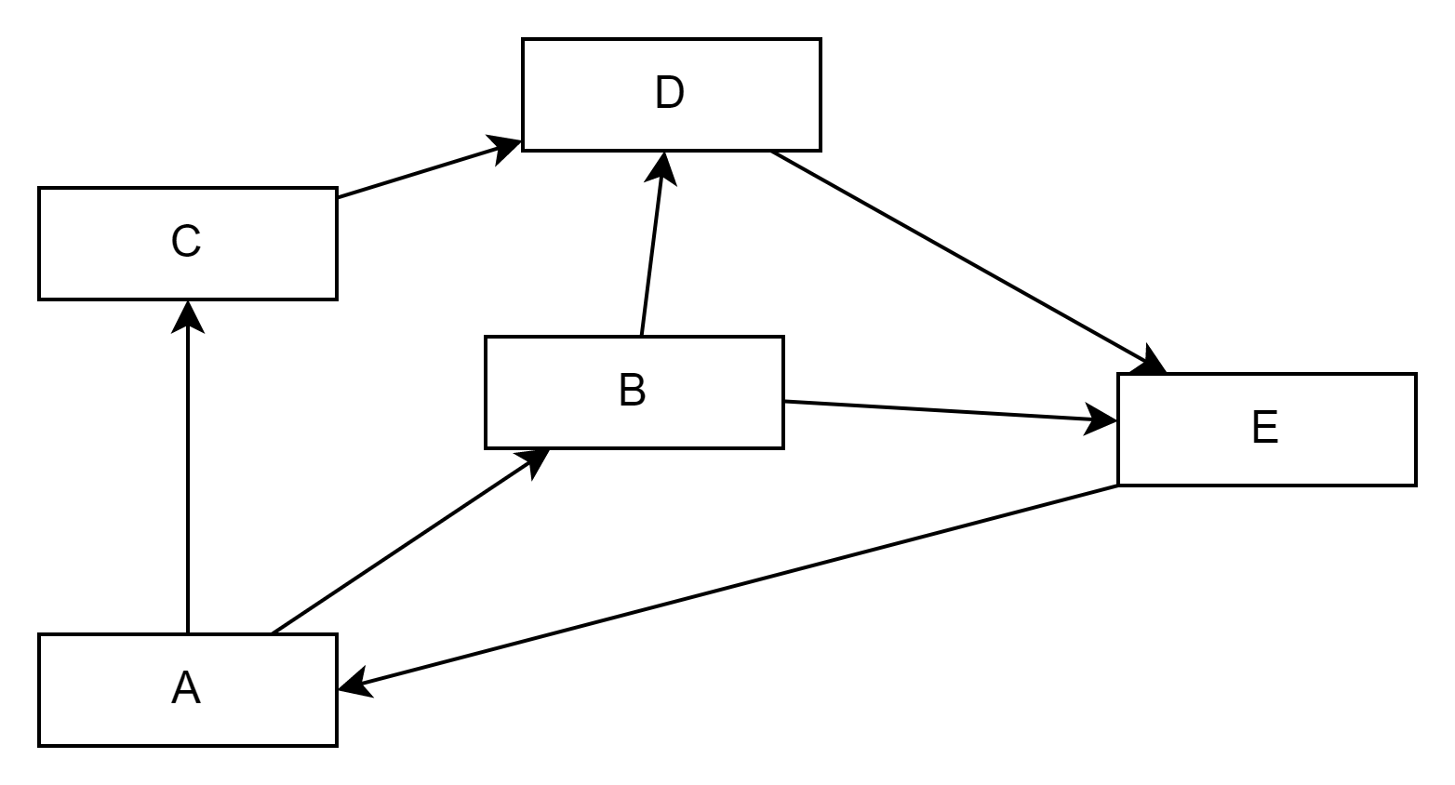
Coupling
Describes how connected software modules are to each other
High Coupling
Low Coupling

Slide 4
Levels of Coupling
Content
Control
Stamp
Data
Common
W
B

Slide 5
Content Coupling
Worst level of coupling
Occurs when one module directly references or changes another module’s contents
This forces modules to be highly dependent on each other

Slide 6
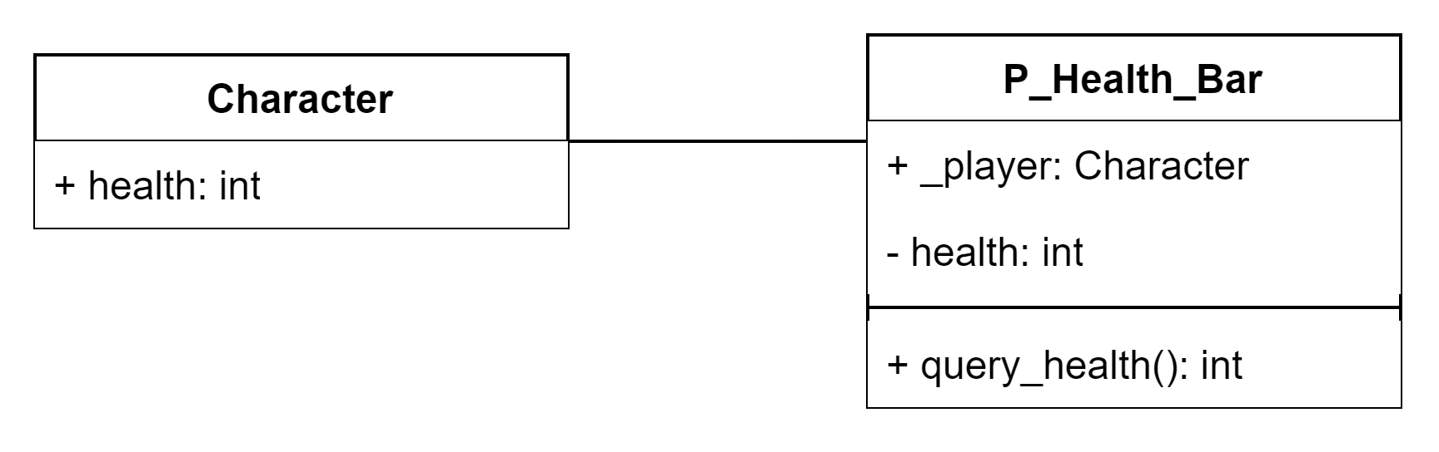
public class Character : MonoBehaviour
{
...
public int health;
...
}
public class P_Health_Bar : MonoBehaviour
{
...
public Character _player;
private int health;
...
public int query_health()
{
health = _player.health;
return health;
}
...
}

Slide 7
Common Coupling
Occurs when multiple modules can read and/or write to the same global resource
This can cause unintended consequences when changes are made to the global resource

Slide 8
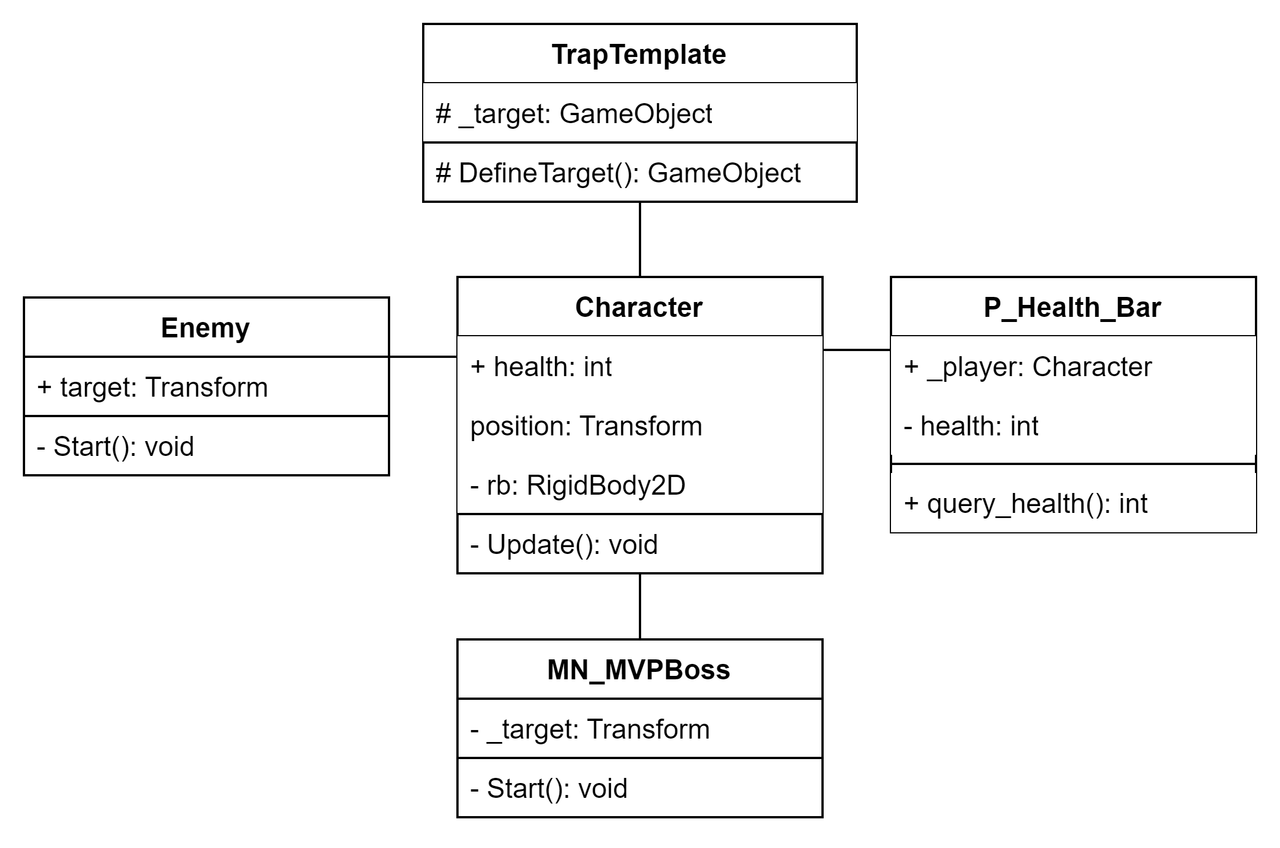

Slide 9
Control Coupling
Occurs when one module of code passes control to another module
Requires one module to tell another module what to do, rather than letting that second module make decisions based on its own state.

Slide 10
Stamp Coupling
Occurs when one module passes an entire data structure to another module, when the second module only needs select fields from the first module.
This passes more data between modules than necessary

Slide 11
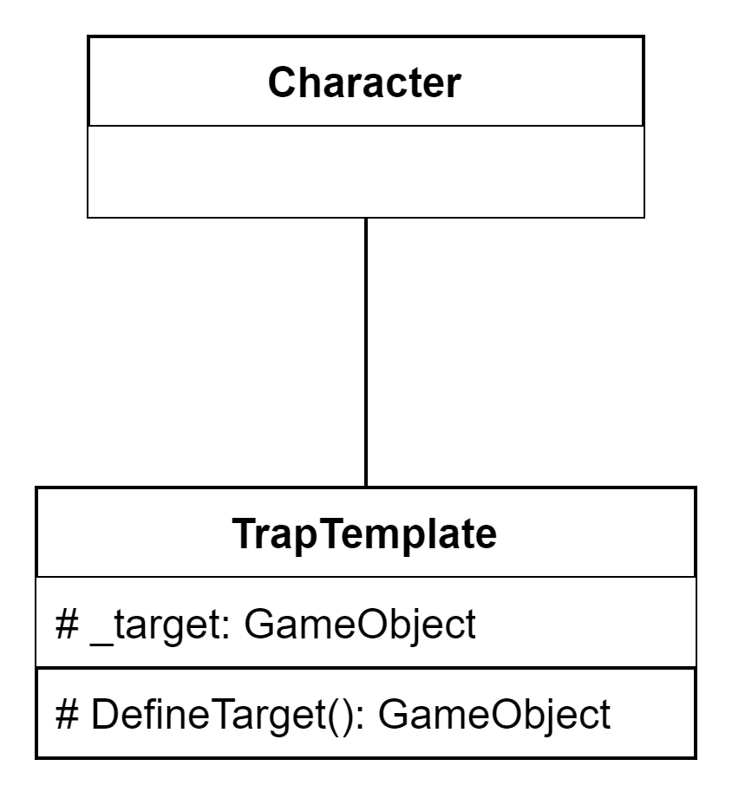
public class Character : MonoBehaviour
{
...
}
public abstract class TrapTemplate : MonoBehaviour
{
...
protected GameObject _target;
... protected GameObject DefineTarget()
{
GameObject target = GameObject.FindGameObjectWithTag("Player");
_target = target;
return target;
}
...
}

Slide 12
Data Coupling
The best level of coupling
Occurs when relationships between modules are simple operations, and there are no unused fields in shared data structures
This lowers the dependencies between modules

Slide 13
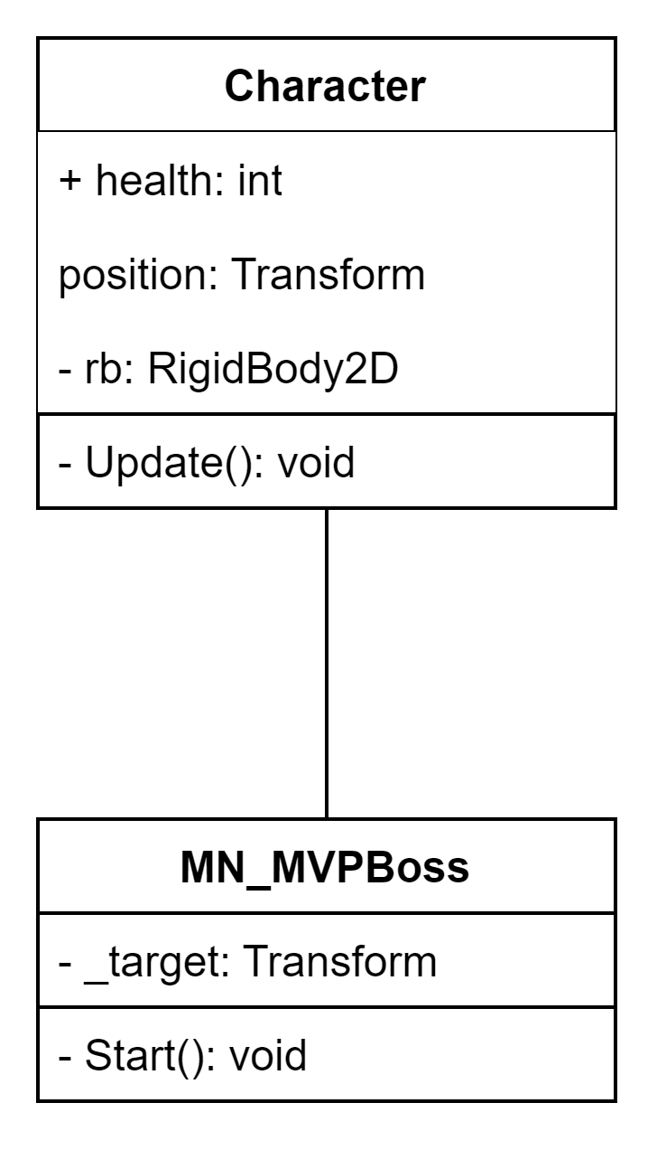
public class Character : MonoBehaviour
{
...
Rigidbody2D rb;
...
void Update()
{
//Moves the player based upon WASD input
float horizontal = Input.GetAxis("Horizontal");
float vertical = Input.GetAxis("Vertical"); Vector3 temp = new Vector3(horizontal, vertical, 0);
temp = temp.normalized * speed * Time.deltaTime; rb.MovePosition(rb.transform.position + temp);
}
}
public class MN_MVPBoss : MonoBehaviour
{
...
private Transform _target;
void Start()
{
...
_target = GameObject.FindGameObjectWithTag("Player").transform;
}
...
}

Slide 14
Subclasses and Coupling
When 2 modules are in a subclass and superclass relationship, there is inherently a strong coupling between them
public abstract class TrapTemplate : MonoBehaviour
{
protected int p_trapDamage;
protected float p_trapSpeed;
protected Vector3 p_projectileSpeed;
protected GameObject p_trapObject;
protected GameObject _target;
public GameObject trapProjectile;
protected Rigidbody2D p_trapBody;
protected bool _isLoaded = true;
...
}
public class CrossbowTrap : TrapTemplate
{
void Start()
{
p_trapBody = GetComponent<Rigidbody2D>();
p_trapObject = gameObject;
p_trapSpeed = 1f;
p_projectileSpeed = transform.up * 10;
DefineTarget();
}
...
}

Slide 15
Cohesion
The measure at which elements within a module interact to increase use/performance
The Goal
1. Increased clarity
2. Ease of maintenance
3. Reusability

Slide 16
Levels of Cohesion
Coincidental
Temporal
Procedural
Functional or Informational
Logical
Communicational
Worst
Best

Slide 17
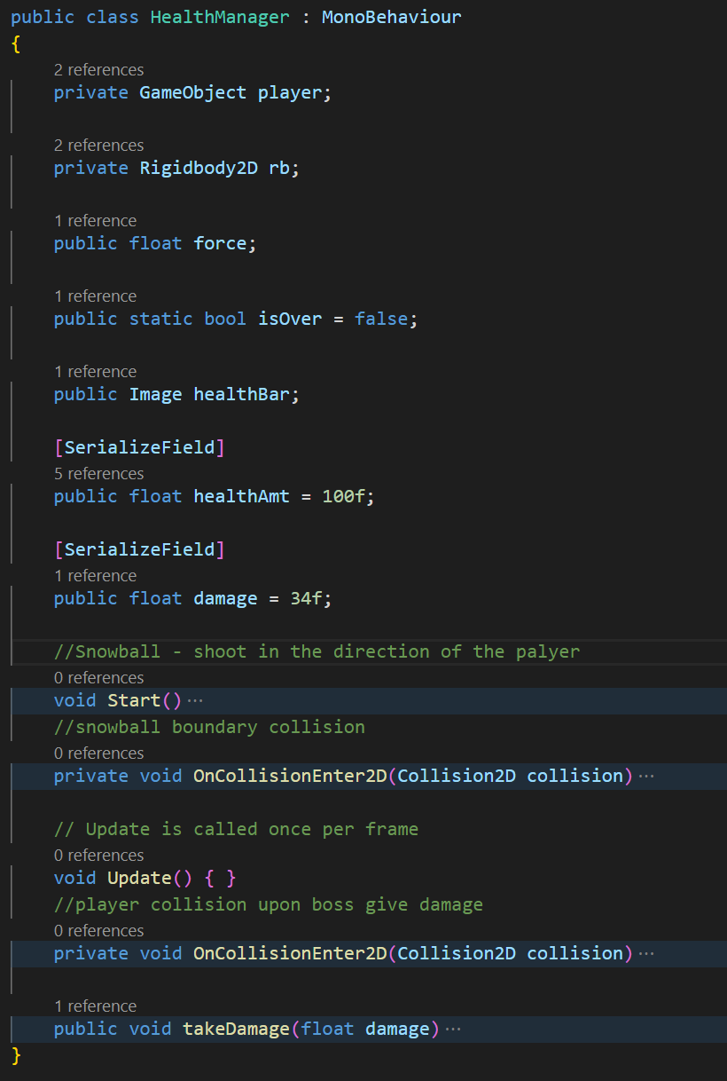
Coincidental Cohesion (worst)
When elements of a module are loosely related or unrelated entirely
Notes:
The class HealthManager shouldn’t have the elements of takeDamage or shooting a snowball, these are elements that should be there own modules and can be delegated to increase reusability and ease maintenance – only thing in common here is location

Slide 18
Logical Cohesion
Module containing elements of similar actions typical I/O
Ex.
Module B
Module A
-Input loginStatus
-Input loginStatus (bool)
-Input Salary ()
-Input Address
Module C
-Input Salary
Module D
-Input Address
BAD
Notes:
Logical cohesion can lack clarity within an interface in this example although all elements are of the type input none of them may invoke the other of if code for more than one action may be connected maintenance will be significanttly harder. To fix this one you would make modules for the different elements
Proper fix

Slide 19
Temporal Cohesion
Elements within a module are related by time
Ex.
MorningRoutine
-checkNews
-makeBreakfast
-brushTeeth
Notes:
There is no reusability, beside the fact these are the first things done in the morning there is no relation at all leading to bad cohesion and maintenance
A fix to this is to have an initializing element in the correct modules along with an initializer module that each may call at the proper time

Slide 20
Procedural Cohesion
Elements within a module are related by the sequence followed by product
Modules of this type : Combine decision making and task execution
Ex.
RevenueReport
-Print revReport
-Update revExpenses
Notes:
The actions with an element of such are weakly related and don’t offer reusability and error handling ie low maintanabiltiy, the processes should be broken up

Slide 21
Communicational Cohesion
Elements within a module are related by the data they all operate upon and contributing to the same output
Ex.
Module A
-Calculate Mean
-Calculate Mode
+ return Mean, mode
Notes:
The combination of processing upon the same data has flaws in Maintenace as if you change code in one area several other areas may effect, there is also low ability for reuse of the code ,to fix this it should be broken up
This cohesion type is ok in use due to its relation of the data set
Stamp coupling

Slide 22
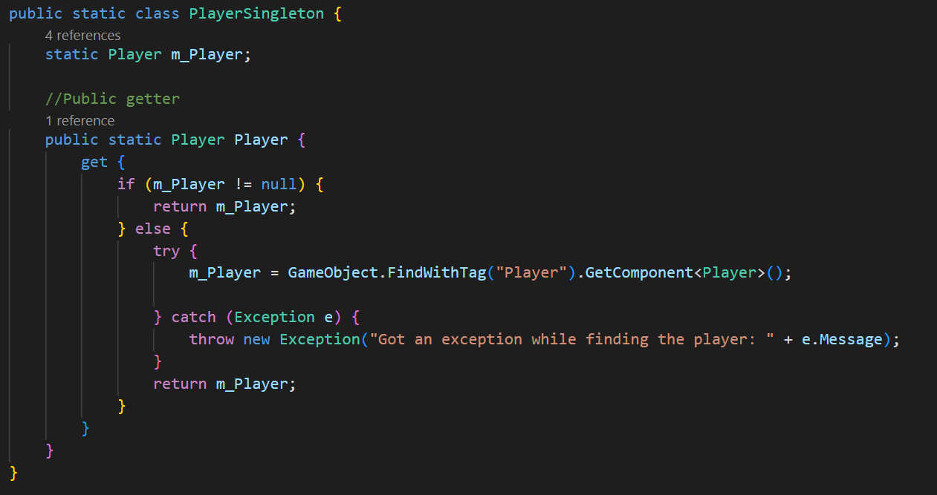
Functional Cohesion (Best)
Elements within a module performs an action in a 1-to-1 case
Ex.
Notes:
Carsons playerSingelton class has one job and that is the to find the player with the scene
The benefit of this is it is highly reusable and if there is an error, maintenance is miniscule

Slide 23
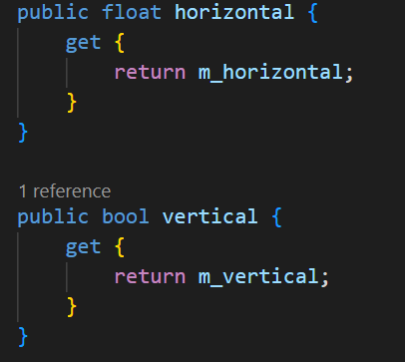
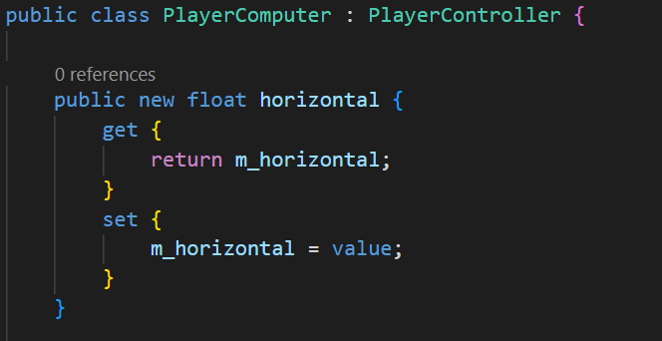
Informational Cohesion (Best)
Elements within a module each have their own entry point, exit, and independent code
Ex.
Notes:
These actions are performed on the same data item being the player
Has the advantages of being an abstract data type – without needing to specify before the class name
Promotes object oriented design

Slide 24

Visibility
How accessible is a variable in a program?
Ability for one object to see and refer to another object
For object A to send a message to object B, B must be visible to A
A
B

Slide 25
Types of Visibility
Attribute
Parameter
Local
Global

Slide 26
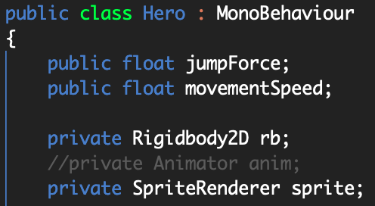

Attribute Visibility
B is an attribute of A
A: class Hero
B: public float jumpForce
Permanent visibility
Remains if A and B exists
Nathan, Hero.cs

Slide 27
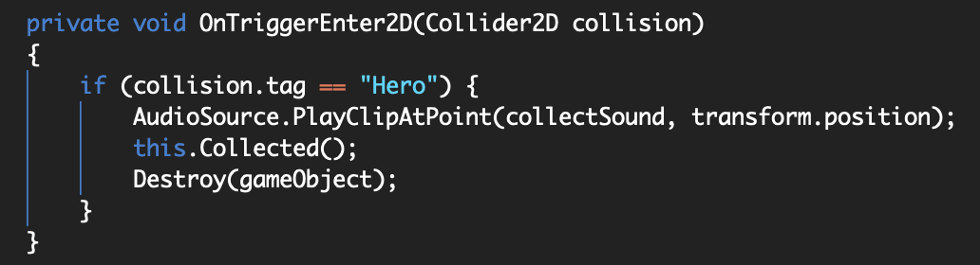
Parameter Visibility
B is passed as a parameter to a method of A
Method of A: void OnTriggerEvent2D, B: Collider2D collision
Temporary visibility
Remains only within the scope of the method
scope
Logan, Item.cs

Slide 28
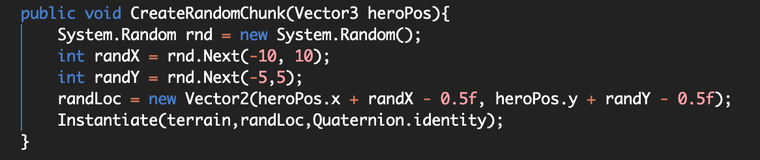
Local Visibility
B is declared as a local object in a method of A
Method of A: void CreateRandomChunck, B: int randX
Temporary visibility
Remains only within the scope of the method
scope
Ian, LoadLevel.cs

Slide 29
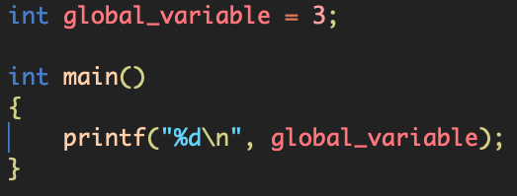
Global Visibility
B is global to A
A: int main, B: global_variable
Permanent visibility
Remains if A and B exists
scope

Slide 30
General
Grasp these principles to successfully design object-oriented software
Grasp these principles to succeed on the POSTMORTEM!
Different "patterns" from previously mentioned patterns
Responsibility
Assignment
Software
Patterns

Slide 31
9 GRASP Patterns
Creator
Information Expert
Low Coupling
Controller
High Cohesion
Polymorphism
Pure Fabrication
Indirection
Protected Variations

Slide 32
Creator
Problem
Suppose you have an object of class A that needs to have several instances created. Who should be responsible for creating those new instances of class A?
A
A
A
A
A
A
Notes:
Hunter

Slide 33
Creator (cont.)
Solution:
Select a class B that bears the responsibility of creating objects of class A if one or more of the following is true:
B contains A
B records A
B closely uses A
B holds the data that will be passed to A (i.e. B is an ‘Expert’ of A)
These conditions also imply that class A is visible to class B

Slide 34
Selecting a Creator
B contains A
B records A
B closely uses A
B holds the data that will be passed to A (i.e., B is an ‘Expert’ of A)
Determine an object’s creator based on how many of these criteria are met
The more criteria met, the higher the coupling between the creator and the created object
Picking an already strongly coupled class to be the creator prevents further coupling

Slide 35
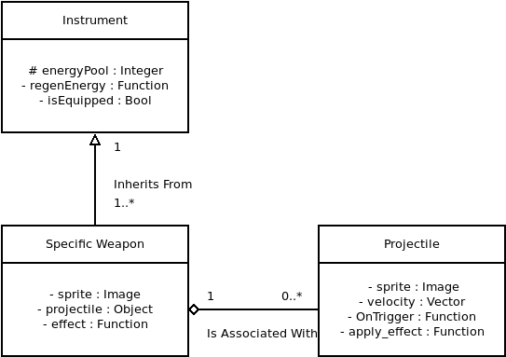
Creator Example

Slide 36
Information Expert
Problem
Solution
What is a general principle of assigning responsibilities to objects?
Assign responsibilities to an ‘Expert Class’, which is a class with the information to complete the task.
Notes:
Hunter

Slide 37
Information Expert (cont.)
Benefits
Detriments
Encapsulates data well
Class behavior is spread across smaller, lightweight classes
Tends to lower cohesion by adding responsibility to a class
Can raise coupling if the added responsibility requires communication with a separate module

Slide 38
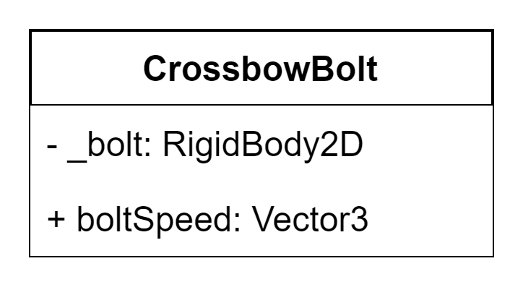
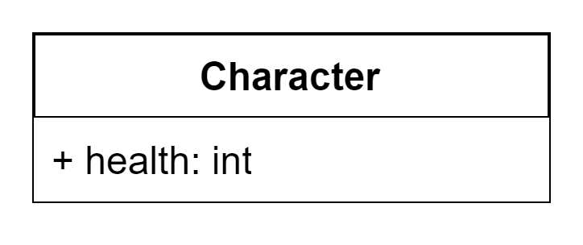




Information Expert Example
Who should measure that the collision occurred to maximize cohesion, minimize coupling, and best utilize visibility?

Slide 39
Low Coupling – How to implement it?
Use private variables and methods
Limit data sharing between modules
When designing modules, classes, and objects make sure they are designed to lower coupling and not raise it
Notes:
Hunter

Slide 40
Controller
Problem
When a request comes from the UI layer, what is the first object that should receive the message to controls/coordinates within the domain layer to accomplish the request?
Solutions
Assign it to a class the represents the overall system
-Façade Controller
2. Assign it to a class that represents a use case handling a specific system operation
-Use Case controller
+ which may imply High Cohesion, Low coupling, and better visibility
Notes:
Al – the controller is a non-user interface obj that receives or handles a system event. It also defines a method for such operations
ultimately delegating the request to another class the control the overall activity within an application
But who is responsible for handling the input system event?
Use case general delagates responsibilties to other component objects

Slide 41
Controllers (cont.)
Pros
Increases potential of reuse and pluggable interfaces
Opportunity to reason about the state of the use case
Cons
Over-assignment of responsibility (bloated controller
Notes:
When properly used it Increases reuse and pluggable interfaces by ensuring that the application logic is not handled in the interface layer allowing the interface to but swapped
Example ensuring states are reached in a sequential order with the use case controller – it is recommended with use case if State information is needed, the same use case controller is used
Cons – this will result is low cohesion as a controllers primary goal is to delagte to othger objects (simply a coordinator)
Signs of bloated controller are the controller itsaelf performs most of the actions without delgating
It interacts with many objects and retains more information that it should or it duplicates information found elsewhere
Example is using a calculator, ui shows the numbers but the controller delagtes the values to the function of the operation

Slide 42
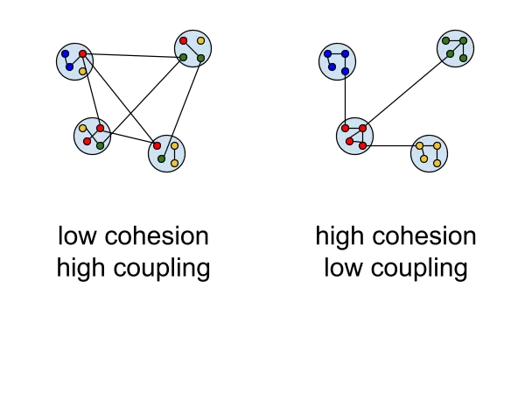
High Cohesion
Problem
Ability to keep objects Focused, Understandable, and Maintainable
Solution
Assign a responsibility so that cohesion remains high
Notes:
Al – to reiterate cohesion is the measure of how strongly related and focused the responsibilities of an element are.
A highly cohesive module doesn’t do tremendous work

Slide 43
Polymorphism
Problem
How to handle alternatives based on type, and to create pluggable software components
Solution
When related alternatives or behaviors vary by type(class), assign responsibility for the behaviors using polymorphic operations to types for which the behaviors differ
Notes:
Al
In other words wanting to change data by type although they may vary in a parent class from one or many subclasses without having to make several changes throughout a moule and its elements

Slide 44
Pure Fabrication
Problem
Which object should be assigned responsibility when you run the risk of violating high cohesion and low coupling?
Solution
Assign a highly cohesive set of responsibilities to a new class
Notes:
Jenna

Slide 45
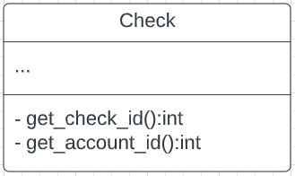
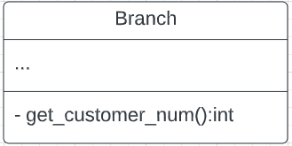
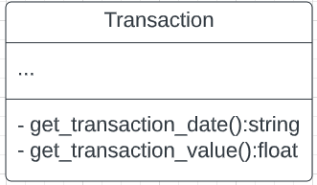
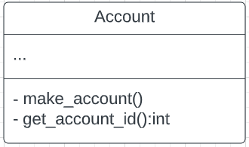

Pure Fabrication Example
void make_account()
{
SAConnection con;
SACommand;
try {
con.Connect(“Banking”, …);
cmd.setConnection(&con);
cmd.SetCommandText(”insert into Accounts (first_name,
last_name) values (”stu”, “dent”);
cmd.Execute();
}
}
Notes:
Jenna

Slide 46
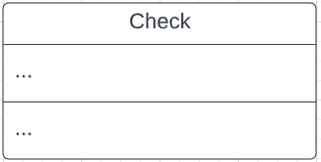
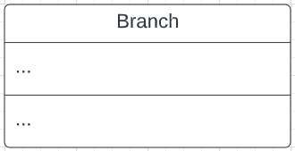
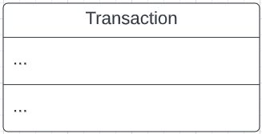
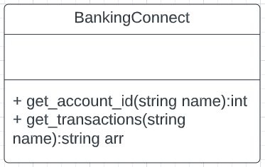
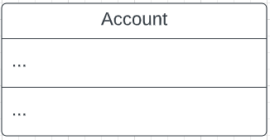
Pure Fabrication Example (cont.)
Coupling?
Cohesion?
Notes:
Jenna

Slide 47
Pure Fabrication Example (cont.)
Low coupling
Classes and databases are now more independent
Changes to the database will not affect interface to database
High cohesion
Many different classes w/ private database methods → single database class w/ public database methods
Reusability
One database methods can be generalized using parameters
Notes:
Jenna

Slide 48
Indirection
Problem
Where do we assign responsibility when we want to avoid direct coupling between two or more objects?
Solution
Assign responsibility to an intermediate object to mediate the between the other objects.
Notes:
Jenna

Slide 49
Indirection Example
Coupling?
Notes:
Jenna

Slide 50
Indirection Example (cont.)
Low coupling
Avoids direct coupling between database and other classes
Changes to database does not affect other classes
Notes:
Jenna

Slide 51
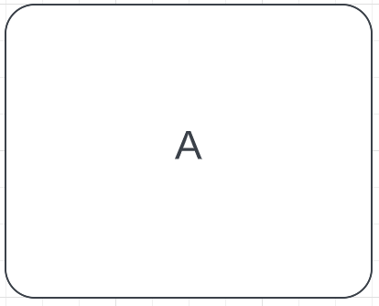
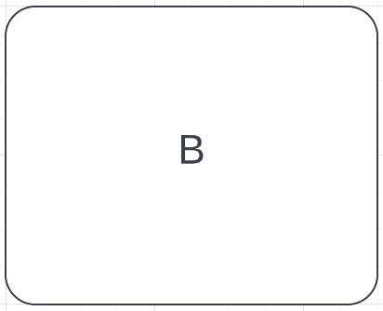
Indirection Example (cont.)
Queues!
Queue
Notes:
Jenna

Slide 52
Protected Variations
Problem
How can I design a system where variations in some elements does not inadvertently affect the functionality of other objects?
Solution
Create an interface for these varying objects to make they appear invariable.
Notes:
Jenna

Slide 53
Protected Variations Example
Notes:
Jenna

Slide 54
Protected Variations Example (cont.)
Low coupling
Prevent changes in the database from affecting banking system classes
Classes are protected from the variations of the database
Especially important for frequently changing code
Notes:
Jenna

Slide 55
GANTT Chart Critiques!

Slide 56

Gruntworx
Notes:
Hunter

Slide 57
Clear Lake Studios
Notes:
Hunter

Slide 58

Clover Games
Notes:
Al – outliers
Projects don't have there dependent tasks netx to them
Outliers I have seen are Karian having x3 the amount time spent compared to the predicted time
There are team leads with nothing planned for this current week, and a member who currently has completed tasks but no actual hours within their section which could effect pay
Besides the few minor thing the overall gant chart looks great, good job!

Slide 59

TTC
Notes:
Jenna

Slide 60

Exodus
Notes:
Jenna

