Slide 1
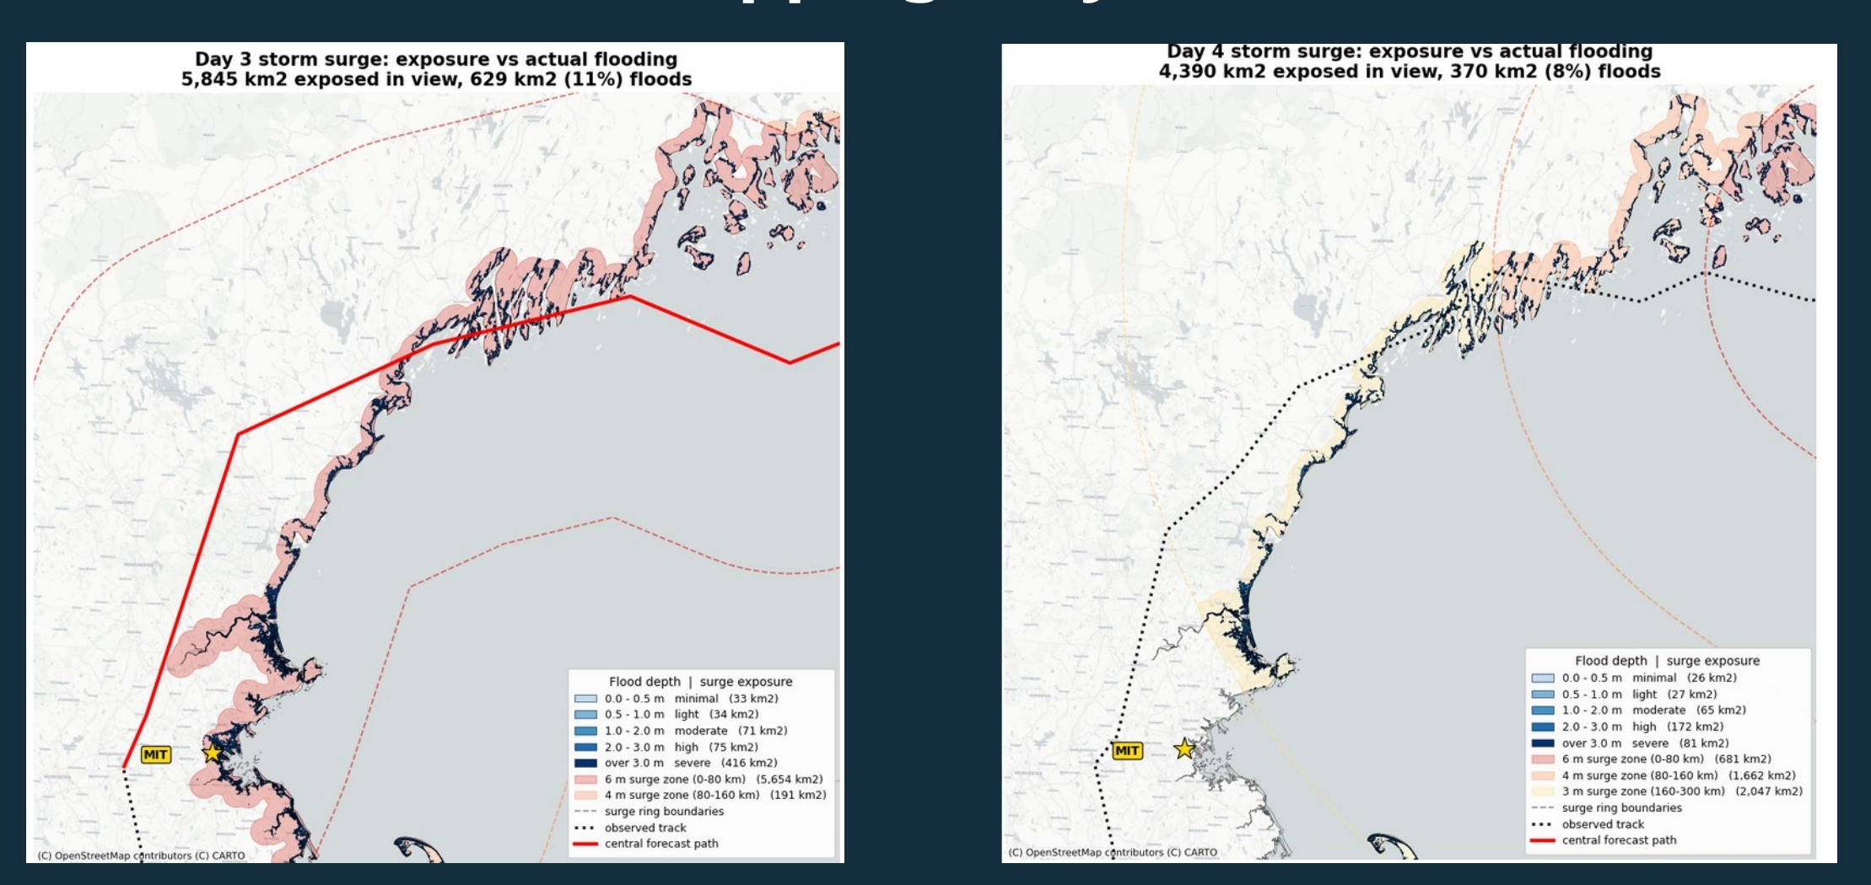
MIT BEAVER WORKS SUMMER INSTITUTE
Hurricane
Claude
Mapping flood risk for disaster response
Cleo Balaranjith · Planning / Flood Mapping + Operations support
Student-team simulation | July–August 2026

Slide 2
01 / ASSIGNMENT
02
What needed to be decided?
A storm track alone could not answer which areas would flood or who might need help.
20
4
6 / 4 / 3 m
370 km²
ensemble tracks
simulation days
surge heights
modeled flooding
per daily forecast
new storm information
distance-based bands
shown on Day 4
MY PRIMARY ROLE
ADDITIONAL SUPPORT
Planning: flood mapping and geographic risk analysis
Operations: imagery analysis and SAR tracking
BWSI REMOTE SENSING / HURRICANE CLAUDE / 2026

Slide 3
02 / APPROACH
03
From forecast to a usable risk map
Each layer answered a question the previous one could not.
01
02
03
04
05
Ensemble paths
Surge bands
Terrain (DEM)
CDC SVI
Response maps
→
→
→
→
Where might the center travel?
How far could water reach?
Where is land low enough to flood?
Where does exposure overlap vulnerability?
Which zones deserve attention?
Methods: Shapely / GeoPandas geometry, UTM 19N buffering, 30 m DEM analysis, SVI overlay
BWSI REMOTE SENSING / HURRICANE CLAUDE / 2026

Slide 4
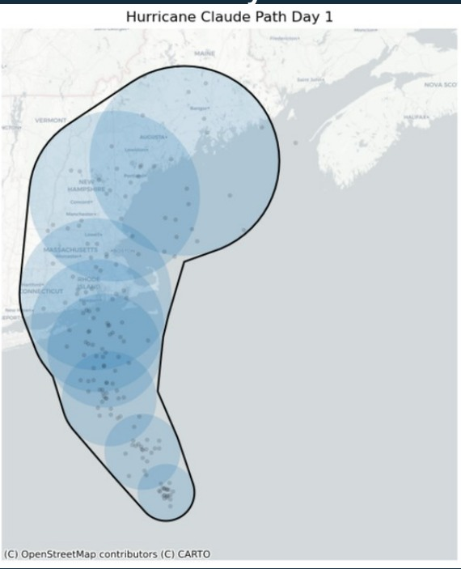
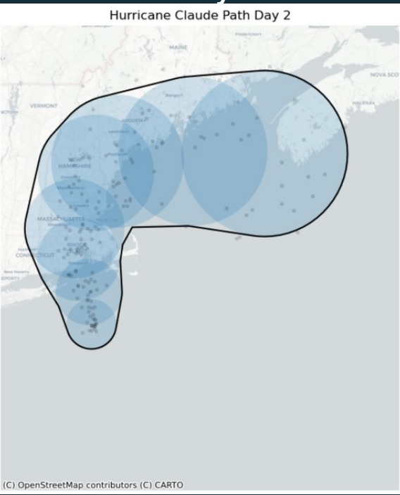
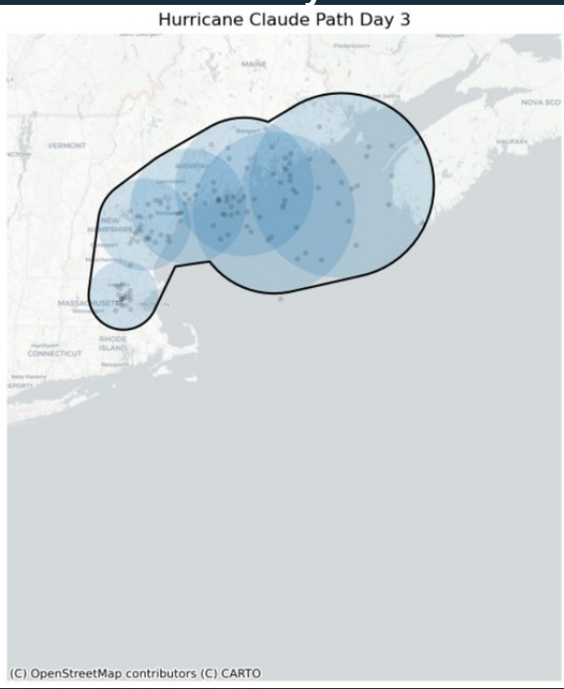
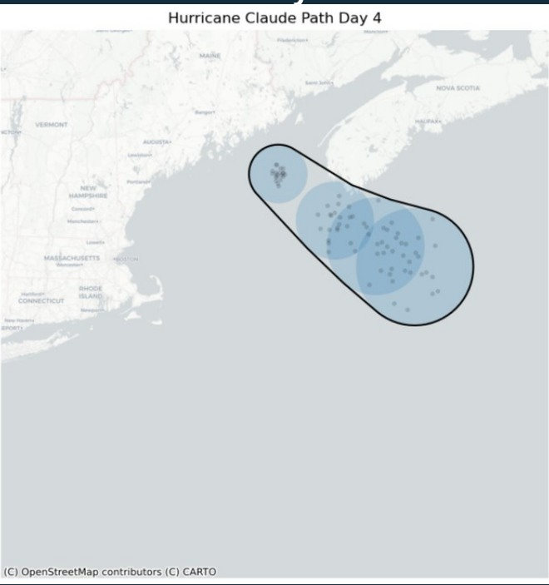
03 / FORECAST
04
Twenty possible paths. One changing forecast.
Ensemble members were summarized into a central track; uncertainty did not disappear.
DAY 1
DAY 2
DAY 3
DAY 4
By Day 4, the forecasted storm had moved largely offshore. The planning maps changed with it.
BWSI REMOTE SENSING / HURRICANE CLAUDE / 2026

Slide 5
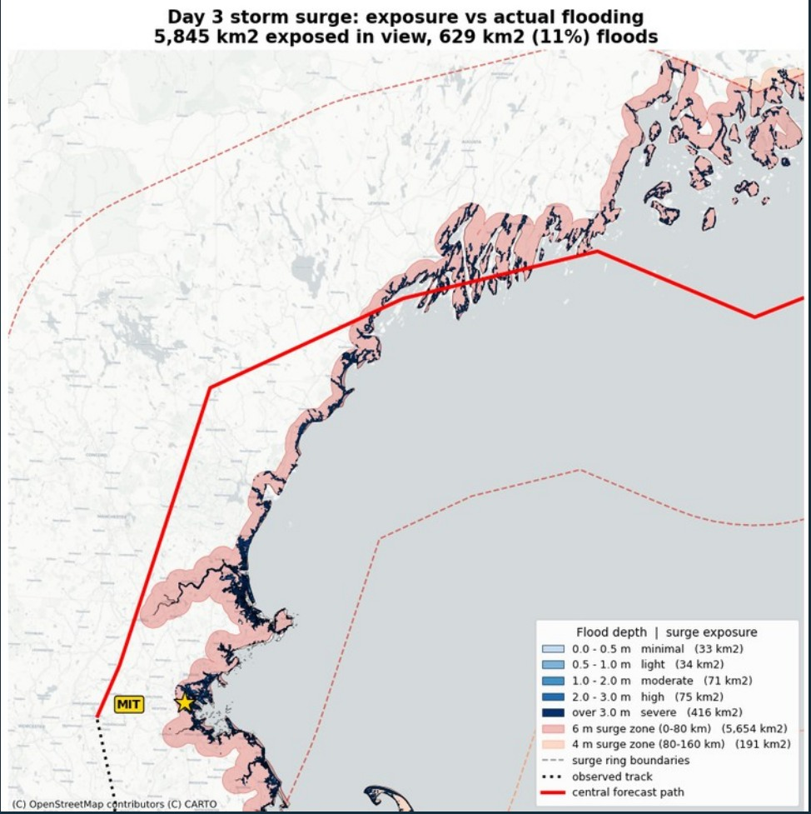
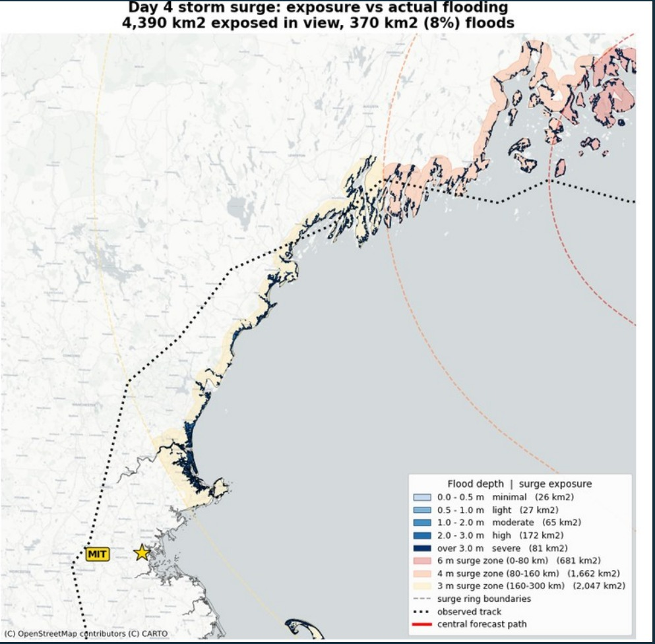
04 / FLOOD MODEL
05
Surge exposure ≠ actual flooding
Adding a digital elevation model removed large areas that were exposed but too high to flood.
DAY 3
5,845
km² exposed
629
km² flooded
DAY 4
4,390 km² exposed → 370 km² modeled flooding (8%)
Figures are from the Planning Team map extent; simulation estimates, not observed damage.
BWSI REMOTE SENSING / HURRICANE CLAUDE / 2026

Slide 6
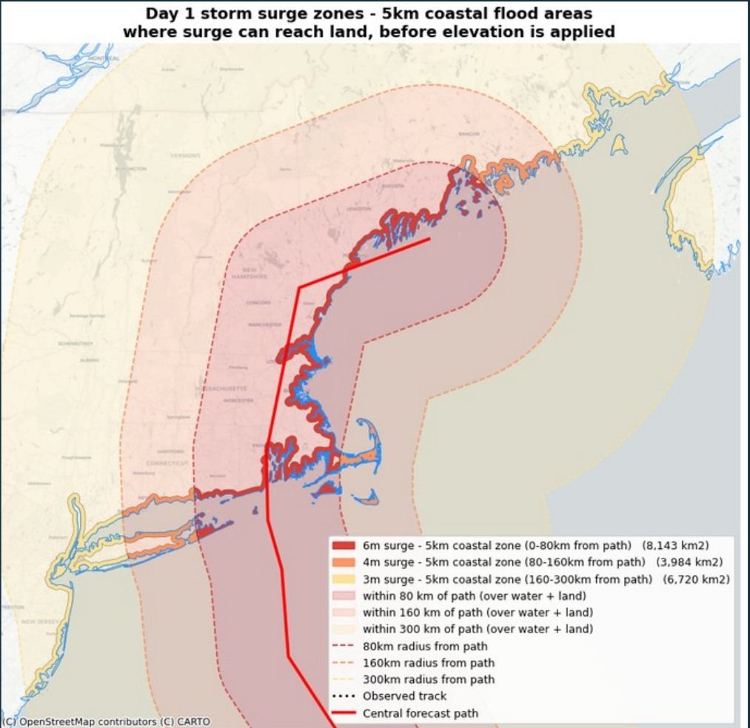
05 / DEBUGGING
06
The five-kilometer buffer looked wrong. It wasn’t.
Boston’s harbors, islands, and inlets changed how a correct distance looked on a map.
WHAT I CHECKED
01 Reprojected to UTM Zone 19N
02 Verified the distance independently
03 Re-examined the coastline geometry
Overlapping buffers along narrow coastal features made the map look bigger than the math suggested.
BWSI REMOTE SENSING / HURRICANE CLAUDE / 2026

Slide 7
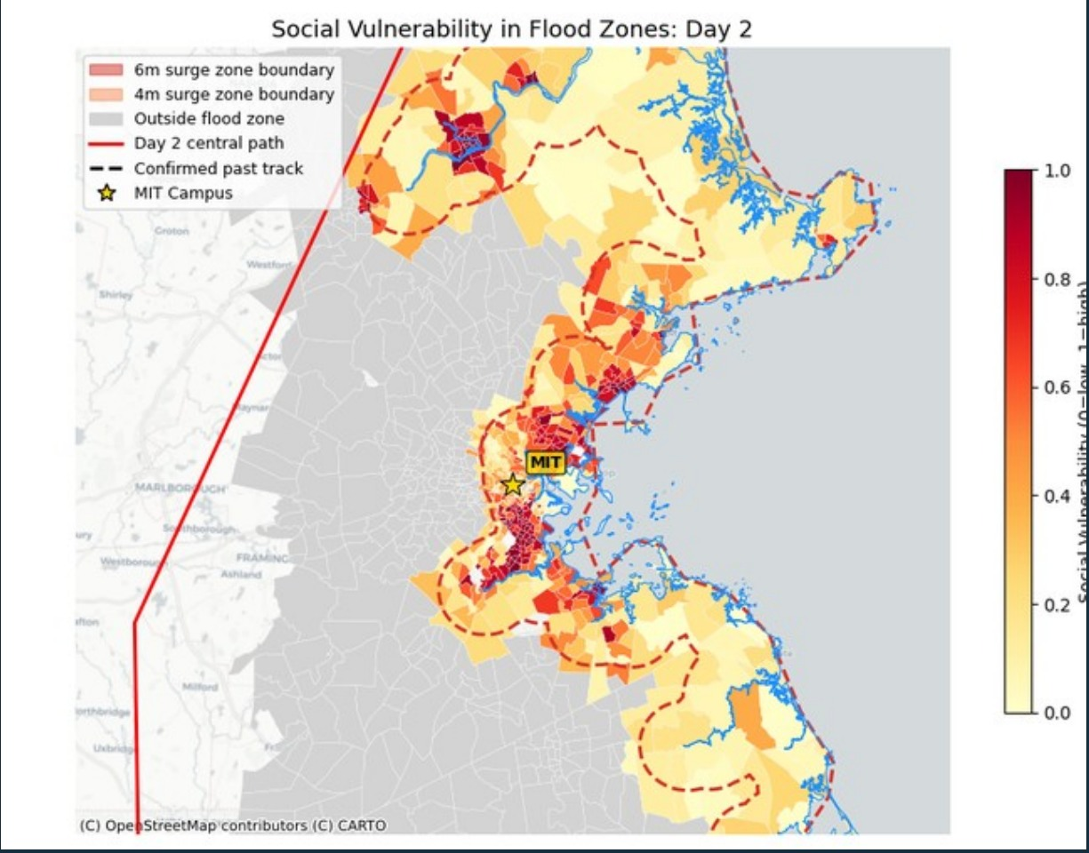
06 / VULNERABILITY
07
Hazard mapping needs people in the picture
The CDC Social Vulnerability Index added context that the water layer could not show.
HOTSPOTS
Chelsea
East Boston
The team’s overlays showed significant coastal exposure overlapping with higher social vulnerability.
SVI helps prioritize further investigation; it is not a substitute for local, real-time emergency information.
BWSI REMOTE SENSING / HURRICANE CLAUDE / 2026

Slide 8
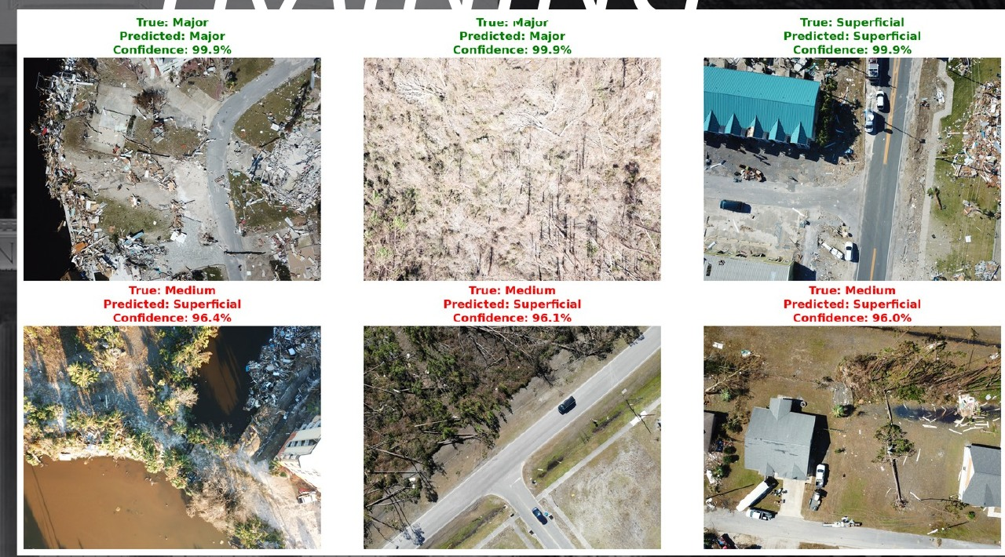
07 / OPERATIONS
08
Supporting damage assessment with imagery
My main ownership was Planning; I also contributed to the Operations Team’s image-analysis work.
TEAM DEEP-LEARNING WORK
ResNet-50 / ResNet-152
Damage classification on RescueNet and xView2 imagery
U-Net + Grad-CAM
Segmentation and interpretation of model attention
The source deck reports team model results. I do not present these as solo architectures or solo training results.
BWSI REMOTE SENSING / HURRICANE CLAUDE / 2026

Slide 9
08 / OPERATIONS
09
Tracking a ship through cloud cover
Synthetic aperture radar (SAR) offered a way to look through a storm when optical imagery could not.
83
VH + VV
Land mask
8
SAR scenes
radar channels
false positives
positions
indexed by timestamp
combined for detections
reduced along coastline
plotted and sanity-checked
WHY WE REVISED IT
Our first coordinates made an implausible zigzagging route. A plausible spatial track mattered more than the fact that the detector returned points.
BWSI REMOTE SENSING / HURRICANE CLAUDE / 2026

Slide 10
09 / WHAT IT MEANS
10
What the maps actually established
A useful result is one you can explain, inspect, and qualify.
Flood geography
The DEM narrowed broad coastal exposure to lower-lying modeled flood zones.
IMPORTANT LIMIT
A simulation, not a live flood prediction.
Vulnerability overlap
East Boston and Chelsea emerged as locations needing particular attention.
The elevation-based bathtub model is a screening approximation. It does not resolve dynamic water flow or certify evacuation routes.
Confidence in outputs
Both coastline buffering and SAR detections needed geographic sanity checks.
Full narrative: medium.com/tierra-insights/zoom-out-from-google-maps-to-remote-sensing-at-mit-bwsi-8da153228e6e
BWSI REMOTE SENSING / HURRICANE CLAUDE / 2026

