Slide 1
Draft Genome assembly and differential expression analysis of durian
Julia Sulyaeva

Slide 2
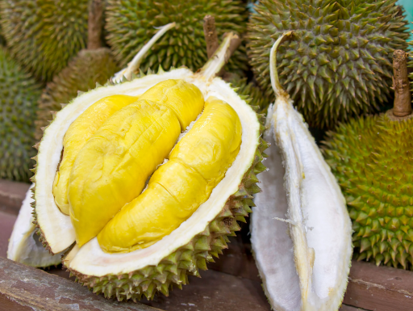
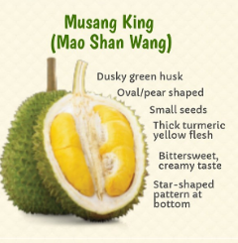
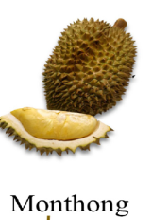
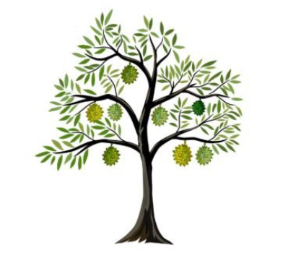
Durian
Durio zibethinus (Jackfruit)
Smell: complex mixture = Sulfur, esthers, alcohols, acids
Cultivars: Musang king, Monthong
Plant organs: leaf, root, aril, stem

Slide 3
PROJECT AIM
Reproduce a part of WGS analysis of Durio zibethinus, from 2017 article by Teh, Lim, Yong, et al (DOI: 10.1038/ng.3972)
Create a genome assembly
Annotate the genome
Analyze expression differences between the different plant organs

Slide 4
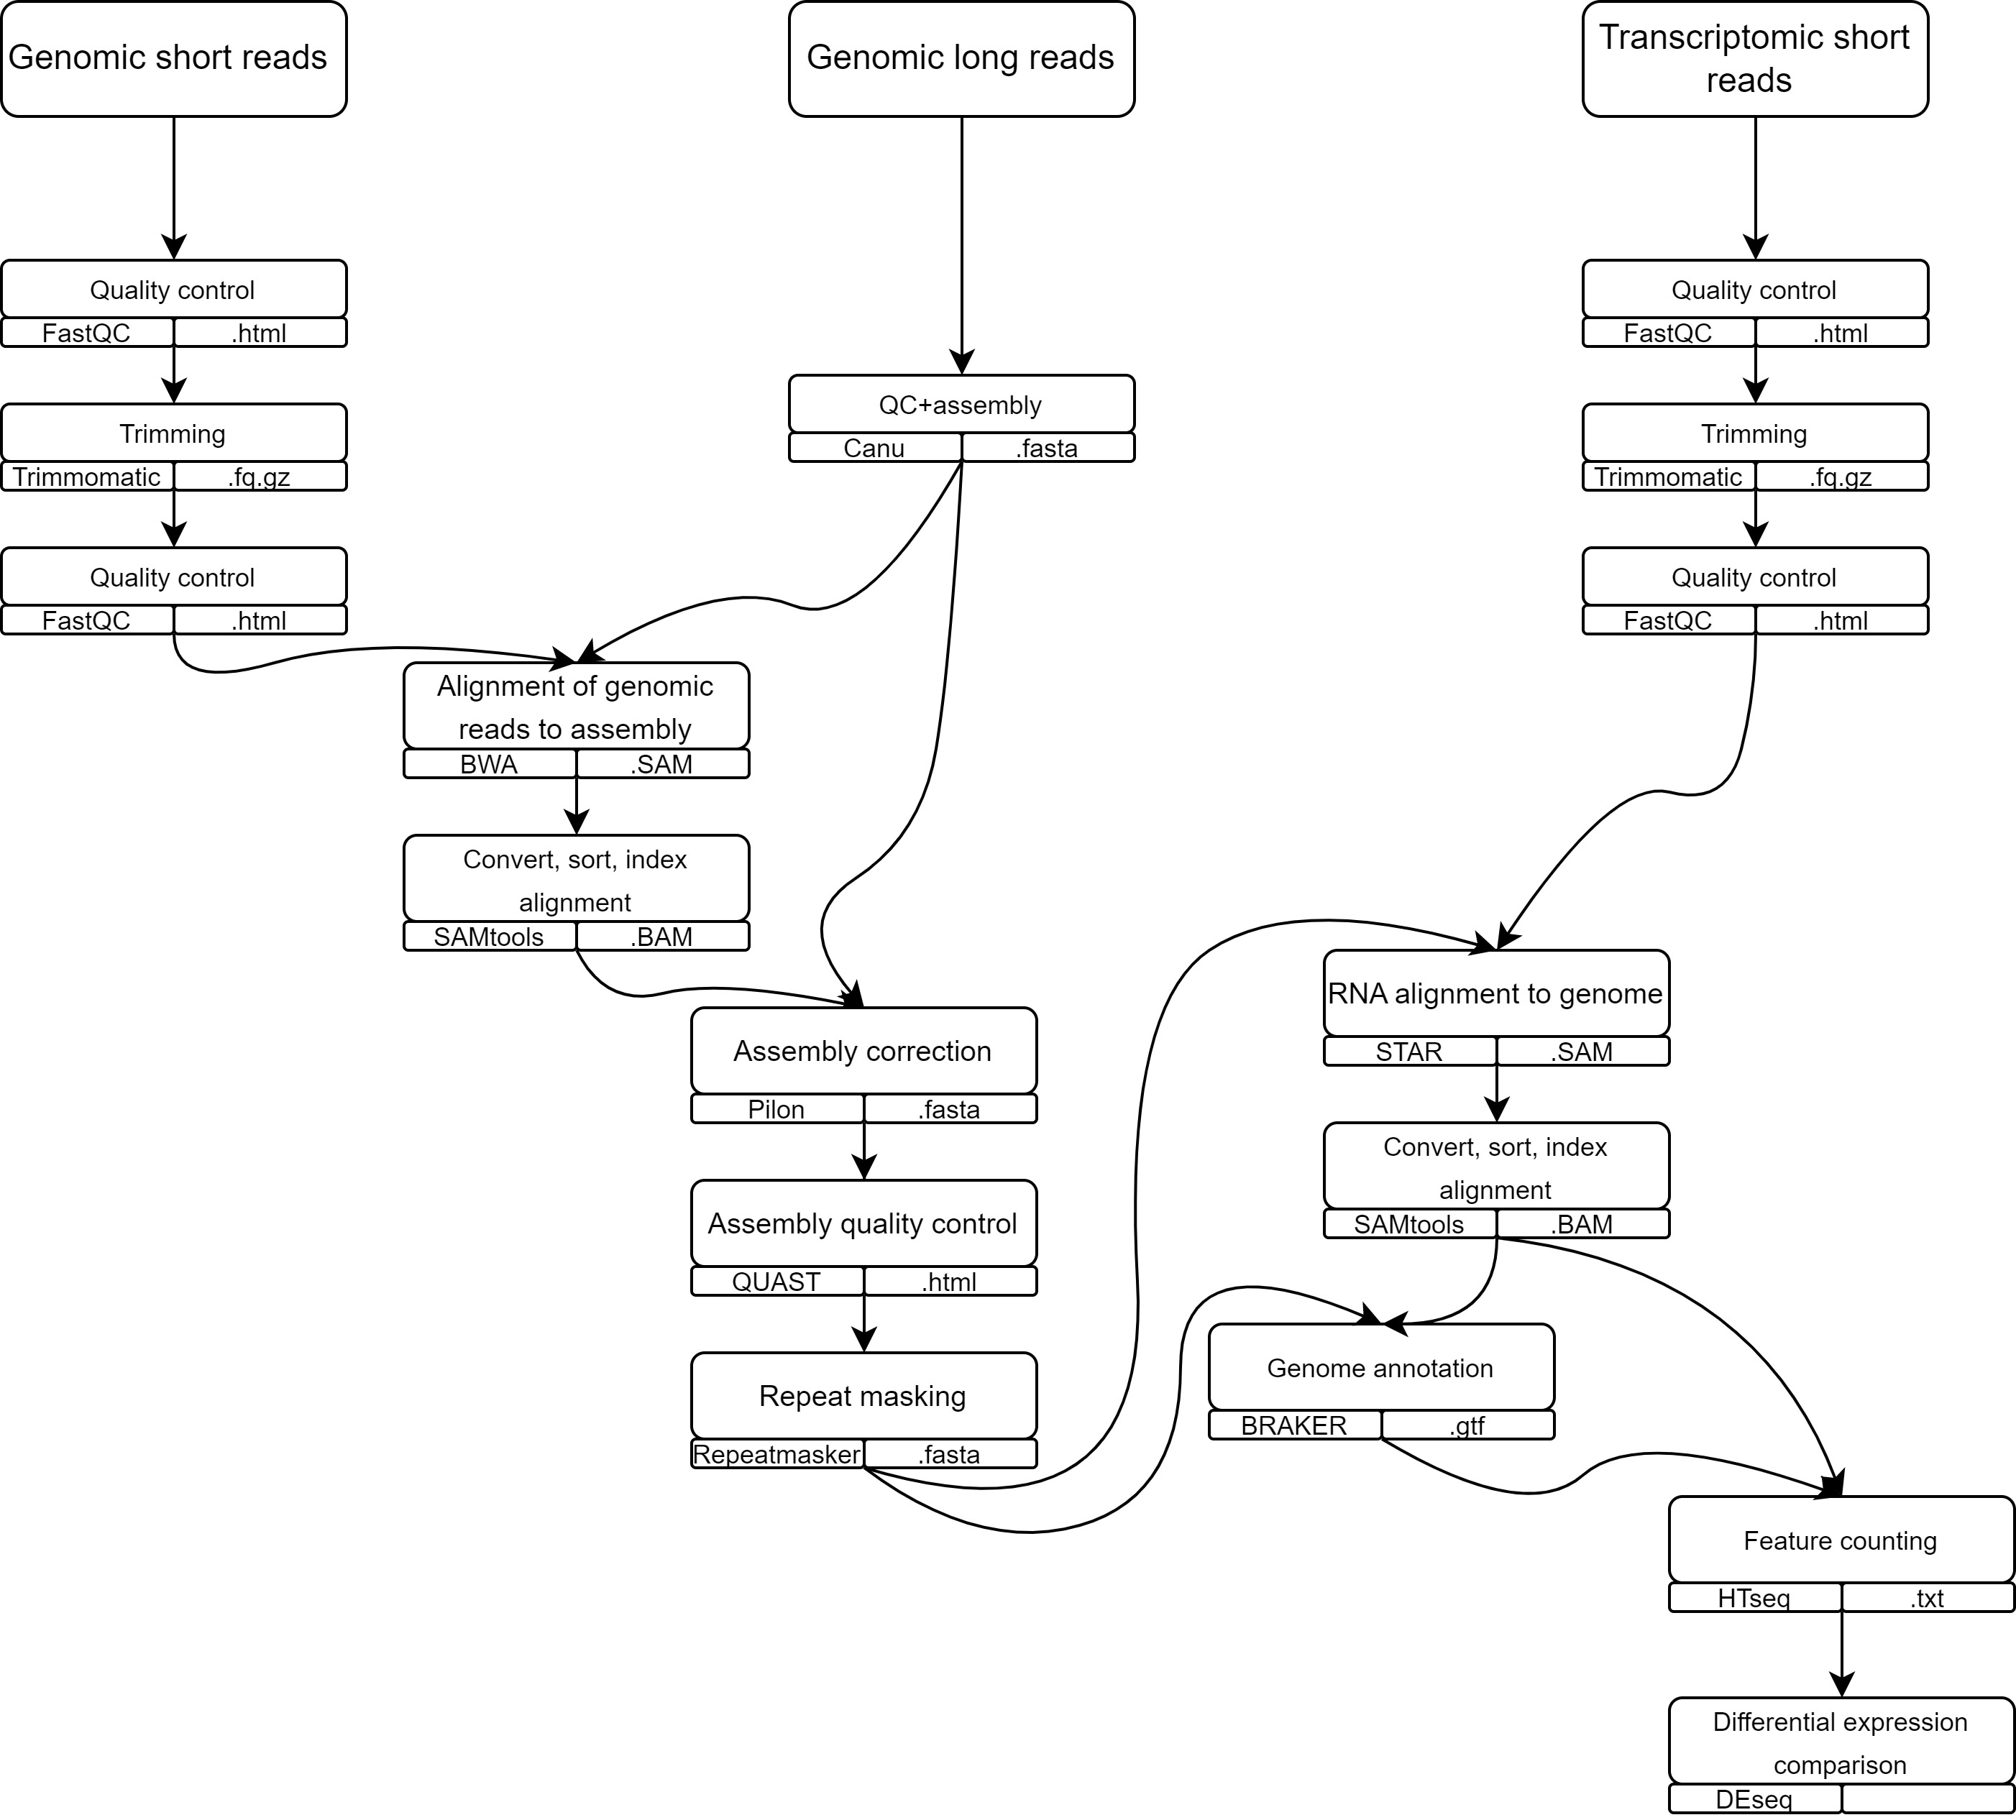
WORKFLOW

Slide 5
RAW DATA

Slide 6
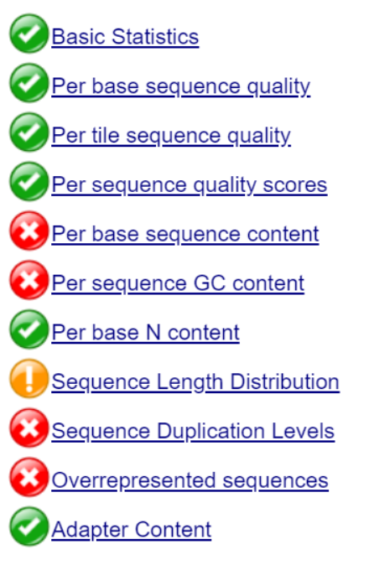
Reads preprocessing + assembly

Slide 7
Assembly improvement

Slide 8
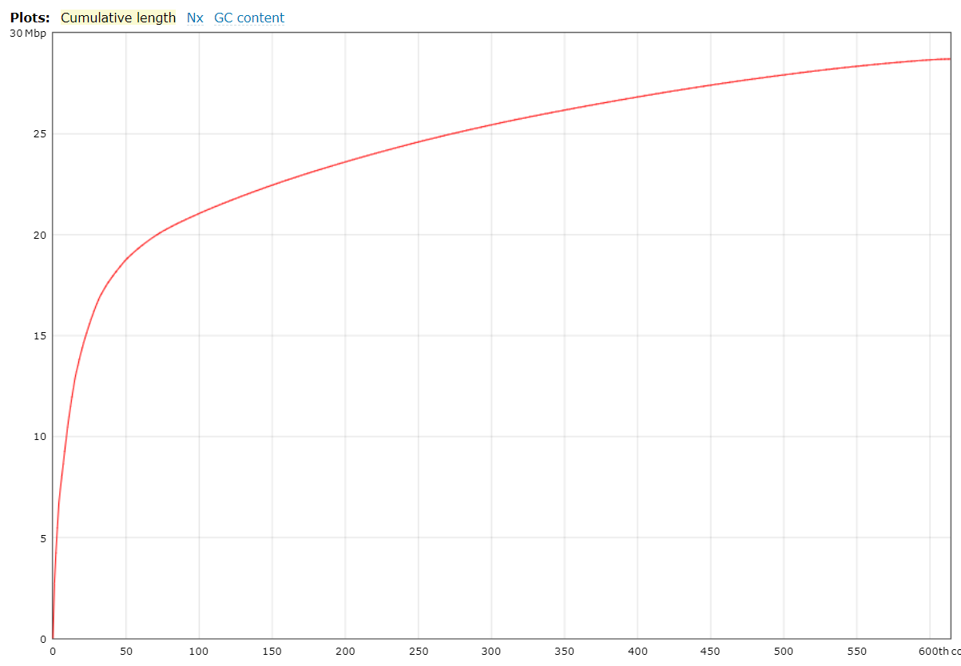
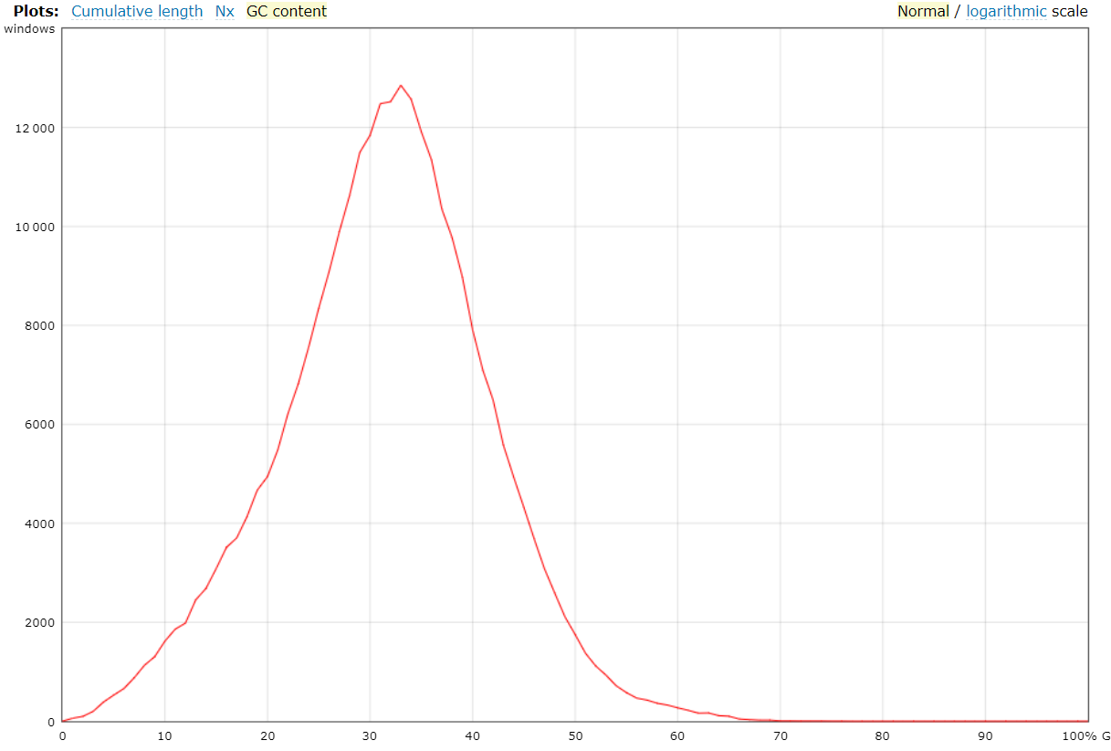
Final assembly
Scaffold 10
614 contigs, all >1000bp
31.44% GC
Plots: cumulative length, GC content

Slide 9
Genome annotation with transcriptome

Slide 10
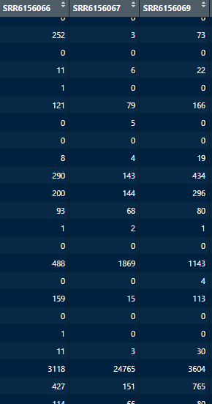
Differential expression analysis

Slide 11
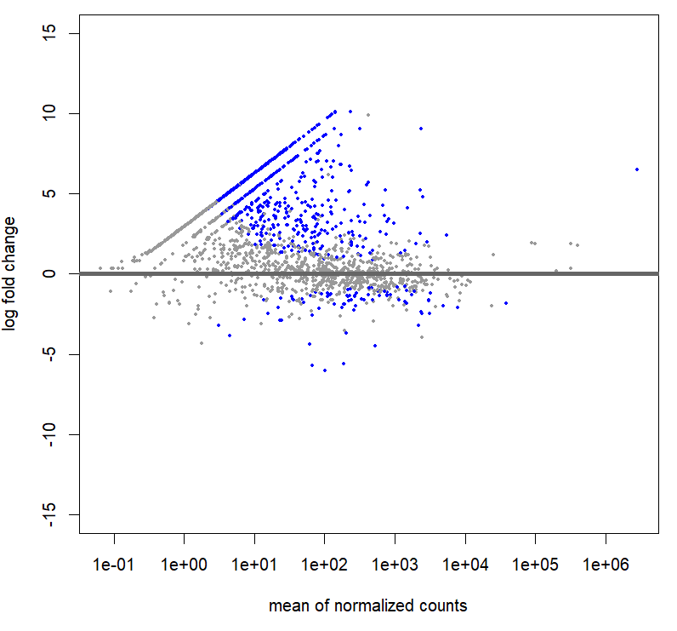
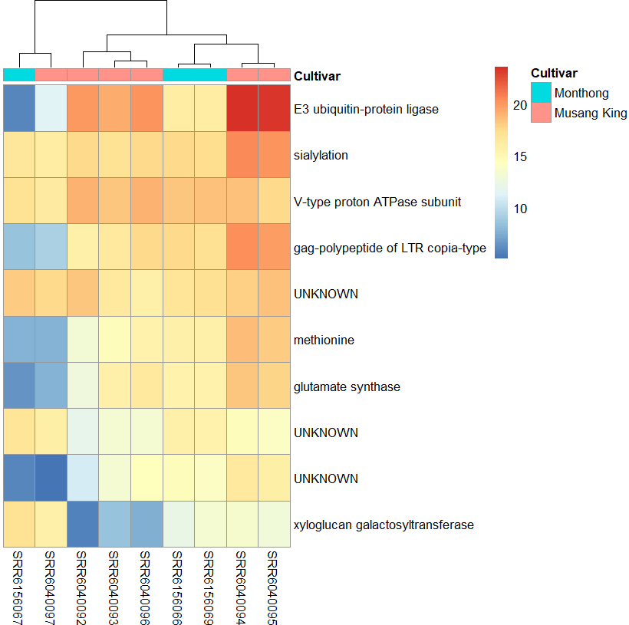
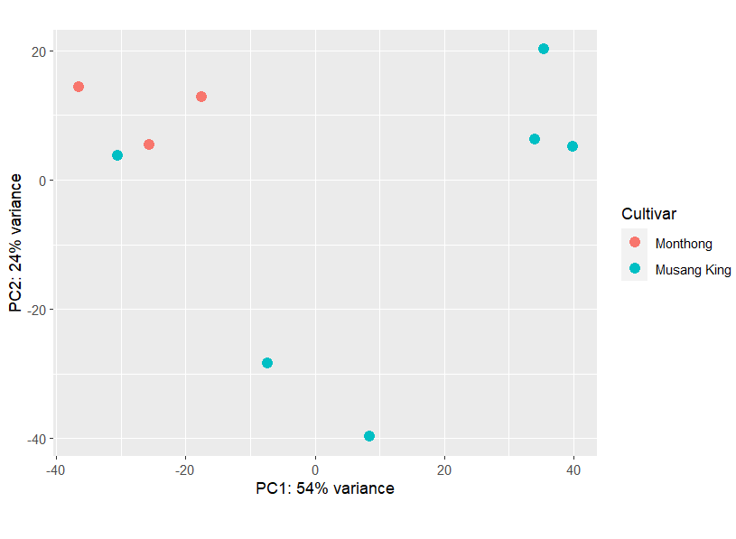
Results: Cultivars

Slide 12
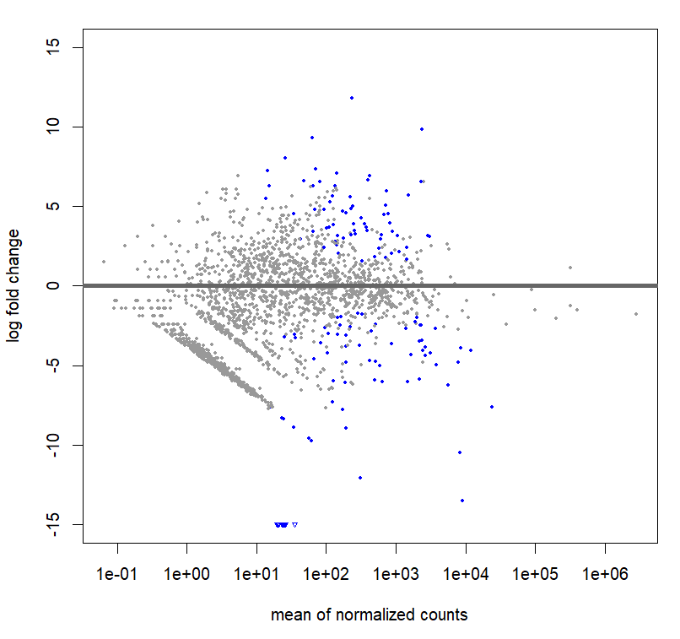
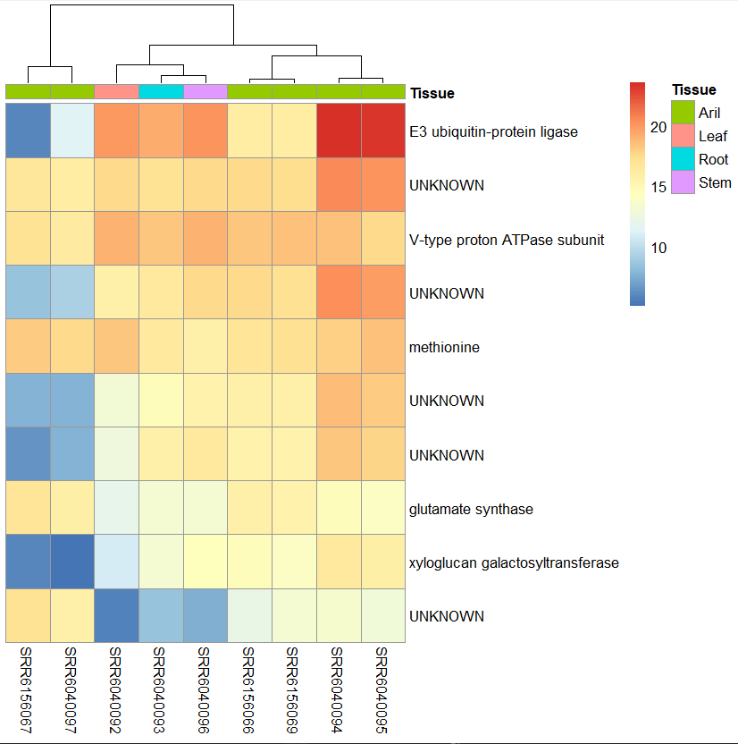
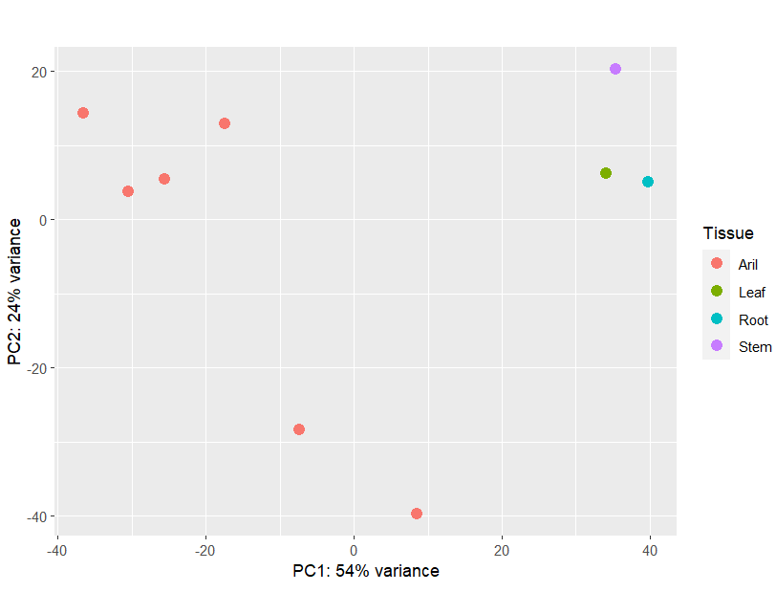
Results: Plant tissues

Slide 13
Conclusion
Successful genome assembly
Large differences in expression between cultivars
More ambiguous differences in expression between plant organs
Expression analysis results not very satisfactory, more analysis would be wished for.

