Slide 1

On the State of Embedded Systems

Slide 2
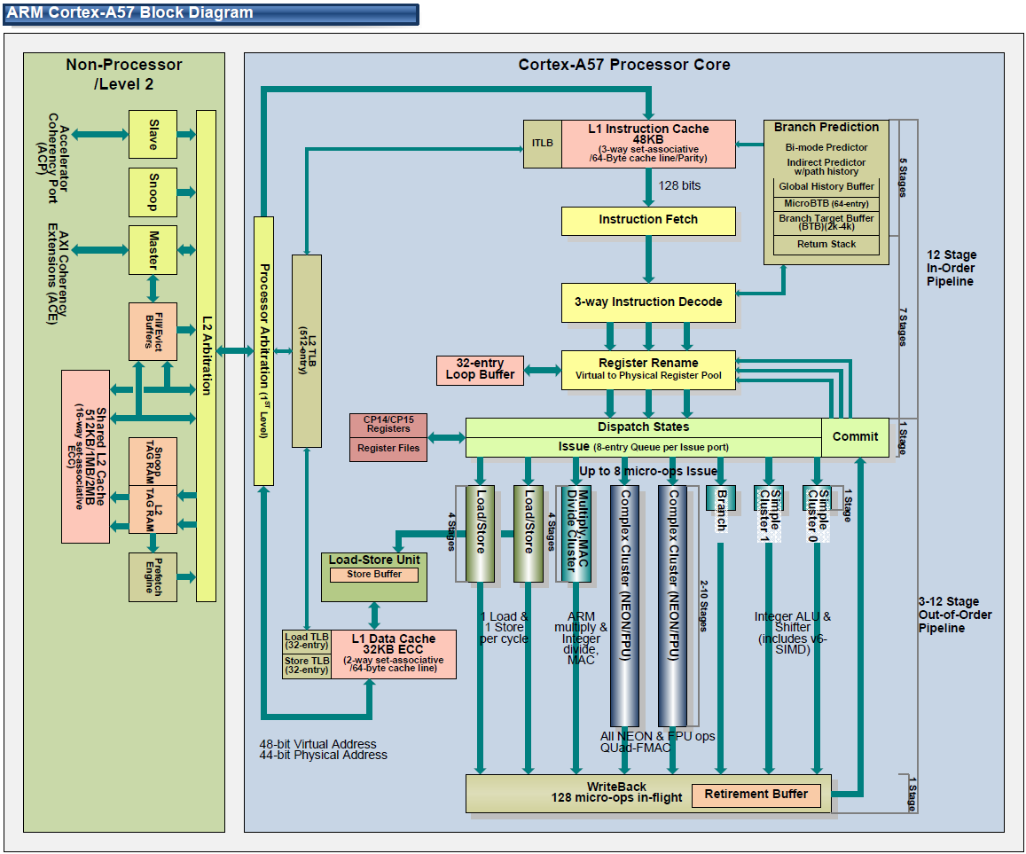
Topics: Embedded…
Computer architecture
CPUs: 8/16 bit → 32/64 bit, pipelining, multi-issue, multi-core
DSPs, FPGAs, more modern → accelerators (GPUs)
ISAs: ARM, RISC-V (many others)
Memory: DRAM/SRAM/ NVRAM/EPROM: caches, MMU/MPU, TLBs, DMA
Devices: I/O, A/D, sensors/actuators, buses/NoC
embedded networking: Ethernet, fieldbus, CAN
TCP/IP
Other protocols

Slide 3
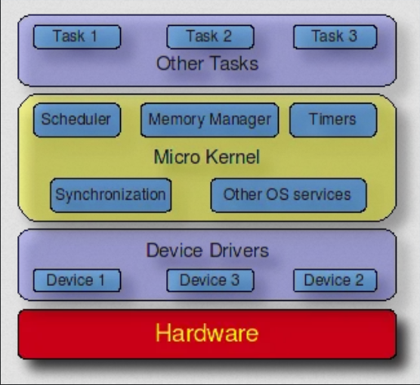
Topics: Embedded…
System /software
Embedded OS / real-time OS (RTOS)
Interrupts/traps/alarms & timers
scheduling, preemption, priorities, processes/tasks/threads
Shmem, communication, msg passing/IPC
Tools: compiler, debugger, runtime systems
Assembly, C/C++
Code optimization

Slide 4
Topics: Embedded…
Design (of small systems) → OUR FOCUS
Software, hardware, co-design
objectives: functional, timing, cost, safety, security, energy, …
OO design
Formal methods:
Hardware: VHDL/Verilog
Software/systems: UML/Statecharts, Matlab/Simulink, Esterel, UPPAAL
State machines: synchronous, async./event-based
Verification of program properties
requirements
specification
architecture
component
design
system
integration

Slide 5
Design flow
Design flow: sequence of steps in a design methodology.
May be partially or fully automated.
Use tools to transform, verify design.
Design flow is one component of methodology. Methodology also includes management organization, etc.
Formal methods, verification → reduce bugs
requirements
bug
cost to fix
coding bug
time

Slide 6
Waterfall model
Early model for software development:
Requirements: determine basic characteristics.
Architecture: decompose into basic modules.
Coding: implement and integrate.
Testing: exercise and uncover bugs.
Maintenance: deploy, fix bugs, upgrade.
requirements
architecture
coding
testing
maintenance

Slide 7
Waterfall model critique
Only local feedback---may need iterations between coding and requirements, for example.
Doesn’t integrate top-down and bottom-up design.
Assumes hardware is given.
requirements
architecture
coding
testing
maintenance

Slide 8
Spiral model
Successive refinement of system.
Start with mock-ups, move through simple systems to full-scale systems.
Provides bottom-up feedback from previous stages.
Working through stages may take too much time.
system feasibility
specification
prototype
initial system
enhanced system
requirements
design
test

Slide 9
Successive refinement model
specify
specify
architect
architect
design
design
build
build
test
test
initial system
refined system

Slide 10
Hardware/software design flow
requirements and
specification
architecture
hardware design
software design
integration
testing

Slide 11
Co-design methodology
Must architect hardware and software together:
provide sufficient resources;
avoid software bottlenecks.
Can build pieces somewhat independently, but integration is major step.
Also requires bottom-up feedback.

Slide 12
Hierarchical design flow
Embedded systems must be designed across multiple levels of abstraction:
system architecture;
hardware and software systems;
hardware and software components.
Often need design flows within design flows.
spec
spec
spec
architecture
HW architecture
SW architecture
detailed design
HW
SW
detailed design
integrate
integration
integration
test
test
test
system
software
hardware

Slide 13
Concurrent engineering
Large projects use many people from multiple disciplines.
Work on several tasks at once to reduce design time.
Feedback between tasks helps improve quality, reduce number of later design problems.
Techniques:
Cross-functional teams.
Concurrent product realization.
Incremental information sharing.
Integrated product management.
Supplier involvement.
Customer focus.

Slide 14
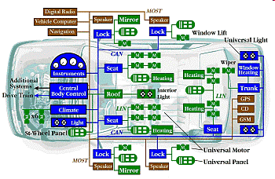
Prius Brake Problems Blamed on Software Glitches
“Toyota officials described the problem as a "disconnect" in the vehicle's complex anti-lock brake system (ABS) that causes less than a one-second lag. With the delay, a vehicle going 60 mph will have traveled nearly another 90 feet before the brakes begin to take hold”
CNN Feb 4, 2010

Slide 15
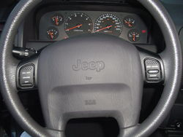
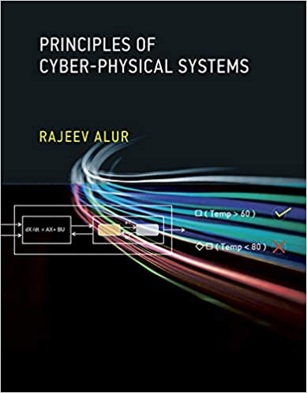
Let’s Design a Cruise Controller
What’s the goal of a cruise controller?
Automatically adjust the speed of the car so that it matches the speed desired by the driver

Slide 16

Block Diagrams of High-Level Design
CruiseController
How does this component interact with the rest of the world ?

Slide 17
Interfaces for Components: Inputs and Outputs
cruise
CruiseController
pause
Driver
inc/dec
Driver interacts with the system using 4 buttons:
Cruise button to turn the cruise on or off
Pause button to suspend/restart its operation
Inc and Dec buttons to increment or decrement desired speed

Slide 18
Interfaces for Components: Inputs and Outputs
cruise
speed
pause
Speedometer
CruiseController
Driver
inc/dec
What other information does the cruise-controller need ?
And who supplies it?

Slide 19
Interfaces for Components: Inputs and Outputs
cruise
speed
pause
Speedometer
CruiseController
Driver
inc/dec
What should be the outputs of the cruise controller?
And who needs these outputs?

Slide 20
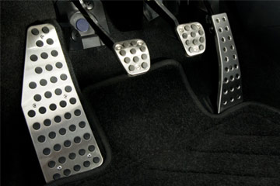
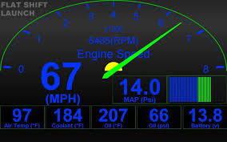
Interfaces for Components: Inputs and Outputs
Throttle
Force
cruise
speed
pause
Speedometer
CruiseController
Driver
inc/dec
DesiredSpeed
speed
Display

Slide 21
Compositional Design
Force
cruise
speed
pause
CruiseController
inc/dec
DesiredSpeed
speed
How to break up the computation of the cruise controller into subtasks?

Slide 22
Decomposing the Cruise Controller
Force
ControlSpeed
cruise
speed
SetSpeed
pause
inc/dec
DesiredSpeed
speed

Slide 23
Designing SetSpeed Component
cruise
speed
SetSpeed
pause
inc/dec
DesiredSpeed
Goal: Compute the desired cruising speed in response to
the commands from the driver

Slide 24
Designing SetSpeed: State Machines
pause, inc, dec
inc: r := r+1
cruise: r := speed
OFF
ON
dec: r := r-1
cruise
pause
cruise
pause
PAUSED
DesiredSpeed corresponds to the variable r
inc, dec

Slide 25
Designing ControlSpeed Component
speed
ControlSpeed
DesiredSpeed
Force
Goal: Determine the force to be applied to throttle so that speed becomes equal to DesiredSpeed

Slide 26
Capturing Requirements
speed
ControlSpeed
DesiredSpeed
Force
Requirements: Mathematically precise description of what a system is supposed to do.
Writing requirements is key to ensuring reliability of systems
Requirement 1: Actual speed eventually converges to desired speed
Requirement 2: Speed of the car stays “stable”

Slide 27

A bit of Physics: Modeling a car
Velocity v
Force F
Weight mg
Friction k v
Angle θ
Newton’s law of motion gives
F – kv – mg sin θ = m a

Slide 28
ControlSpeed Component
ControlSpeed
F = K_{P} ( v – r)
DesiredSpeed r
Force F
Velocity v
F – kv – mg sin θ = m a
Angle θ of the road with horizontal (disturbance)
Car
Control Theory: Mathematical techniques to compute force (F) as a function of velocity (v) and desired speed (r)

Slide 29
Does our controller work ?
ControlSpeed
F = K_{P} ( v – r)
r
Force F
Velocity v
F – kv – mg sin θ = m a
θ
Car
Verification Tools: Allow you to check if system model indeed works as expected, that is, satisfies requirements
→ Matlab

Slide 30
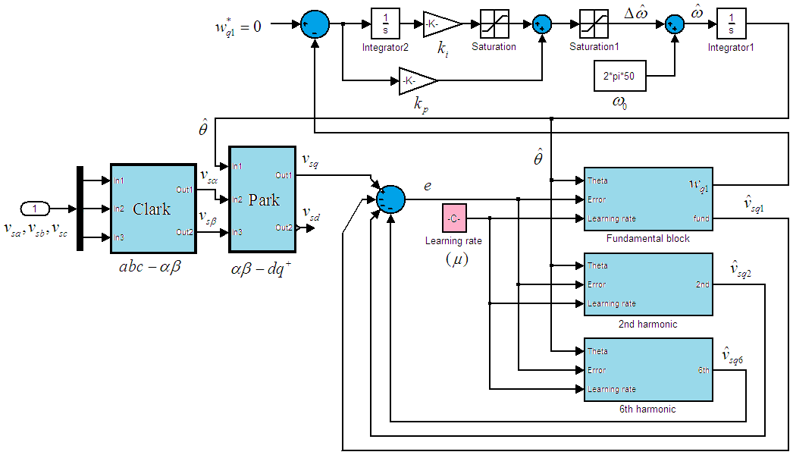
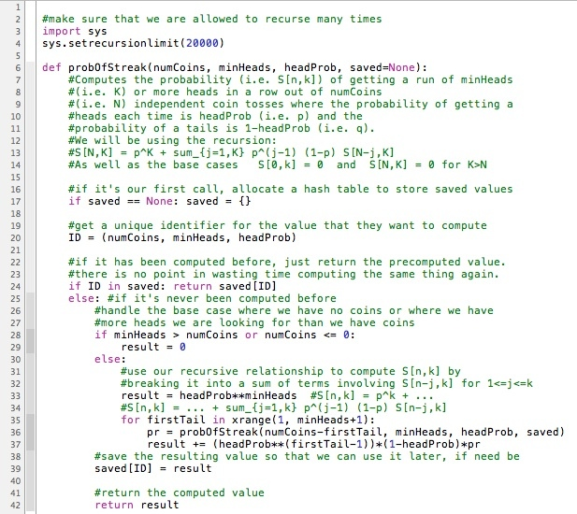
Model-based design != Coding
Design using high-level block diagrams and state machines gets automatically compiled into low-level code !
Models not only of system being designed, but also of its environment

Slide 31
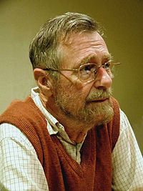
Verification != Simulation/Testing
Model/Program
Verifier
yes/proof
Requirement
no/bug
Program testing can be used to show the presence
of bugs, but never their absence!
Edsger W. Dijkstra

Slide 32
Formal Verification
Model/Program
Verifier
yes/proof
Requirement
no/bug
Goal: Establish that model satisfies requirements under all possible scenarios
First challenge: Need formal definitions of “model” and “requirement” to make the problem mathematically precise
Second challenge: Need verification techniques and tools

