Slide 1
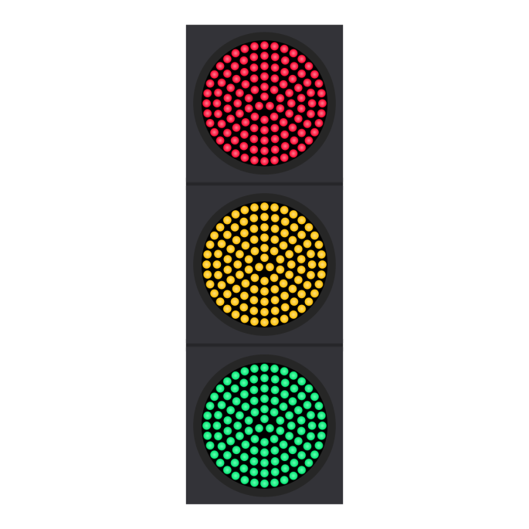
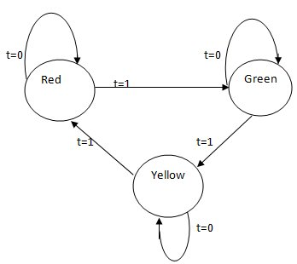
Modeling Synchronous Systems

Slide 2
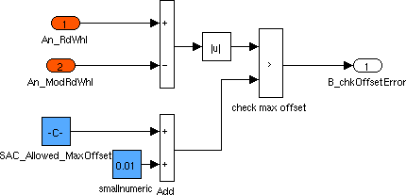
Model-Based Design
Block Diagrams
Widely used in industrial design
Tools: Simulink, Modelica, LabView, RationalRose…
Key question: what is the execution semantics?
What is a base component?
How do we compose components to form complex components?

Slide 3
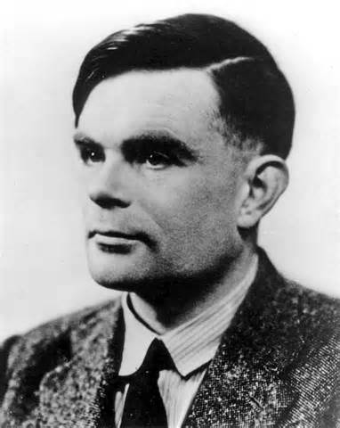
Functional vs. Reactive Computation
Classical model of computation: Functional
Given inputs, a program produces outputs
Desired functionality described by a mathematical function
Example: Sorting of names, Shortest paths in a weighted graph
Theory of computation provides foundation for this
Canonical model: Turing machines
Reactive
System interacts with its environment via inputs and outputs in an ongoing manner
Desired behaviors: which sequences of observed input/output interactions are acceptable?
Example: Cruise controller in a car

Slide 4
Sequential vs. Concurrent Computation
Classical model of computation: Sequential
A computation is a sequence of instructions executed one at a time
Well understood and canonical model: Turing machines
Concurrent Computation
Multiple components/processes exchanging information and evolving concurrently
Logical vs. physical concurrency
Broad range of formal models for concurrent computation
Key distinction: Synchronous vs Asynchronous

Slide 5
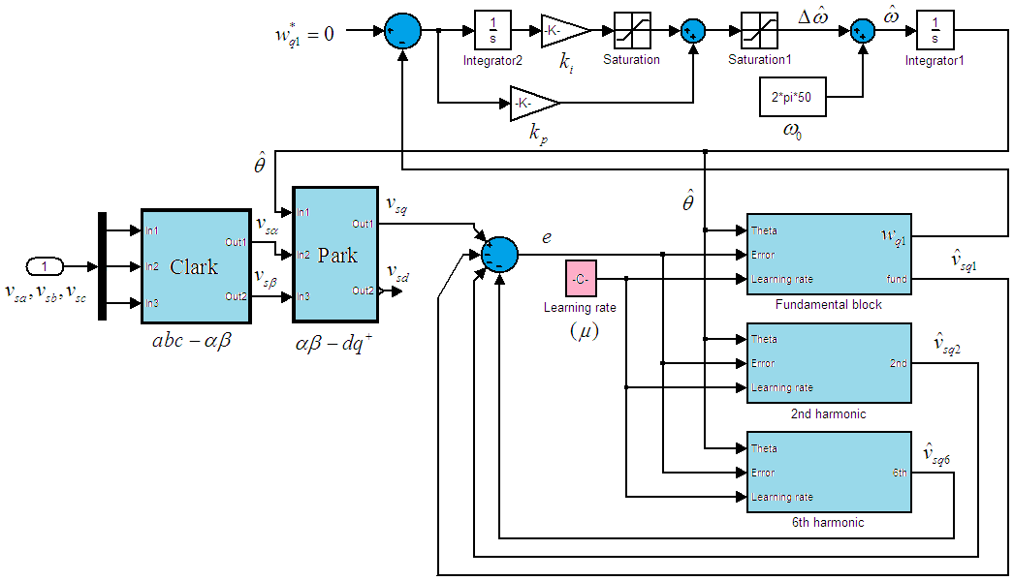
Synchronous Models
All components execute in a sequence of (logical) rounds in lock-step
Example: Component blocks in digital hardware circuit
Clock drives all components in a synchronized manner
Key idea in synchronous languages:
Design system using such a synchronous round-based computation
Benefit: Design is simpler (why?)
Challenge: Ensure synchronous execution even if implementation platform is not single-chip hardware

Slide 6
First Example: Delay
bool in
bool x := 0
bool out
out:=x ; x:= in
Input variable: in of type Boolean
Output variable: out of type Boolean
State variable: x of type Boolean
Initialization of state variables: assignment x:=0
In each round, in response to an input, produce output and update state by executing the update code: out:=x; x:=in

Slide 7
Delay: Round-based Execution
bool in
bool x := 0
bool out
out:=x ; x:= in
Initialize state to 0
Repeatedly execute rounds. In each round:
Choose a value for the input variable in
Execute update code to produce output out and change state
input/output
Sample execution: notation: old state new state
0
1 / 0
1 / 1
0 / 1
0 / 0
1 / 0
1
1
0
0
1

Slide 8
Synchrony Hypothesis
Assumption: Time needed to execute the update code is negligible compared to delay between successive input arrivals
Logical abstraction:
Execution of update code takes zero time
Production of outputs and reception of inputs occurs at same time
When multiple components are composed, all execute synchronously and simultaneously
Implementation must ensure that this design-time assumption is valid

Slide 9
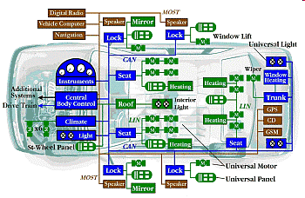
Components in an Automobile
Components need to communicate and coordinate over a shared bus
Design abstraction: Synchronous time-triggered communication
Time is divided into slots
In each slot, exactly one component sends a message over the bus
CAN protocol implements time-triggered communication (via TDMA)

Slide 10
Synchronous Reactive Component
Delay
bool x := 0
bool out
bool in
out:=x ; x:= in
Inputs
Outputs
State variables:
Declaration + Initialization
Update code:
To be executed in each round

Slide 11
Model Definition
Syntax: How to describe a component?
Variable declarations, types, code describing update …
Semantics: What does the description mean?
Defined using mathematical concepts such as sets, functions …
Formal: Semantics is defined precisely
Necessary for tools for analysis, compilation, verification …
Defining formal semantics for a “real” language is challenging
But concepts can be illustrated on a “toy” modeling language
Our modeling language: Synchronous Reactive Components
Representative of many “academic” proposals
Industrial-strength synchronous languages
Esterel, Lustre, VHDL, Verilog, Stateflow…

Slide 12
SRC Definition (1): Inputs
Delay
Inputs
bool in
Each component has a set I of input variables
Variables have types. E.g. bool, int, nat, real, {on, off} …
Input: Valuation of all the input variables
set of inputs denoted Q_{I}
For Delay
I contains a single variable in of type bool
set of inputs is {0, 1}
Example: I contains two variables: int x , bool y
Each input is a pair: (integer value for x and 0/1 value for y)

Slide 13
SRC Definition (2): Outputs
Delay
Outputs
bool out
Each component has a set O of typed output variables
Output: Valuation of all the output variables
set of outputs denoted Q_{O}
For Delay
O contains a single variable out of type bool
set of outputs is {0, 1}

Slide 14
SRC Definition (3): States
Delay
State variables:
Declaration
bool x
Each component has a set S of typed state variables
State: Valuation of all the state variables
The set of states denoted Q_{S}
For Delay
S contains a single variable x of type bool
set of states is {0, 1}
State is internal and maintained across rounds

Slide 15
SRC Definition (4): Initialization
Delay
State variables:
Declaration + Initialization
bool x := 0
Initialization of state variables specified by Init
Sequence of assignments to state variables
Semantics of initialization:
set [Init] of initial states, which is a subset of Q_{S}
For Delay
Init is given by the code fragment x:=0
set [Init] of initial states is {0}
Component can have multiple initial states
Example: bool x := choose {0, 1}

Slide 16
SRC Definition (5): Reactions
Delay
Update code:
To be executed in
each round
out:=x ; x:= in
Execution in each round given by code fragment React
Sequence of assignments and conditionals that assign output variables and update state variables
Semantics of update:
The set [React] of reactions, where each reaction is of the form (old) state -- input / output → (new) state
[React] is a subset of Q_{S} x Q_{I} x Q_{O} x Q_{S}
For Delay:
React is given by the code fragment out:=x; x:=in
There are 4 reactions: 0 -0/0-> 0; 0 -1/0-> 1; 1 -0/1-> 0; 1 -1/1-> 1

Slide 17
Multiple Reactions
bool in
bool x := 0
bool out
out:=x ; x:= choose { in, x}
During update, either x is updated to input in, or left unchanged
Motivation: models that an input may be “lost”
Nondeterministic reactions
Given (old) state and input, output/new state need not be unique
set [React] of reactions now contains
0 -0/0-> 0
0 -1/0-> 1; 0 -1/0-> 0
1 -0/1-> 0; 1 -0/1-> 1
1 -1/1-> 1

Slide 18
Multiple Reactions
bool in
bool x := 0
bool out
if x != in then { out:=x; x:=in}
A component may not accept all inputs in all states
Motivation: “blocking” communication
Possible set of reactions in certain state/input combinations may be empty
set [React] of reactions now contains
0 -1/0-> 1
1 -0/1-> 1

Slide 19
Syntax Errors
bool in
bool x := 0
bool out
x := out; out:= in
If update code cannot be executed, then no reaction possible
In above: set [React] of reactions is the empty set
Update code expected to satisfy a number of requirements
Types of variables and expressions should match
Output variables must first be written before being read
Output variable must be explicitly assigned a value

Slide 20
Semantic Equivalence
DiffSquare1
DiffSquare
local int x, y;
x := in1 + in2;
y := in1 –in2;
out := x * y
int in1
int in1
int out
int out
out := in1² – in2²
int in2
int in2
Both have identical sets of reactions
Syntactically different but semantically equivalent
Compiler can optimize code as long as semantics is preserved!

Slide 21
Synchronous Reactive Component Definition
Set I of typed input variables: gives set Q_{I} of inputs
Set O of typed output variables: gives set Q_{O} of outputs
Set S of typed state variables: gives set Q_{S} of states
Initialization code Init: defines set [Init] of initial states
Reaction description React: defines set [React] of reactions of the form s –i/o-> t, where s, t are states, I is an input, and o is an output
Synchronous languages in practice:
Richer syntactic features to describe React
Key to understanding: what happens in a single reaction?
Formal semantics: Necessary for development of tools!

Slide 22
Definition of Executions
Given component C = (I, O, S, Init, React), what are its executions?
Initialize state to some state s₀ in [Init]
Repeatedly execute rounds. In each round n=1,2,3,…
Choose an input value i_{n} in Q_{I}
Execute React to produce output o_{n} and change state to s_{n}
that is, s_{n-1} – i_{n} / o_{n} → s_{n} must be in [React]
Sample execution:
s₀
i₁ / o₁
i₂ / o₂
s₂
i₃ / o₃
s₃
s₁

Slide 23
What does this component do ?
bool x := 0; y:= 0
bool in
if y then out := x
else out := 0;
x := in;
y := ~ y
bool out

Slide 24
Extended State Machines
Input: bool press
( press=0 & x<10 )
→ x:=x+1
(press=0) ?
(press=1) ?
int x:=0
off
on
( press=1 | x>=10 )
→ x:=0
mode is a state variable ranging over {on, off}
Reaction corresponds to executing a mode-switch
Example mode-switch: from on to off with
Guard (press=1 | x>=10) and Update code x:=0

Slide 25
Executing ESMs: Switch
Input: bool press
( press=0 & x<10 )
→ x:=x+1
(press=0) ?
(press=1) ?
int x:=0
off
on
( press=1 | x>=10 )
→ x:=0
State of the component Switch assigns values to mode and x
Initial state: (off, 0)
Sample Execution:
(off,0) -0-> (off,0) -1-> (on,0) -0-> (on,1) -0-> (on,2) … -0->(on,10) -0-> (off,0)

Slide 26
Modified Switch: What executions are possible?
Input: bool press
( press=0 & x<=10 )
→ x:=x+1
(press=0)?
(press=1) ?
int x:=0
off
on
( press=1 | x>=10 )
→ x:=0

Slide 27
Finite-State Components
Delay
DiffSquare
bool x := 0
int in1
bool in
bool out
int out
out := in1² – in2²
out:=x ; x:= in
int in2
A component is finite-state if all its variables range over finite types
Finite types: bool, enumerated types (e.g. {on, off}), int[-5..5]
Delay is finite-state, but DiffSquare is not

Slide 28
Mealy Machines (for Finite-state components)
Delay
bool in
bool x := 0
bool out
out:=x ; x:= in
0 / 0
1 / 1
1 / 0
0
1
0 / 1
Finite-state components are amenable to exact, algorithmic analysis

Slide 29
Switch: Is it finite-state?
Input: bool press
(press=0 & x<10)
→ x:=x+1
(press=0) ?
(press=1) ?
int x:=0
off
on
int[0,10] x:=0
(press=1 | x>=10)
→ x:=0

Slide 30
Combinational Components
Delay
DiffSquare
bool x := 0
int in1
bool in
bool out
int out
out := in1² – in2²
out:=x ; x:= in
int in2
A component is combinational if it has no state variables
DiffSquare is combinational, but Delay is not
Hardware gates are combinational components

Slide 31
Top-Down Design + Case Study
Starting point: Inputs and outputs of desired design C
Models/assumptions about the environment in which C operates
Informal/formal description of desired behavior of C
Example: Cruise Controller

Slide 32
Top-Down Design of a Cruise Controller
ThrottleController
event(real) F
event second
event cruise
Clock
CruiseController
event inc
Driver
Sensor
event rotate
event dec
nat speed
event(nat) cruiseSpeed
Display

Slide 33
Decomposing CruiseController

Slide 34
Tracking Speed
MeasureSpeed
event rotate
nat speed
event second
Inputs: Events rotate and second
Output: current speed
Computes the number of rotate events per second (see notes)

Slide 35
Tracking Cruise Settings
SetSpeed
event cruise
nat speed
event(nat) cruiseSpeed
Inputs from the driver: Commands to turn the cruise-control on/off and to increment/decrement desired cruising speed from driver
Input: Current speed
Output: Desired cruising speed
What assumptions can we make about simultaneity of events?
Should we include safety checks to keep desired speed within bounds?
event inc
event dec

Slide 36
Controlling Speed
ControlSpeed
nat speed
event(real) F
event(nat) cruiseSpeed
Inputs: Actual speed and desired speed
Output: Pressure on the throttle
Goal: Make actual speed equal to the desired speed (while maintaining key physical properties such as stability)
Design relies on theory of dynamical systems (Chapter 6)

Slide 37
Transmission Shift: Logic? Is it finite-state?
(rotate=0 & gas = 0 & selectgear = 1)
On,D
(rotate=0 & gas = 0 & selectgear = 0)
(power & break) ?
off
On,N
(power & break & rotate = 0)?
(rotate=0 & gas=0 & selectgear=-1) ?
On,R
(rotate=0 & gas=0 & selectgear=0) ?

