Slide 1
CSC 549/ECE 591: Embedded/Real-Time Systems for Autonomous Driving with Machine Learning
Instructor: Frank Mueller
Grader: Jinming Xing
Spring 2026

Slide 2
Questions?
Read message board
Post on message board
Ask the TA
Ask before class (if there is time)
Ask after class
Come by during office hours

Slide 3
Logistics
Instructor: Frank Mueller
Office: 3266 EB2
Office Hours: M 9:30-10:30am
Grader: Jingmin Xing
Office: zoom
Office Hours: T, TH 1:00-2:30pm
More information
https://fictional-meme-l1ooj6e.pages.github.io/

Slide 4
Course Overview
Goals (3 pillars):
Embedded Systems
Real-Time Systems
Automotive Systems
Structure:
Each major area:
Introduce basics quickly
Present and discuss papers
Assignments

Slide 5
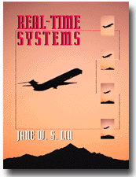
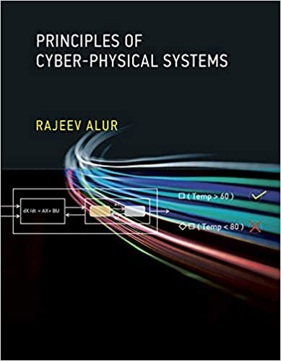
Textbooks – background reading
Jane Liu. Real-Time Systems, Prentice-Hall, 2000.
R. Alur. Principles of Cyber-Physical Systems, MIT Press, 2015.

Slide 6
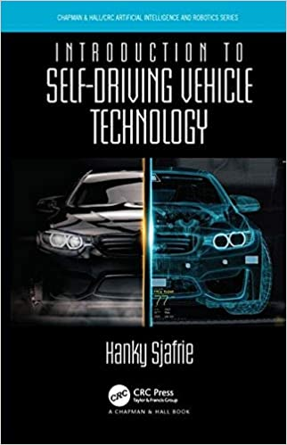
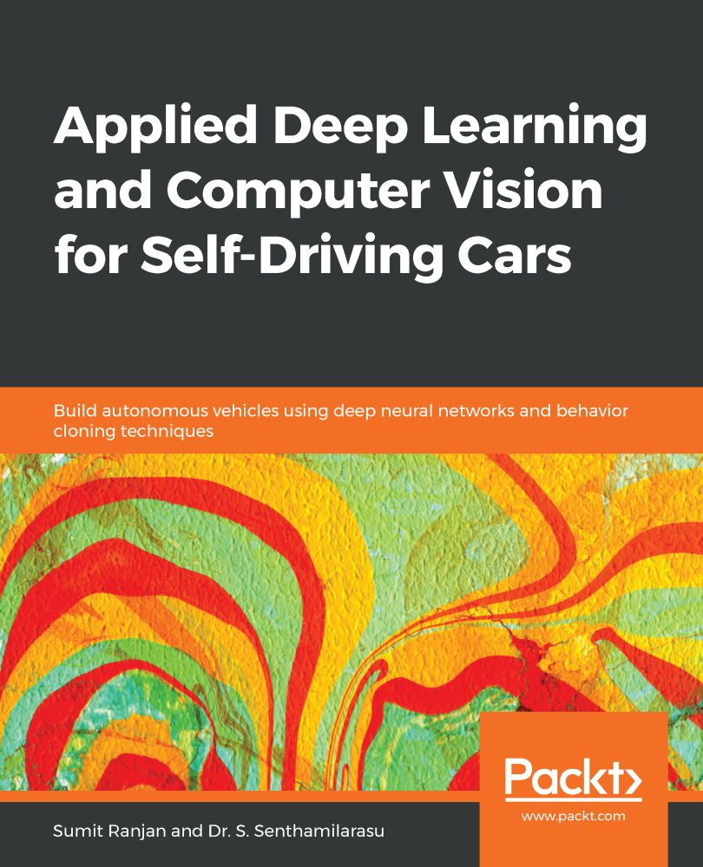
Textbooks - optional
Hanky Sjafrie. Introduction to Self-Driving Vehicle Technology
Sumit Ranjan (Author), Dr. S. Senthamilarasu Applied Deep Learning And Computer Vision For Self Driving

Slide 7
Topics →
Embedded Systems
Design & Implementation
Architecture & Platforms
Software Design
Networking
Real-time Systems
Operating systems,
Scheduling, resource handling
Timing analysis
System design
Autonomous Driving
Automotive design standards
Automotive control systems
Machine learning (NN & more)
Cross-cutting topics
Embedded architectures
Acceleration: GPU, FPGA,…
Power awareness
Distributed systems

Slide 8
Programming Assignments
Goals
Learn to design, implement, and evaluate automotive subsystems
Improve systems programming skills w/ C/C++, Python, Java:
Threads
Synchronization
Timing
Scheduling
Machine learning frameworks
Structure
Small teams (3 students per team, find peers)
Facilities
ARC cluster (remote)

Slide 9
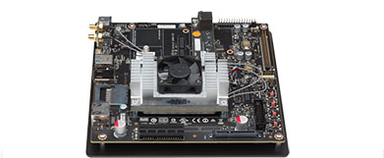
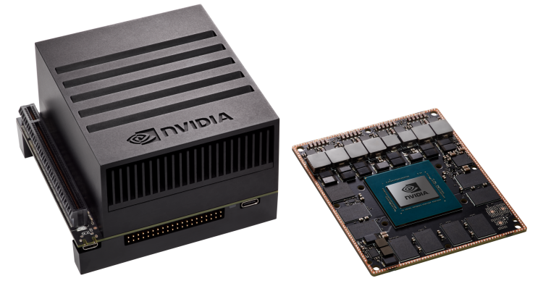
ARM+GPU Platforms
NVIDIA Jetson TX-1
GPU: 1 TFLOP/s 256-core (Maxwell), CUDA support
CPU: 64-bit ARM® A57 quad core
Memory: 4 GB LPDDR4 | 25.6 GB/s
NVIDIA AGX Xavier
GPU: 32 TFLOP/s 512-core (Volta), CUDA support
CPU: 64-bit ARMv8 octa core
Programmable Vision Accelerator (PVA): 1.7 CV TOP/s
deep learning accelerator (DLA):
2x5.7 TFLOP/s at half precision (float16)
2x11.4 TFLOP/s at quarter precision (int8)

Slide 10

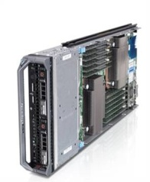
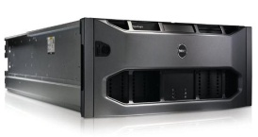
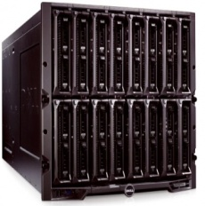
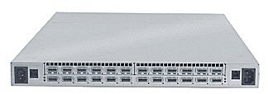
ARC Cluster
Beowulf-like cluster
80 Compute nodes
16 cores, AMD/Intel mix, 16GB-1.2TB RAM, NVIDIA GPU (different ones), 1TB HD, 120GB-1.6TB SSD
Interconnects
100Gb/s Infiniband fat tree
1Gbps Ethernet switches
Storage
90TB NFS (default)
90TB BeeGFS (data)
Gnu+PGI C/C++/Fortran compilers
MPI,OpenMP,CUDA,OpenACC, Hadoop, Spark, Tensorflow…
ARC - A Root Cluster
Head/Login Nodes
PFS Switch Stack
Compute/ Spare Nodes
GEther Switch Stack
I/O Nodes
Storage Array
SSD+
SATA
IB Switch Stack
Front Tier
Interconnect
Mid Tier
Back Tier

Slide 11
Course Requirements
Prerequisites: none, but helpful are
CSC 501 Graduate OS, CSC 548 Parallel Systems
some architecture course
Good programming skills in C/C++, Python, Java
Linux
What to expect
Readings and a presentation
Several programming assignments
two exams

Slide 12
Grading
First test 20%
Second test 20%
Programming assignments 60%
On-line syllabus and policies

Slide 13
Today
What is
An embedded system?
A real-time system?
An automotive system?

Slide 14
(1) Embedded System
Definition:
Programmable device:
4-64 bit CPU, opt. digital signal processor (DSP), …
Special purpose (not a general-purpose computer)
Interacts with environment
Sensors
Actuators (opt.)
Examples:
Printer/Xerox copier
Cell phone
Automotive control
IoT
…
output
analog
CPU
input
analog
embedded
computer
mem

Slide 15
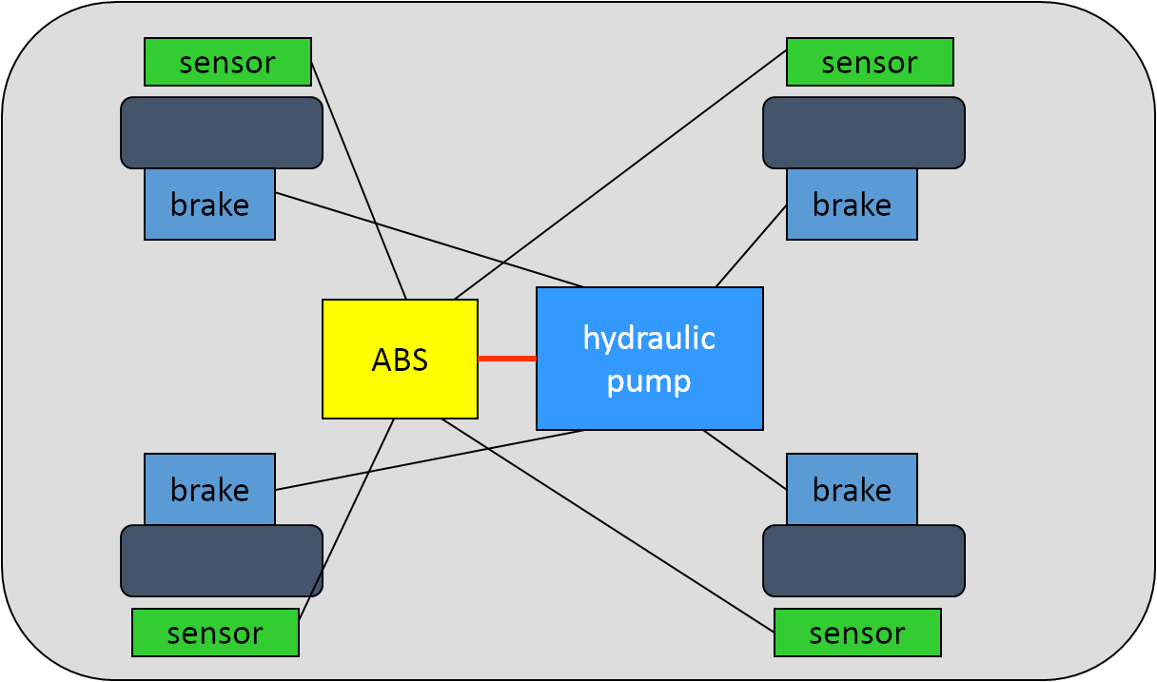
Networked Control System (NCS)
Embedded + internal network
Effectively a distributed system
Controls physical environment
Example: automotive subsystems (BMW 850i)
Oldest: ABS
Next: ESC / ASC (elect. stability control)/ (automatic stab. ctrl.)
Cannot easily compose → interdependent (both physically in subsystems and logically)
Need to communicate between them → meet real-time deadlines

Slide 16
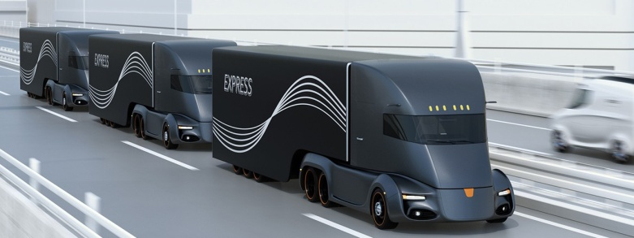
Cyber Physical System (CPS)
Embedded control system(s)
Subject to safety concerns → no harm of environment
Externally networked (often over Internet, sometime intranet)
Subject to network attacks (main difference to NCS)
Need cyber security: authentication, encryption, …
integrity → correctness of data values
Privacy → no leak of sensitive data
Distributed system control between systems/subsystems
Control difference to NCS blurry
One take: NCS has single controller, CPS can have many
Subsystems need not be physically connected
Example: convoy driving w/ vehicle-to-vehicle (V2V) communication

Slide 17
(2) Real-time System →
A real-time system is a system whose specification includes both logical and temporal correctness requirements
Logical Correctness: Produces correct outputs
Can by checked, for example, by Hoare logic
Temporal Correctness: Produces outputs at the right time
Design/verification methods covered in this class
Characteristics
Event-driven, reactive
High cost of failure
Concurrency/multiprogramming
Stand-alone/continuous operation
Reliability/fault-tolerance requirements
Predictable behavior → meet deadline
Need not be high performance, just “fast enough”

Slide 18
Sample Real-Time Applications
Many real-time systems are control systems.
Example 1: A simple one-sensor, one-actuator control system.
reference
input r(t)
r_{k}
A/D
control-law
computation
u_{k}
y_{k}
D/A
A/D
y(t)
u(t)
sensor
plant
actuator
The system
being controlled

Slide 19
Simple Control System (Continued)
Pseudo-code for this system:
set timer to interrupt periodically with period T;
at each timer interrupt do
do analog-to-digital conversion to get y;
compute control output u;
output u and do digital-to-analog conversion;
od
T is called the sampling period. T is a key design choice. Typical
range for T: seconds to milliseconds.

Slide 20
Multi-rate Control Systems
More complicated control systems have multiple sensors and actuators and must support control loops of different rates. Example 2: Helicopter flight controller.
Do the following in each 1/180-sec. cycle:
validate sensor data and select data source;
if failure, reconfigure the system
Every sixth cycle do:
keyboard input and mode selection;
data normalization and coordinate
transformation;
tracking reference update
control laws of the outer pitch-control loop;
control laws of the outer roll-control loop;
control laws of the outer yaw- and
collective-control loop
Every other cycle do:
control laws of the inner
pitch-control loop;
control laws of the inner roll- and
collective-control loop
Compute the control laws of the inner
yaw-control loop;
Output commands;
Carry out built-in test;
Wait until beginning of the next cycle
Note: Having only harmonic rates simplifies the system.

Slide 21
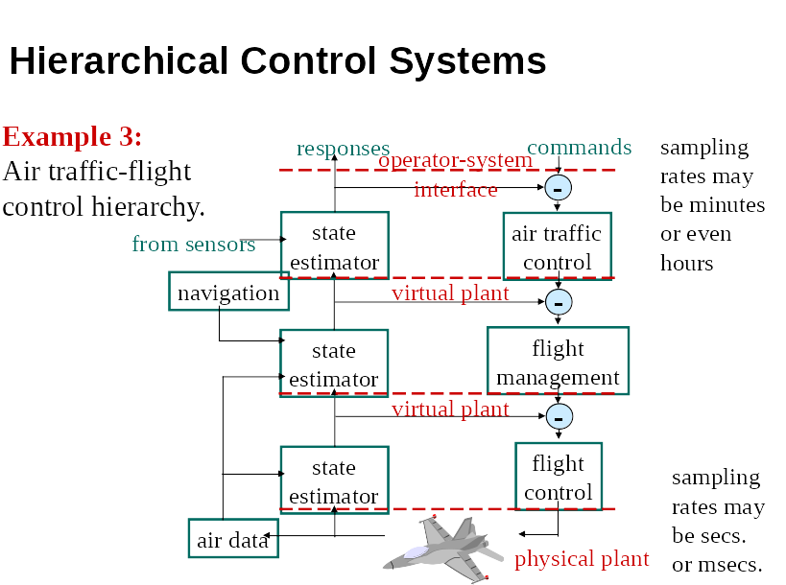

Slide 22
Real Time Terminology
Task: A sequential piece of code.
Job: Instance of a task.
Jobs require resources to execute.
Example resources: CPU, network, disk, critical section.
We will simply call all hardware resources “processors”.
Release time of a job: The time instant the job becomes ready to execute.
Deadline of a job: The time instant by which the job must complete execution.
Relative deadline of a job: “Deadline − Release time”.
Response time of a job: “Completion time − Release time”.

Slide 23
Example
0 1 2 3 4 5 6 7 8 9 10 11 12 13 14 15
= job release
= job deadline
Job is released at time

Slide 24
Example
0 1 2 3 4 5 6 7 8 9 10 11 12 13 14 15
= job release
= job deadline
Job is released at time 3.
It’s (absolute) deadline is at time

Slide 25
Example
0 1 2 3 4 5 6 7 8 9 10 11 12 13 14 15
= job release
= job deadline
Job is released at time 3.
It’s (absolute) deadline is at time 10.
It’s relative deadline is

Slide 26
Example
0 1 2 3 4 5 6 7 8 9 10 11 12 13 14 15
= job release
= job deadline
Job is released at time 3.
It’s (absolute) deadline is at time 10.
It’s relative deadline is 7.
It’s response time is

Slide 27
Example
0 1 2 3 4 5 6 7 8 9 10 11 12 13 14 15
= job release
= job deadline
Job is released at time 3.
Its (absolute) deadline is at time 10.
Its relative deadline is 7.
Its response time is 6.

Slide 28
Types Real-Time Systems
Hard real-time system:
hard deadline must be met
any hard deadline ever missed → system incorrect
Requires a means for validating that deadlines are met
Examples: Nuclear power plant control, flight control.
Soft real-time system:
soft deadline may occasionally be missed
Question: How to define “occasionally”? Depends… → (m,k)-firm deadline: at least m out of any k deadlines must be met
Examples: Telephone switches, multimedia applications.
Hybrid system: hard + soft components
Often mixed criticality: different levels of “hard” RT
increasingly common: automotive, avionics, …

Slide 29
Notation
Each job J_{i} is characterized by its
release time r_{i}
absolute deadline d_{i}
relative deadline D_{i}
execution time e_{i}.
Sometimes range of release times: [r_{i}⁻, r_{i}⁺] → release-time jitter
Sometimes range over [e_{i}⁻, e_{i}⁺]
difficult to get a precise estimate of e_{i} (more on this later)
Periodic task has a period p_{i}: exact spacing between jobs J_{i}
Ignore: Only Liu textbook says p_{i} is minimum time b/w jobs
Sporadic task: Released at arbitrary times, hard deadline
Aperiodic tasks: Released at arbitrary times, soft (or no deadline)

Slide 30
Examples
A periodic task T_{i} with r_{i} = 2, p_{i} = 5, e_{i} = 2, D_{i} =5 executes like this according to the rest of the world:
0 1 2 3 4 5 6 7 8 9 10 11 12 13 14 15 16 17 18
= job release
= job deadline
(According to Liu, it could execute like this:)
0 1 2 3 4 5 6 7 8 9 10 11 12 13 14 15 16 17 18
To the rest of the world, this is a sporadic task.

Slide 31
Definitions for Periodic Task Systems
The jobs of task T_{i} are denoted J_{i,1}, J_{i,2}, … .
r_{i,1} (the release time of J_{i,1}) is called the phase of T_{i}.
Synchronous System: Each task has a phase of 0.
Asynchronous System: Phases are arbitrary.
Hyperperiod: Least common multiple of {p_{i}}.
Task utilization: u_{i} = e_{i}/p_{i}.
System utilization: U = ∑_{i=1..n}u_{i}.
Task dependencies: Critical Sections, Precedence Constraints.
E.g, job J_{i} released only after job J_{k} completes.
Tasks with no dependencies are called independent.

Slide 32
Algorithms
A scheduler or scheduling algorithm, which generates a schedule at runtime (following some policy)
A feasibility or schedulability-analysis algorithm, which checks if timing constraints are met (typically statically, without running)
All scheduling algorithms
static scheduling
(or offline, or clock driven)
dynamic scheduling
(or online, or priority driven)
static-priority
scheduling
dynamic-priority
scheduling

Slide 33
Optimality and Feasibility
A schedule is feasible if all timing constraints are met.
term “correct” is probably better — see the next slide.
A task set T is schedulable using scheduling algorithm A if A always produces a feasible schedule for T.
A scheduling algorithm is optimal if it always produces a feasible schedule when one exists (under any scheduling algorithm).
Can similarly define optimality for a class of schedulers, e.g., “an optimal static-priority scheduling algorithm.”

Slide 34
Feasibility versus Schedulability
To most people in real-time community:
feasibility → an exact schedulability test
schedulability → a sufficient schedulability test.
terms are used somewhat inconsistently in papers
yes
Algorithm for
Checking Feasibility
T is schedulable
Task Set T
no
T is not schedulable
yes
T is schedulable
Algorithm for
Checking Schedulability
Task Set T
no
don’t know

Slide 35
Automotive Control Systems
Type of NCS/CPS with hard+soft real-time deadlines (hybrid)
Engine/drive control
Safety systems
Driver assist systems
Entertainment systems
Security systems?
Theft control → common
Cyber-physical security → rare

Slide 36
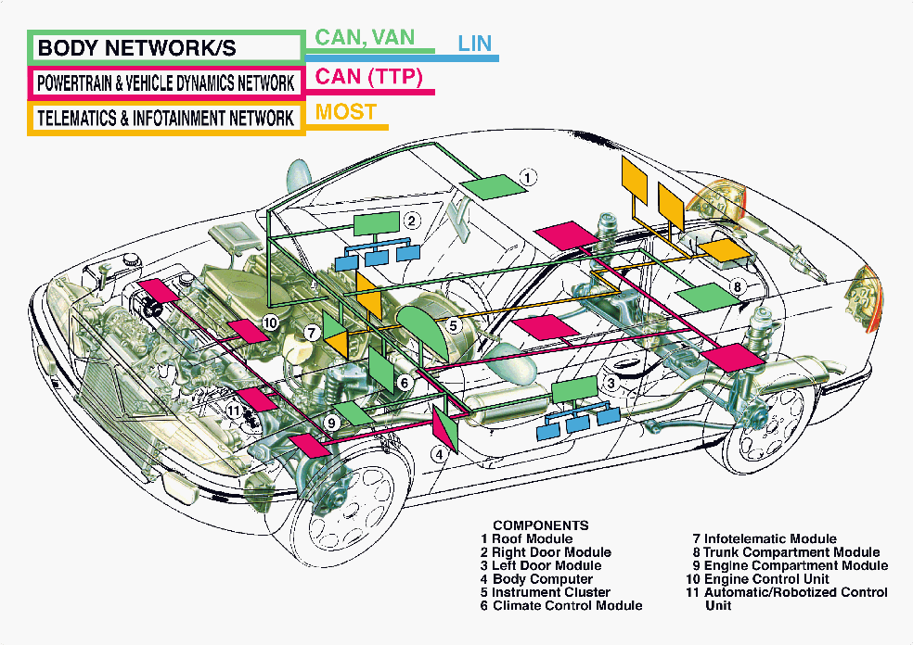
Automotive Sensor, Actuators, Networks
Control Area Network
Vehicle Area Network
Local Interconnected Network
Media Oriented System Transport

Slide 37








The Automotive Electronic Design Chain
Manufacturers become integrators
Product Definition
Platforms
Design And Assembly
IP
Interfaces

Slide 38
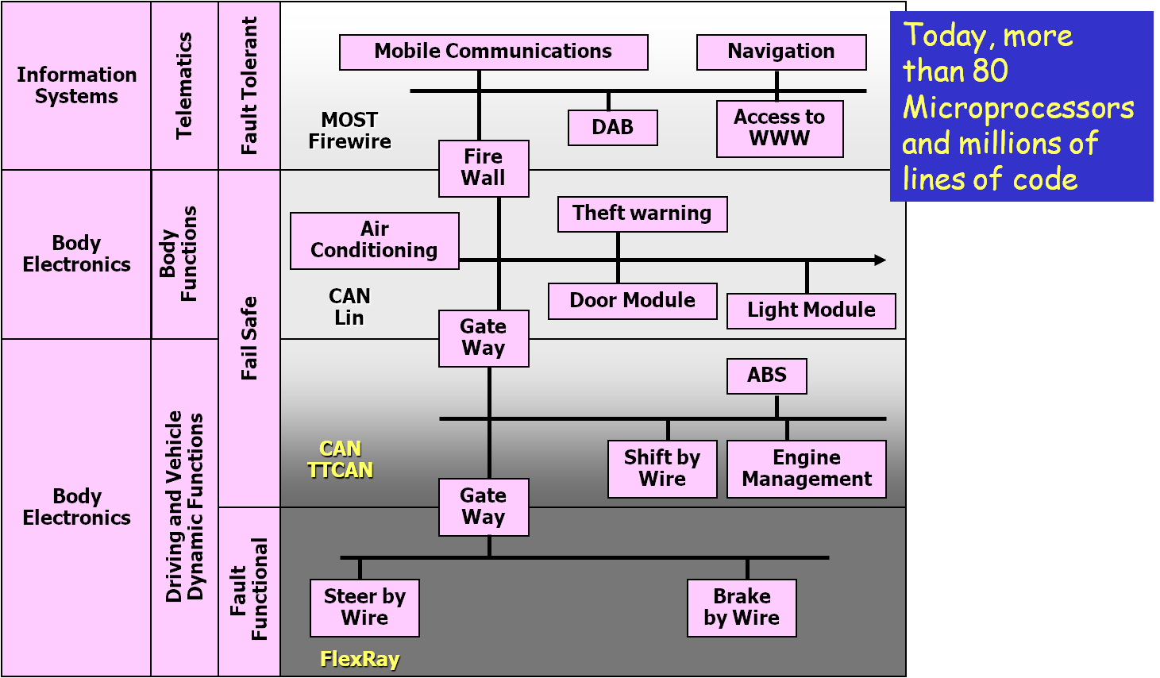
Automotive Control: Distributed Systems

Slide 39
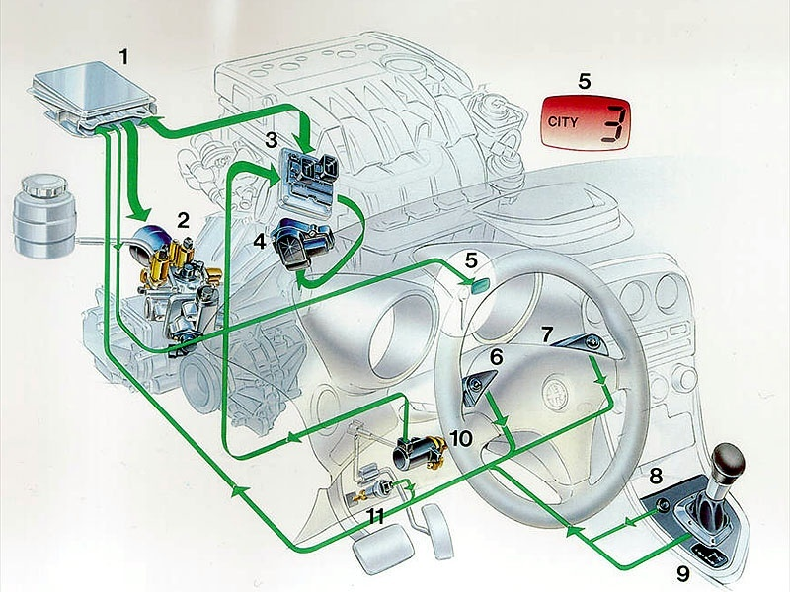
Automotive Supply Chain: Tier 1 Subsystem Providers
1 Transmission ECU
2 Actuation group
3 Engine ECU
4 DBW
5 Active shift display
6/7 Up/Down buttons
8 City mode button
9 Up/Down lever
10 Accelerator pedal position sensor
11 Brake switch
Subsystem Partitioning
Subsystem Integration
Software Design: Control Algorithms, Data Processing
Physical Implementation and Production

Slide 40
Automotive Supply Chain: Tier 2 Platform & IP Providers
Application Platform layer
(≅ 10% of total SW)
OSEK
RTOS
Application
Libraries
Customer
Libraries
CCP
Speedometer
Tachometer
Water temp.
Application
Specific
Software
Speedometer
Tachometer
Odometer
---------------
KWP 2000
SW Platform layer
(> 60% of total SW)
Transport
OSEK
COM
Application Programming Interface
I/O drivers & handlers
(> 20 configurable modules)
Sys. Config.
Boot Loader
μControllers Library
HW layer
Nec78k
HC08
HC12
H8S26
MB90
ST10
“Software” platform: RTOS and communication layer
“Hardware” platform: Hardware and IO drivers

Slide 41
Virtual Integration for Distributed System Design (by BMW)
Functional Network Definition and Validation (Timed and un-Timed)
Fct₁
Spec
&
Sim.
analysis
Fct₁
Spec
&
Sim.
Fct_{n}
Spec
&
Sim.
Fct_{n}
Spec
&
Sim.
Fct₁
Spec
&
Sim.
Fct₁
Spec
&
Sim.
Fct_{n}
Spec
&
Sim.
Fct_{n}
Spec
&
Sim.
ECU SW Scheduling Adoption and Validation
specification
Virtual
Integration
Communication Protocol Adoption and Validation
system design
real virtual
real virtual
implementation
Safety Concept Proof via Fault Injection
ECU₁
ECU₁
ECU_{k}
Integration
ECU Optimization/Derivative Design
ECU_{k}
Integration
Integration
ECU₁
calibration
ECU₁
ECU_{n}
ECU_{n}
production & after sales
now
tomorrow
Source BMW
Notes:
1.

Slide 42
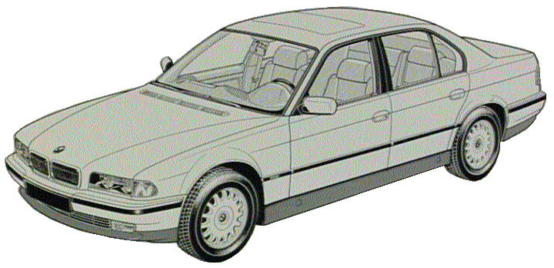

Design Flow
Requirement Specification
Algorithm Specifications
Algorithm Analysis
Algorithm Design
Environment-Test Bench Modeling
Algorithms
Behavioral Modeling
Architectural Modeling
Virtual Prototyping
Behavior IPs
Architectural IPs
Architecture IP Authoring
Mapping
Distributed Architecture Analysis
ECU Scheduling Analysis
System Model
Synthesis Export
Algorithm Performance
Physical Prototyping
SW platform
SW tasks
Communication
Protocol
Configuration
Load
Performance Simulation
Compile/Link/Load

Slide 43
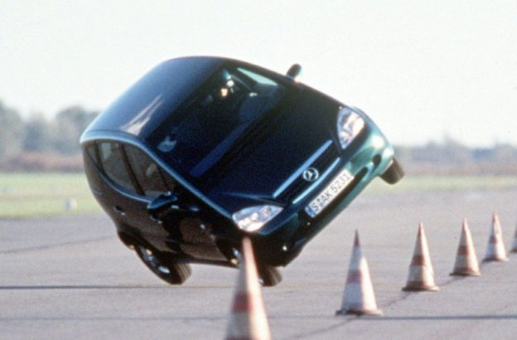

State of Automotive Computer Control
Control systems
ABS, ESC/ASC, traction control system (“Elk test”)
Air bag
Engine control (injection)
Hill start assist
Drive (steer) by wire
Assist systems
Tire pressure monitoring
Backup camera
automatic cruise control (follow speed of leading car)
Blind spot information system
Lane departure warning
Collision avoidance system
Drive drowsiness detection
Automatic parking system

Slide 44
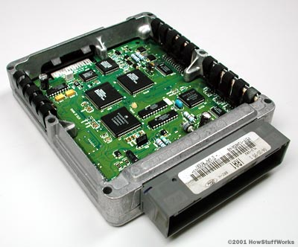
Integration
Too many subsystems, wires (4km!!), controls
Consolidate into electronic control units (ECUs)
Higher-end embedded systems (multi-cores, GPUs, …)
Multiple vendors needs to share ECU for their subsystems
Inter-operability challenges!
Objective: reduce 70-200 micro-processors →3-4 ECUs
Propulsion: ICE, EV, hybrid (ASIL D)
Safety: airbag braking, steering, ADAS (ASIL D)
Body: AC/heat, door modules, seat electronics, parking
brake, lighting, security (ASIL B) (also infotainment)
Partitioned hypervisors for mixed criticality
Use shared-bus networks → automotive Ethernet
less weight/cost for wires

Slide 45

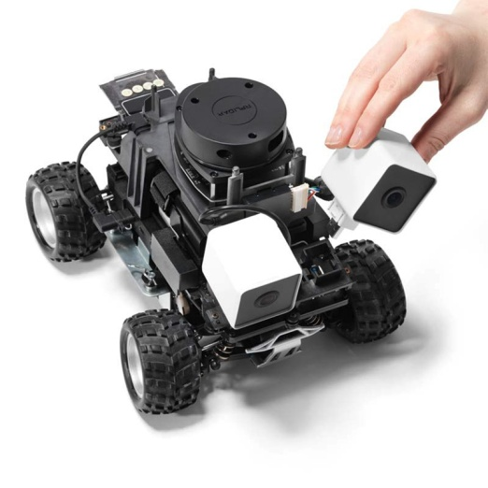
Bringing it all together
Embedded systems
Conventional control: use formal methods
Machine learning
Object recognition, tracking etc.
High-level decision trees / reinforcement learning?
Real-time systems
Verified scheduling at low level
Timing analysis of code
Dynamic vs. static

