Slide 1
Dynamic-priority Scheduling (Jaffay et al.+Chapter 6)
Remaining scheduling disciplines we consider are priority-based
Jobs have priorities
Scheduler always selects highest-priority ready job to run
First, dynamic-priority scheduling.
different jobs of a task may be assigned different priorities
Example:
job J_{i,k} of task T_{i} has higher priority than job J_{j,m} of T_{j}
but job J_{i,l} of T_{i} has lower priority than job J_{j,n} of T_{j}
Later: static-priority scheduling

Slide 2
Outline
earliest-deadline-first (EDF) and
least-laxity-first (LLF) (called least-slack-time-first by Liu)
Outline:
Optimality of EDF and LLF (Section 4.6 of Liu).
Utilization-based schedulability test for EDF (Section 6.3).
Non-preemptive EDF from: Jeffay, Stanat, and Martel, “On Non-preemptive Scheduling of Periodic and Sporadic Tasks,” 18th IEEE RTSS, 1991, pp. 129-139.

Slide 3
Notation of Real-Time Tasks
Model assumed in this chapter:
n periodic tasks T₁,…,T_{n}.
The “rest of the world” periodic model is assumed.
T_{i} is specified by (φ_{i}, p_{i}, e_{i}, D_{i}), where
φ_{i} is its phase (0 unless indicated)
p_{i} is its period (an integer or, at least, rational)
e_{i} is its execution cost per job, and
D_{i} is its relative deadline.
Will abbreviate as (p_{i},e_{i},D_{i}) if φ_{i}=0, and (p_{i},e_{i}) if φ_{i}=0 ∧ p_{i}=D_{i}.

Slide 4
Optimality of EDF
Theorem 4-1: [Liu and Layland] When preemption is allowed and
jobs do not contend for resources, the EDF algorithm can produce a
feasible schedule of a set J of jobs with arbitrary release times and
deadlines on a processor if and only if J has feasible schedules.
Notes:
Applies even if tasks are not periodic.
If periodic, a task’s relative deadline can be less than its
period, equal to its period, or greater than its period.
Precedence constraints are allowed (in which case deadlines
must be consistent with them — see Sec. 4.5).

Slide 5
Proof of Theorem 4-1
To show: any feasible schedule of J can be systematically
transformed into an EDF schedule.
Suppose parts of two jobs J_{i} and J_{k} are executed out of EDF order:
J_{i}
J_{k}
r_{k}
d_{k}
d_{i}
This situation can be corrected by performing a “swap”:
J_{k}
J_{k}
J_{i}

Slide 6
Proof (Continued)
If we inductively repeat this procedure, we can eliminate all
out-of-order violations.
The resulting schedule may still fail to be an EDF schedule because
it has idle intervals where some job is ready:
J_{k}
J_{k}
J_{i}
Such idle intervals can be eliminated by moving some jobs forward:
J_{k}
J_{k}
J_{i}

Slide 7
LLF Scheduling
Definition: At any time t, the slack (or laxity) of a job with deadline d is equal to d − t minus the time required to complete the remaining portion of the job.
LLF Scheduling: The job with the smallest laxity has highest priority at all times.
deadline
laxity:
4 4 4 3 3 3 3 2 2 1 0

Slide 8
Optimality of LLF
Theorem 4-3: When preemption is allowed and jobs do not contend
for resources, the LLF algorithm can produce a feasible schedule of
a set J of jobs with arbitrary release times and deadlines on a
processor if and only if J has feasible schedules.
The proof is similar to that for EDF and is left as an exercise.
Question: Which of EDF and LLF would be preferable in practice?

Slide 9
Preemptive vs. Nonpreemptive EDF
The rest of our discussion of dynamic-priority scheduling will focus
preemptive and nonpreemptive EDF. We first show the following:
Theorem: Non-preemptive EDF is not optimal.
Proof: Consider a system of three jobs J₁, J₂, and J₃ such that
(r₁, e₁, d₁) = (0, 3, 10), (r₂, e₂, d₂) = (2, 6, 14), (r₃, e₃, d₃) = (4, 4, 12).
Here’s a schedule (any schedule, does not need to be EDF):
J₁
J₃
J₂
0 1 2 3 4 5 6 7 8 9 10 11 12 13 14
Notes:
Optimal: always produces feasible schedule if one exists

Slide 10
Proof (Continued)
But under non-preemptive EDF, a deadline is missed!
J₁
J₂
J₃
0 1 2 3 4 5 6 7 8 9 10 11 12 13 14
r₁
r₂
r₃
J₃’s deadline
Question: Should we conclude from this result that preemptive EDF is always better than non-preemptive EDF in practice?
Note: EDF optimality proof assumes no penalty due to preemption
Are there other practical issues we have ignored?

Slide 11
Utilization-based Schedulability Test for (Preemptive) EDF
Note: Whenever we say “EDF” from now on, we mean preemptive
EDF, unless specified otherwise.
Theorem 6-1: [Liu and Layland] A system T of independent,
preemptable, periodic tasks with relative deadlines equal to their
periods can be feasibly scheduled (under EDF) on one processor
if and only if its total utilization U is at most one.
Proof: The “only if” part is obvious: If U > 1, then some task
clearly must miss a deadline. So, we concentrate on the “if” part.

Slide 12
Setting Up the Proof
We wish to show: U ≤ 1 ⇒ T is schedulable.
We prove the contrapositive, i.e., T is not schedulable ⇒ U > 1.
Assume T is not schedulable.
Let J_{i,k} be the first job to miss its deadline.
T_{i}
t₋₁
r_{i,k}
r_{i,k+1}
this is the last “idle instant” (each task whose next job has a deadline
at or before r_{i,k+1} either has no ready job, or has just released a job,
and no job with a deadline after r_{i,k+1} executes in [t₋₁, r_{i,k+1}].)

Slide 13
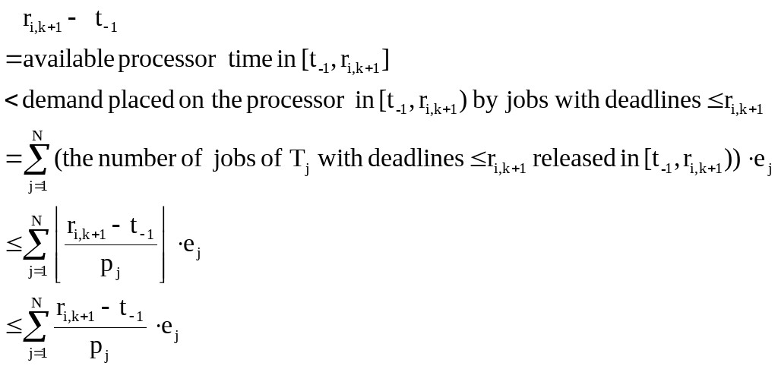
Proof (Continued)
Because J_{i,k} missed its deadline…
the demand placed on the processor in [t₋₁, r_{i,k+1}) by jobs with deadlines
≤ r_{i,k+1} is greater than the available processor time in [t₋₁, r_{i,k+1}].
Thus,

Slide 14
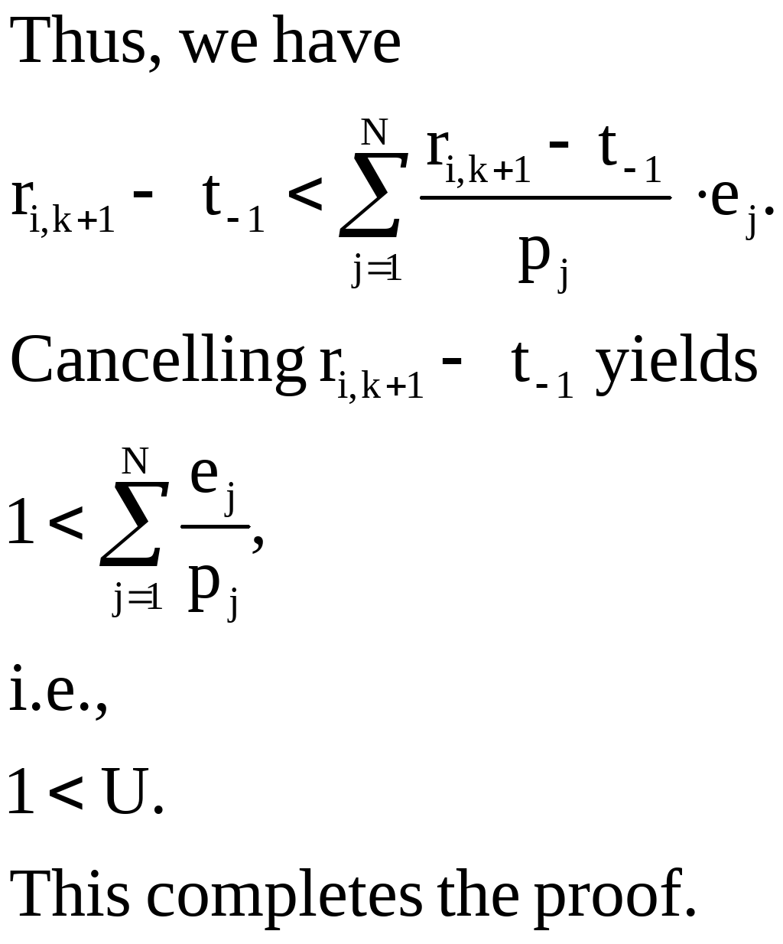
Proof (Continued)
Note: This proof is
actually still valid if
relative deadlines are
larger than periods.

Slide 15
EDF with Deadlines < Periods
If deadlines are less than periods then U ≤ 1 is no longer a sufficient schedulability condition.
This is easy to see. Consider two tasks such that, for both, e_{i} = 1 and p_{i} = 2. If both have deadlines at 1.9, then the system is not schedulable, even though U = 1.
For these kinds of systems, we work with densities instead of utilizations.
Definitions:
The density of task T_{k} is δ_{k} = e_{k}/min(D_{k}, p_{k}).
The density of the system is defined to be Δ = ∑_{k=1,…,N} δ_{k}.
Notes:
δ delta, Δ Delta

Slide 16
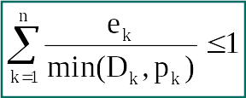
Deadlines < Periods (Continued)
Theorem 6-2: A system T of independent, preemptable, periodic
tasks can be feasibly scheduled on one processor if its density is
at most one.
The proof is similar to that for Theorem 6-1 and is left as an
exercise.
Note: This theorem only gives sufficient condition.
We refer to the following as the schedulability condition for EDF:

Slide 17
Proof of Non-tightness
To see that Δ > 1 doesn’t imply non-schedulability, consider the
following example.
Example: We have two tasks T₁ = (2, 0.6, 1) and T₂ = (5, 2.3).
Δ = 0.6/1 + 2.3/5 = 1.06. Nonetheless, we can schedule this task
set under EDF:
T₁
repeats
T₂
0 1 2 3 4 5 6 7 8 9 10

Slide 18
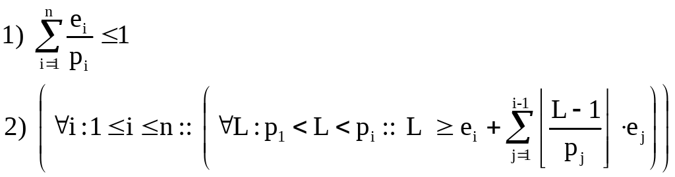
Non-preemptive EDF (Jeffay et al.)
Theorem : Let T = {T₁, T₂, …, T_{n}} be a system of independent,
periodic tasks with relative deadlines equal to their periods such that
the tasks in T are indexed in non-decreasing order by period (i.e.,
if i < j, then p_{i} ≤ p_{j}). T can be scheduled by the non-preemptive EDF
algorithm if:
Condition is necessary and sufficient for real-world sporadic tasks

Slide 19
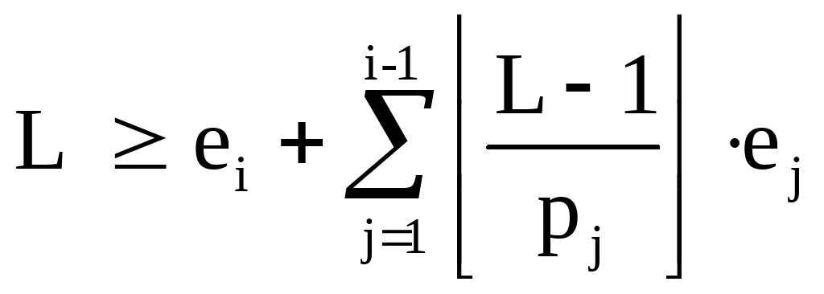
Explanation
The first condition is just a constraint on utilization.
In the second condition, the term
gives an upper bound on processor demand in an interval [t, t+L].
Intuition: The “worst-case” pattern of job releases occurs when a job of some T_{i} begins executing (non-preemptively!) one time unit before some tasks with smaller periods begin releasing some jobs.
These other jobs are blocked by the job of T_{i}.

Slide 20
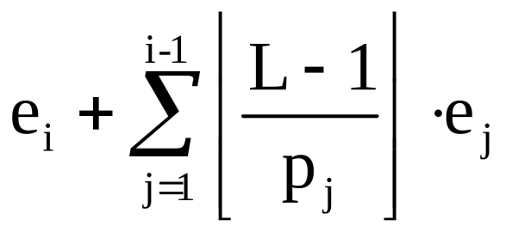
Second Condition (Continued)
T₁
T₂
T₃
T_{i}
For any L over the range p₁ < L < p_{i}, the total demand on the processor in [t, t + L] due to jobs with deadlines at or before t + L is:
For the system to be schedulable, this demand must not exceed the
length of the interval (which is L).

Slide 21
Proof of Theorem
Suppose conditions (1) and (2) hold for T but a deadline is missed.
Let t_{d} be the earliest point in time at which a deadline is missed.
There are two cases:
Case 1: No job with a deadline after time t_{d} is scheduled prior to time t_{d}. The analysis is just like with preemptive EDF.
As before, let t₋₁ be the last “idle instant”.
As before, because a deadline is missed at t_{d},
demand over [t₋₁, t_{d}] exceeds t_{d} − t₋₁.
In addition, this demand is at most ∑_{j=1,..,n} ⎣(t_{d} − t₋₁)/p_{j}⎦⋅e_{j}.
Thus, we have t_{d} − t₋₁ < ∑_{j=1,..,n} ⎣(t_{d} − t₋₁)/p_{j}⎦⋅e_{j} ≤ ∑_{j=1,..,n} [(t_{d} − t₋₁)/p_{j}]⋅e_{j}.
This implies utilization exceeds one, which contradicts condition (1).

Slide 22
Proof (Continued)
Case 2: Some job with a deadline after time t_{d} is scheduled prior to t_{d}.
Let T_{i} be the task with the last job with a deadline after t_{d} that is
scheduled prior to t_{d}. Then, we have the following:
T_{i}
Time
t_{i}
t_{d}
If there is any idle time in [t_{i}, t_{d}], then there exists an idle instant at or after T_{i}’s job finishes and at/before t_{d} → reason as in Case 1.
So, assume there is no idle time in [t_{i}, t_{d}]. Let us bound the processor
demand in [t_{i}, t_{d}] …

Slide 23
Proof (Continued)
Observe the following:
p_{i} > t_{d} − t_{i}.
This follows from the fact that the job of task T_{i} scheduled at time t_{i} had a deadline after t_{d}.
No task with index greater than i is scheduled in the interval [t_{i}, t_{d}].
Other than a job of task T_{i}, no job scheduled in [t_{i}, t_{d}] could have been released at time t_{i}.
There is no idle time in the interval [t_{i}, t_{d}].
There is a least one job that is released in [t_{i}+1, t_{d}] with a deadline at or before time t_{d}.

Slide 24
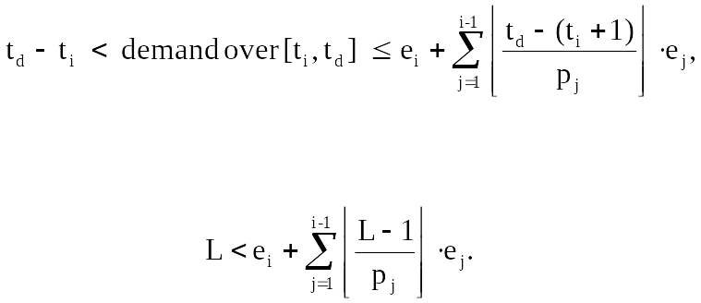
Proof (Continued)
From these facts, we conclude
and p₁ < t_{d} − t_{i} < p_{i}. Let L = t_{d} − t_{i}. Then,
This contradicts condition (2).

Slide 25
Notes
Note that this scheduling condition requires pseudo-polynomial time to evaluate. (Why?)
Using “real-world” terminology, this condition is necessary and sufficient for sporadic and non-concrete periodic task systems. (Why?)
“Concrete” = fixed release times (though maybe not all 0).
For a non-concrete task system to be feasible, it must be schedulable for any initial phasing.
In the rest of the paper, it is shown that the feasibility problem for non-preemptive concrete periodic task systems is NP-hard in the strong sense.
Implies that a pseudo-polynomial-time feasibility test is unlikely for such systems. (We cover this result later when we consider intractability.)

Slide 26

Pseudocode for Tasks as POSIX Threads
Scheduler implements policy (preemptive or not)
Tasks can be implemented as threads
Jobs are successive executions (of a loop body) w/ absolute waits
Why is this important?
Works for static and dynamic priority scheduling
Can add phasing:
Keep 1 start time per task
Add phase offset (plustime)
Code would be easier w/ absolute waits (commonly not part of API)
struct timeval starttime; // all tasks start
int main(…) {
gettimeofday(&starttime);
plustime(&starttime, 1); // +1 sec
pthread_create(&t1, t1code, …);
…
}
void *t1code(int *args) {
struct timeval wait, now, release;
release = starttime;
t1init();
do {
gettimeofday(&now);
// wait = release – now → abs. wait !!!
minustime(&wait, &release, &now);
nanosleep(&wait, &wait);
t1job();
plustime(&release, &t1_period);
} while (TRUE); // forever
}

Slide 27

Linux SCHED_DEADLINE
POSIX has real-time threading support for dynamic prio scheduling
Linux: called SCHED_DEADLINE, implemented via CBS+GRUB
clock_gettime(CLOCK_REALTIME, &starttime);
for (k = 0; k < MAXTHREADS; k++)
pthread_create(&th[k].thread_id, &attr, task, &th[k]);
void *task(void *arg) {
struct thread_info *tinfo = arg;
// core pinning omitted due to lack of space, see SCHED_FIFO slides
if (policy == SCHED_DEADLINE) {
sattr.size = sizeof(sattr);
sattr.sched_flags = 0; sattr.sched_nice = 0; sattr.sched_priority = 0;
sattr.sched_policy = SCHED_DEADLINE; // EDF
sattr.sched_runtime = tinfo->runtime.tv_sec * 1000000000 + tinfo->runtime.tv_nsec;
sattr.sched_period = tinfo->period.tv_sec * 1000000000 + tinfo->period.tv_nsec;
sattr.sched_deadline = tinfo->deadline.tv_sec * 1000000000 + tinfo->deadline.tv_nsec;
ret = sched_setattr(0, &sattr, 0); // 0=self, o/w use gettid()
}
PLUS_NTIME(release, starttime, tinfo->phase);
do {
clock_nanosleep(CLOCK_REALTIME, TIMER_ABSTIME, &release, &remain);
PLUS_NTIME(release, release, tinfo->period);
body(tinfo->thread_num);
} while (TRUE);
}

