Slide 1
Simulator enhancement with Gaussian Process System Identification

Slide 2

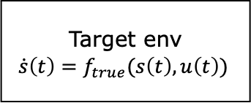

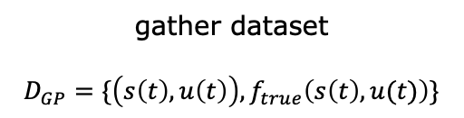
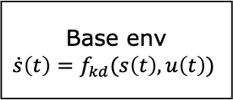
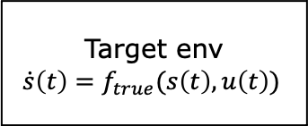
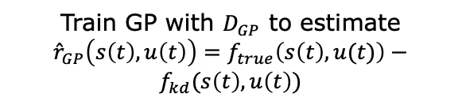



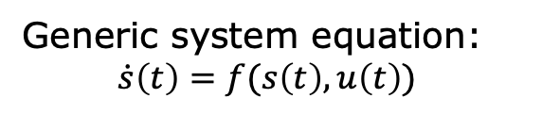
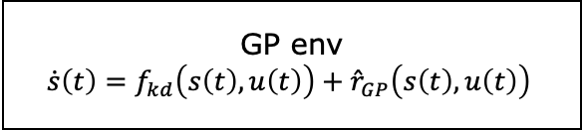

Framework
Generic system equation:
$\dot{s}\left(t\right)={f(s\left(t\right), u\left(t\right))}_{ }$
Initialization: Target env ($f_{true}$), Base env (known dynamics $f_{kd})$
Simulation
Real world
Deploy $π_{0}$
Target env
$$\dot{s}\left(t\right)={f_{true}(s\left(t\right), u\left(t\right))}_{ }$$
Base env
$$\dot{s}\left(t\right)={f_{kd}(s\left(t\right), u\left(t\right))}_{ }$$
Train $π_{0}$
Roll $π_{0}$
gather dataset
$$D_{GP}=\{\left(s\left(t\right), u\left(t\right)\right), f_{true}\left(s\left(t\right), u(t)\right)\}$$
Train GP with $D_{GP}$ to estimate
${\hat{r}}_{GP}\left(s\left(t\right), u\left(t\right)\right)=f_{true}\left(s\left(t\right), u(t)\right)−$ $f_{kd}(s\left(t\right), u\left(t\right))$
GP env
$$\dot{s}\left(t\right)={f_{kd}\left(s\left(t\right), u\left(t\right)\right)+{\hat{r}}_{GP}\left(s\left(t\right), u\left(t\right)\right)}_{ }$$
Deploy $π_{1}$
Target env
$$\dot{s}\left(t\right)={f_{true}(s\left(t\right), u\left(t\right))}_{ }$$
Train $π_{1}$
Roll $π_{1}$
…

Slide 3
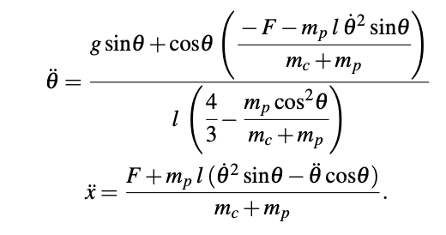
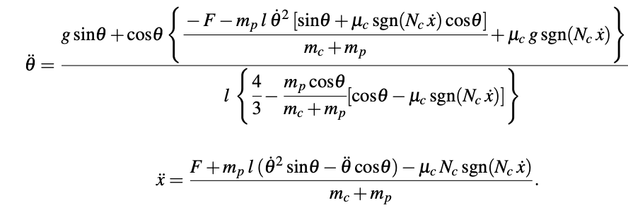
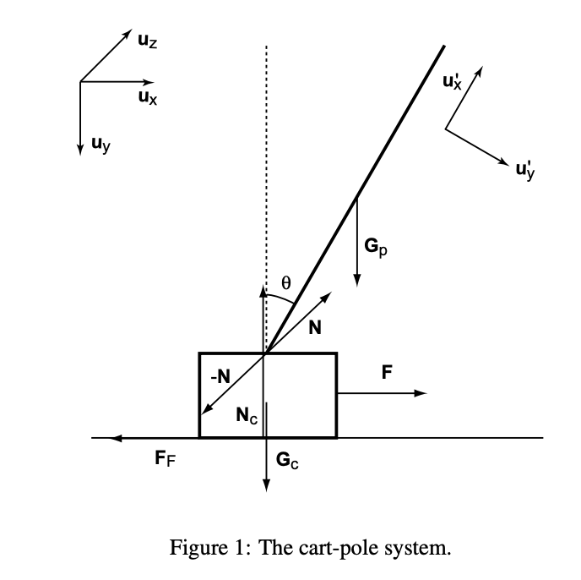
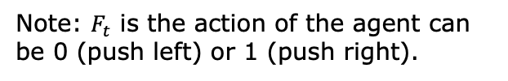
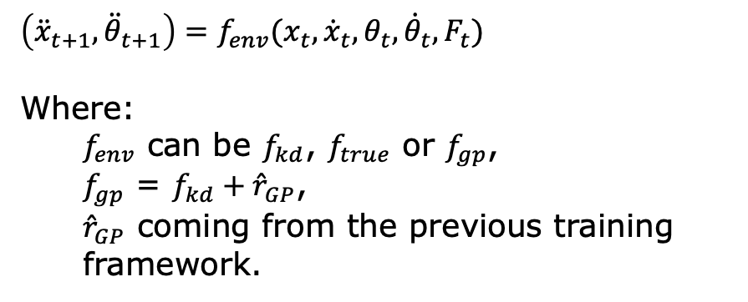
Inverted Pendulum case (Sim2Sim)
Base env equations (represents simulation)
Target env equations (represents real world)
$$\left({\ddot{x}}_{t+1},{\ddot{θ}}_{t+1}\right)={f_{env}(x_{t}, {\dot{x}}_{t}, θ_{t}, {\dot{θ}}_{t}, F_{t})}_{ }$$
Where:
$f_{env}$ can be $f_{kd}$, $f_{true}$ or $f_{gp}$,
$f_{gp}$ = $f_{kd}+{\hat{r}}_{GP}$,
${\hat{r}}_{GP}$ coming from the previous training framework.
Note: $F_{t}$ is the action of the agent can be 0 (push left) or 1 (push right).
Clément Garancini
3

Slide 4
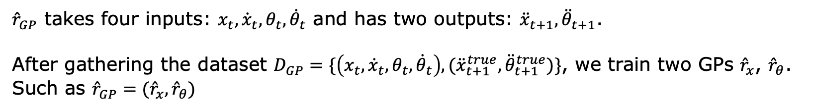

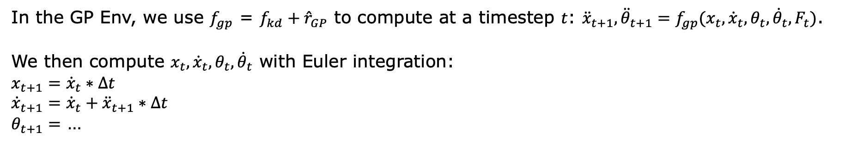

Inverted Pendulum Gaussian Process
1) How to obtain ${\hat{r}}_{GP}$?
${\hat{r}}_{GP}$ takes four inputs: $x_{t}, {\dot{x}}_{t}, θ_{t}, {\dot{θ}}_{t}$ and has two outputs: ${\ddot{x}}_{t+1},{\ddot{θ}}_{t+1}$.
After gathering the dataset $D_{GP}=\{\left(x_{t}, {\dot{x}}_{t}, θ_{t}, {\dot{θ}}_{t}\right),{(\ddot{x}}_{t+1}^{true},{\ddot{θ}}_{t+1}^{true})\}$, we train two GPs ${\hat{r}}_{x}$, ${\hat{r}}_{θ}$.
Such as ${\hat{r}}_{GP}=({\hat{r}}_{x},{\hat{r}}_{θ})$
2) How to use ${\hat{r}}_{GP}$?
In the GP Env, we use $f_{gp}$ = $f_{kd}+{\hat{r}}_{GP}$ to compute at a timestep $t$: ${\ddot{x}}_{t+1},{\ddot{θ}}_{t+1}=f_{gp}(x_{t}, {\dot{x}}_{t}, θ_{t}, {\dot{θ}}_{t}, F_{t})$.
We then compute $x_{t}, {\dot{x}}_{t}, θ_{t}, {\dot{θ}}_{t}$ with Euler integration:
$$x_{t+1}={\dot{x}}_{t}∗Δt$$
$${\dot{x}}_{t+1}={\dot{x}}_{t}+{\ddot{x}}_{t+1}∗Δt$$
$θ_{t+1}=$ …

Slide 5
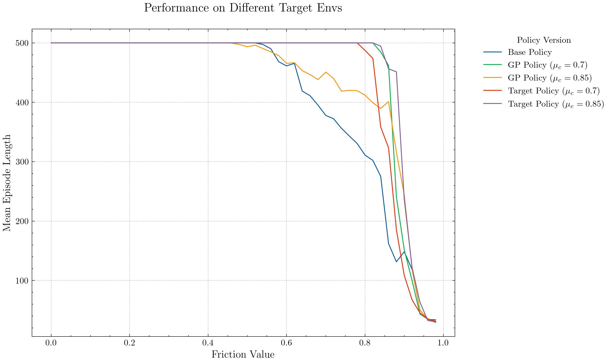
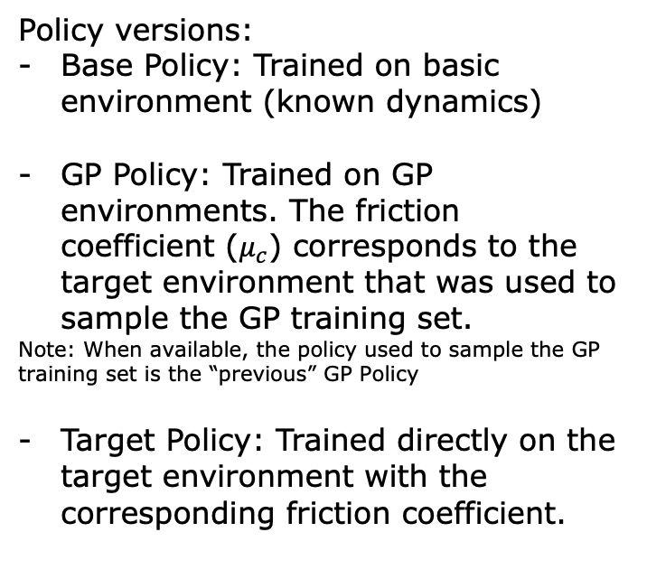
Inverted Pendulum Gaussian Process Result
Policy versions:
Base Policy: Trained on basic environment (known dynamics)
GP Policy: Trained on GP environments. The friction coefficient ($μ_{c}$) corresponds to the target environment that was used to sample the GP training set.
Note: When available, the policy used to sample the GP training set is the “previous” GP Policy
Target Policy: Trained directly on the target environment with the corresponding friction coefficient.

Slide 6
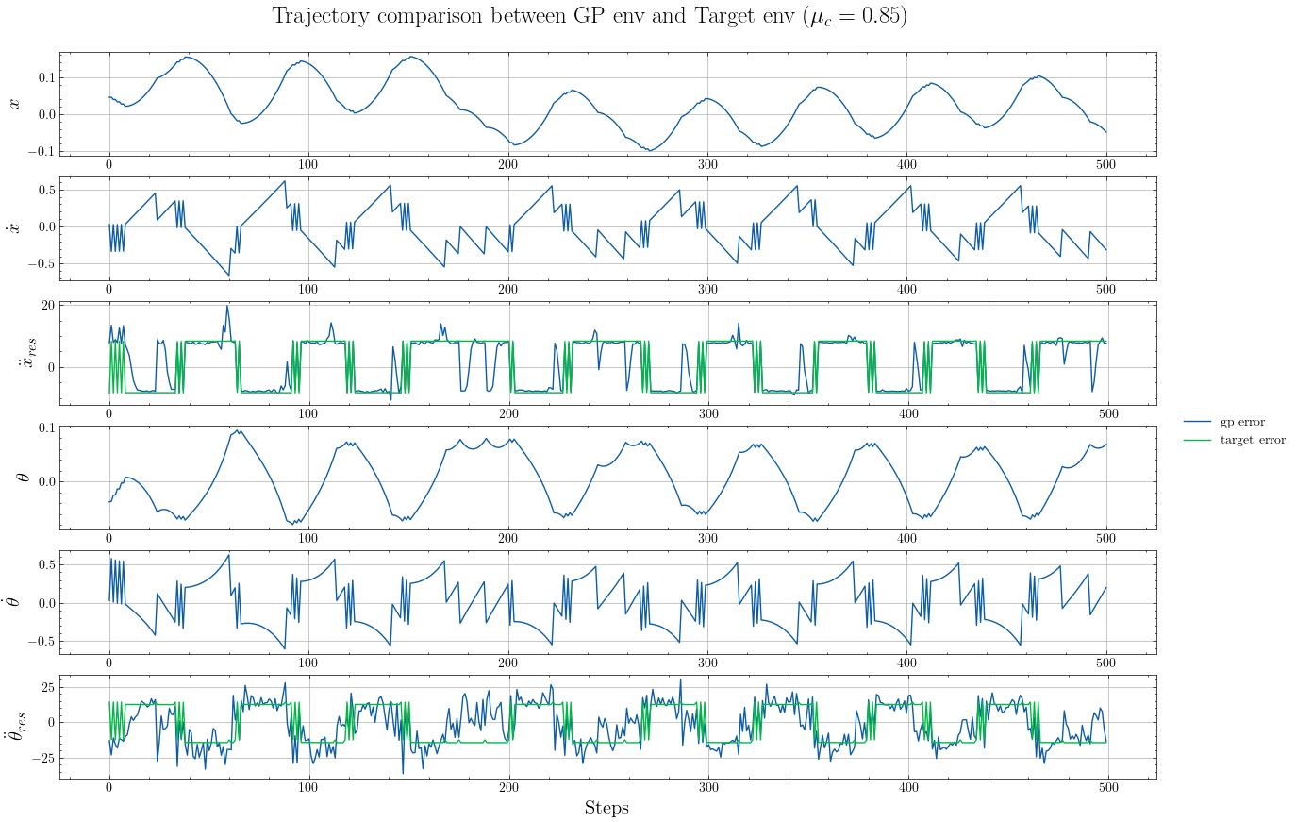
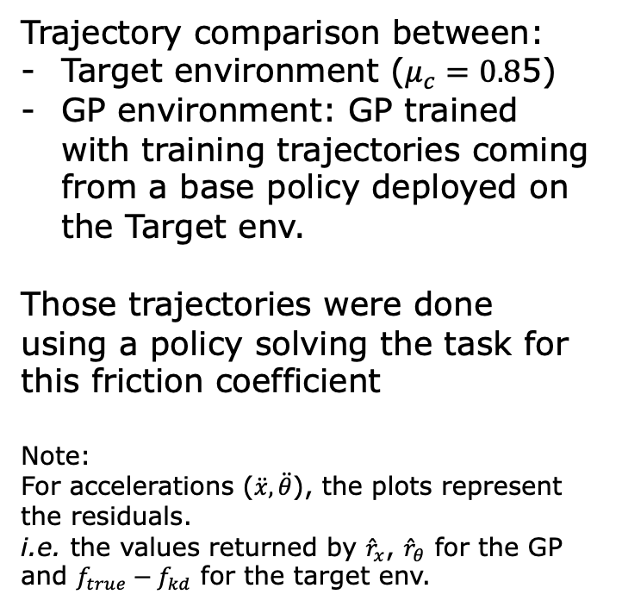
Inverted Pendulum Gaussian Process Result
Trajectory comparison between:
Target environment ($μ_{c}=0.8$5)
GP environment: GP trained with training trajectories coming from a base policy deployed on the Target env.
Those trajectories were done using a policy solving the task for this friction coefficient
Note:
For accelerations ($\ddot{x},\ddot{θ}$), the plots represent the residuals.
i.e. the values returned by ${\hat{r}}_{x}$, ${\hat{r}}_{θ}$ for the GP and $f_{true}−f_{kd}$ for the target env.

Slide 7
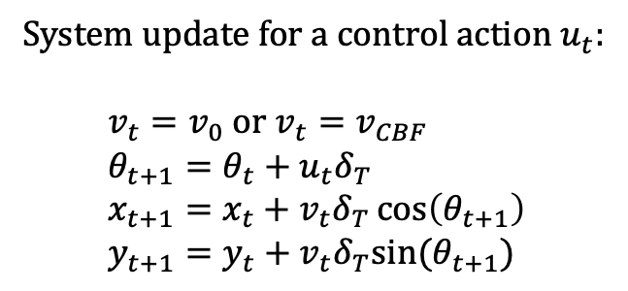
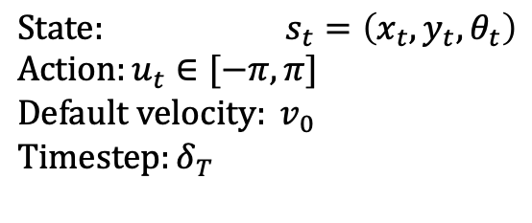
Cognifly case (Sim2Real)
Unicycle Env Equations (simulation)
Cognifly (real world)
$$State: s_{t}=\left(x_{t}, y_{t}, θ_{t}\right) \\ {Action:u}_{t}∈[−π, π] \\ {Default velocity: v}_{0} \\ Timestep:δ_{T}$$
System update for a control action $u_{t}$:
$$v_{t}=v_{0} or v_{t}=v_{CBF} \\ θ_{t+1}=θ_{t}+u_{t}δ_{T} \\ x_{t+1}=x_{t}+v_{t}δ_{T}\cos\left(θ_{t+1}\right) \\ y_{t+1}=y_{t}+v_{t}δ_{T}sin⁡(θ_{t+1})$$

Slide 8
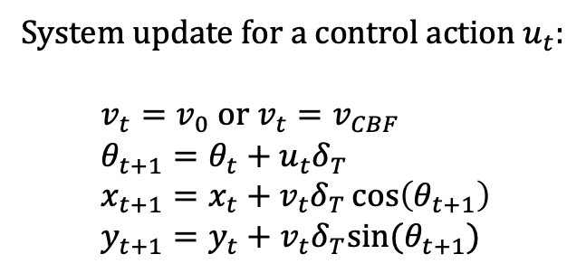
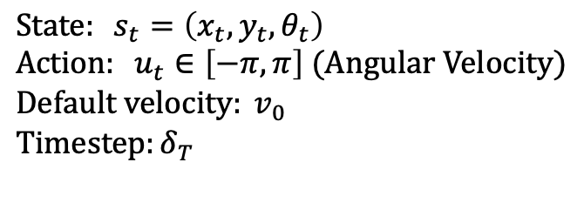
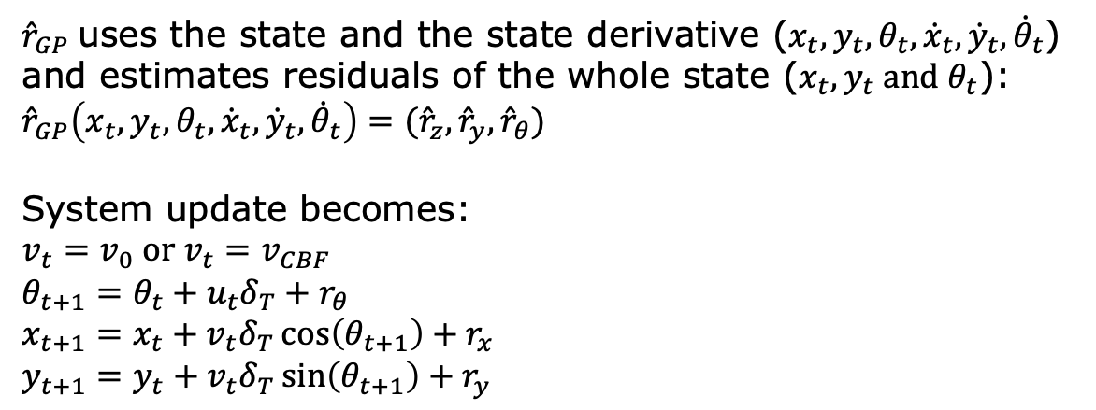
Gaussian Process for Cognifly
Unicycle Env Equations (Known Dynamics)
System update for a control action $u_{t}$:
$$v_{t}=v_{0} or v_{t}=v_{CBF} \\ θ_{t+1}=θ_{t}+u_{t}δ_{T} \\ x_{t+1}=x_{t}+v_{t}δ_{T}\cos\left(θ_{t+1}\right) \\ y_{t+1}=y_{t}+v_{t}δ_{T}sin⁡(θ_{t+1})$$
$$State: s_{t}=\left(x_{t}, y_{t}, θ_{t}\right) \\ {Action: u}_{t}∈\left[−π, π\right] (Angular Velocity) \\ {Default velocity: v}_{0} \\ Timestep:δ_{T}$$
Gaussian Process enhancement
${\hat{r}}_{GP}$uses the state and the state derivative ($x_{t}, y_{t}, θ_{t},{\dot{x}}_{t}, {\dot{y}}_{t}, {\dot{θ}}_{t}$) and estimates residuals of the whole state ($x_{t}, y_{t} and θ_{t}$):
$${\hat{r}}_{GP}\left(x_{t}, y_{t}, θ_{t},{\dot{x}}_{t}, {\dot{y}}_{t}, {\dot{θ}}_{t}\right)=({\hat{r}}_{z},{\hat{r}}_{y},{\hat{r}}_{θ})$$
System update becomes:
$$v_{t}=v_{0} or v_{t}=v_{CBF} \\ θ_{t+1}=θ_{t}+u_{t}δ_{T}+r_{θ} \\ x_{t+1}=x_{t}+v_{t}δ_{T}\cos\left(θ_{t+1}\right)+r_{x} \\ y_{t+1}=y_{t}+v_{t}δ_{T}\sin\left(θ_{t+1}\right)+r_{y}$$

Slide 9
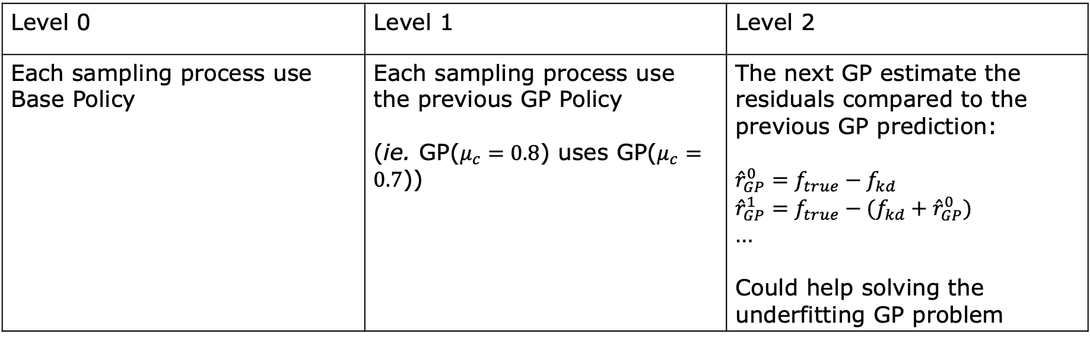
Ideas
Add action input to GP (Obvious I guess…)
Compare different levels of GP “chaining”:
Level 0 | Level 1 | Level 2
Each sampling process use Base Policy | Each sampling process use the previous GP Policy (ie. GP($μ_{c}=0.8$) uses GP($μ_{c}=0.7$)) | The next GP estimate the residuals compared to the previous GP prediction: $${\hat{r}}_{GP}^{0}=f_{true}−f_{kd}$$ $${\hat{r}}_{GP}^{1}=f_{true}−(f_{kd}+{\hat{r}}_{GP}^{0})$$ … Could help solving the underfitting GP problem

Slide 10



Framework
Generic system equation:
$\dot{s}\left(t\right)={f(s\left(t\right), u\left(t\right))}_{ }$
Initialization: Target env ($f_{true}$), Base env (known dynamics $f_{kd})$
Policy Training Loop
GP Training loop
$$[η_{min};η_{max}]$$
Update Range
Training env
Target env
$$η_{true}$$
Training env
Training env
$$η∈[η_{min};η_{max}]$$
Training env
Training env
Draw one at
each episode
Training env
Every n episodes
Train GP
Train
Train policy
Policy
Deploy for
evaluation

