Slide 1
Introduction to SIMS project
Customer panel meeting
2022-10-13

Slide 2
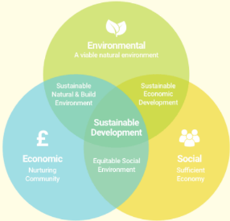


Problem definition
Notes:
It’s now more important than ever to think about how we can work and live with sustainability in mind.
The Swedish registration office has the idea that by helping new entrepreneurs to think about sustainability even before the company is created, It could help companies to make a large positive impact on the climat in the longer run.
The idea for helping the new entrepreneur is to create an AI-driven sustainability barometer for companies to test their business idea.
This tool will help companies reach the United Nations UN’s 17 goals for sustainable development.

Slide 3
Suggested prototype
Web Server
DATABASE
Computing server
FORM
API server
RESULT
AI PROCESSING
API CALLS
Entrepreneur
Notes:
quite simple in theory
when a new entrepreneur wants to assess the sustainability of his business idea, he or she can fill a form.
form contains questions about his business idea and collects data
data then used for an AI processing, output is a short analysis of the sustainability.
presented in a nice format to the user in a web page
also presented are some links to articles relevant to the entrepreneur to help make his business more sustainable

Slide 4

Landing page

Slide 5
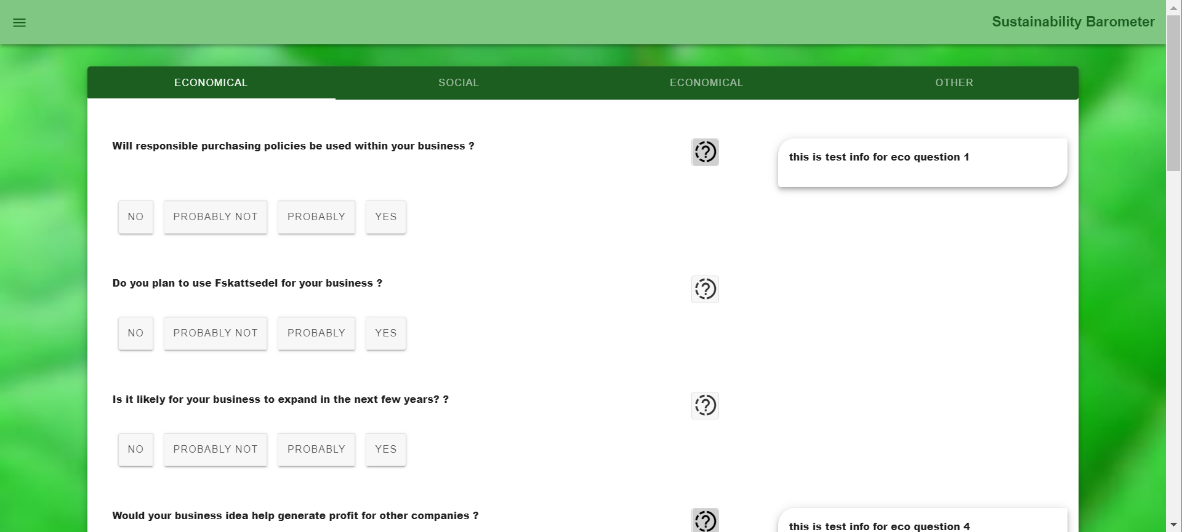
Form page

Slide 6
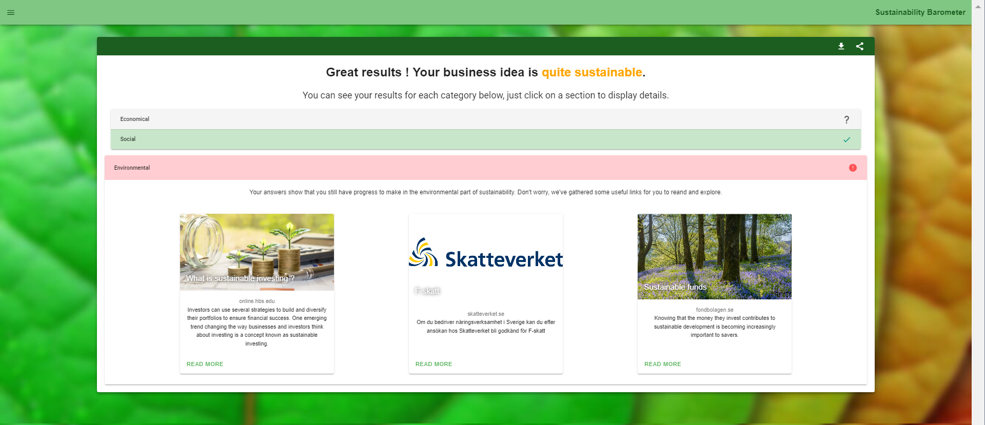
Result page

Slide 7
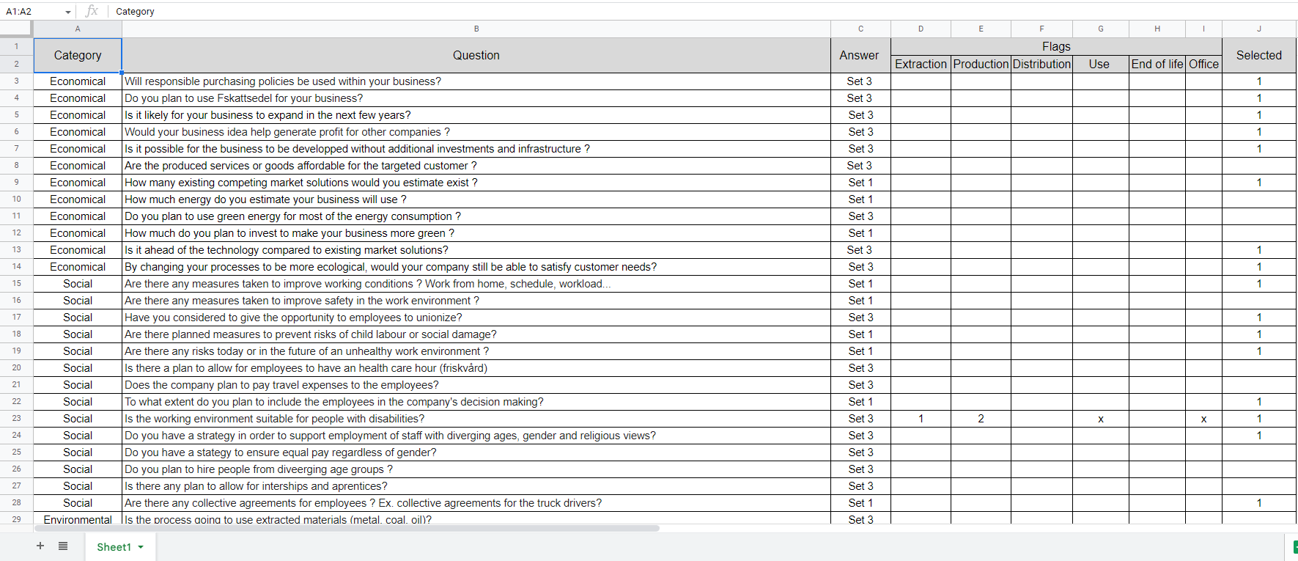
Questions for sustainability
Environmental
Social
Economic
Positive influence

Slide 8
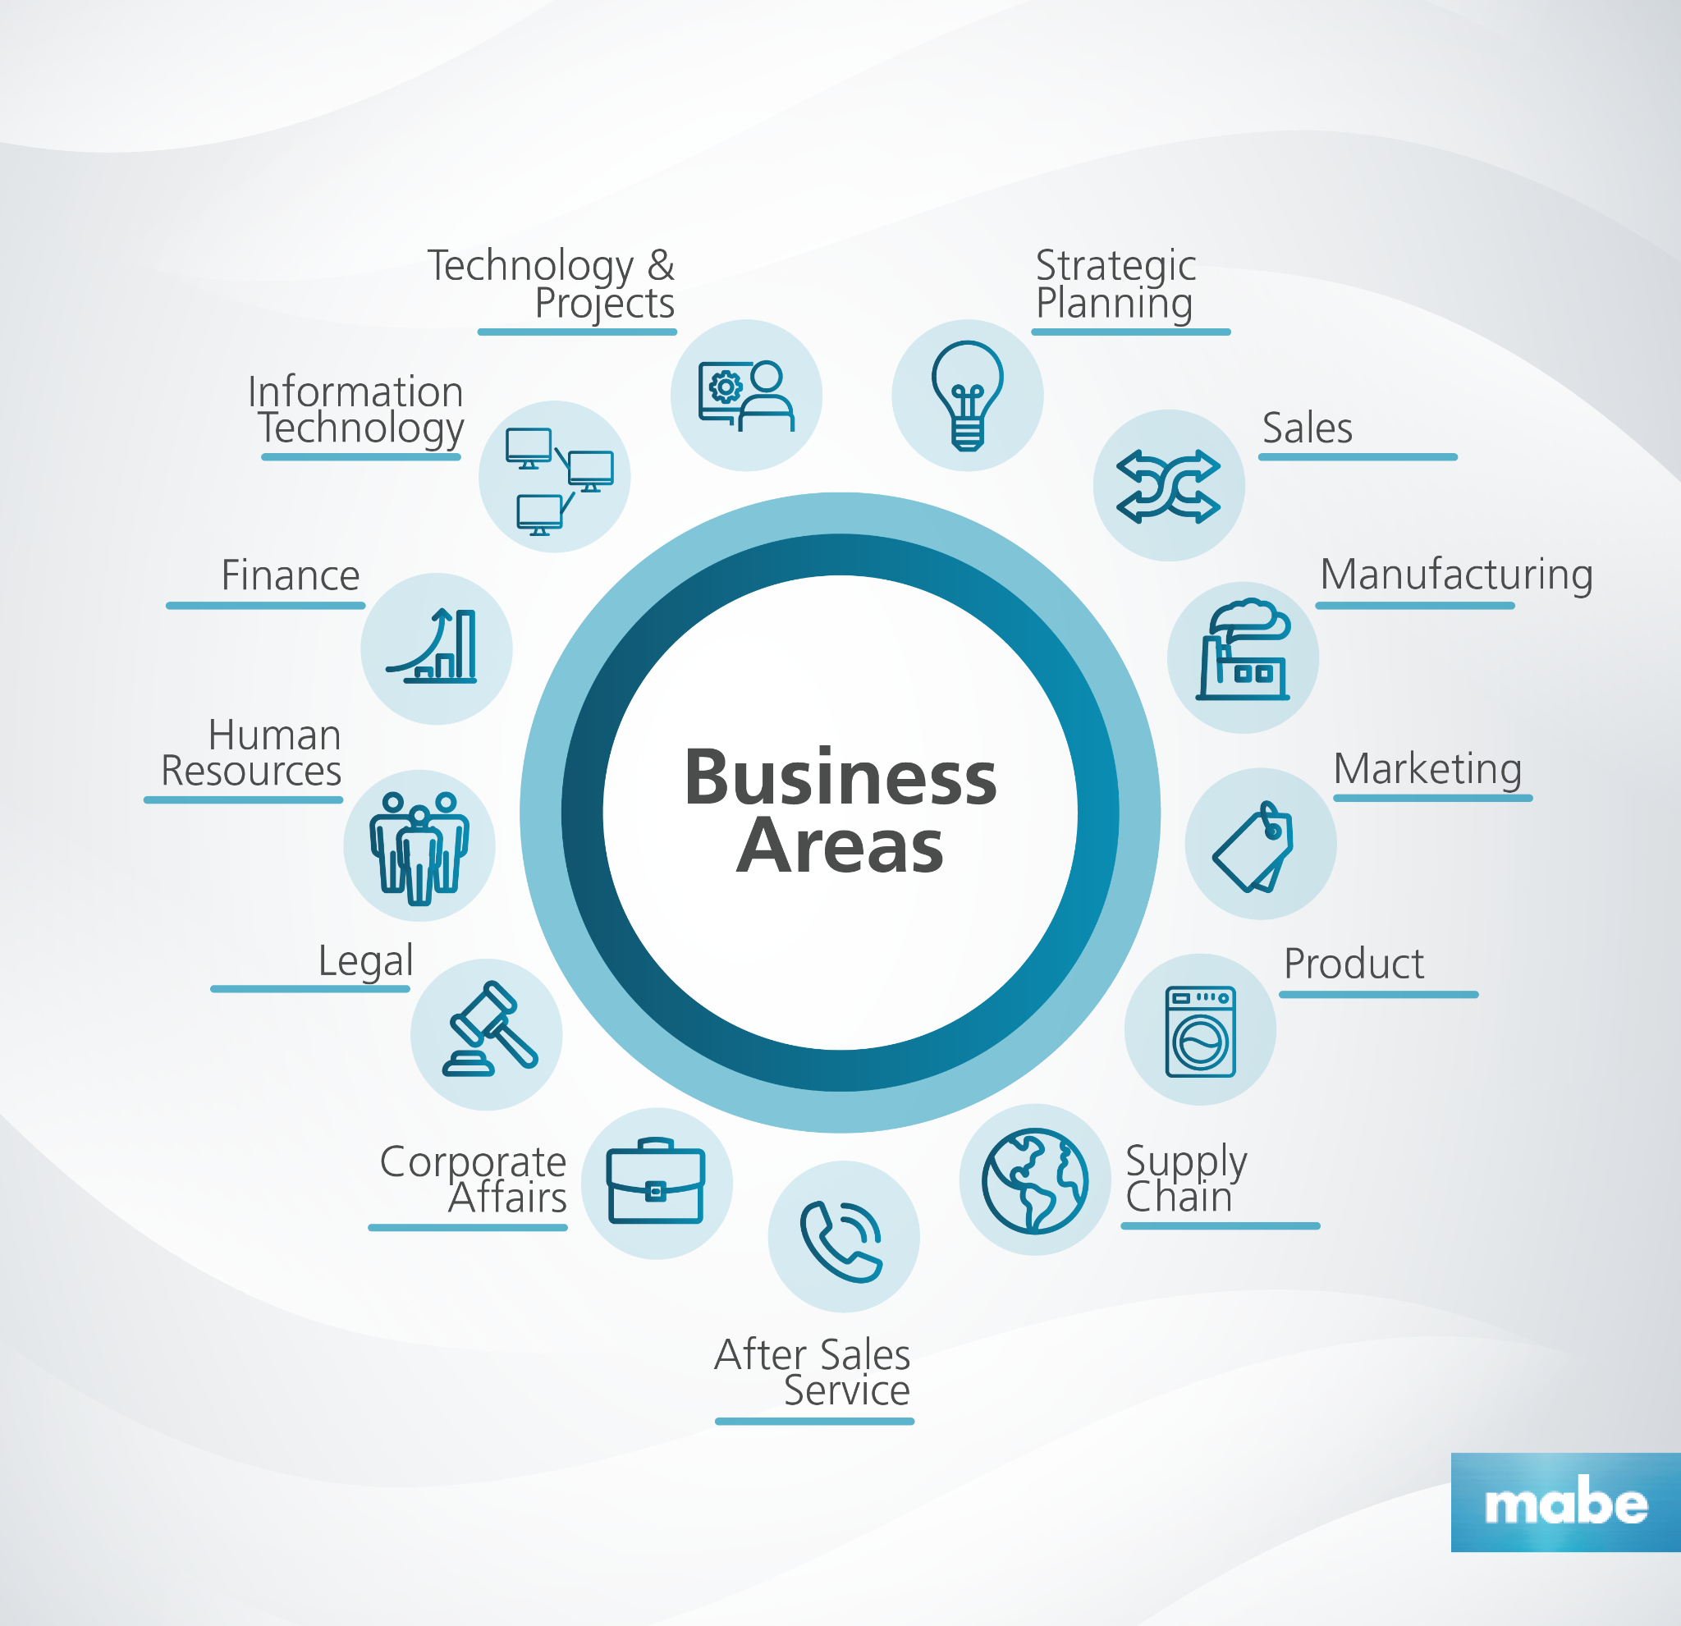

Weighting questions

Slide 9
Questions
What is the customer panel?
State the questions in Google form and send to the customer panel in order to evaluate the quality of the questions? (Not for using their answers)
For the AI model we are thinking of sending the questions to companies that are said to work sustainable in order to use their answers to train the model on what sustainability is. Can we use the answers from customer panel also to determine what sustainability is?
Appropriate to ask the companies in the customer panel what other features they would wish to have in a service like this? Needs from the user?

