Slide 1
Summary of work

Slide 2
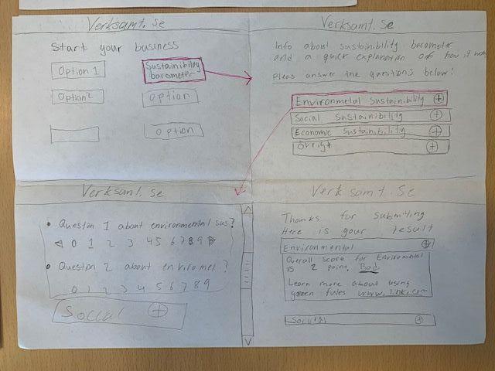
Design studio 1

Slide 3
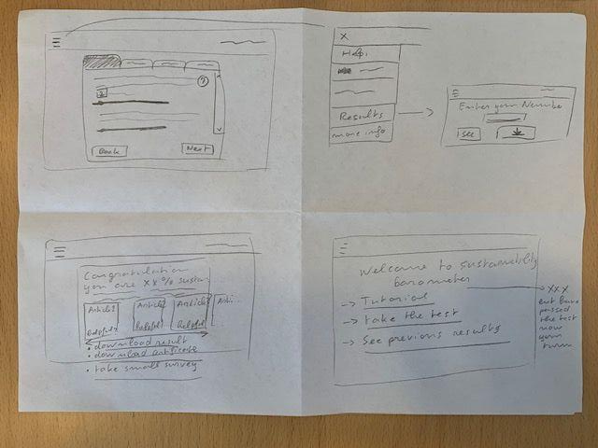
Design studio 2

Slide 4
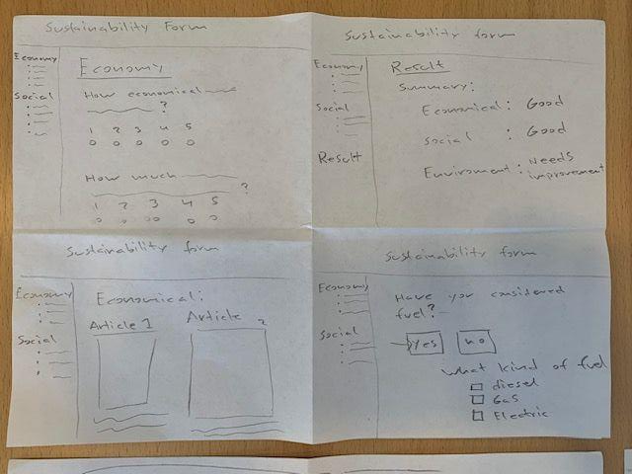
Design studio 3

Slide 5
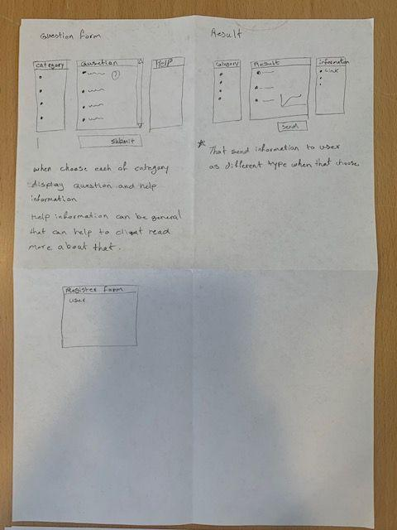
Design studio 4

Slide 6
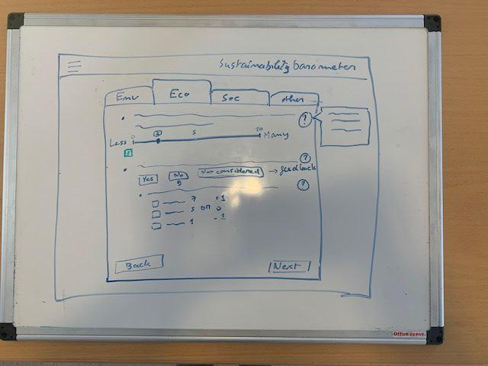
First common mockup: form page

Slide 7
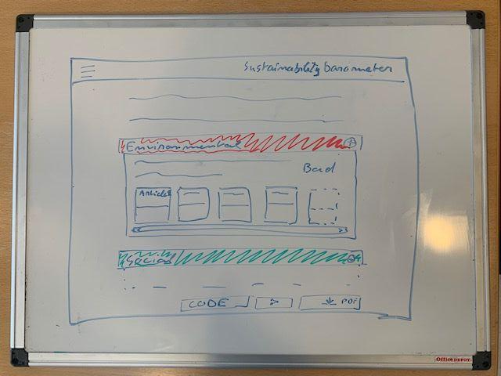
First common mockup: result page

Slide 8
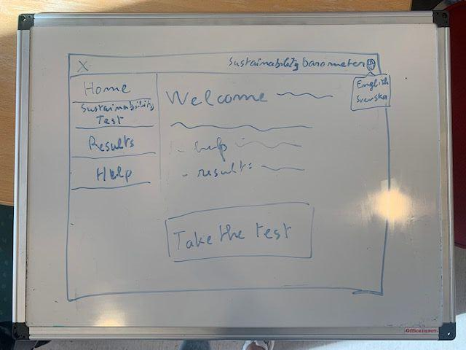
First common mockup: home page and nav bar

Slide 9
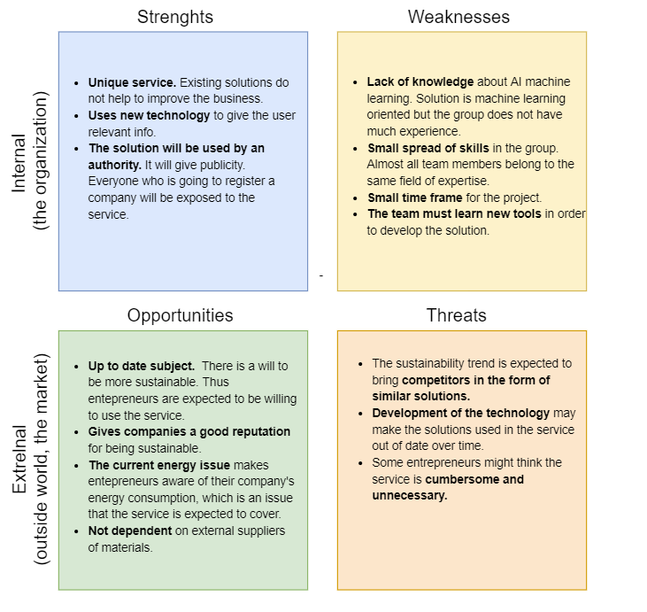
SWOT- analysis

Slide 10
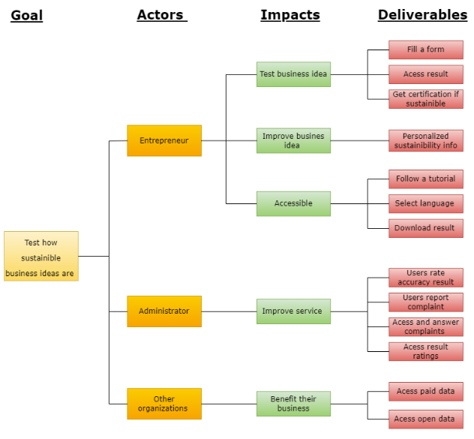
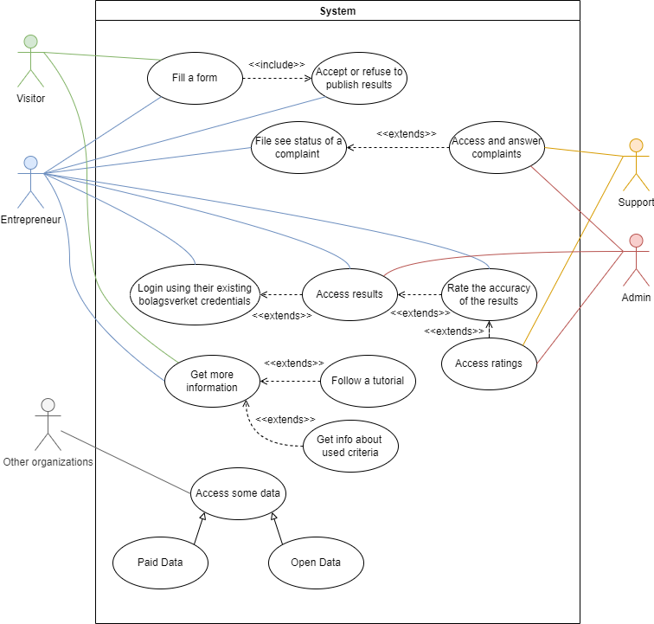
Requirement capturing:
Use case diagram
Impact map
User stories
Kano

Slide 11
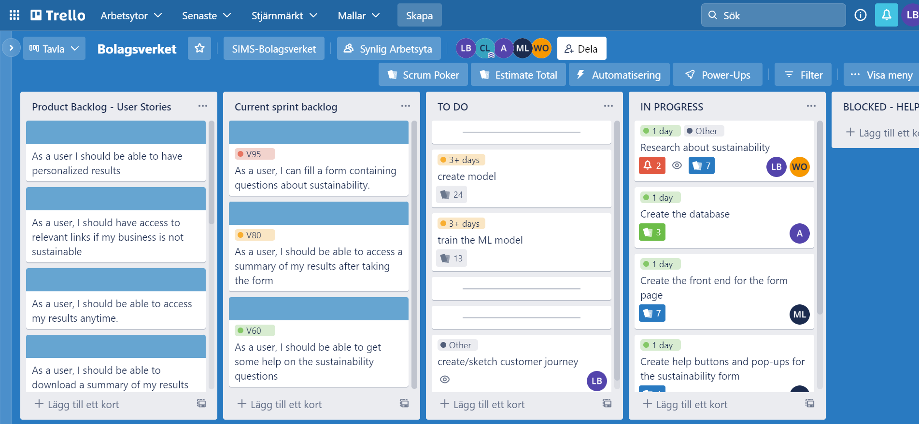
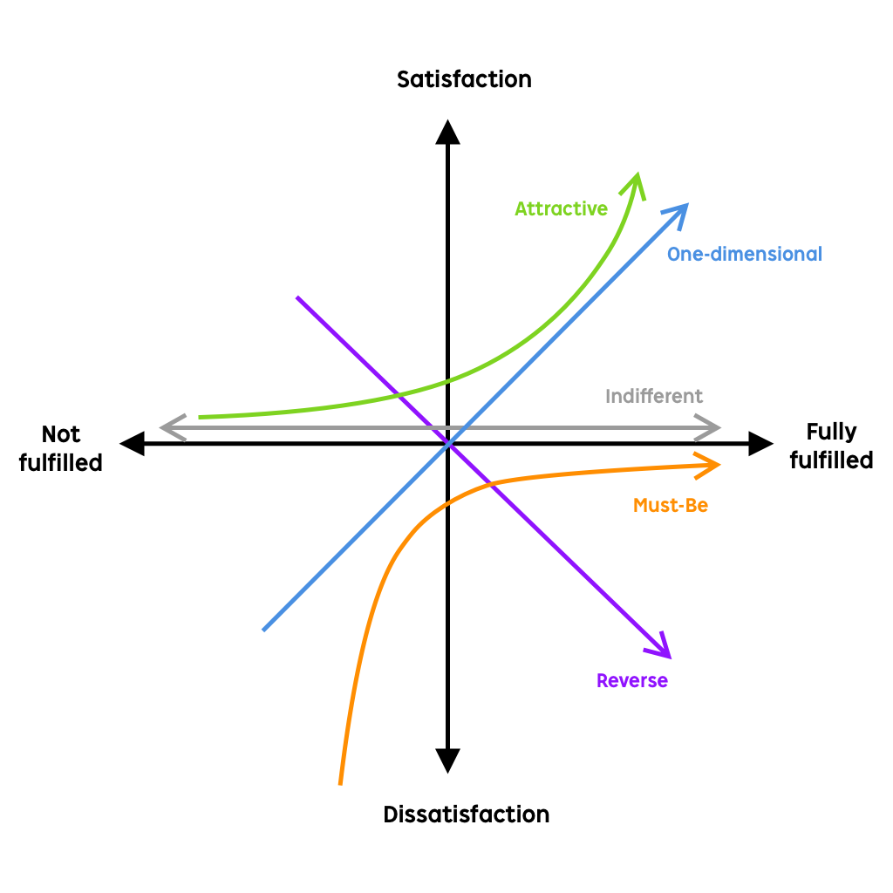

Slide 12
Sustainability questions
Positive influence?

