Slide 1


Pitch & Project plan
2022-09-15
Wisam Orabi Alkhen––Mattias Lindblom—-Lovisa Berglund—-Clément Lefebvre—-Ahmad Setoodeh
Notes:
As you have probably seen, in recent years, the world has changed. Floods, famine, energy outages, and fires are becoming more frequent. There is a famous proverb that says: “The best time to plant a tree was 20 years ago. The second best time is now. Knowing the impact companies can have on this issue, Bolagsverket decided to work on the problem from the start.
Our approach on their need is a programming solution involving Artificial Intelligence to assess the sustainability of a company. Our software will ask the entrepreneur some questions about their business idea, and then provide useful links or articles to educate on ways to be more sustainable.
The benefit of our solution is that it uses new technology to influence companies to develop their business in a more sustainable way. This is something than could also can help to develop partnerships in the future since most companies are aiming to be more sustainable.
Today there exist similar solutions on the market but compared to our solution, these solutions do not seem to help to improve ideas, they just tell you how your actions will affect the sustainability.

Slide 2




Need
Approach
Benefit
Competition
Notes:
As you have probably seen, in recent years, the world has changed. Floods, famine, energy outages, and fires are becoming more frequent. There is a famous proverb that says: “The best time to plant a tree was 20 years ago. The second best time is now. Knowing the impact companies can have on this issue, Bolagsverket decided to work on the problem from the start.
Our approach on their need is a programming solution involving Artificial Intelligence to assess the sustainability of a company. Our software will ask the entrepreneur some questions about their business idea, and then provide useful links or articles to educate on ways to be more sustainable.
The benefit of our solution is that it uses new technology to influence companies to develop their business in a more sustainable way. This is something than could also can help to develop partnerships in the future since most companies are aiming to be more sustainable.
Today there exist similar solutions on the market but compared to our solution, these solutions do not seem to help to improve ideas, they just tell you how your actions will affect the sustainability.

Slide 3
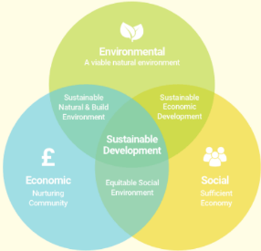


Problem definition
Notes:
//Wisam as you heard before.
-It’s now more important than ever to think about how we can work and live with sustainability in mind.
-The Swedish registration office has the idea that by helping the new entrepreneur to think about sustainability even before the company is created,
-It could help the company to make a large positive impact on the climat in the longer run.
-The idea for helping the new entrepreneur is to create an AI-driven sustainability barometer for companies to test their business idea.
-This tool will help companies reach the United Nations UN’s 17 goals for sustainable develop¨ment.

Slide 4
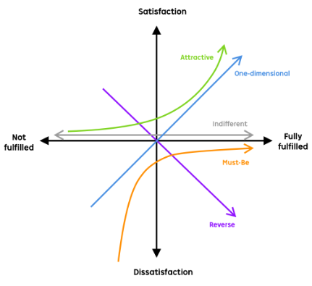
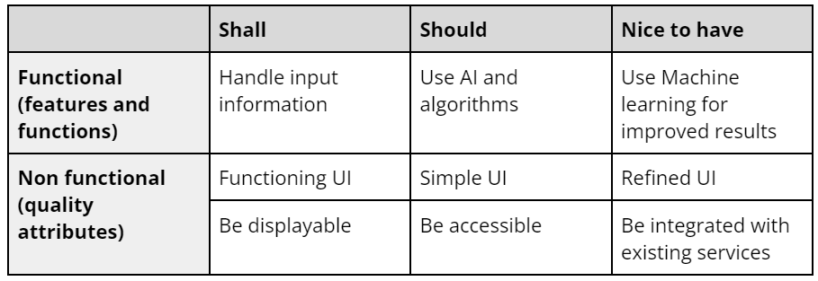
R
Kano model for identifying requirements and goals
Three columns for dividing requirements
Notes:
// Mattias
For measuring and creating our goals for the project, we have decided to follow the Kano-Model. The Kano model is suitable for a project like this where time is a bit limited. The basic idea is to identify what requirements and features that would satisfy the customer the most.
With this model in mind we made an requirement analysis table. On this picture there is an small sample of our requirement table for demonstration purposes. We made three columns, the shall column contains the features that we think needs to be implemented into the solution. The should column contains the features that would greatly improve both the quality and usability of the solution. And the last column Nice to have column is the requirements that we would like to implement but should not be prioritized.
[Explain last row as an example]
I can talk through the last row in this table as an example.
If we look at the last row in the table: When we talked about the user interface for our solution, we agreed on that the UI atleast should be displayable, and it would be good if it was accessible from multiple sources, and it would be great if our solution could be integrated in some other already existing service for even more accessibility.
[probably Skip this]
The table is also grouped in two categories, functional and non-functional requirements. functional requirements can be summarized as technical features that work a bit behind the scenes like algorithms for an example. Where as non-functional requirements could be like the UI that the user interacts with.
So with all of this in mind, we are trying to identify what we think are reasonable goals that is also achievable for this project. In a perfect example, it would of course be to implement every quality of life feature that we could think of. But with this model, we can ensure that we are spending our time and resources on the features that matter the most for our solution.

Slide 5
Suggested prototype
Web page
Computing server
FORM
DATA
DATABASE
AI PROCESSING
RESULT
Entrepreneur
Notes:
//Clément
quite simple in theory
when a new entrepreneur wants to assess his sustainability, can fill a form.
form contains questions about his business idea and collects data
data then used for an AI processing, output is a short analysis of the sustainability.
presented in a nice format to the user in a web page
also presented are some links to articles relevant to the entrepreneur to help make his business more sustainable

Slide 6
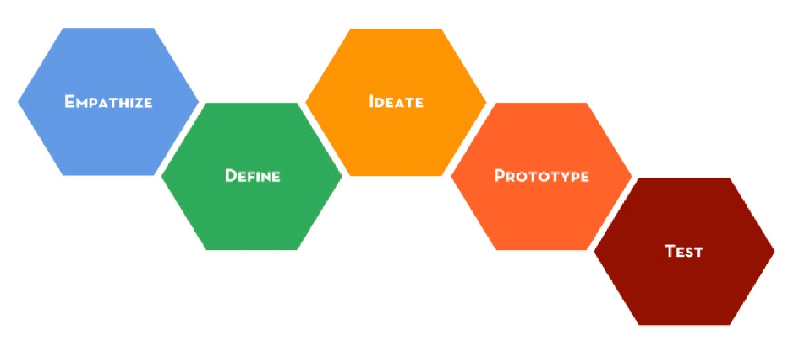
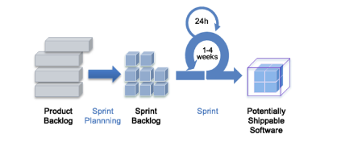
Project methods
Scrum
Timeboxing
Four sprints
Design thinking
Emphasize- researching the user's needs
Define- stating needs and problem
Ideate- challenging assumptions and creating ideas
Prototype- creating solutions
Testing- trying out the solution
Work in sprints executed according to the phases
Notes:
//Lovisa .
In this project, work is planned to be structured and conducted using a combination between two agile methods, Scrum and Design Thinking.
The scrum method is based on timeboxing. Therefore work in scrum is divided into different sprints where a goal is defined and the group works to achieve this common sprint goal. The reason why the Scrum method is going to be used in this project is because it is suitable for small groups and provides quick and easy prototyping.
Design thinking ia a methodology where the project is divided into different phases. The empathize phase is about researching the user's needs. The define phase is about stating these. The ideate phase is about challenging assumptions and creating ideas. The prototype phase is about creating solutions. The test phase is about trying out the solution.
The Design Thinking method is expected to work as a suitable complement to scrum. This is because the phases from Design Thinking can be used to divide and structure work within the sprints. This means that for each sprint in the project, work will be executed according to the phases in design thinking. This will create an improvement for each sprint and contribute to an iterative result where new knowledge phases is created.

Slide 7
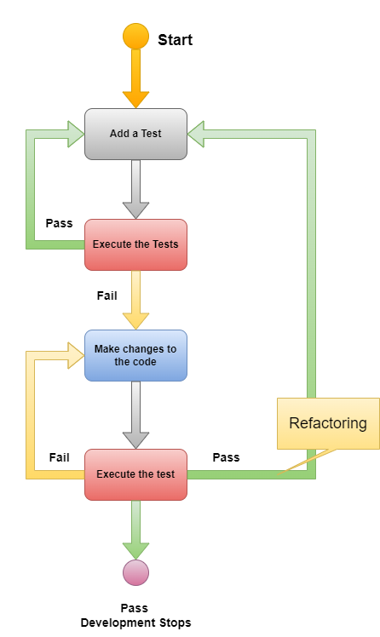
Development methods
●TDD (Test Driven Development )
That diagram show step by step test process
● Choose or input information for test
● Run test and see if they pass or fail
● If the test passes, show the result or if it fails change the code
● Run tests again and if it passes, refactor
● If it passes, go to step 1
● If it fails, go to step 3
Notes:
//Ahmad
TDD test have the following steps:
1- Add a test.
2- Run tests and see if they pass or fail.
3- Change the code, if the test does not pass.
4- Run tests again and see if it passes or fails.
5- If it passes, gå to step 1.
6- If it fails, gå to step 3.

Slide 8
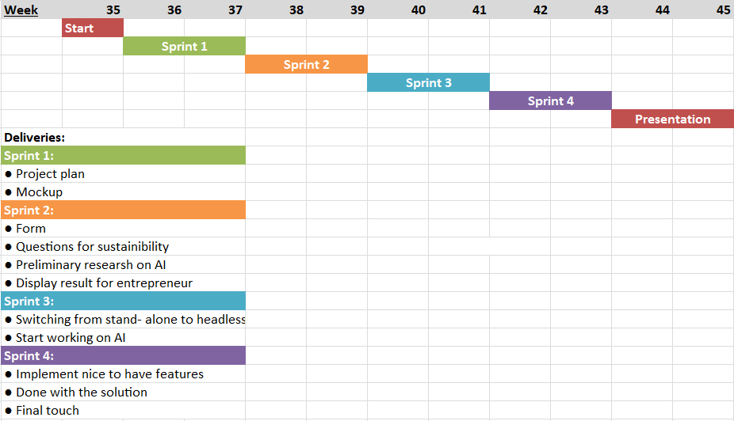
Time schedule
Notes:
//Lovisa
For this project, the time will be divided into four different sprints where each sprint covers the Design Thinking phases. It is expected that every sprint will last about two weeks. On the last days of each sprint, the work will focus more on preparing for the sprint review meetings rather than completing user stories for the actual sprint.

Slide 9
Risk analysis
Lack of
knowledge
Lack of time
Performance
Cost
Notes:
// Wisam
and here is the most important points in risk analysis
the first one is Lack of time to develop every part of the solution.
and the possible Solutions for this point are by organize and follow the Scrum method to respect deadlines,
the second point is Lack of knowledge about AI artificial intelligence. AI
the possible Solutions for this is by 1-Reserving the time in the schedule to learn about this technology, and ask the company for a mentor or available resources.
the third point is the Performance : like AI can require high resources.
the possible Solutions could be: by Separate AI processing from the website. like by using microservices
and the laste point is the Cost : like AI can require specific and powerful hardware.
the possible Solutions could be: by provide hardware and expertise from companies( AI-hub).

Slide 10
Thank you for your attention!
Questions?
Notes:
So that was our plan and we are excited to work on the project for the next 10 weeks. Thank you for listening to our presentation!

