Slide 1
AI-Project about Steam
Konstantin Wetscher, Clemens Gugerbauer

Slide 2
Data
SteamCharts player data
6,725 games
Monthly average & peak players
Web-scraped (SteamCharts)
Incomplete coverage (low-player games missing)

Slide 3
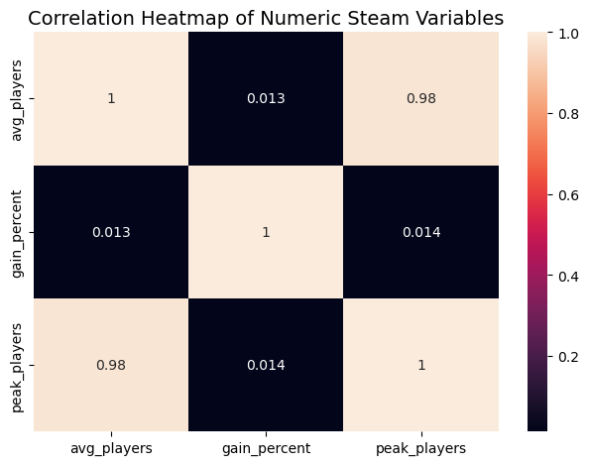
Data prepartion
Converted dates to datetime
Removed invalid/non-numeric values

Slide 4
Research Questions
How do the maximum players change over time?
How did they achieve this?
- Wie ändert sich die Spieleranzahl, wenn ein neues Spiel rauskommt? (e.g. Forza Horizon 4 und dann kommt Forza Horizon 5)
- Unterscheiden sich alte Klassiker von neuen Spielen hinsichtlich Peak-Dynamik?

Slide 5
Resarch Question 1
How do the maximum players change over time?
How did they achieve this?

Slide 6
Resarch Question 2

Slide 7
Resarch Question 3

Slide 8
Conslusion
Peaks fade, classics last
Sequels shift players

