Slide 1
Evaluating Bias Detection and Mitigation in Student Failure and Crime Datasets Using Fairlearn and AIF360
Bernhard Kollmann, Clemens Thrakl

Slide 2
Scope of the work
2 Frameworks - AIF360 | Microsoft Fairlearn
2 Datasets - Student Failures | Crime Statistic
2 Iterations - Raw | Cleaned Data
Sensitive Features Alone | Groups
Mitigation Steps Individually | Iteratively

Slide 3
Research Quesition
How effective are Fairlearn and AIF360 in detecting and mitigating bias in student failure and crime datasets, and what insights can be derived regarding the socio-economic implications of these biases?
Socioeconomic Nature and Relevance:
How do the socio-economic backgrounds of students and crime rates influence bias, and what is the relevance of addressing bias in these datasets for societal equity?
Bias Detection and Mitigation:
Which key differences in bias detection and mitigation capabilities between Fairlearn and AIF360 when applied to student failure and crime datasets exist?
Correlations Between Datasets:
What correlations can be drawn between biases in student failure rates and crime rates, and how do these correlations inform our understanding of socio-economic factors and systemic inequalities?

Slide 4
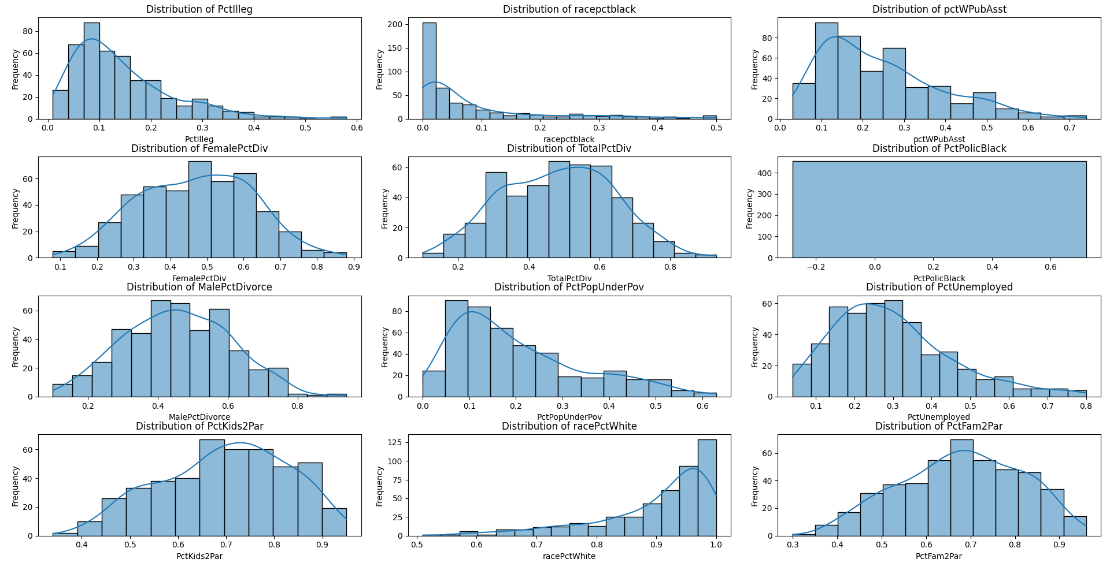
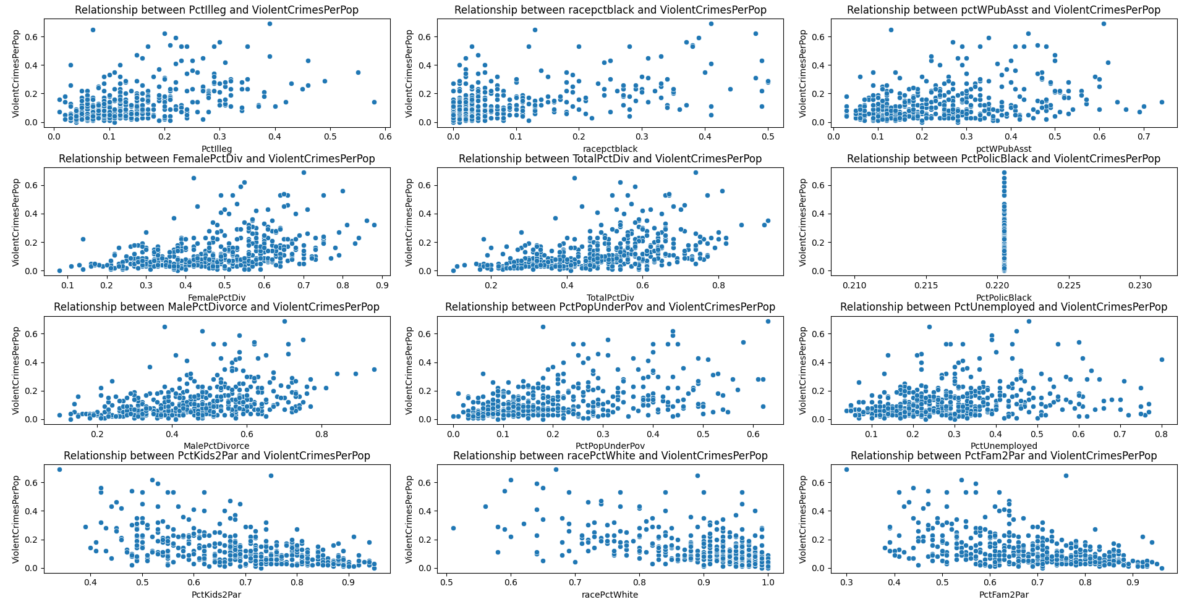
Socioeconomic Background & Relevancy Crime

Slide 5
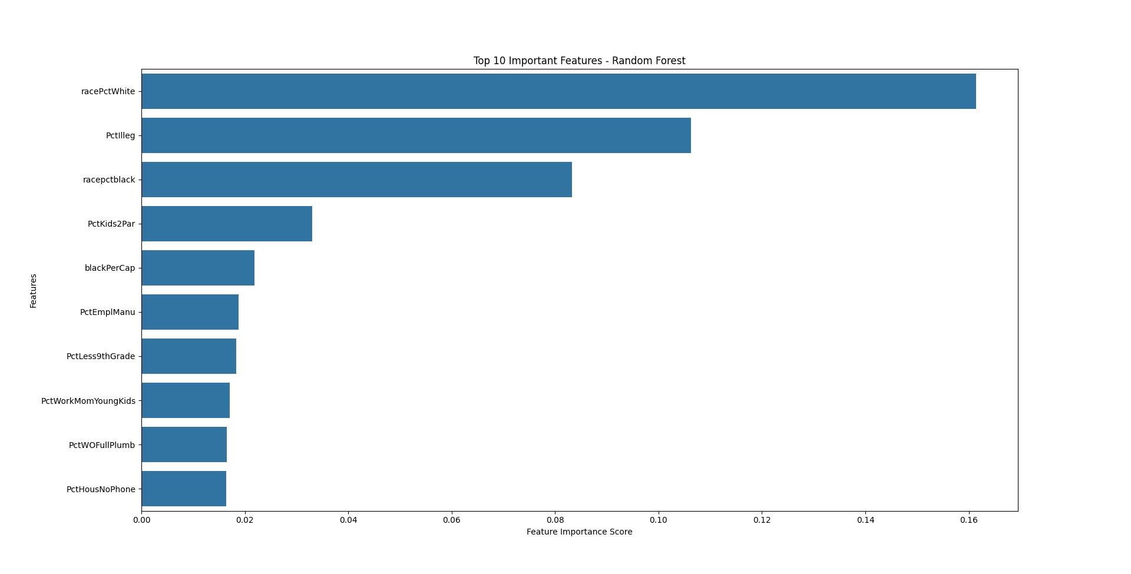

Slide 6
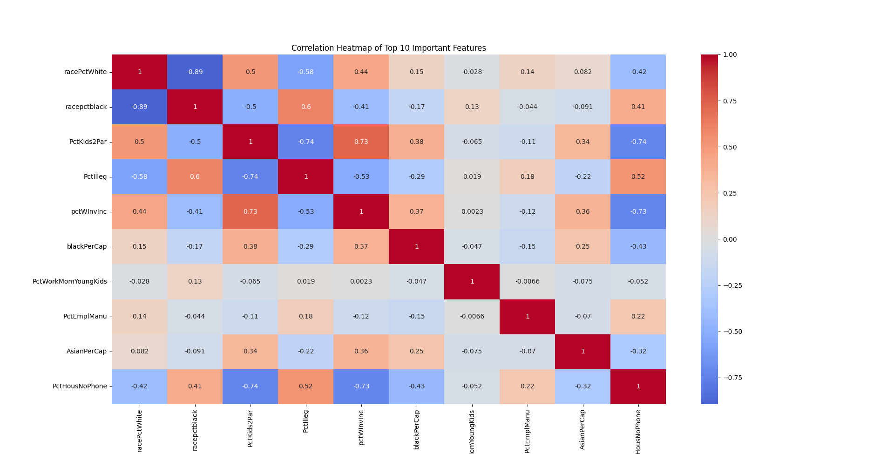
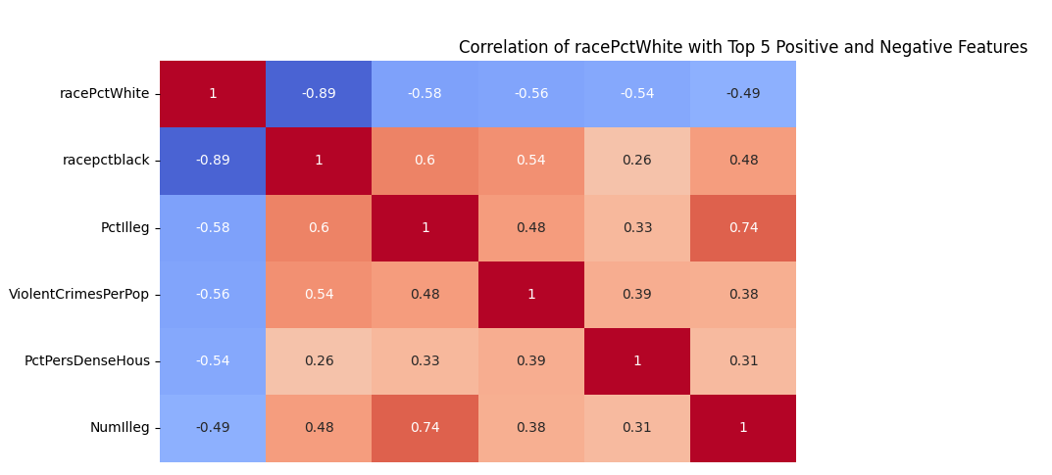
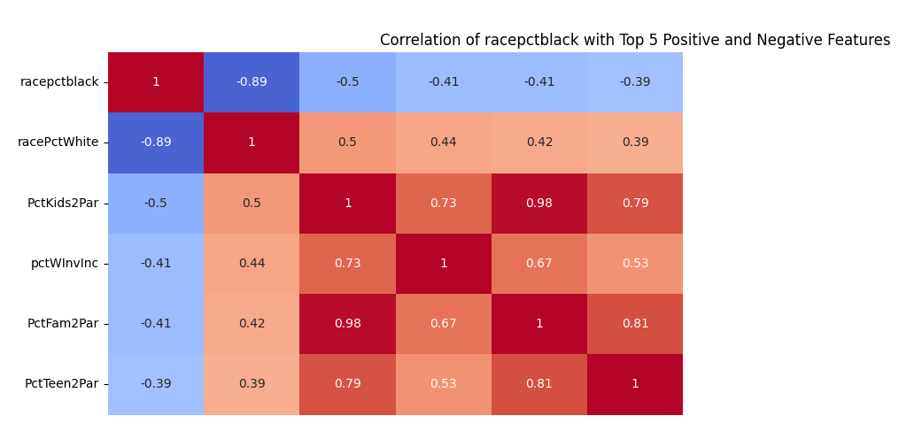

Slide 7
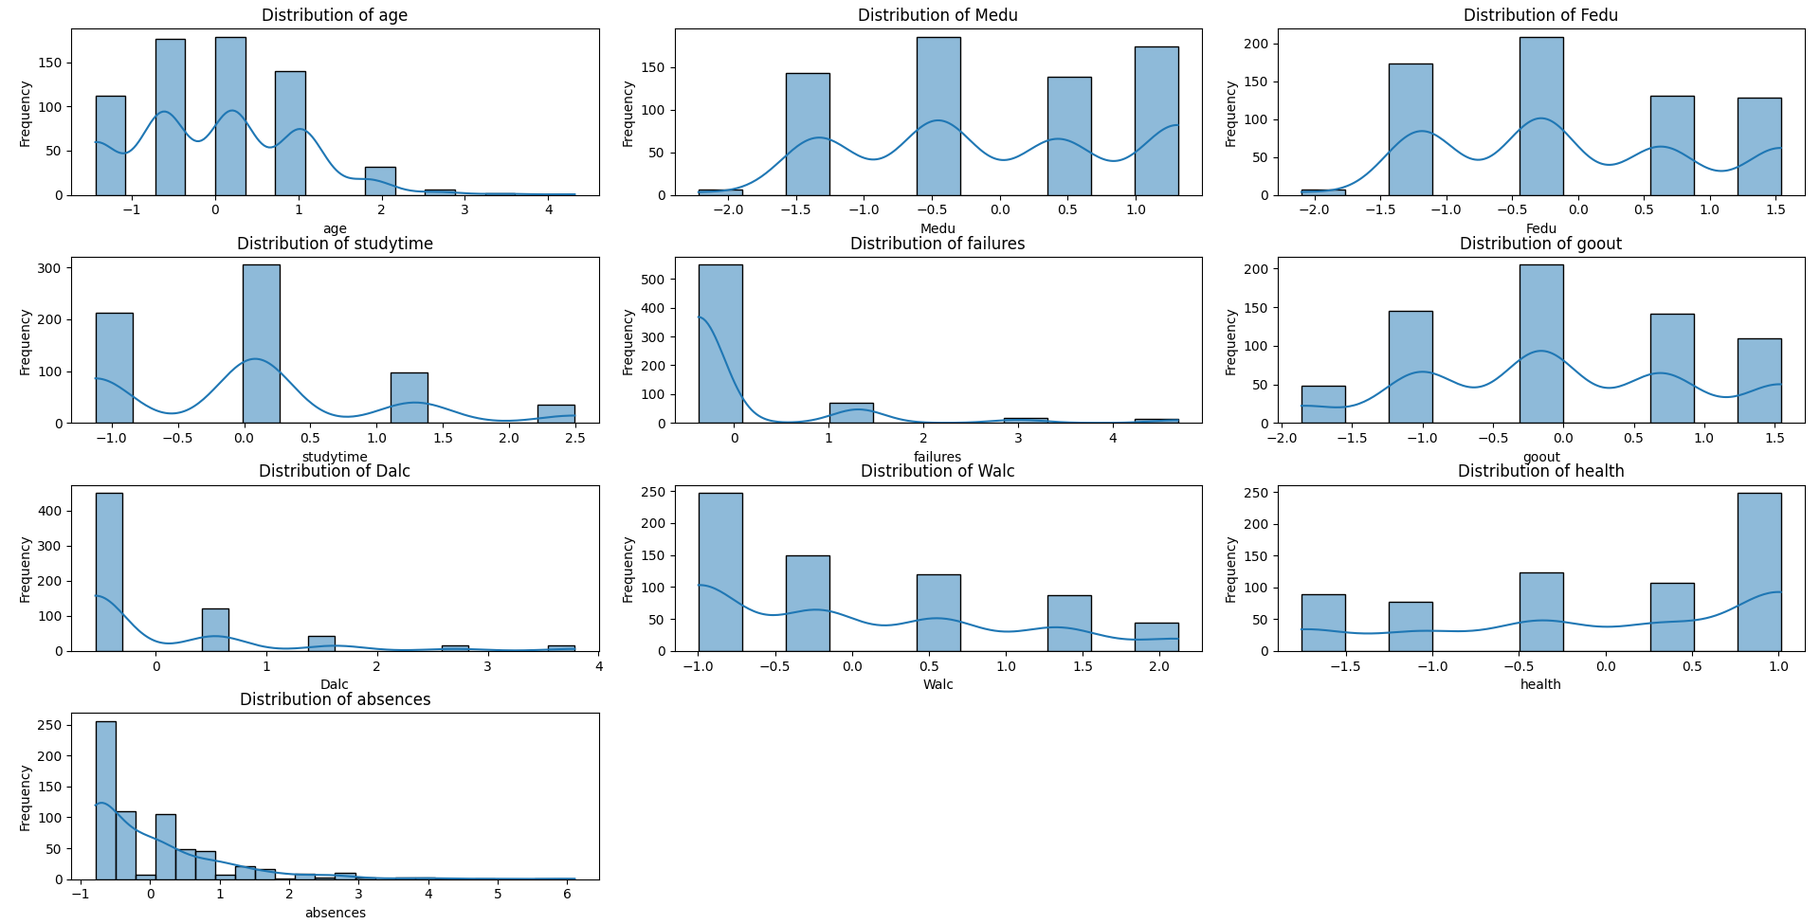
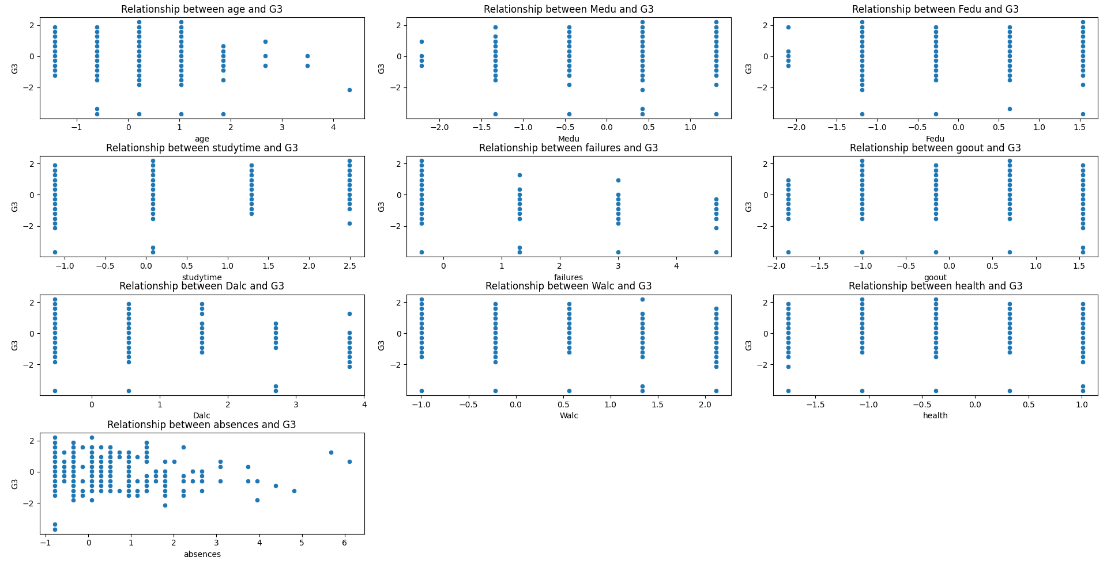
Socioeconomic Background & Relevancy Student

Slide 8
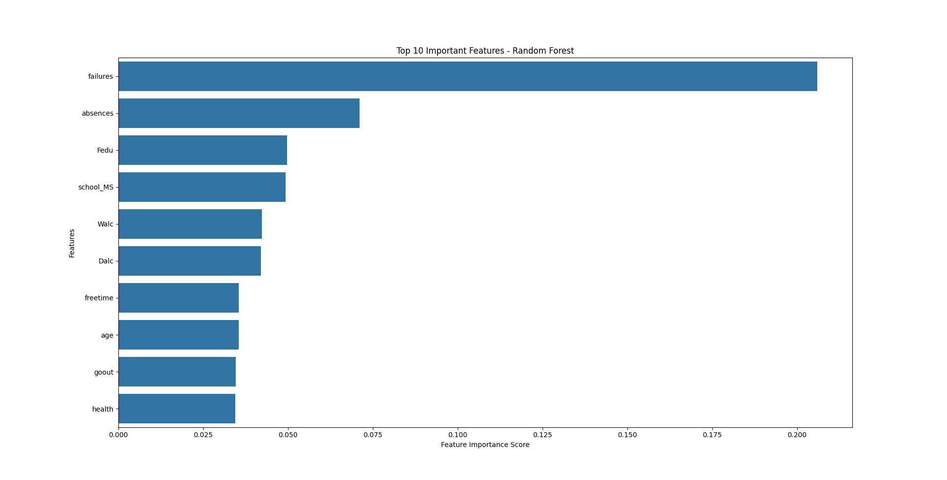

Slide 9
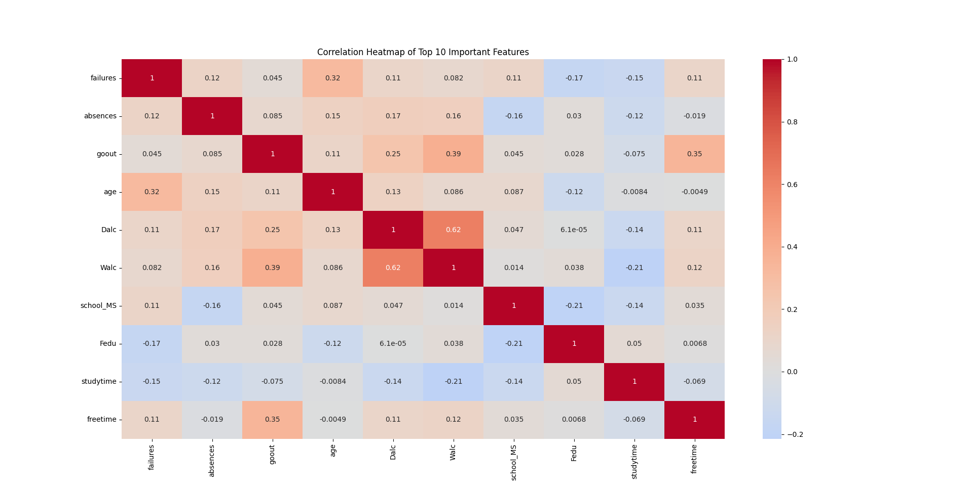

Slide 10
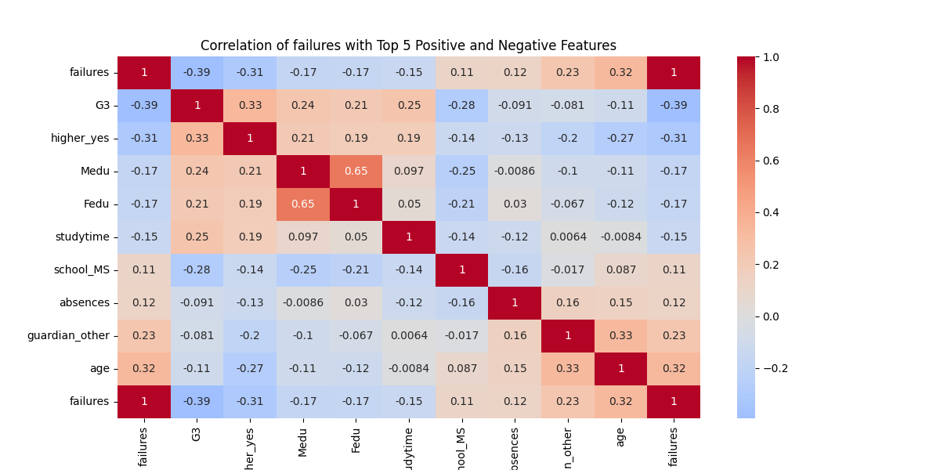
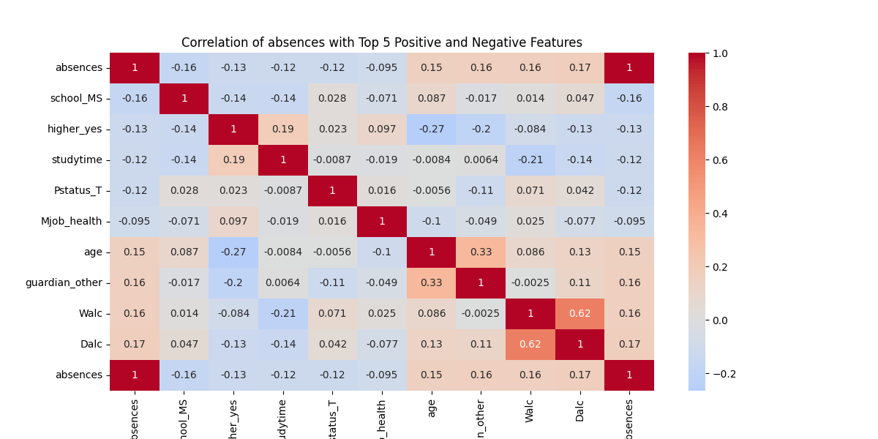

Slide 11
Research Question 1
Significant potential biases detected in crime and student performance datasets are influenced by socio-economic factors such as race, parental education, and income levels etc.
Fairlearn and AIF360 perfect for identifying and mitigating these biases
Crucial to ensure unbiased decision-making and supporting equitable policy interventions.

Slide 12
Bias Detection

Slide 13
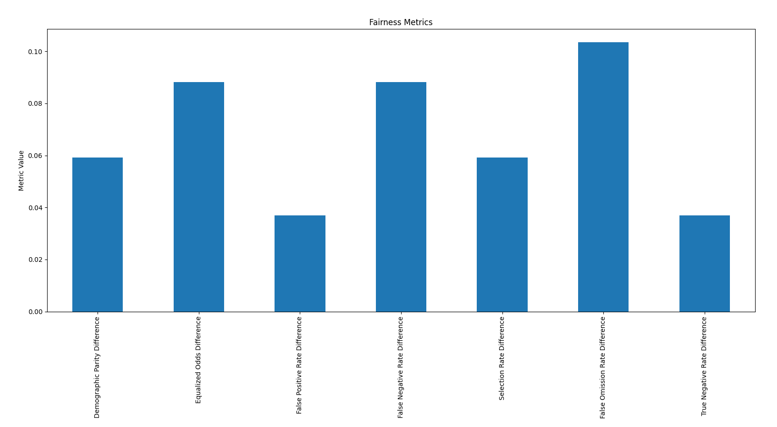
Bias detection - Student

Slide 14
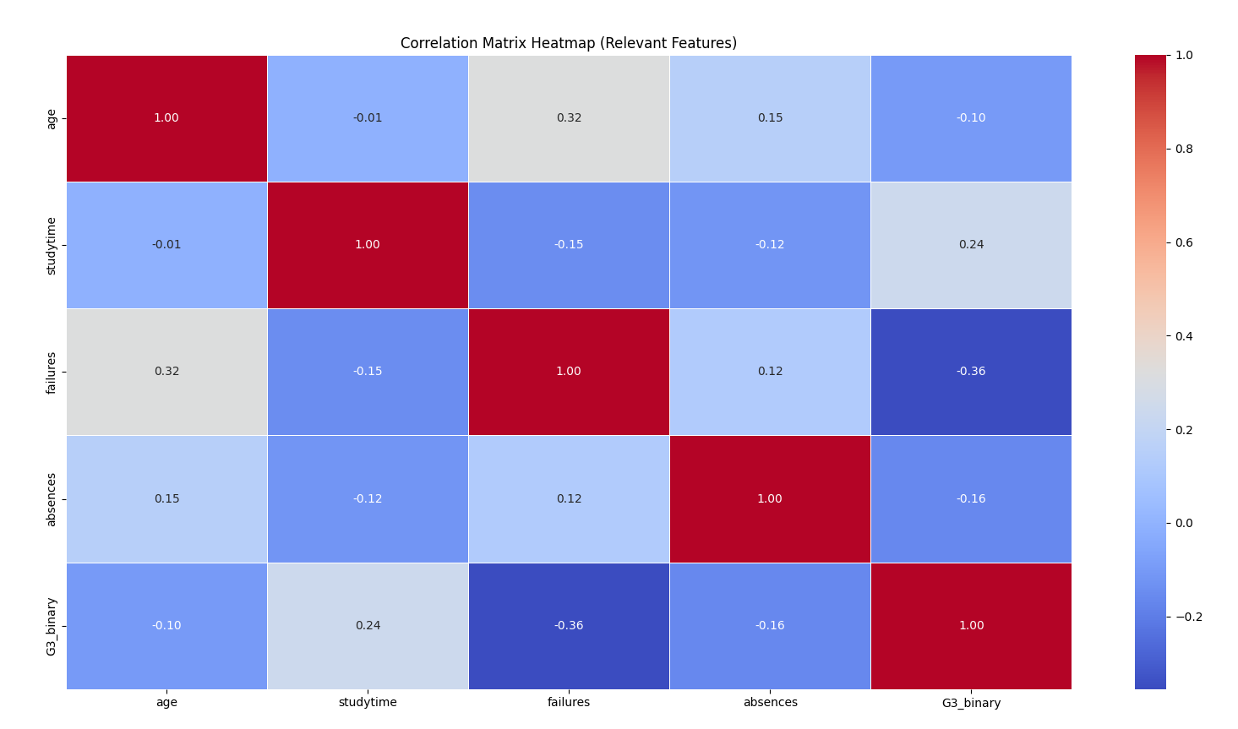
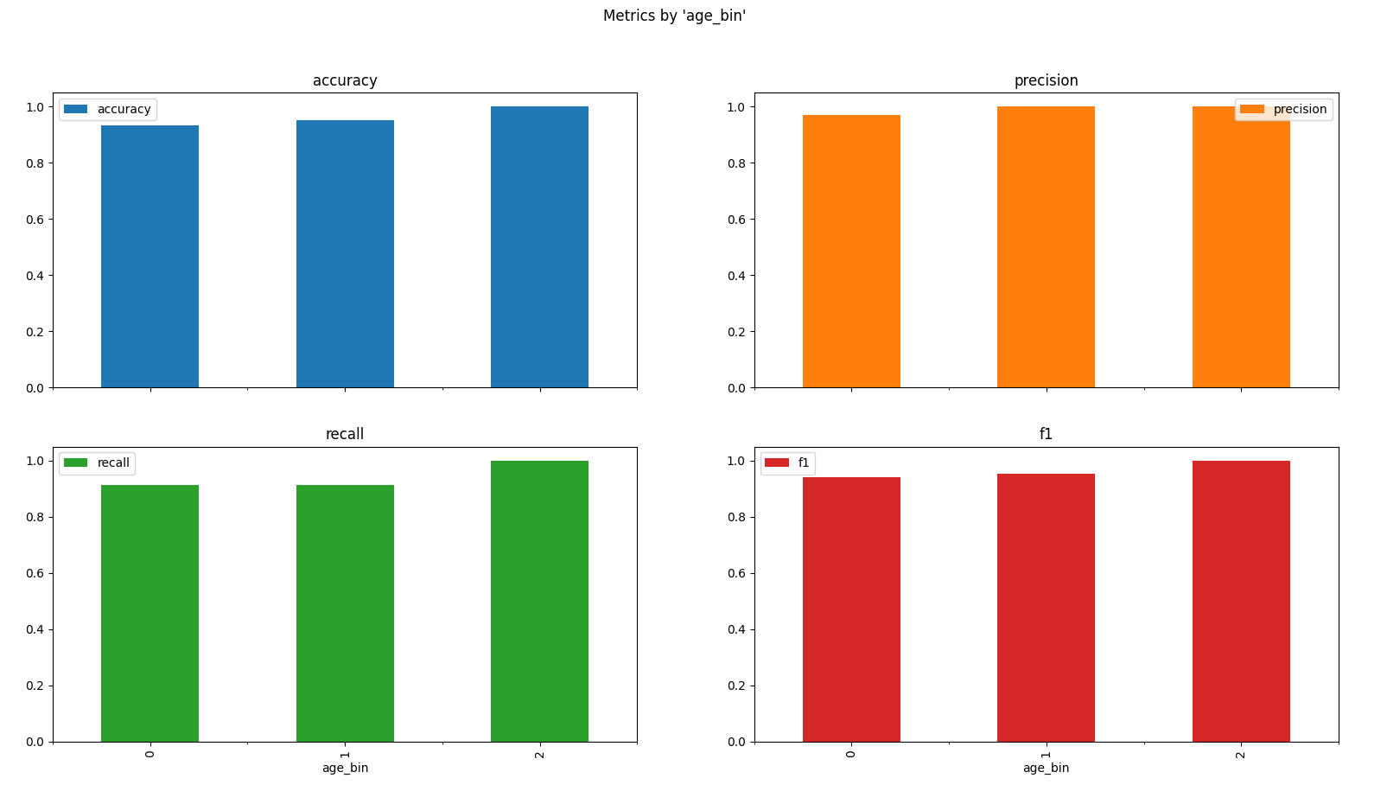
Bias detection - Student

Slide 15
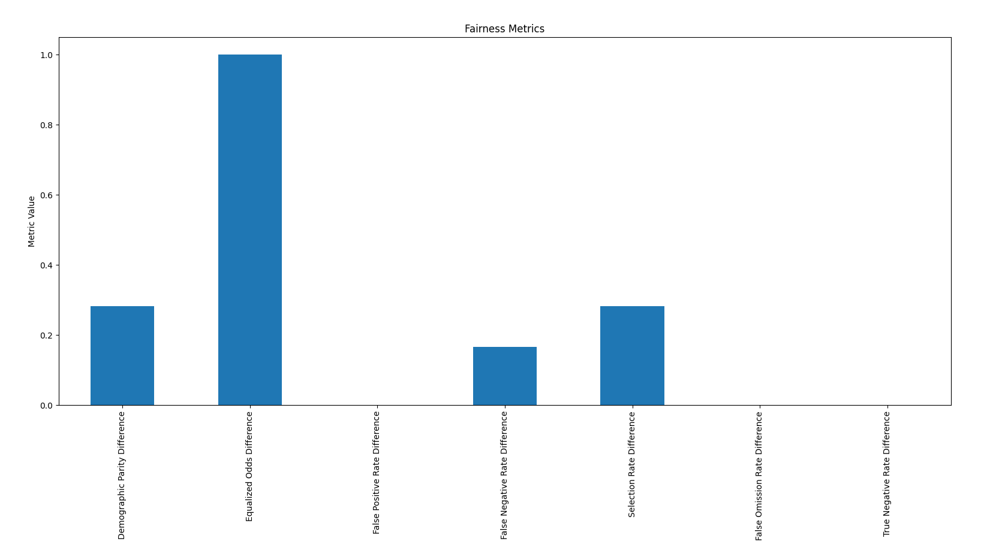
Bias detection - Crime

Slide 16
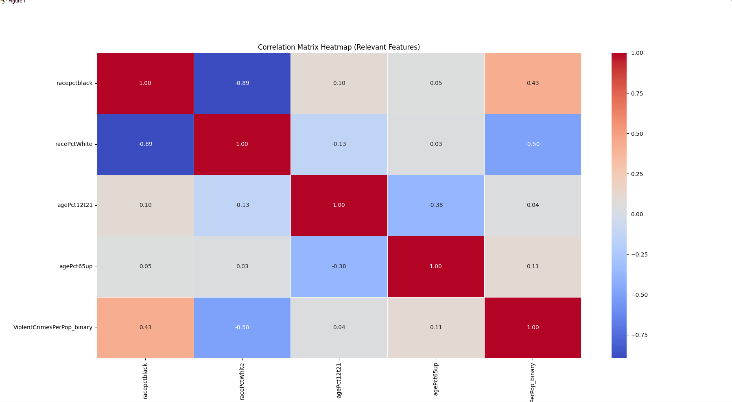
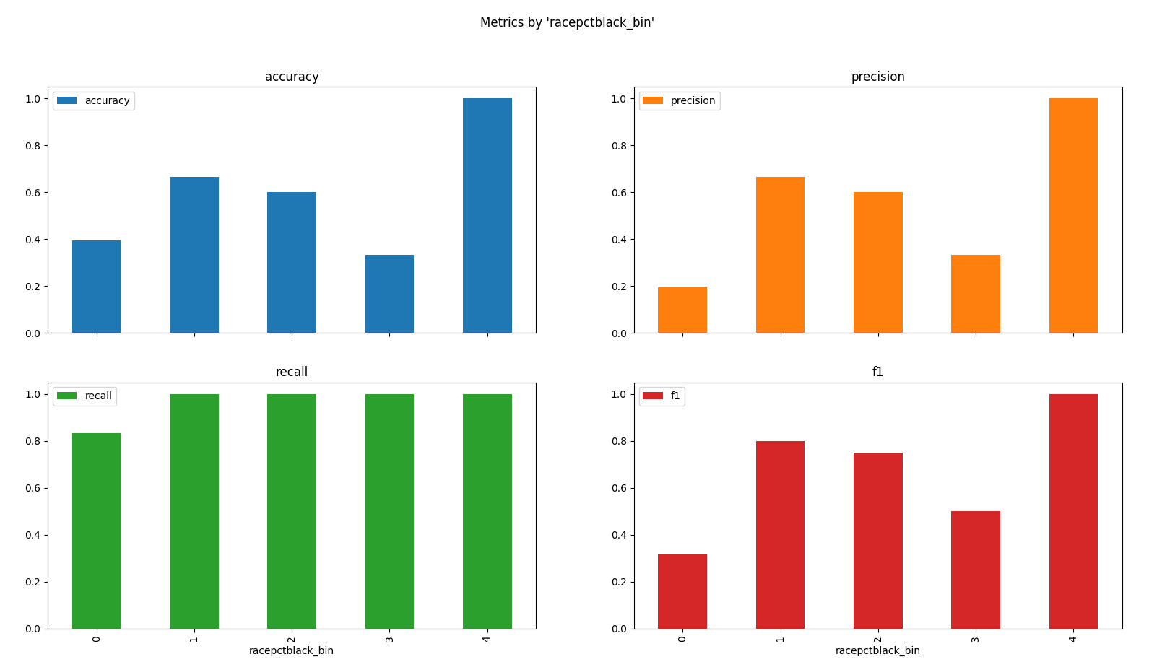
Bias detection - Crime

Slide 17
Bias Mitigation

Slide 18
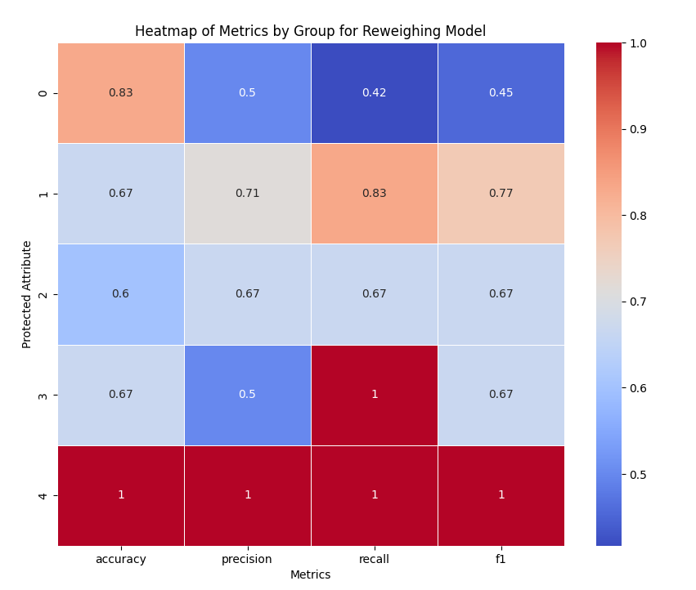
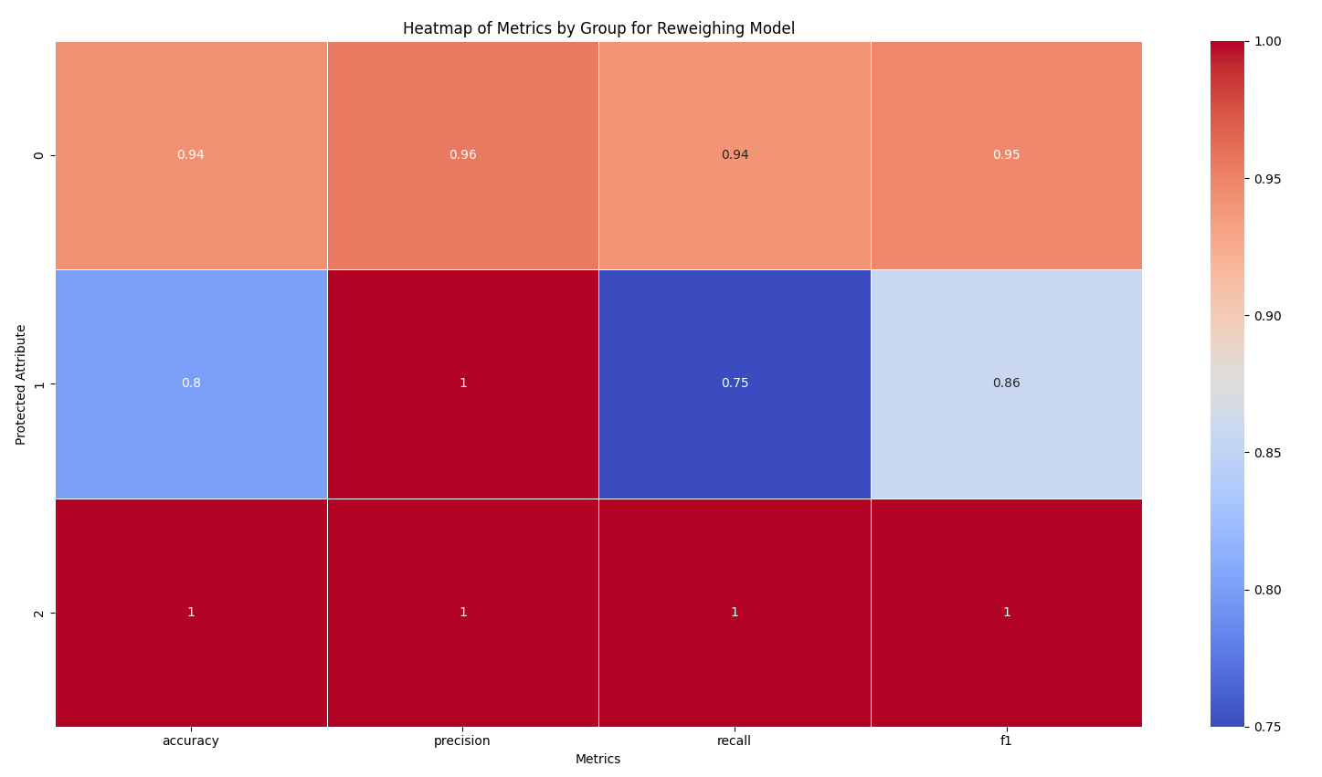
Reweighing Fairlearn
Crime
Student

Slide 19
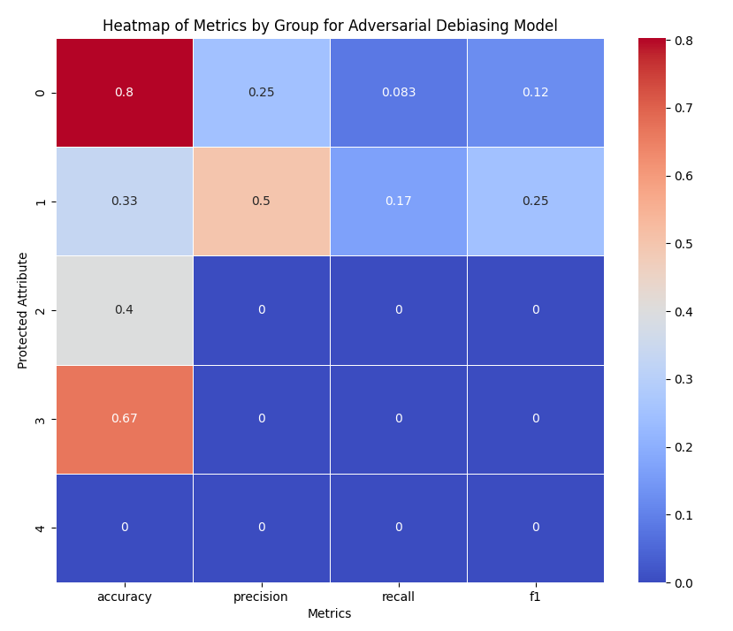
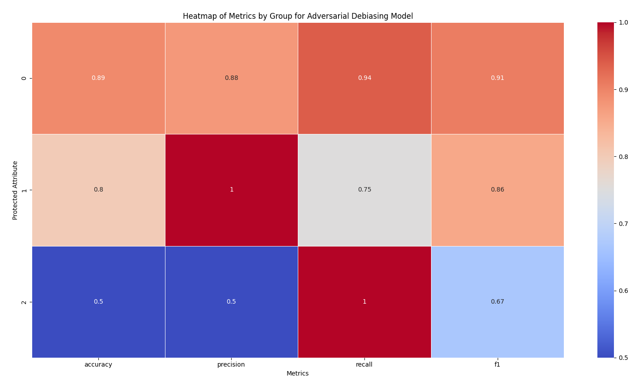
Adversarial Debiasing - Fairlearn
Crime
Student

Slide 20
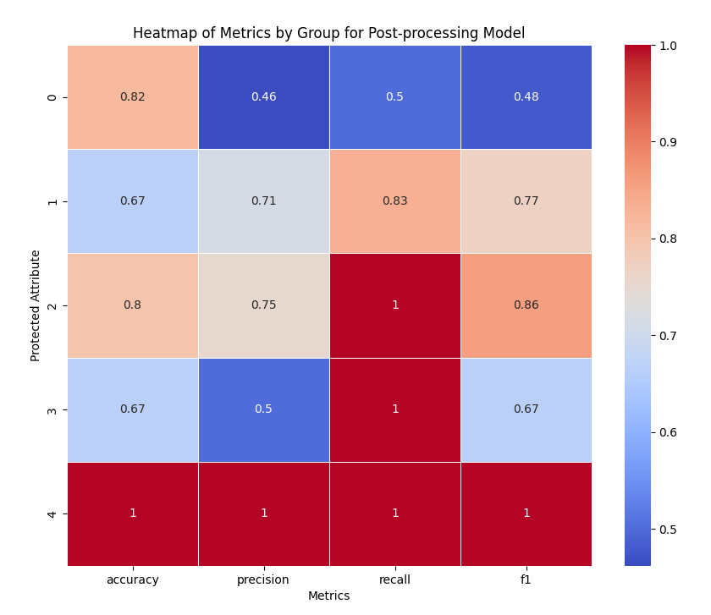
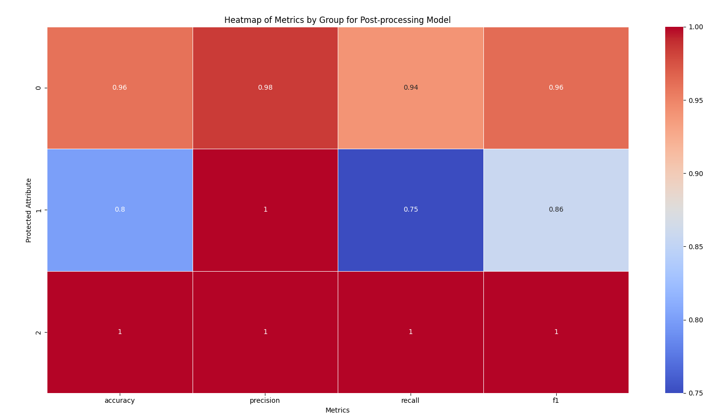
Post-Processing - Fairlearn
Crime
Student

Slide 21
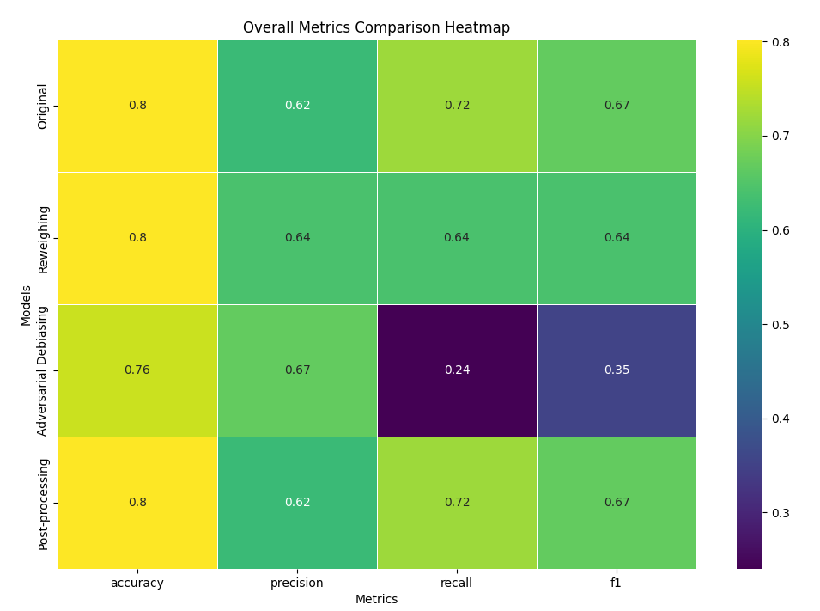
Fairlearn Combined Results - Crime

Slide 22
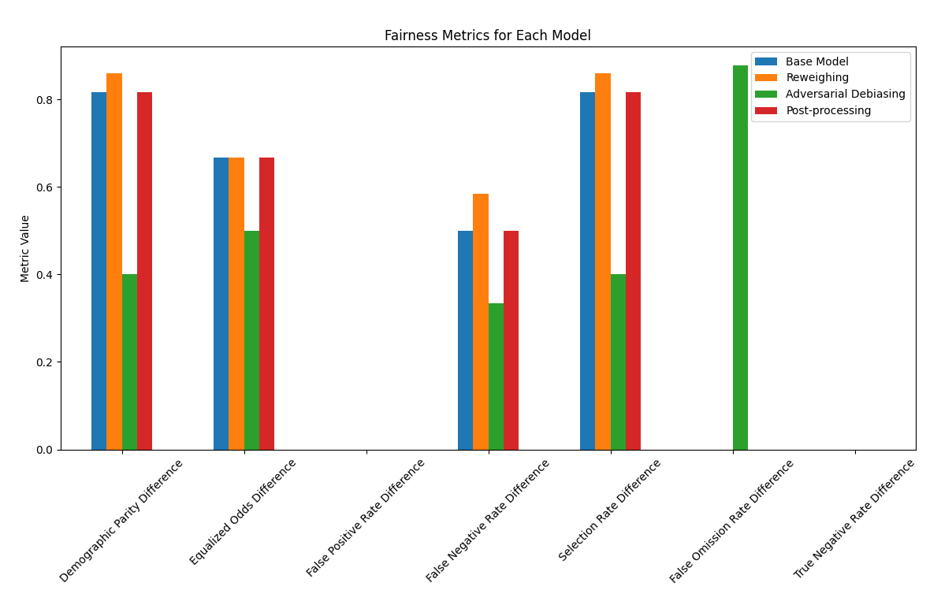
Fairlearn Combined Results - Crime

Slide 23
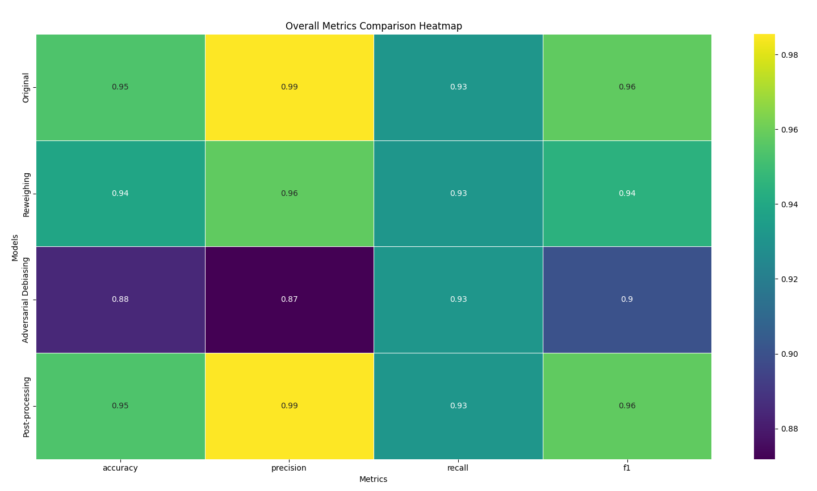
Fairlearn Combined Results - Student

Slide 24
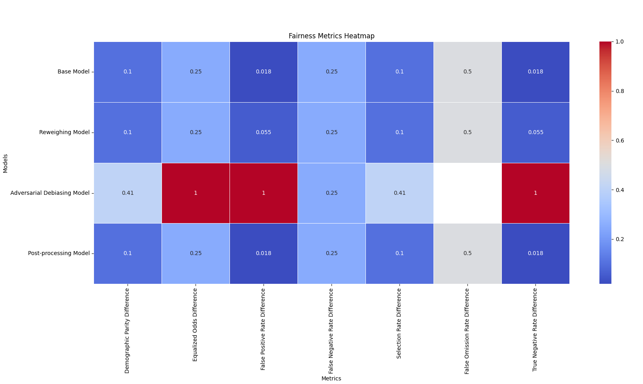
Fairlearn Combined Results - Student

Slide 25
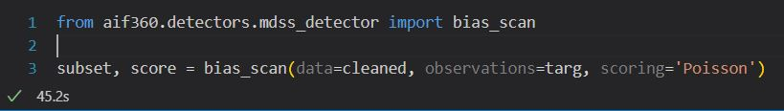
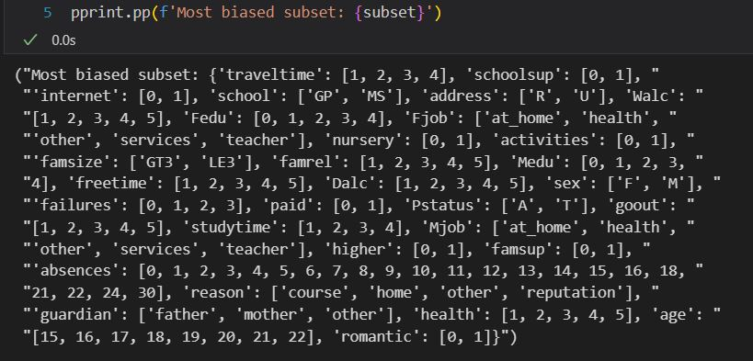
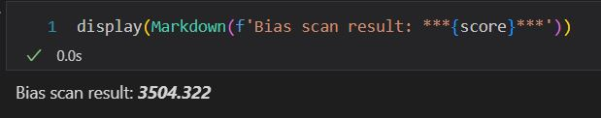
Bias Detection – Aif360

Slide 26
Aif360 Fairness Metrics
Smooth empirical differences in fairness = Probability of favourable and unfavourable outcomes between intersecting group
Disparate Impact = Rate of positive outcomes of unprivileged groups / Rate of positive outcomes of privileged groups
Statistical parity difference = Difference in the ratio of favourable outcomes between monitored groups and reference groups
1. Z. Zhang, D. Wang, B. Yang and J. Yin, "Weighted Multidimensional Scaling Localization Method With Bias Reduction Based on TOA," in IEEE Sensors Journal, vol. 23, no. 17, pp. 19803-19814, 1 Sept.1, 2023, doi: 10.1109/JSEN.2023.3296986. keywords: {Sensors;Location awareness;Estimation;Mathematical models;Noise measurement;Weight measurement;Time measurement;Bias reduction;Cramér–Rao lower bound (CRLB);multidimensional scaling (MDS);sensor-based localization;time-of-arrival (TOA) measurement}
IBM (2024). SED. Available at: https://dataplatform.cloud.ibm.com/docs/content/wsj/model/wos-smooth-empirical-diff.html?context=cpdaas
Truong, B. (2021). Mitigating Bias in AI with AIF360. [online] Medium. Available at: https://towardsdatascience.com/mitigating-bias-in-ai-with-aif360-b4305d1f88a9.
dataplatform.cloud.ibm.com. (n.d.). Statistical parity difference | IBM Cloud Pak for Data as a Service. [online] Available at: https://dataplatform.cloud.ibm.com/docs/content/wsj/model/wos-stat-parity-diff.html?context=cpdaas

Slide 27
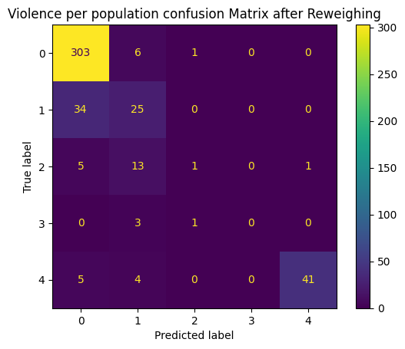
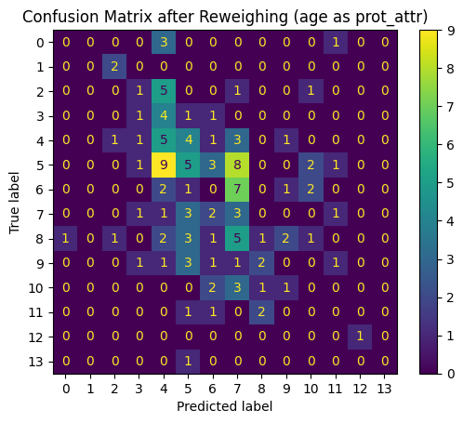
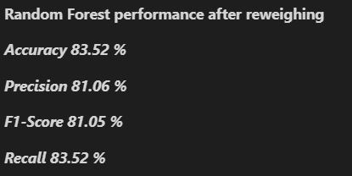
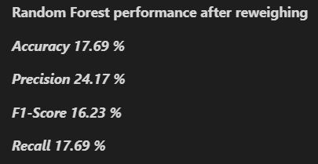
Pre-Processing: Reweighing Aif360
Crime
Student

Slide 28
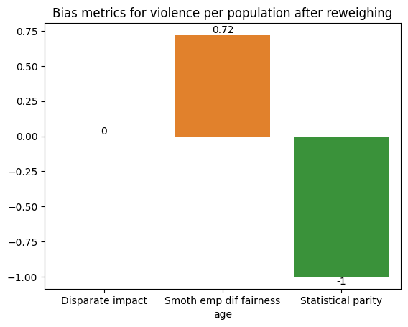
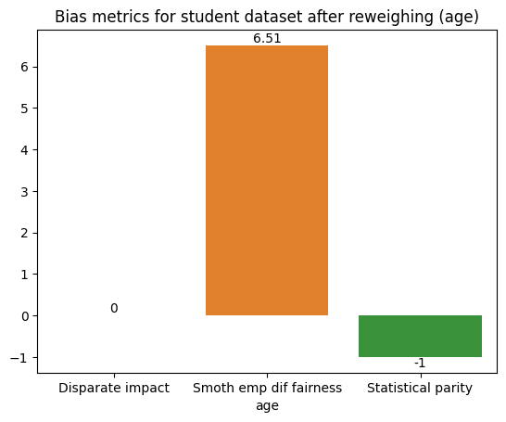
Reweighing Aif360
Crime
Student

Slide 29
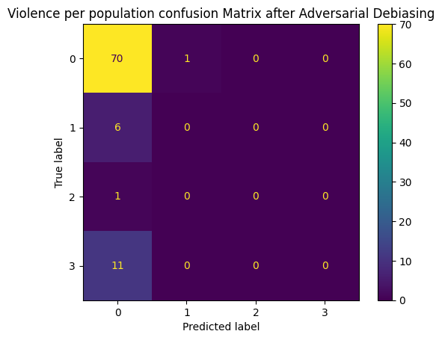
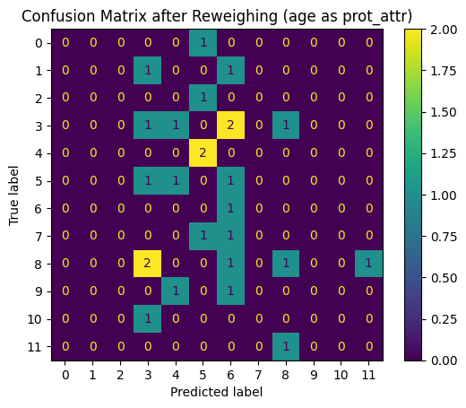
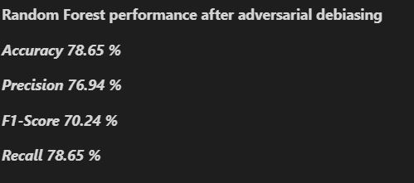
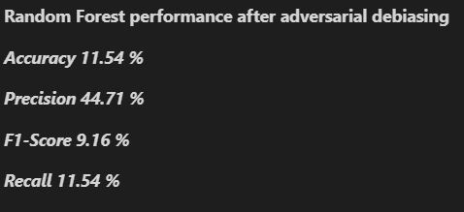
Adversarial Debiasing - Aif360
Crime
Student

Slide 30
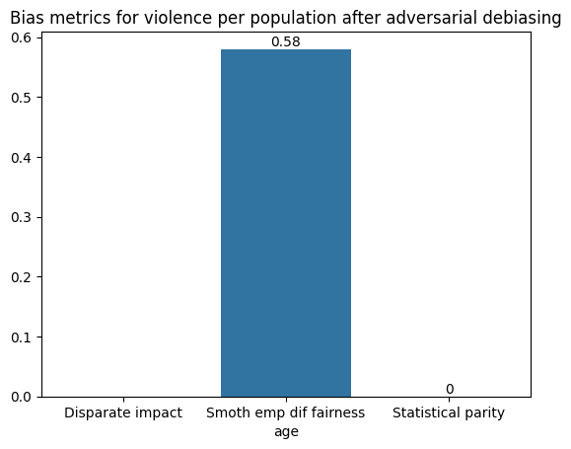
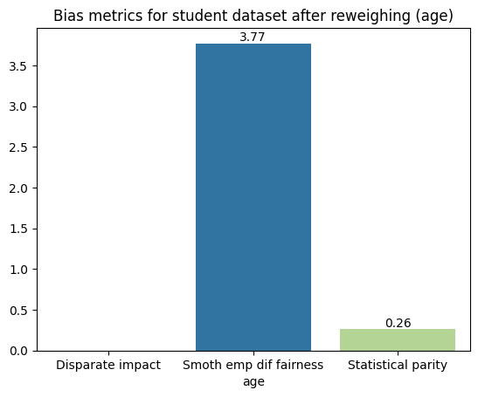

Adversarial Debiasing - Aif360
Crime
Student
nan

Slide 31
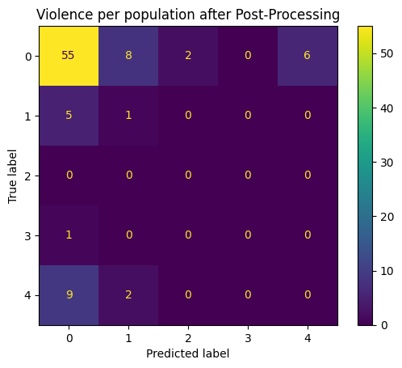
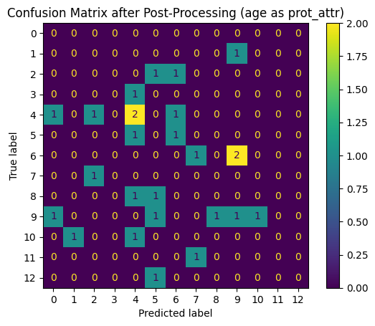
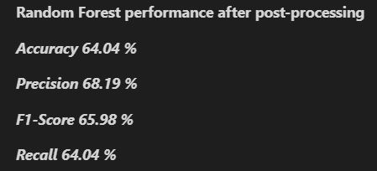
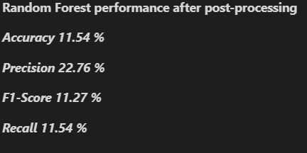
Post-Processing Aif360
Crime
Student

Slide 32
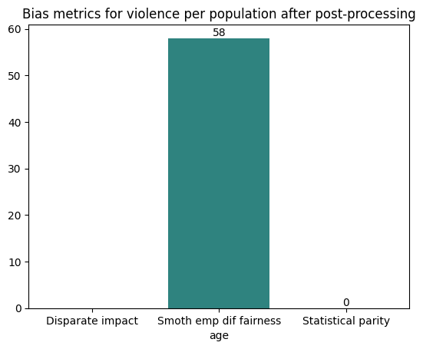
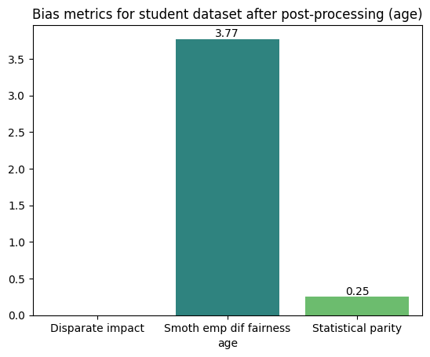
Post-Processing Aif360
Crime
Student
nan

Slide 33
Research Question 2
Fairlearn easier applicable, very well suited for bias detection fast and good results, very well suited for gaining an overview
AIF360 a bit limited for bias detection, harder to set up and get to work propperly, once applied has comparatively more mitigation options
Fairlearn good results in combination with pre and post-processing, in-processing a bit difficult - If training data not adequately represents all sensitive groups, difficult to tweak correctly

Slide 34
Research Question 2
Fairlearn
Aif360
Easier applicable
Very well suited for bias detection
Fast results
Very well suited for gaining an overview
Good results in combination with pre and post-processing
In-Processing a bit difficult
If training data not adequately represents all sensitive groups, difficult to tweak correctly
Limited bias detection
More challenging to set up and get to work propperly
Once set up properly, more mitigation options and metrics
(Api to sklearn)

Slide 35
Research Question 3
Biases in the crime dataset are generally more extreme, particularly related to socio-economic factors such as race, background, and family structure, while the student dataset shows high biases primarily in absence and previous failures (personal behavior).
Effective bias mitigation techniques reduce these biases in both datasets, but this often comes at the cost of decreased accuracy and precision.
These findings highlight the trade-offs involved in addressing systemic inequalities and socio-economic disparities, informing our understanding of the complex interplay between education and crime.

Slide 36
Research Question 3
Biases in the crime dataset are generally more extreme, particularly related to socio-economic factors
Student dataset shows high biases primarily in absence and previous failures (personal behavior).
Bias mitigation techniques reduce these biases in both dataset.
But this often comes at the cost of decreased accuracy and precision.
Highlight trade-offs involved in addressing systemic inequalities and socio-economic disparities, informing our understanding of the complex interplay between education and crime.

Slide 37

Thanks for your Attention

Slide 38
Q & A
Feel free to ask!

Slide 39
Takeaway - Conclusion
Differences – Bias
Performance differences for all mitigations
Fairlearn
Reweighing best
Aif360
AdvesarialDebiasing

Slide 40
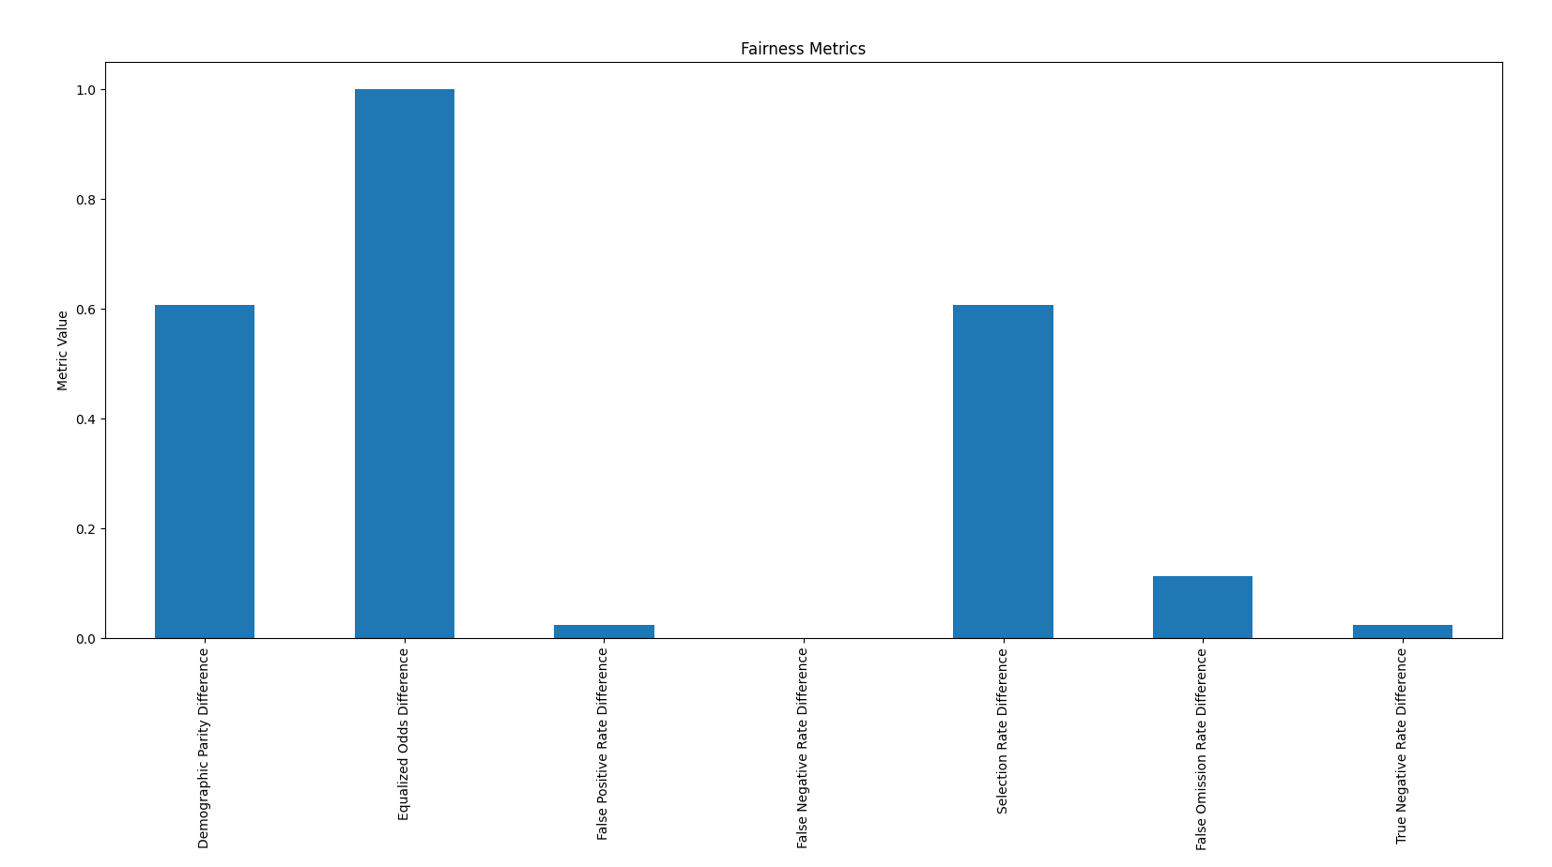
Bias detection results Student Failure

Slide 41

Bias detection results Crime PCTFam2Par

Slide 42

Bias Mitigation Crime Grouped features

Slide 43



Bias Mitigation Crime Grouped features

Slide 44

Bias Mitigation Crime Grouped features

Slide 45

Bias Mitigation Crime indirect correlation

Slide 46

Bias Mitigation Crime indirect correlation

Slide 47

Bias Mitigation Crime indirect correlation

Slide 48

Bias Mitigation Crime indirect correlation

Slide 49



Bias Mitigation Crime indirect correlation

Slide 50

Bias Mitigation Student Grouped features

Slide 51

Bias Mitigation Student Grouped features

Slide 52

Bias Mitigation Crime Iterative Mitigation

Slide 53

Bias Mitigation Crime Iterative Mitigation

Slide 54

Bias Mitigation Crime Raw Data

Slide 55

Bias Mitigation Crime Raw Data

Slide 56

Bias Mitigation Crime Raw Data

Slide 57

Bias Mitigation Crime Raw Data

Slide 58

Bias Mitigation Crime Raw Data

Slide 59

Aif360 - Test of RegressionDataset
Attribute only available in a
StructuredDataset

Slide 60
Bias Detection Metrics Explanation
Demographic Parity Difference:
Measures the difference in selection rates (i.e., the proportion of positive predictions) across different demographic groups. A lower value indicates more equal treatment of different groups by the model.
Equalized Odds Difference:
Compares the true positive rates and false positive rates between demographic groups. A lower value suggests that the model's error rates are more evenly distributed among different groups, indicating fairer performance.
False Positive Rate Difference:
Indicates the difference in the rate of false positives (incorrectly predicting a positive outcome) between groups. A lower value means the model is equally likely to falsely identify a positive case across groups.
False Negative Rate Difference:
Shows the difference in the rate of false negatives (incorrectly predicting a negative outcome) between groups. A lower value suggests that the model misses positive cases at similar rates across groups.
Selection Rate Difference:
Measures the variation in the proportion of positive predictions made by the model across different demographic groups. A smaller value implies a more equitable distribution of positive predictions.
False Omission Rate Difference:
Represents the difference in the rate at which actual positives are misclassified as negatives (false omissions) between groups. A lower value indicates that the model is equally reliable in predicting negatives across groups.
True Negative Rate Difference:
Reflects the difference in the rate of true negatives (correctly predicting a negative outcome) between groups. A lower value means the model is similarly effective at identifying negatives across different demographic groups.

Slide 61
Privileged vs. Unprivileged
Privileged and unprivileged features are used in bias mitigation to identify and address disparities in machine learning models.
Privileged features refer to attributes that correspond to groups receiving favorable treatment or advantages (e.g., higher socioeconomic status, majority racial groups)
Unprivileged features refer to attributes that correspond to disadvantaged or underrepresented groups (e.g., lower socioeconomic status, minority racial groups).
These distinctions help in defining fairness constraints and ensuring that the model does not disproportionately benefit the privileged groups over the unprivileged ones, thereby promoting equity and reducing bias in predictions.

Slide 62
Data Cleaning
Imputation with Mean Values
Dropping Non-Essential Columns
IQR Method for Outlier Removal
Standardization of Numerical Features
Correlation Matrix Visualization

Slide 63
Bias Mitigation - Worse Results
Reweighing:
Reweighing adjusts the weights of different samples to reduce bias, but it can introduce noise or instability in the model's learning process, leading to worse performance.
It can also cause the model to overfit on certain samples with higher weights, reducing its ability to generalize and increasing bias in underrepresented groups.

Slide 64
Bias Mitigation - Worse Results
Adversarial Debiasing:
Adversarial debiasing involves a complex training process with competing objectives, which can sometimes lead to suboptimal solutions if the adversary is not strong enough or if the training is not properly balanced.
The method may inadvertently amplify biases if the adversarial network overpowers the primary model, causing instability and poor bias mitigation performance.

Slide 65
Bias Mitigation - Worse Results
Post-Processing:
Post-processing techniques adjust predictions after the model has been trained, which can sometimes lead to inconsistencies and unintended consequences if the adjustments are too aggressive or not well-calibrated.
These techniques can also fail to address underlying biases in the model's learned representations, resulting in persistent or even amplified biases in the final predictions.

Slide 66
Limitations
One significant challenge was ensuring the quality and consistency of the datasets.
Potential trade-off between reducing bias and maintaining model performance.
Challenges in interpreting the results of certain bias mitigation techniques, particularly when they performed worse than the base model. - Solved with: Additional analyses and considering context-specific factors that might influence these outcomes
Expand the groups of sensitive features even more and perform even more in depth tests

Slide 67
Further metrics
MDSS Score
Detect bias by "minimizing noise" in a multidimensional dataset, essentially detecting where most uneven distributions are located.
SED
The Smoothed empirical differential (SED) metric compares the differential of smoothed probability between groups of features.
1. Z. Zhang, D. Wang, B. Yang and J. Yin, "Weighted Multidimensional Scaling Localization Method With Bias Reduction Based on TOA," in IEEE Sensors Journal, vol. 23, no. 17, pp. 19803-19814, 1 Sept.1, 2023, doi: 10.1109/JSEN.2023.3296986. keywords: {Sensors;Location awareness;Estimation;Mathematical models;Noise measurement;Weight measurement;Time measurement;Bias reduction;Cramér–Rao lower bound (CRLB);multidimensional scaling (MDS);sensor-based localization;time-of-arrival (TOA) measurement}
2. IBM (2024). SED. Available at: https://dataplatform.cloud.ibm.com/docs/content/wsj/model/wos-smooth-empirical-diff.html?context=cpdaas

Slide 68
Mitigation Schlachtplan
Student
Age
Wenn Zeit: Dalc
Crime
PctBlack,
WennZeit: pctWhite, (Fam2par)
Confusion
Accuracy, Recall, Precision, F1
Heatmap
Y achse --> Protected attr
X achse: --> disparate impact, equal opportunity, and statistical parity difference

