Slide 1
Startup Success Prediction
Machine Learning on a 100 000-row Kaggle Dataset
Supervised Classification · Unsupervised Clustering · PCA
Ognjen · Yuzhen PSL M1 — March 2026

Slide 2
Dataset & Problem Statement
100 000 startups · 10 features · no missing values
Class Distribution
· 7 numerical: revenue, traction, funding, experience, team, market, burn
· 3 categorical: investor_type, sector, founder_background
Failure 55.6%
Target: outcome → 3 classes
· Failure 55.6% · Acquisition 42.3% · IPO 2.1%
Two questions:
Acquisition 42.3%
· Part 1: Predict outcome? (Supervised)
· Part 2: Natural groups in data? (Unsupervised)
IPO 2.1%

Slide 3
EDA — Key Finding: Most Features are Noise
Spearman ρ ≈ 0 for 5 / 7 features
Spearman ρ with outcome
· funding, founder_exp, team_size, market_size, burn_rate
revenue_million
ρ=0.45
Only 2 features carry real signal:
product_traction
ρ=0.38
· revenue_million ρ ≈ 0.45 ★
· product_traction_users ρ ≈ 0.38 ★
burn_rate
ρ=0.03
Preprocessing pipeline:
market_size
ρ=0.02
· log1p + StandardScaler (numerical)
· OrdinalEncoder (categorical)
team_size
ρ=0.01
· Pipeline + ColumnTransformer → no data leakage
founder_exp
ρ=0.00
funding_rounds
ρ=0.00
This finding recurs in supervised coefficients and unsupervised cluster profiles.

Slide 4
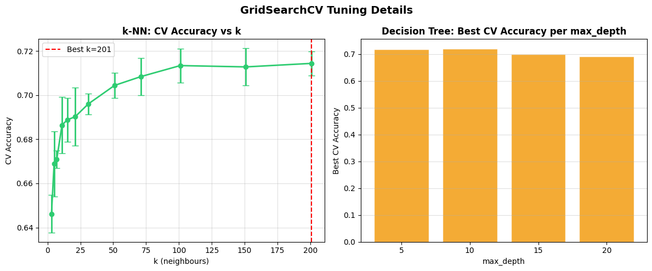
Part 1 — Supervised Learning: Pipeline & Tuning
4 classifiers: k-NN · Decision Tree · LR · LDA
GridSearchCV Tuning Detail
Each wrapped in Pipeline (leakage-free):
· Preprocessor → Classifier
Tuning: 5-fold StratifiedKFold + GridSearchCV
· k-NN: n_neighbors (subsample 5 000 rows)
· DT: max_depth, min_samples_split
· LR: max_iter=1000 (no C tuning)
· LDA: cross_val_score only
Final eval on 20 000-row held-out test set

Slide 5
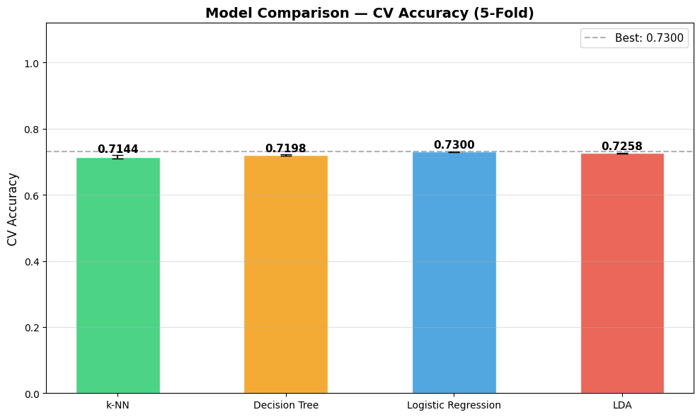
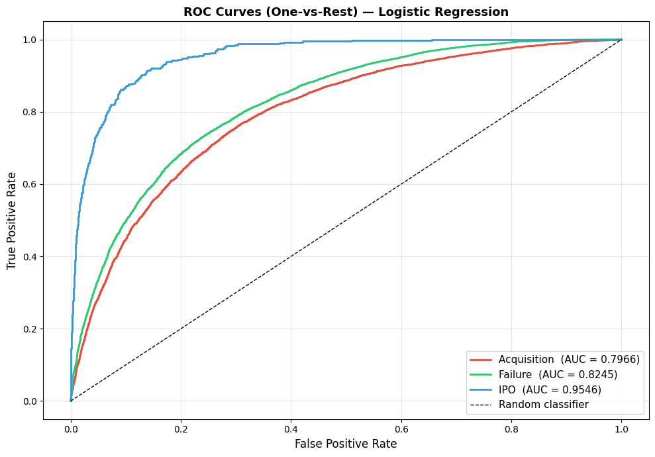
Part 1 — Results: 3-Class Classification
CV Accuracy — All Models
ROC Curves — One-vs-Rest (3-class)
Best model: Logistic Regression | CV 0.730 | Test 0.720
Failure F1=0.775 · Acquisition F1=0.682 · IPO F1≈0.22 → IPO nearly unlearnable
Top LR coefficients: revenue_million & product_traction (consistent with EDA ★)
IPO motivates binary classification →

Slide 6
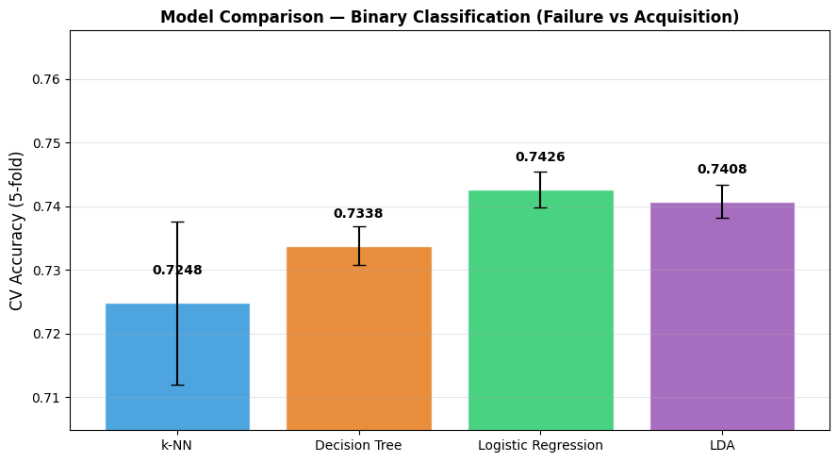
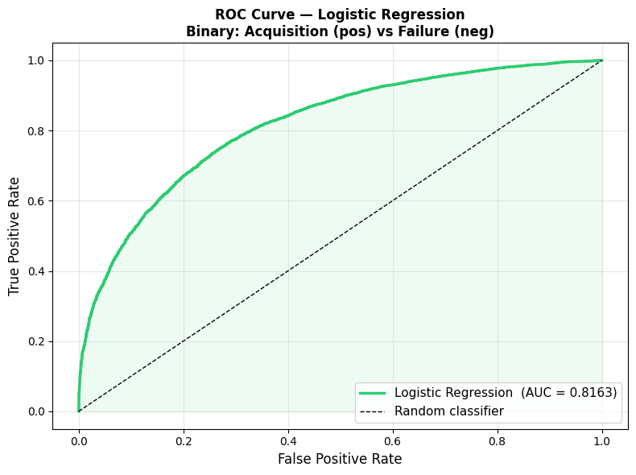
Binary Classification — Removing IPO
CV Accuracy — Binary Models
ROC Curve — Acquisition vs Failure
Macro F1: 0.584 → 0.737 (+26%) · AUC = 0.816 · Best: Logistic Regression
Removing IPO (2.1%) recovers a strong binary classifier — class imbalance was the bottleneck
AUC=0.816: ranks Acquisition above Failure correctly in 81.6% of random pairs

Slide 7
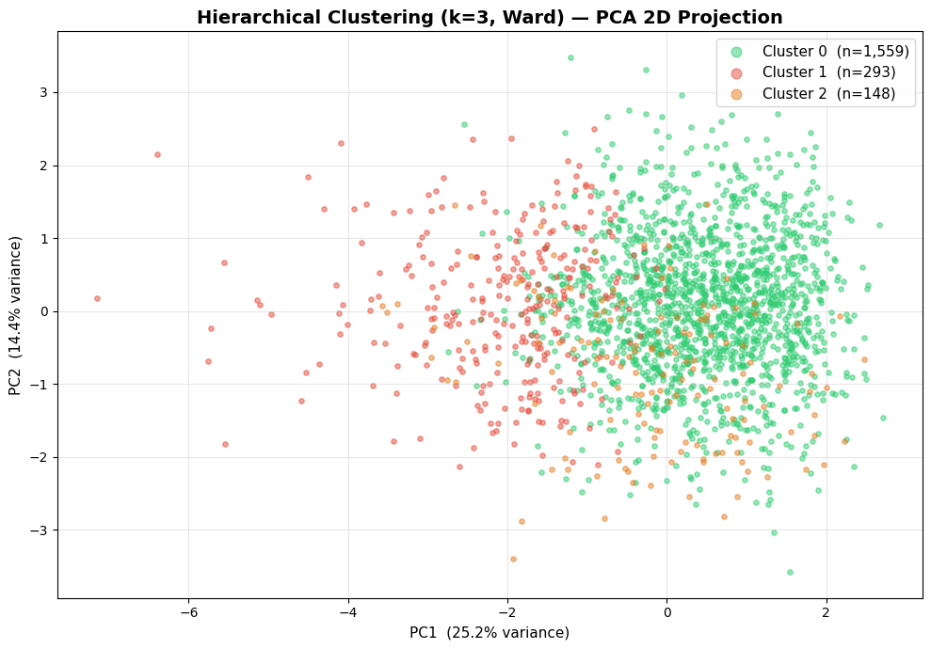
Part 2 — Unsupervised Learning: Approach
Outcome label set aside → cluster on X only
Dendrogram — Ward linkage
· 7 numerical features only (categorical excluded)
· log1p + StandardScaler
PCA → 2D (PC1+PC2 = 39.65% variance)
Two methods cross-validate each other:
· K-Means (k=3) → full 100 000 rows
· Agglomerative/Ward → 5 000-row subsample
· (O(n²) memory — not scalable to 100k)
Dendrogram (right) confirms k=3:
· Large gap before 3rd merge

Slide 8
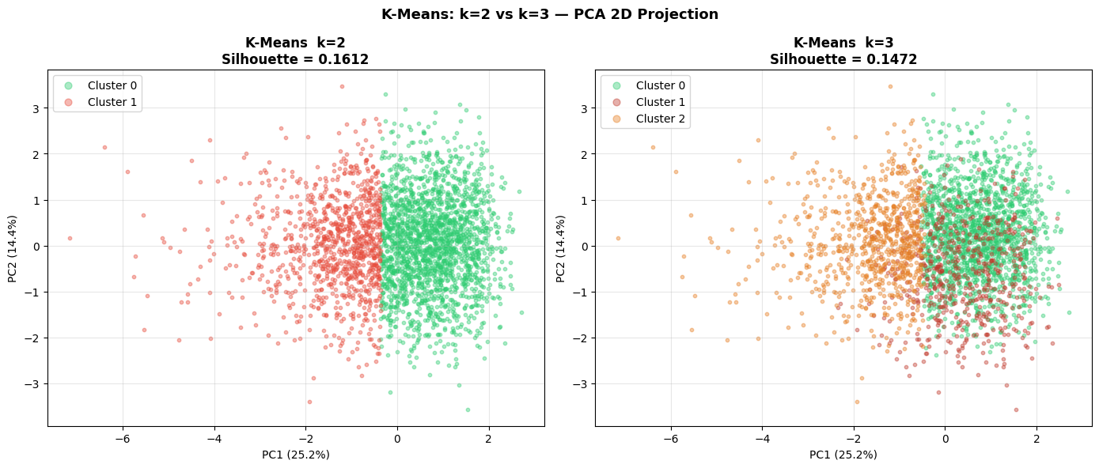
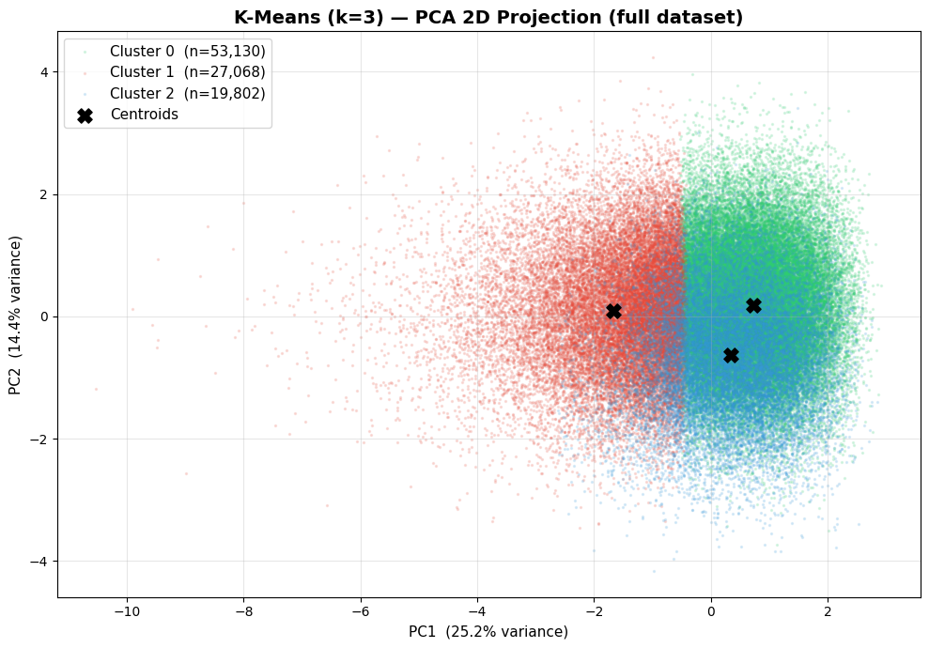
Choosing k = 3 — Visual Comparison
K-Means k=2 vs k=3 (PCA 2D)
Why k = 3 ?
Silhouette scores:
· k=2 → 0.1612
· k=3 → 0.1553 (similar)
Dendrogram gap at k=3
k=3: richer interpretation
· Not just high vs low revenue
· 3 distinct startup profiles
k≥4 no improvement
Low silhouette scores expected — synthetic dataset with 5 near-random features · k=3 chosen for interpretability
K-Means k=3 — full dataset

Slide 9
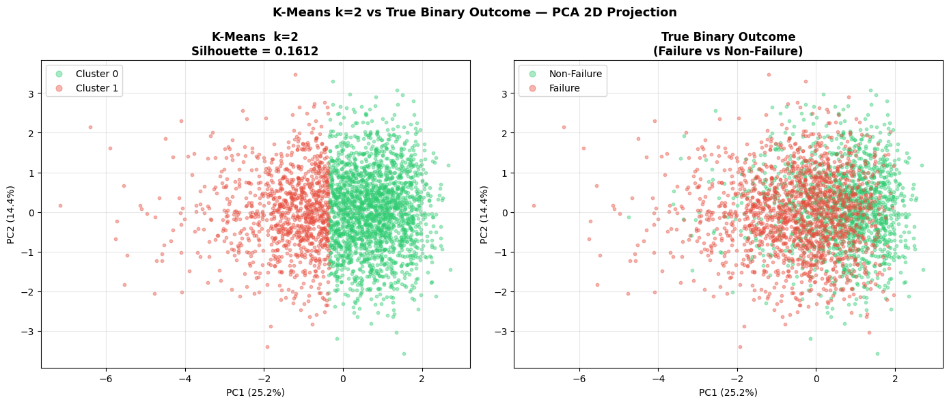
k=2 Sanity Check — Clusters vs True Labels
K-Means k=2 vs True Binary Outcome (Failure / Non-Failure)
Cluster 1 → 79.7% Failure · Cluster 0 → 75.4% Non-Failure
Partial alignment — 2nd dimension of variation inside Non-Failure → justifies k=3

Slide 10
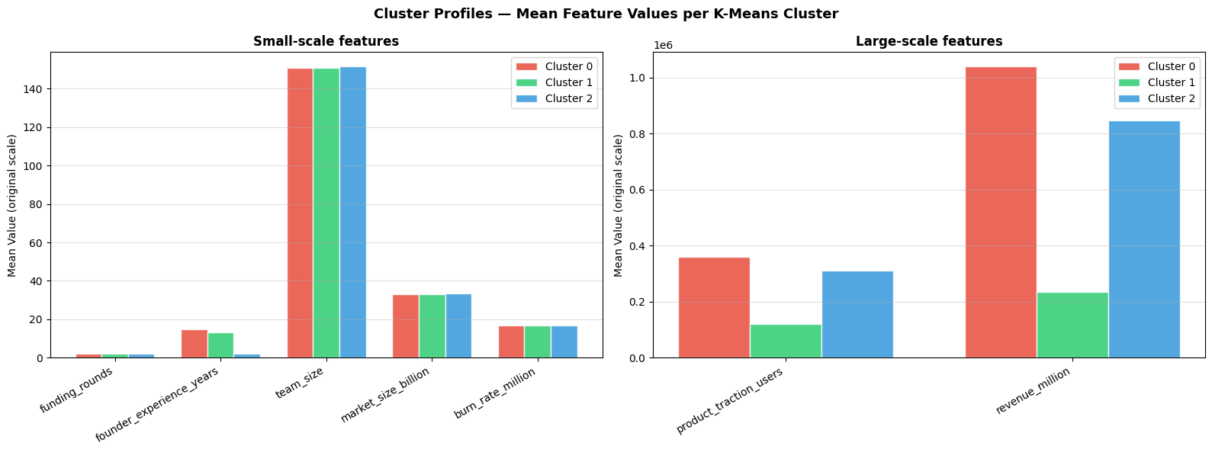
Cluster Profiles — Mean Feature Values
Mean feature values per K-Means cluster (original units)
Left: small-scale features (funding, experience, team, market, burn) Right: large-scale (product_traction, revenue)
Clusters differ almost exclusively on revenue & traction — the 2 features with real signal ★

Slide 11
Cluster Archetypes
Each cluster interpreted on its own terms — independent of outcome labels
Cluster
Revenue
Traction
team_size
Profile
0 🟢
High ~1 040k
High ~360k
~148
High-revenue, established companies
1 🔴
Low ~120k
Low ~115k
~148
Low-traction, struggling startups
2 🔵
Mid ~850k
Mid ~305k
~148
Mid-revenue, early-stage startups
All clusters have similar team_size & founder_experience → revenue & traction are the true discriminators

Slide 12
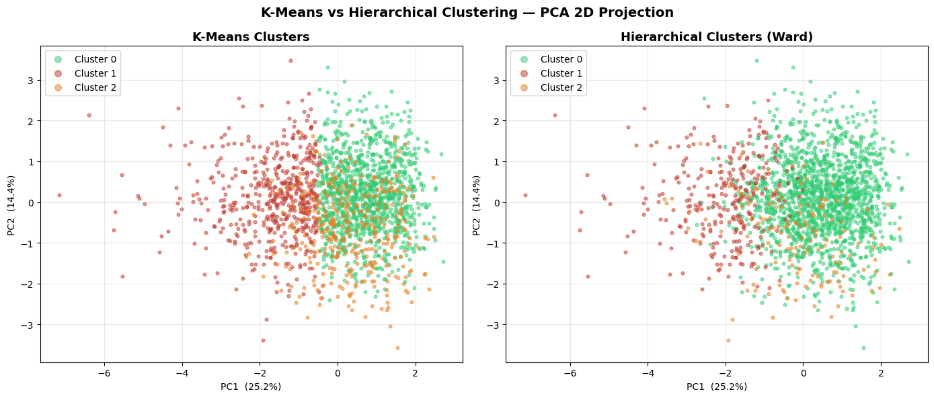
Validation — K-Means vs Hierarchical Clustering
Same 3 groups found independently by both methods → structure is real
K-Means (left): full 100k rows — provides centroids for profiling Hierarchical/Ward (right): 5k subsample — independent cross-check

Slide 13
Conclusion
✅ Supervised: Logistic Regression — Test accuracy 72%
Both analyses converge:
· Binary (no IPO): macro F1 0.737 · AUC 0.816
revenue_million & product_traction_users
✅ Unsupervised: 3 coherent startup archetypes
· Confirmed by K-Means & Ward independently
⚠️ Fundamental limit: dataset is synthetic
are the only 2 features that predict startup outcome and define cluster structure
· 5 / 7 features are near-random noise
🔭 Extensions:
· Random Forest, XGBoost · UMAP
EDA ★ → Supervised coefficients ★ → Cluster profiles ★ → All point to same conclusion ✓

