Slide 1
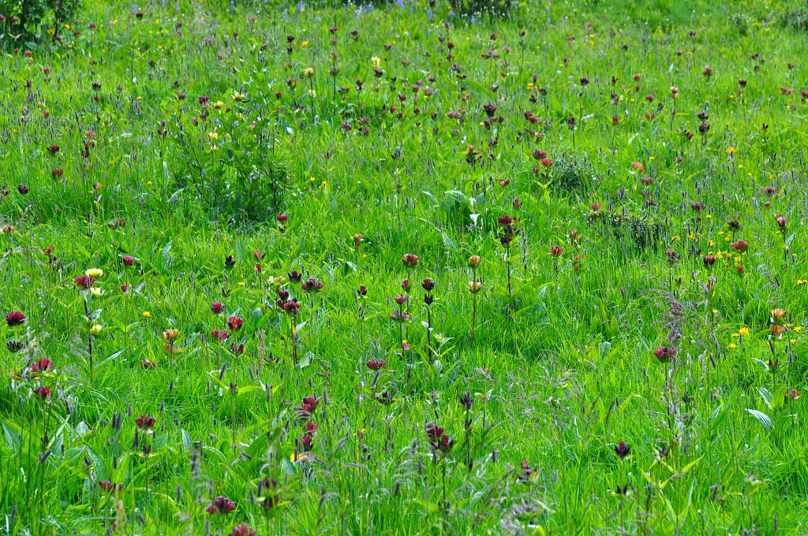
Dynamic vegetation modelling for the assessment of key ecosystem services in mountain grasslands
Committee 1 – 8th October 2015
Viguier Clément
Supervised by Reineking Björn

Slide 2
Committee schedule
30min presentation
1h discussion
Committee and me
Committee and Björn
Synthesis
Lunch

Slide 3
Dynamic vegetation modelling for the assessment of key ecosystem services in mountain grasslands

Slide 4
Ecosystem services assessment

Slide 5
Intra-specific variability
Importance of intra-specific variability in community response
Sources of intra-specific variability
Genetic
Epigenetic
Phenotypic
plasticity

Slide 6
Questions
Role of phenotypic plasticity as important driver of instra-specific variability on:
species specific responses to altitude gradient;
diversity and productivity: impact of grazing and climate change;
community stability in climate change context.

Slide 7
Grass representation
Strategy space:
seed mass,
maturity,
geometry,
shoot:root,
active:structural
Fast-slow differentiation

Slide 8
Functional equilibrium
Co-limitation of shoot and root activities
→ Lot of allocation schemes possible.

Slide 9
« Reactivity » and « memory »
How to balance species genetic informations and individual experience ?
Plastic response depends on:
plasticity capacity = reactivity and productivity,
conditions perception = local conditions + memory + reactivity

Slide 10
Model processes

Slide 11
Source of intra-specific vairaibility: the role of plasticity and local environment
Different species responses in sign and amplitude along the altitude gradient.
Two hypotheses to link phenotypic plasticity and contrasting responses:

Slide 12
Source of intra-specific vairaibility: the role of plasticity and local environment
Same seed rain on multiple site along an altitude gradient
Turn-over = importance of local adaptation
Homogeneity = mechanisms lacking
Similar = supports role of phenotypic plasticity
Role of plasticity capacity ?
Role of conditions perception ?

Slide 13
How does phenotypic plasticity impact on coexistence and productivity mechanisms ?
Diversity:

Slide 14
How does phenotypic plasticity impact on coexistence and productivity mechanisms ?
Same seed rain with and without plastiicty
Plasticity effect?
Niche partitionning
Niche overlapping
Plasticity versus non plasticity?
Range of strategies (niches) and functionnal diversity.

Slide 15
How does phenotypic plasticity impact on coexistence and productivity mechanisms ?
Productivity:
How does grazing and climate change impact productivity diversity relationship?

Slide 16
Roel of phenotypic plasticit in community resistance to invasion in climate change context ?
Phenotypic plasticity promotes niche filling and so resistance to invasion
Phenotypic plasticity increase chances of emergence of invasive species in a niche gap
Same seed rain with and without plastiicty,
Folowing different climate change scenarios.
The relationship between plasticity capacity and climate change forcing can also be explored.

Slide 17
Schedule

Slide 18
Training
English (writing)
Development of applications for numerical simulations
Data analysis

Slide 19
Thank you for your attention ! Questions ?

