Slide 1
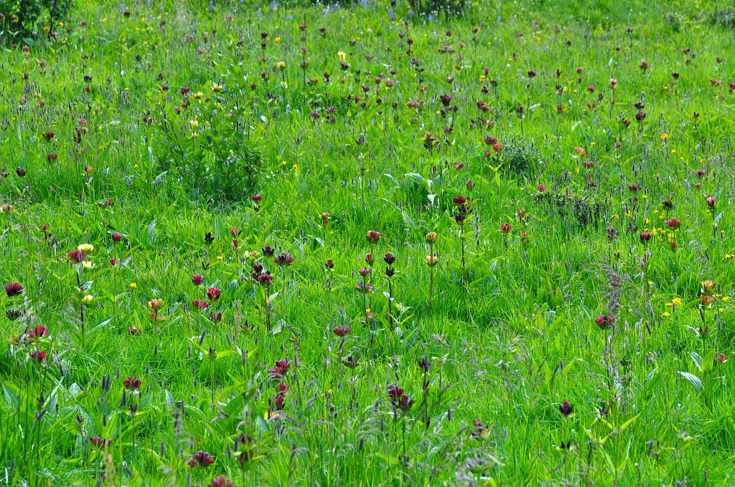
Dynamic vegetation modelling for the assessment of key ecosystem services in mountain grasslands
Committee 1 – 8th October 2015
Viguier Clément
Supervised by Reineking Björn

Slide 2
Committee schedule
30min presentation
1h discussion
Committee and me
Committee and Björn
Synthesis
Lunch

Slide 3
Dynamic vegetation modelling for the assessment of key ecosystem services in mountain grasslands

Slide 4
Ecosystem services assessment

Slide 5
Intra-specific variability
Imporatance of intra-specific variability in community response
Sources of intra-specific variability

Slide 6
Questions
Role of phenotypic plasticity as important driver of instra-specific variability on:
species specific responses to altitude gradient;
diversity and productivity: impact of grazing and climate change;
community stability in climate change context.

Slide 7
Grass representation
Trade-off
Compartments
Plasticity
…

Slide 8
Reactivity and memory
Why?
How?

Slide 9
Model processes
sdf

Slide 10
Source of intra-specific vairaibility: the role of plasticity and local environment
Pattern to explain
Hypotheses H1 and H1’
Others (PP is not that important)

Slide 11
Source of intra-specific vairaibility: the role of plasticity and local environment
Simulations
Expectations

Slide 12
How does phenotypic plasticity impact coexistence mechanisms ?
Hypotheses

Slide 13
How does phenotypic plasticity impact coexistence mechanisms ?
Expectations diversity and productivity … 2 slides ?

Slide 14
Roel of phenotypic plasticity in community resistance to invasion ?
Climate changes,

Slide 15
Schedule

Slide 16
Training
English (writing)
Development of applications for numerical simulations
Data analysis

