Slide 1

Workshop
Complete Jira Workshop
By Deepak Rai

Slide 2

What you get from this session?
1. Atlassian Jira & Evolution ?
2. Jira Architecture
3. Issues, Versions, Components, Creating Projects
4. Agile Boards & Configuration (Scrum/Kanban)
5. Search & JQL
6. Jira Boards Customization
7. Jira Project Customization
8. Detailed Scrum/Kanban Setup
9. Roadmap, Dashboard & Reports
10. Jira Administration

Slide 3
Topic Details
Issues
Versions
Components
Creating Projects
Scrum and Kanban
Running Sprints, backlog and work estimation
Agile Boards and their Configuration
Creating Boards
Difference between boards
Configuring the boards(Columns, swimlanes, quick filters, card colours, card layout, issue detail view and general setting)
Creating, sharing and Configuring Dashboards
Adding Gadgets to Dashboards and configuring them.
Creating, sharing and configuring Filters
Subscriptions
Searching in Jira(Issue Navigator, Basic Search and Advanced Search)
JQL( Theory and sample JQL's)
Jira administration

Slide 4

Trainer Intro
Working Professional having 10+ Years of experience in Software Industry.
Worked different region in world like UK, France, China, Poland etc.
Expertise: Software Testing, AWS, RPA Tools, Jira, Rally, Python, HTML, CSS, IPTV/STB

Slide 5

Expectations
What’s your expectation from this Training?

Slide 6
What is Jira
Jira Software is part of a product family that helps teams of all kinds to manage their jobs. Jira was originally designed as a tracker for problems and bugs.
Jira was originally designed as a tracker for problems and bugs in Australia.
Today, however, Jira has become a powerful work management tool for all types of applications, from requirements and test case management to agile software.
JIRA name is a truncation of Gojira (the name for Godzilla in Japanese) that can be a reference to Bugzilla (a bug tracker and testing tool of Mozilla).
It is a platform-independent tool; that can be worked with different types of operating systems.
It is written in the JAVA programming language.
Jira has evolved into a powerful work management tool for all kinds of use cases, from requirements and test case management to agile software development.

Slide 7
Jira uses
Jira Used For:
Jira for requirements & test case management.
Jira for agile teams
Jira for project management teams
Jira for software development teams
Jira Software for DevOps teams
Jira for product management teams
Jira for task management
Jira for bug tracking

Slide 8
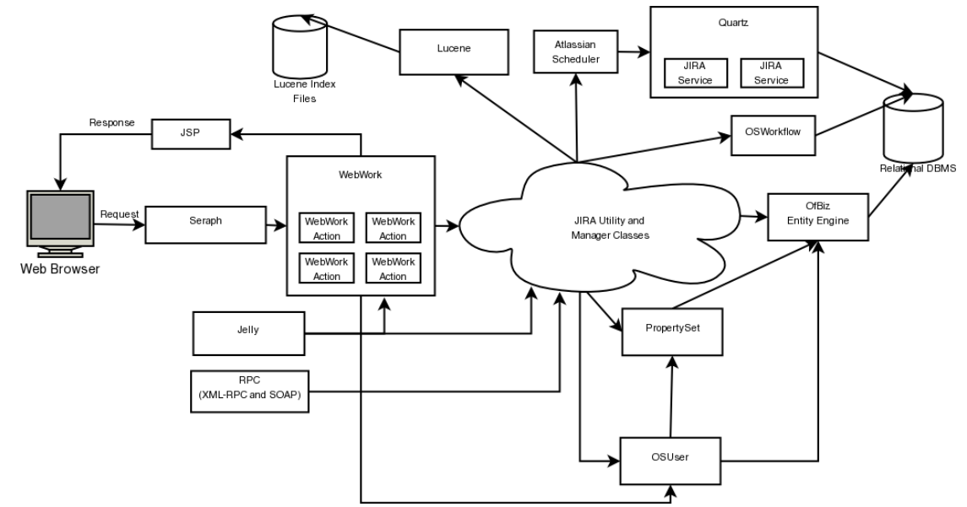
Jira Architecture

Slide 9
DEMO

Slide 10
Thank You!
Deepak Rai

