Slide 1
Introduction to the Kubernetes

Slide 2
agenda
Understanding the need of Kubernetes
Understanding Kubernetes architecture
Understanding Kubernetes Concepts
Kubernetes and Microservices
Understanding Kubernetes master and its component: - Kube-apiserver
- etcd
- kube-scheduler
- kube-controller-manager
Understanding Kubernetes nodes and its component:
- kubelet
- kube-proxy
- container runtime
Understanding Kubernetes Addons
- DNS - Web UI (Dashboard)
- Container Resource Monitoring
- Cluster-level logging

Slide 3
Understanding Kubernetes Terminology
Kubernetes pod overview
Kubernetes replication controller overview
Kubernetes deployment Overview
Kubernetes service overview
Understanding Kubernetes running environment options
Working with first pods
Working with first replication controller
Working with first deployment
Working with first services
Introduction and basic working of helm.

Slide 4
What is container orchestration?
Container orchestration automates the deployment, management, scaling, and networking of containers.
Enterprises that need to deploy and manage hundreds or thousands of Linux® containers and hosts can benefit from container
orchestration.
Container orchestration can be used in any environment where you use containers.
It can help you to deploy the same application across different environments without needing to redesign it.
And microservices in containers make it easier to orchestrate services, including storage, networking, and security.
Container orchestration

Slide 5
What is container orchestration used for?
Use container orchestration to automate and manage tasks such as:
Provisioning and deployment
Configuration and scheduling
Resource allocation
Container availability
Scaling or removing containers based on balancing workloads across your infrastructure
Load balancing and traffic routing
Monitoring container health
Configuring applications based on the container in which they will run
Keeping interactions between containers secure

Slide 6
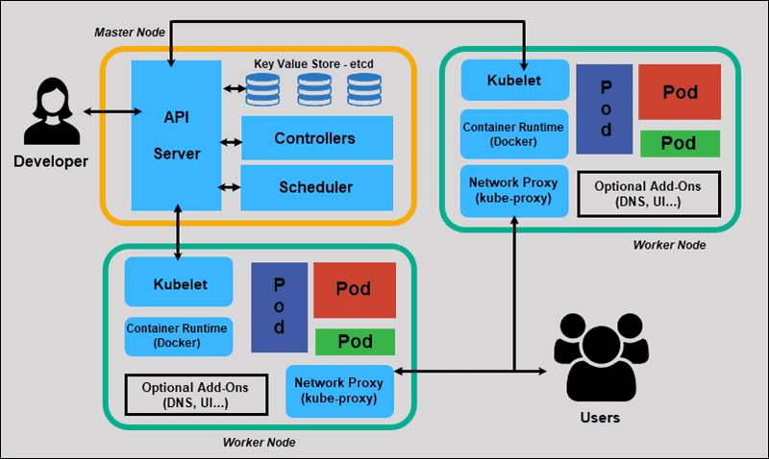
Understanding Kubernetes architecture

Slide 7
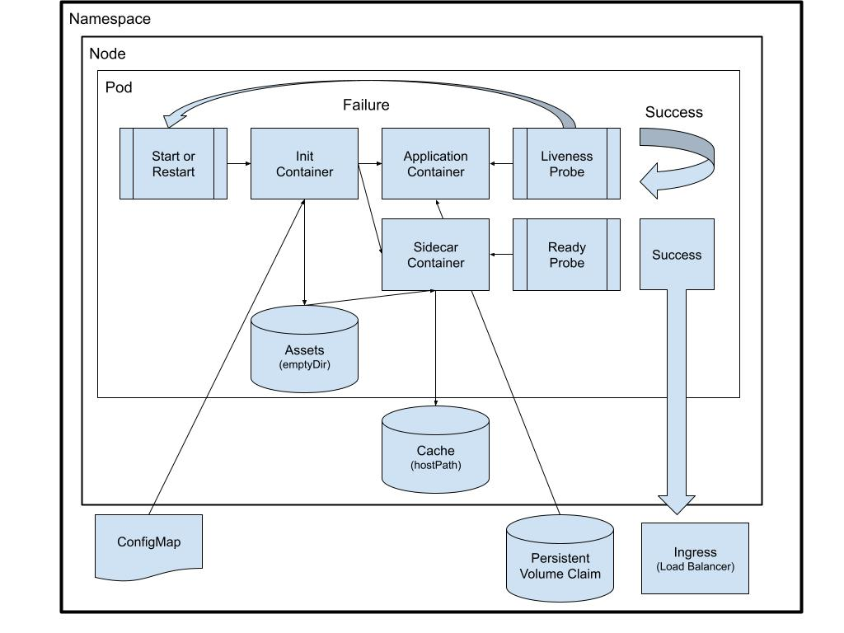
Understanding Kubernetes Concepts
kubernetes concepts

Slide 8
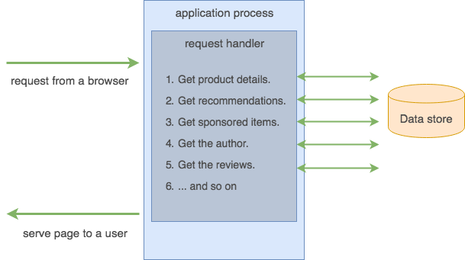
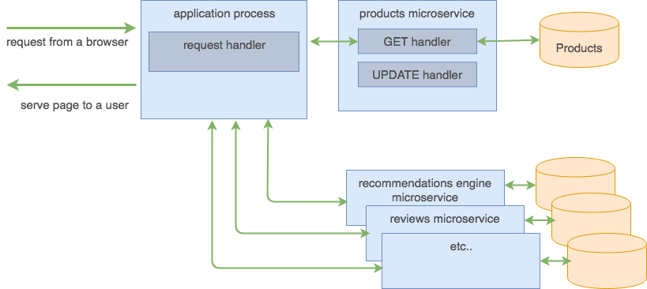
Kubernetes and Microservices
Fundamentally, a microservice is just a computer program which runs on a server or a virtual computing instance
and responds to network requests.
How is this different from a typical Rails/Django/Node.js application? It is not different at all.
In fact, you may discover that you already have a dozen of microservices deployed at your organization.
There are not any new magical technologies that qualify your application to be called a microservice.
A microservice is not defined by how it is built but by how it fits into the broader system or solution.
microservices

Slide 9
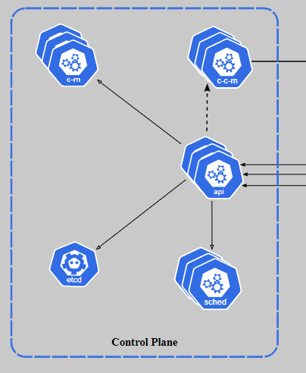
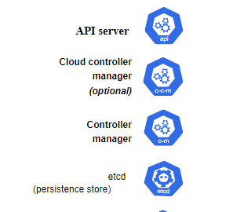

Understanding Kubernetes master and its component:
Control plane component

Slide 10
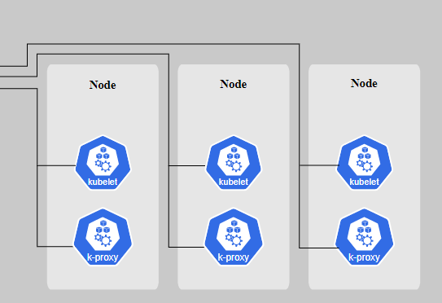
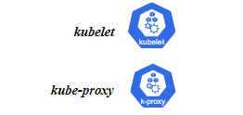
Understanding Kubernetes nodes and its component:
Node Components

Slide 11
Understanding Kubernetes Addons
DNS
While the other addons are not strictly required, all Kubernetes clusters should have cluster DNS, as many examples rely on it.
Cluster DNS is a DNS server, in addition to the other DNS server(s) in your environment, which serves DNS records for Kubernetes services.
Containers started by Kubernetes automatically include this DNS server in their DNS searches.
Dns
Web UI (Dashboard)
Dashboard is a general purpose, web-based UI for Kubernetes clusters. It allows users to manage and troubleshoot applications running in the cluster, as well as the cluster itself.
Dashboard
Addons

Slide 12
Understanding Kubernetes Addons
Container Resource Monitoring
Container Resource Monitoring records generic time-series metrics about containers in a central database, and provides a UI for browsing that data.
Cluster-level Logging
A cluster-level logging mechanism is responsible for saving container logs to a central log store with search/browsing interface

Slide 13
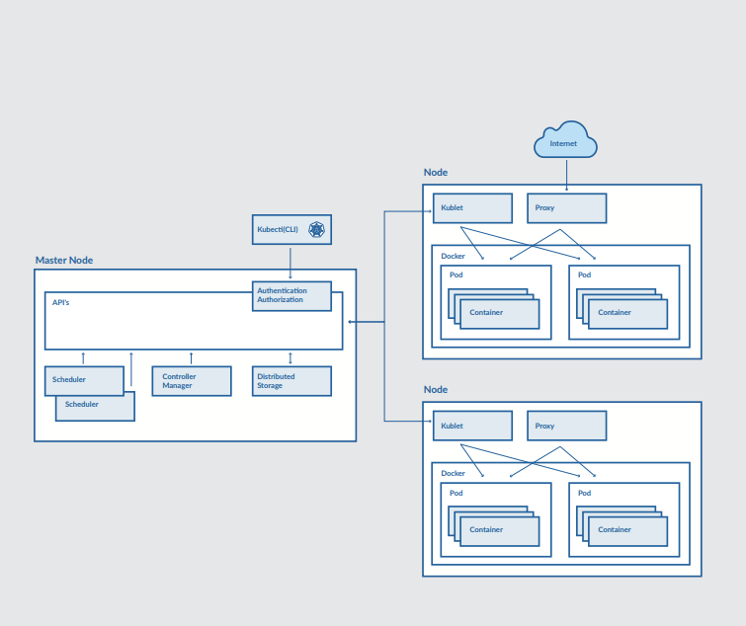
Understanding Kubernetes Terminology
Kubernetes Terminology

Slide 14
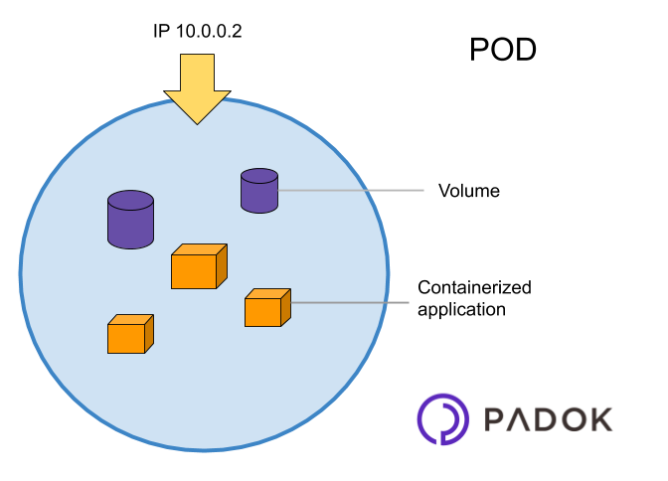
Kubernetes pod overview
pods

Slide 15
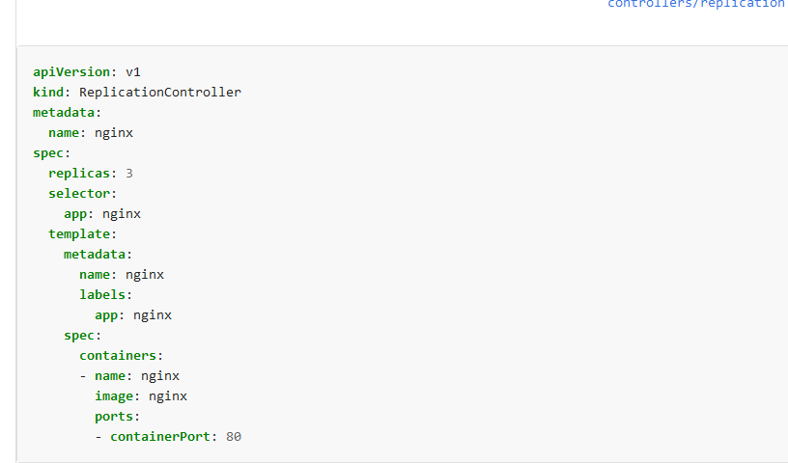
Kubernetes replication controller overview
https://kubernetes.io/docs/concepts/workloads/controllers/replicationcontroller/

Slide 16
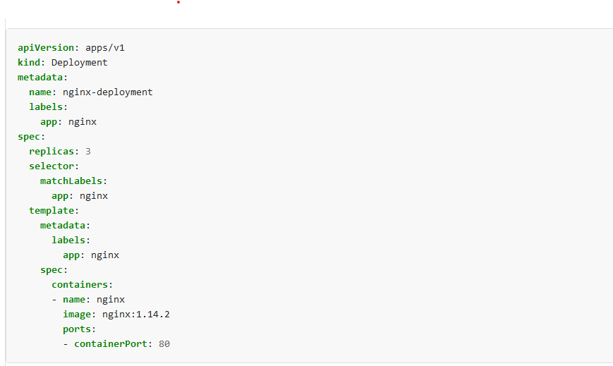
Kubernetes deployment Overview
https://kubernetes.io/docs/concepts/workloads/controllers/deployment/

Slide 17
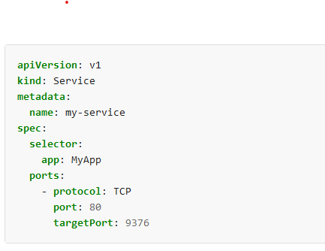
Kubernetes service overview
https://kubernetes.io/docs/concepts/services-networking/service/

Slide 18
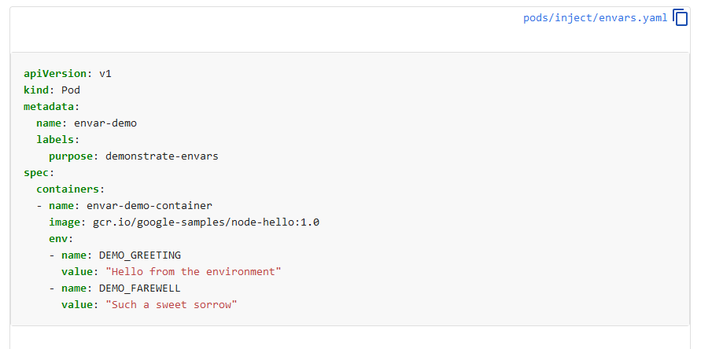
Understanding Kubernetes running environment options
https://kubernetes.io/docs/tasks/inject-data-application/define-environment-variable-container/

Slide 19
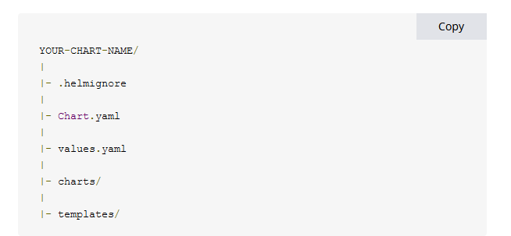
Introduction and basic working of helm.
helm

