Slide 1
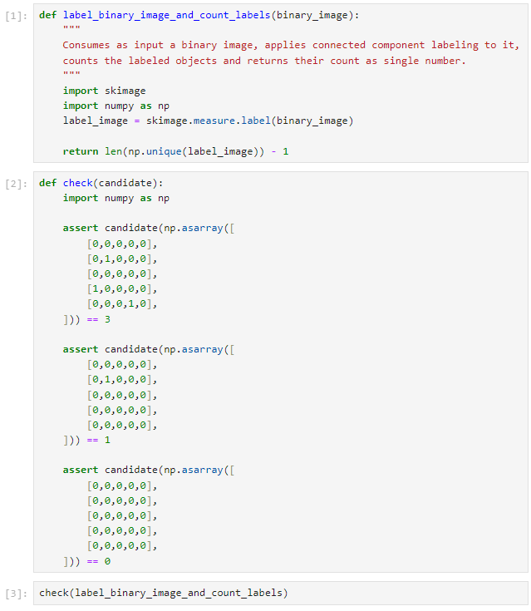
Prompt
Reference solution
Unit test

