Slide 1
2017-2018 Recap DeepLearningPlayground

Slide 2

OBJECTIVE
Put theorical concepts into practice !
Tensorflow, Jupyter, Tensorboard…

Slide 3
1.
CHAPTERS 6-7-8 : FeedForward & Optimization
1 Sessions

Slide 4
CONCEPTS
Optimizers : SGD, Adam, RMSProp
Regularization : L2, Dropout
Early Stopping
(Gradient Clipping, Batch Normalization…)

Slide 5
2.
CHAPTER 9 : CNNs
2 Sessions

Slide 6
CONCEPTS
Convolutional Layers
Max Pooling
Zero Padding

Slide 7
3.
CHAPTER 10 : RNNs
5 Sessions

Slide 8
CONCEPTS
Vanilla RNNs
Encoders-Decoders (Seq2Seq)
LSTM
(Other GRUs)

Slide 9
Neural Machine Translation

Slide 10
DATASET (BEFORE PROCESSING)
European Parliament proceedings (1996)
11 languages
French to English
2,007,723 sentences
51,388,643 French words
50,196,035 English words

Slide 11
DATASET (AFTER PROCESSING)
Replaced barely used words by token : <5
Kept only short sentences : 5 words max in output
Removed anomalies : len(fr) > 3*len(en) || len = 0
Reduced to 10 000 sentences
10,000 sentences (90% Train/Test)
5,636 French words
4,477 English words

Slide 12
ARCHITECTURE
the
debate
is
closed
<None/>
<None/>
DECODER
[0 0 … 1 0]
[0 0 … 0 0]
[0 1 … 0 0]
[0 0 … 0 0]
[0 0 … 0 1]
[0 0 … 0 1]
…
…
…
…
…
…
4477 neurons
LSTM
LSTM
LSTM
LSTM
LSTM
LSTM
LSTM
LSTM
LSTM
LSTM
LSTM
LSTM
LSTM
LSTM
LSTM
LSTM
LSTM
LSTM
LSTM
LSTM
LSTM
LSTM
LSTM
LSTM
LSTM
LSTM
LSTM
LSTM
LSTM
LSTM
LSTM
LSTM
LSTM
LSTM
LSTM
LSTM
…
…
64 units
LSTM
LSTM
LSTM
LSTM
LSTM
LSTM
LSTM
LSTM
LSTM
LSTM
LSTM
LSTM
LSTM
LSTM
LSTM
LSTM
LSTM
LSTM
LSTM
LSTM
LSTM
LSTM
LSTM
LSTM
LSTM
LSTM
LSTM
LSTM
LSTM
LSTM
64 units
[0 0 … 1 0]
[0 0 … 0 0]
[0 1 … 0 0]
[0 0 … 0 0]
[0 0 … 0 1]
le
debat
est
clos
<None/>
ENCODER

Slide 13
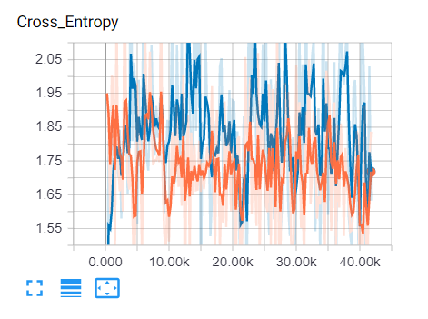
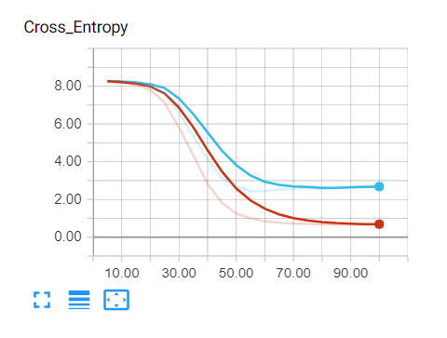
TRAINING
First training :
Not learning !
Implementation validation :
Reduced TrainSet to 5 samples
Check if Overfitting

Slide 14
TRAINING
Diagnostic :
Sentences with empty input/output
Almost whole output padded => learns to just pad
Corrections :
Remove anomalies
Mask padding in gradient calculation ?

Slide 15
WHAT’S NEXT ?
Attention Mecanism
Use Embeddings instead of OneHotEncoding
Improve the latent space

Slide 16
Conclusion

Slide 17
Chapters repartition
Read / Dev
Real time working

Slide 18
THANKS!
Any questions?
You can find me at:
@ClementRomac
Github/ClementRomac

