Slide 1



Engineering softwares

Slide 2
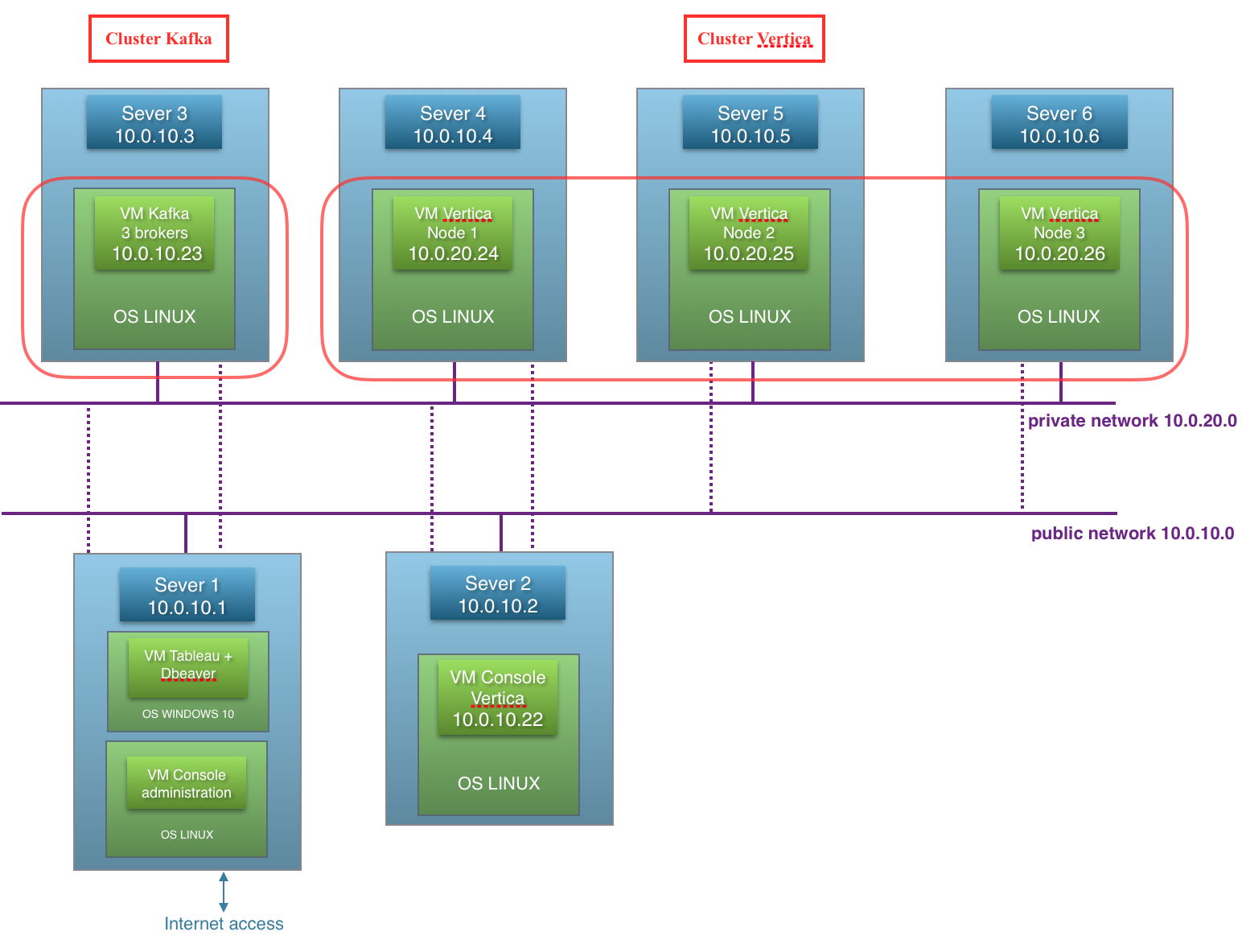
Architecture of linky project

Slide 3
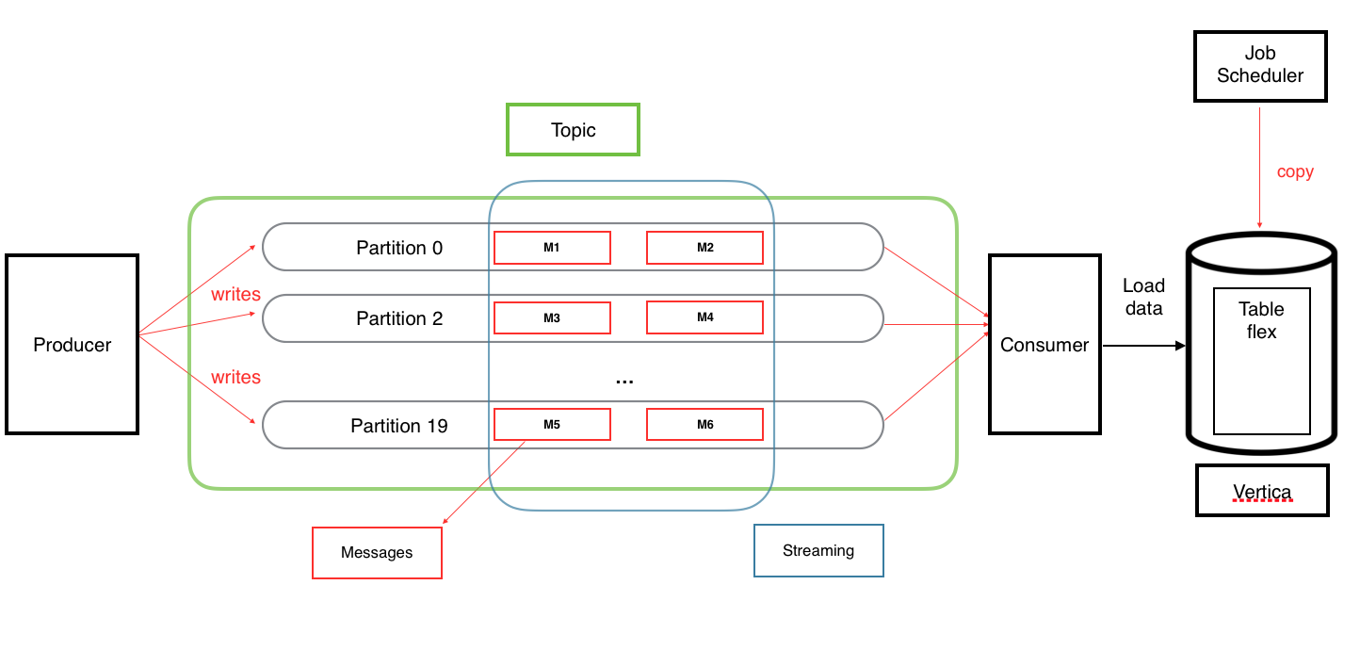
First implementation of Kafka used for linky project

Slide 4
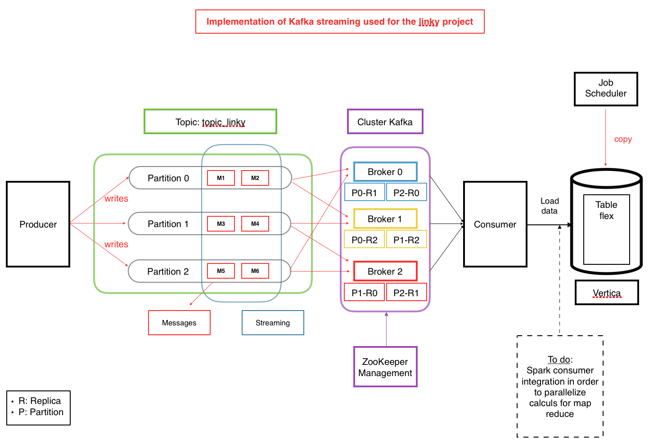
Implementation of Kafka streaming used for linky project

Slide 5
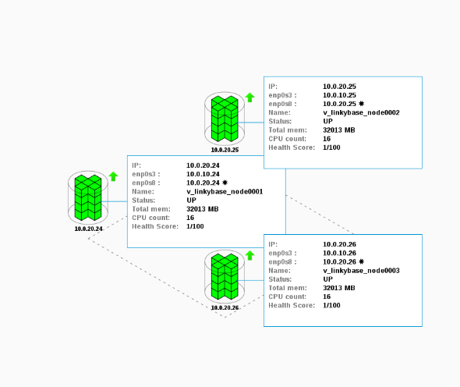
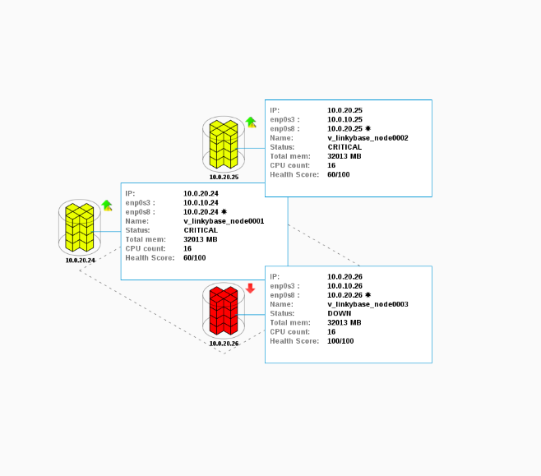
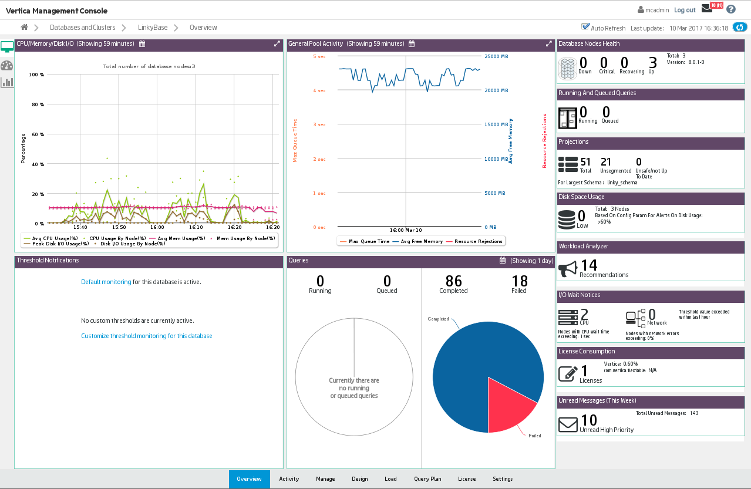
High Availability
Security
Powerful console management

