Slide 1

Network Intrusion detection using Artificial Intelligence
By Clementine Mamogale

Slide 2
Outline
Introduction
Research problem
System overview
Models
Results
Conclusion

Slide 3

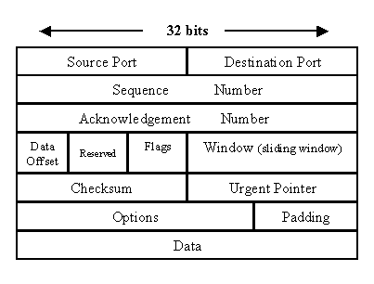
Network intrusion detection system
A security technology
monitor and protect network
Analyze packets - normal or malicious
https://www.techrepublic.com/article/exploring-the-anatomy-of-a-data-packet/

Slide 4
Research Problem
Network intrusion detection system (NIDS) is expensive
A NIDS that uses AI is cheaper,
Works better than the traditional NIDS
Can be deployed in critical infrastructure

Slide 5
System overview
Datasets
Pre-processing
Model selection
Training
Testing
Classification

Slide 6
Datasets
KDD+
It is used in many NIDS research papers since it is old, 1999
Can be used for good baseline of the system
CICIDS 2017
It is new, it uses modern technologies
It has datasets that occurred recently

Slide 7
Pre-Processing
KDD+ Pipeline
Duration
Protocol type
Src_bytes
Dst_bytes
Labels
CICIDS 2017 Pipeline
Flow Duration
Total Forward
Total backward
Forward Packet Length
Backward Packet Length
Labels

Slide 8
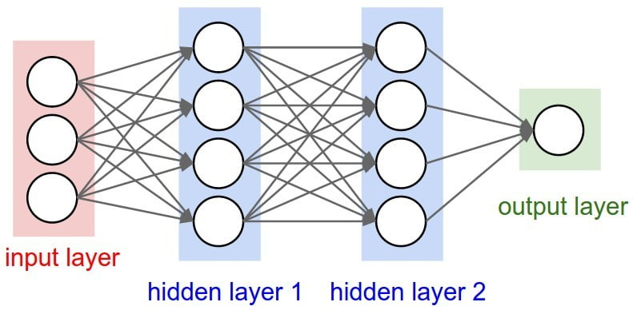
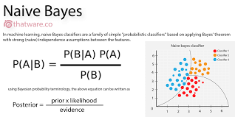
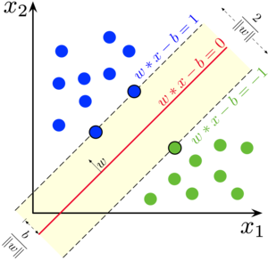
Model Selection
Deep Neural Network (DNN)
Naïve bayes
Support Vector Machine (SVM)
https://www.bmc.com/blogs/deep-neural-network/
https://towardsdatascience.com/introduction-to-na%C3%AFve-bayes-classifier-fa59e3e24aaf
https://en.wikipedia.org/wiki/Support-vector_machine

Slide 9
Results
Model | Dataset | Accuracy
Deep Neural Network (DNN) | KDD+ | ~90.92%
Deep Neural Network (DNN) | CICIDS 2017 | N/A
Naïve Bayes | KDD+ | ~55.6%
Naïve Bayes | CICIDS 2017 | ~93.09
Support Vector Machine (SVM) | KDD+ | ~46.38%
Support Vector Machine (SVM) | CICIDS 2017 | ~97.48%

Slide 10






Technologies used
Numpy, SKLearn, and Matplotlib

Slide 11
Conclusion
NIDS can be done using AI
Takes time to train the model, but…
Beneficial to many organizations and businesses

