Slide 1


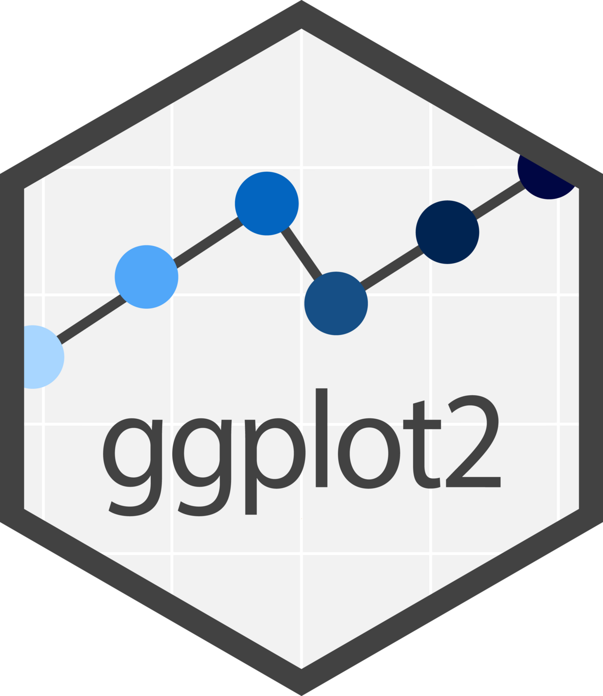


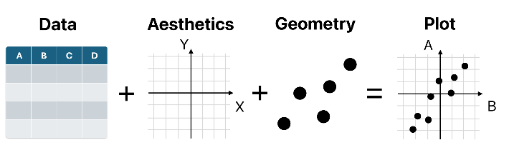

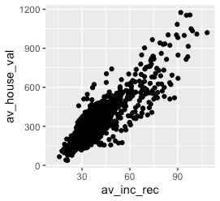
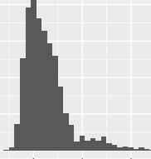

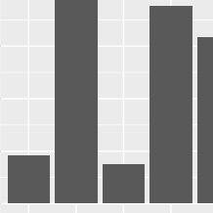
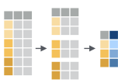

Geospatial Data Carpentry Workshop for Urbanism: : CHEATSHEET
Basics
Data manipulation
Data visualization
Vector data
USING LIBRARIES
ASSIGNMENT
DPLYR
GGPLOT2
SF BASICS
install.packages(“here”)
library(here)
x <- “apple”
ggplot2 is based on the grammar of graphics - idea that plots are build based on three components: data set, coordinate system, and geoms—visual marks that represent data points.
st_read(dsn, layer, ...) Read file or database vector dataset as a sf object
Pipes
x %>% f(y) or x |> f(y) becomes f(x,y)
st_geometry_type(x, by_geometry = TRUE) Return the geometry type of an object
DATA TYPES
as.character(x) | “1” , “2”, “one” | Character strings
as.numeric(x) | 1, 2, 1 | Numbers
as.logical(x) | TRUE, FALSE, T | Boolean
as.factor(x) | “1”, “2”, “1” Levels: “1”, “2” | Strings with preset levels
st_crs(x, …) Set or retrieve coordinate reference system (CRS) from an sf object
SUBSET
Long output with all CRS info
Short output with specific parts of CRS
df %>% select(variables) ​​​
Select columns by name.
data
aesthetics
ggplot(dataset,
aes(x=variable) +
geom_histogram()
st_crs(x, …)$Name – Get CRS name
st_crs(x, …)$epsg – Get EPSG code
df %>% filter(condition) ​​​
Extract rows meeting logical condition
geometry
st_bbox(obj, ...) Return bounding box of an sf object as an object of class bbox with xmin, ymin, xmax and ymax values
CREATE NEW VARIABLE
The geom_ functions define shape of a plot.
st_transform(x, crs, ...) Convert coordinates of an sf, sfc, sfg or bbox object
VECTORS
SCATTER PLOT
ggplot(df, aes(x = var1, y = var2) +
geom_point()
Function c() joins elements of the same data type:
df %>% mutate(x=mean(y)) ​​​
st_length(x, ...) Compute the length of a LINESTRING or MULTILINESTRING geometry in a projected CRS like Amersfoort / RD New (EPSG:28992)
Combine vectors to create a new one
Compute new columns
c(1, 2, 4, 5)
c(y, x)
HISTOGRAM
ggplot(df, aes(x = var1) + ​
geom_histogram()
st_write(obj, dsn, layer = NULL, ...) Write sf object to file
SUMMARISE
Missing values
df %>% summarize(x=mean(y)) ​​​
BAR CHART
is.na(x) | Is missing
!is.na(x) | Not missing
Summarize data into summary table
ggplot(df, aes(x = var1, y = var2) +
geom_col()
VISUALISING SF OBJECTS
geom_sf() visualise sf objects with ggplot2
EXPLORE DATASETS
GROUP CASES
to create summaries
by category
TITLES AND LABELS
coord_sf() ensures that all layers use the same CRS, either specified with the crs parameter or taken automatically from the first layer that defines a CRS
head(df,n) | First n rows of dataset df
summary(df) | Summary stats of df
nrow(df) | Number of rows in df
ncol(df) | Number of columns in df
labs() function allows naming axes, adding titles and useful legend names
sf object
plot1 +
labs( title = “Plot title",
subtitle = “Plot subtitle”
x = “Axis X",
y = “ Axis Y",
color = “Legend title ")
ggplot(data) +
geom_sf() +
coord_sf(datum = st_crs(28992))
df %>%
group_by(variable) ​​​%>% summarize(x=mean(y)) ​​​%>%
ungroup() ​​​
No need to specify x and y
Remove grouping
rainbow(n) Create a vector of n colors, optionally customized with the palette parameter (e.g., palette = “viridis”)
CC BY SA • Rbanism community • rbanism@tudelft.nl • TU Delft Library • Rbanism.org • Learn more at edu.nl/pa78a • Workshop version beta • Updated: 2025-02

Slide 2



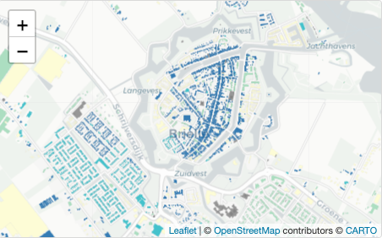
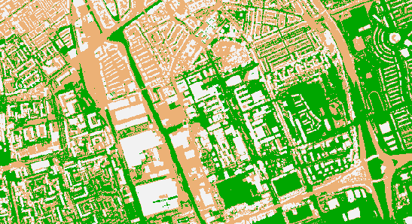
Geospatial Data Carpentry Workshop for Urbanism: : CHEATSHEET
Raster Data
Open Street Map
Geoprocessing
TERRA BASICS
PROJECTIONS
BOUNDING BOX
BUFFER
describe(x, ...) Describe the properties of spatial data in a file.
crs(x, …) Get or set the coordinate reference system of a SpatRaster or SpatVector.
With the OSMdata package, it is possible to geocode a spatial text using the Nominatim API. The function `getbb` returns the coordinates of its bounding box: xmin, xmax, ymin and ymax.
A buffer corresponds to a circular polygon around an ‘x’ feature with a specified distance ‘dist’
rast(x, nrows, ncols,…) Create a SpatRaster, from scratch, from a filename, or from another object.
project(x, y, …) Change the coordinate reference system ("project") of a SpatVector, SpatRaster or a matrix with coordinates.
sf::st_buffer(x,dist)
osmdata::getbb(“place name”)
UNION
summary(x, …) Compute summary statistics (min, max, mean, and quartiles). A sample of cells is used for very large files.
OVERPASS QUERY
A union corresponds to the combination of polygons by removing internal boundaries
PLOT
To extract and download Open Street Map (OSM) data into R, we access the Overpass API using a query, to which we add OSM features defined by hierarchical tags called keys and values. To download data about greenhouses for example, the key is “building” and the value “greenhouse”.
sf::st_union(x,y,...) |>
sf::st_cast(to = “POLYGON”) |>
sf::st_as_sf()
values(x,…) Get the cell values of a SpatRaster or the attributes of a SpatVector.
plotRGB(x,filename,…) Make a Red-Green-Blue plot based on three layers in a SpatRaster.
Type of resulting object
Format of resulting object
DATA WRANGLING
EXPORT
osmdata::opq(bbox) |>
add_osm_feature(key, value)|>
osmdata_sf()
CENTROID
If TRUE, coordinates are included
writeRaster(x,filename,…) Write a SpatRaster to a file.
A centroid corresponds to the
centre of mass of a geometric object.
Disables geographic projection
Format of resulting object (sf object)
as.data.frame(x, xy=FALSE, geom, na.rm=NA, …) Coerce a SpatRaster or SpatVector to a data.frame.
Visualisation
The result of this query can contain points, lines and/or polygons, each described by a data frame.
sf::sf_use_s2(FALSE)
sf::st_centroid(x) |>
sf::st_transform(.,crs)
ggplot2::geom_raster(x, aes(fill=z), …) Draw a raster plot.
Reproject the resulting object
minmax(x, …) and setminmax(x, …) Get or compute the min and max cell values.
Interactive mapping
ggplot2::coord_equal(ratio = 1, xlim = NULL, ylim = NULL, …) Cartesian coordinates with fixed "aspect ratio"
The leaflet package provides a way to create map with interactive features such as zoom, popups, image overlay, etc.
INTERSECT / INTERSECTION
nlyr(x, …) Get the number of rows (nrow), columns (ncol), cells (ncell), layers (nlyr), resolution (res), and other dimensions of a SpatRaster.
Terrain.colors(n, alpha, rev=FALSE) Create a vector of n contiguous colors
‘Intersect’ tests whether geometric objects x and y intersect each other. ‘Intersection’ performs the intersection and returns an object of the same type as x.
sf::st_intersection(x,y)
ext(x,…) Get a SpatExtent of a SpatRaster, SpatVector, or other spatial objects.
AREA
leaflet(x) |>
addTiles() |>
addPolygons()
Background map
Computation of the area of a set of
features x
Specifies area unit
Added geometries from x
sf::st_area(x) |>
units::set_units(., km^2)
CC BY SA • Rbanism community • rbanism@tudelft.nl • TU Delft Library • Rbanism.org • Learn more at edu.nl/pa78a • Workshop version beta • Updated: 2025-02

