Slide 1



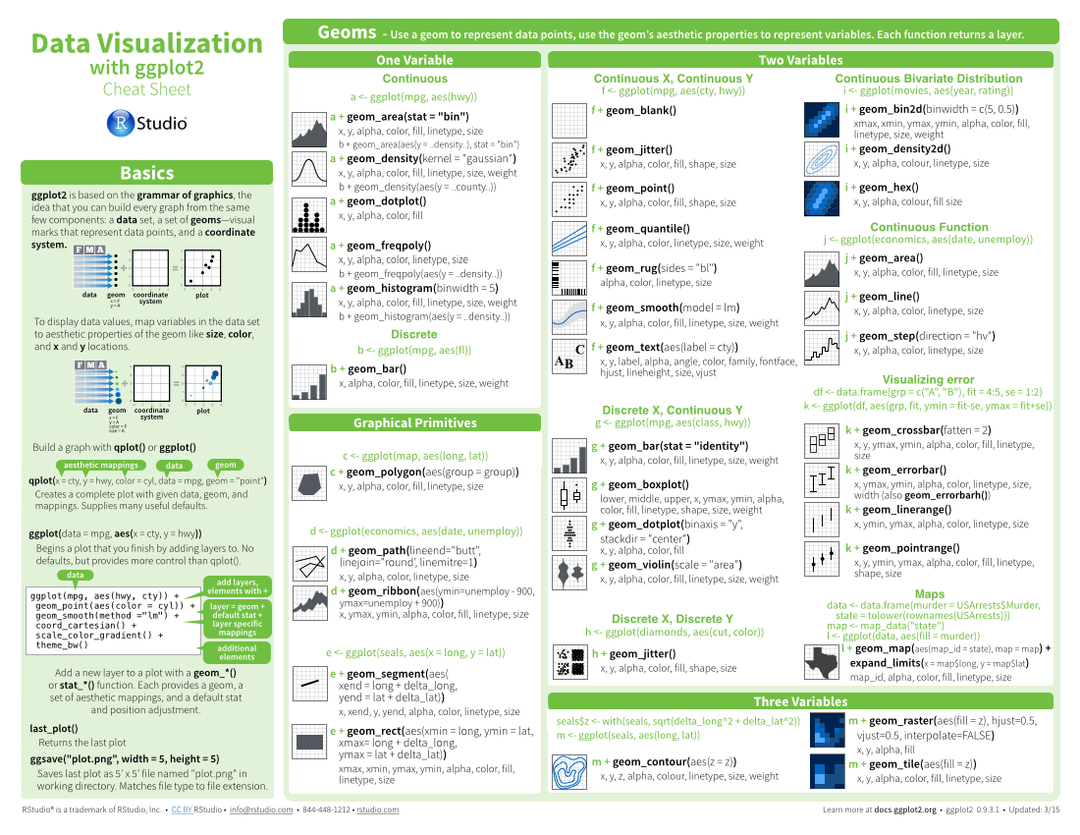




Geospatial Data Carpentry Workshop: : CHEAT SHEET
Basics
Visualisation
Vector data
Mapping
Thank you for making a new cheatsheet for R! These cheatsheets have an important job:
FONTS
Cheatsheets make it easy for R users
to look up useful information.
This template uses several fonts: Helvetica Neue, Menlo, Source Sans pro, which you can acquire for free here, www.fontsquirrel.com/fonts/source-sans-pro, and Font Awesome, which you can acquire here, fortawesome.github.io/Font-Awesome/get-started/
Use headers, colors, and/or backgrounds to separate or group together sections.
Remember that the best cheatsheets are visual—not written—documents. Whenever possible use visual elements to make it easier for readers to find the information they need.
Create a visual hierarchy. Help users navigate the page with titles, subtitles, and subsubtitles
CODE
Where possible, use code that works when run.
Title
ggplot(mpg, aes(hwy, cty)) +
geom_point(aes(size = fl)) +
geom_smooth(method ="lm")
To use a font awesome icon, copy and paste one from here https://fontawesome.com/v4/cheatsheet/ Then set the text font to font awesome.
Use a layout that flows and makes it easy to zero in on specific topics.
SUBTITLE
SUBSUBTITLE
Word balloons
can help explain
code
Fit sections to content. Try several different layouts.
Use numbers or arrows to link sections if the order/flow is confusing.
Quickly identify content with a package hexsticker (if available)
MOCK TABLES
KEYNOTE
Use visualizations to explain concepts quickly and concisely.
I make my cheatsheets in Apple Keynote, and not latex or R Markdown, because presentation software makes it much easier to tweak the visual appearance of a document
summary function
Use visual elements to make the sheet scannable.
KEYNOTE TIPS
MOCK GRAPHS
Select multiple elements by holding down shift and then selecting each. Click on a selected element before letting go of shift to unselect it.
To group elements together. Select them all , then click Arrange > Group
To evenly space multiple objects, select them all then Right Click > Align objects or Right Click > Distribute objects
Click on a table, then visit Format >Table > Row and Column Size to make even width rows/columns.
i + geom_area() x, y, alpha, color, fill, linetype, size
i + geom_line() x, y, alpha, color, group, linetype, size
Copyright
Use visual emphasis (like color, size, and font weight) to make important information easy to find.
Each cheatsheet should be licensed under the creative commons license.
To license the sheet as creative commons, put CC'd by <your name> in the small print at the bottom of each page and link it to
http://creativecommons.org/licenses/by/4.0/
TABLES
sub-option | description
citation_package | The LaTeX package to process citations, natbib, biblatex or none
code_folding | Let readers to toggle the display of R code, "none", "hide", or "show"
colortheme | Beamer color theme to use
dplyr::lag() - Offset elements by 1
dplyr::lead() - Offset elements by -1
YOUR LOGO
(optional)
RStudio® is a trademark of RStudio, Inc. • CC BY SA Your Name • your@email.com • 844-448-1212 • your.website.com • Learn more at webpage or vignette • package version 0.5.0 • Updated: 2017-01

Slide 2



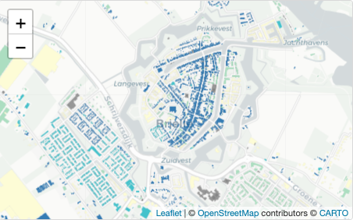
Geospatial Data Carpentry Workshop: : CHEAT SHEET
Raster Data
Layout Suggestions
Open Street Map
GIS functions
Thank you for making a new cheatsheet for R! These cheatsheets have an important job:
Use headers, colors, and/or backgrounds to separate or group together sections.
BOUNDING BOX
BUFFER
Section 1
Section 2
Section 3
With the OSMdata package, it is possible to geocode a spatial text using the Nominatim API. The function `getbb` returns the coordinates of its bounding box: xmin, xmax, ymin and ymax.
A buffer corresponds to a circular polygon around an ‘x’ feature with a specified distance ‘dist’
Cheatsheets make it easy for R users
to look up useful information.
sf::st_buffer(x,dist)
Remember that the best cheatsheets are visual—not written—documents. Whenever possible use visual elements to make it easier for readers to find the information they need.
osmdata::getbb(“place name”)
Create a visual hierarchy. Help users navigate the page with titles, subtitles, and subsubtitles
UNION
OVERPASS QUERY
A union corresponds to the combination of polygons by removing internal boundaries
Title
To extract and download Open Street Map (OSM) data into R, we access the Overpass API using a query, to which we add OSM features defined by hierarchical tags called keys and values. To download data about greenhouses for example, the key is “building” and the value “greenhouse”.
sf::st_union(x,y,...) |>
sf::st_cast(to = “POLYGON”) |>
sf::st_as_sf()
Use a layout that flows and makes it easy to zero in on specific topics.
SUBTITLE
Type of resulting object
SUBSUBTITLE
Format of resulting object
Fit sections to content. Try several different layouts.
Use numbers or arrows to link sections if the order/flow is confusing.
Quickly identify content with a package hexsticker (if available)
osmdata::opq(bbox) |>
add_osm_feature(key, value)|>
osmdata_sf()
CENTROID
A centroid corresponds to the
centre of mass of a geometric object.
Disables geographic projection
Use visualizations to explain concepts quickly and concisely.
Format of resulting object (sf object)
The result of this query can contain points, lines and/or polygons, each described by a data frame.
sf::sf_use_s2(FALSE)
sf::st_centroid(x) |>
sf::st_transform(.,crs)
summary function
Reproject the resulting object
Use visual elements to make the sheet scannable.
Interactive mapping
The leaflet package provides a way to create map with interactive features such as zoom, popups, image overlay, etc.
INTERSECT / INTERSECTION
i + geom_area() x, y, alpha, color, fill, linetype, size
i + geom_line() x, y, alpha, color, group, linetype, size
‘Intersect’ tests whether geometric objects x and y intersect each other. ‘Intersection’ performs the intersection and returns an object of the same type as x.
Copyright
Each cheatsheet should be licensed under the creative commons license.
To license the sheet as creative commons, put CC'd by <your name> in the small print at the bottom of each page and link it to
http://creativecommons.org/licenses/by/4.0/
sf::st_intersection(x,y)
Use visual emphasis (like color, size, and font weight) to make important information easy to find.
AREA
dplyr::lag() - Offset elements by 1
dplyr::lead() - Offset elements by -1
leaflet(x) |>
addTiles() |>
addPolygons()
Background map
Computation of the area of a set of
features x
Specifies area unit
Added geometries from x
sf::st_area(x) |>
units::set_units(., km^2)
YOUR LOGO
(optional)
RStudio® is a trademark of RStudio, Inc. • CC BY SA Your Name • your@email.com • 844-448-1212 • your.website.com • Learn more at webpage or vignette • package version 0.5.0 • Updated: 2024-05

Slide 3

Geospatial Data Carpentry Workshop: : CHEAT SHEET
Intro to R
Vector data
Raster Data
Thank you for making a new cheatsheet for R! These cheatsheets have an important job:
Use headers, colors, and/or backgrounds to separate or group together sections.
Create a visual hierarchy. Help users navigate the page with titles, subtitles, and subsubtitles
Quickly identify content with a package hexsticker (if available)
Fit sections to content. Try several different layouts.
Use numbers or arrows to link sections if the order/flow is confusing.
Cheatsheets make it easy for R users
to look up useful information.
Section 1
Section 2
Section 3
Title
Remember that the best cheatsheets are visual—not written—documents. Whenever possible use visual elements to make it easier for readers to find the information they need.
SUBTITLE
SUBSUBTITLE
Use a layout that flows and makes it easy to zero in on specific topics.
Mapping
FONTS
CODE
This template uses several fonts: Helvetica Neue, Menlo, Source Sans pro, which you can acquire for free here, www.fontsquirrel.com/fonts/source-sans-pro, and Font Awesome, which you can acquire here, fortawesome.github.io/Font-Awesome/get-started/
Where possible, use code that works when run.
Word balloons
ggplot(mpg, aes(hwy, cty)) +
geom_point(aes(color = cyl)) +
geom_smooth(method ="lm")
can help explain
code
Use visualizations to explain concepts quickly and concisely.
summary function
To use a font awesome icon, copy and paste one from here fortawesome.github.io/Font-Awesome/cheatsheet/. Then set the text font to font awesome.
ICONS
☞    
These are just font awesome characters
Use visual elements to make the sheet scannable.
i + geom_area() x, y, alpha, color, fill, linetype, size
i + geom_line() x, y, alpha, color, group, linetype, size
KEYNOTE
MOCK TABLES
I make my cheatsheets in Apple Keynote, and not latex or R Markdown, because presentation software makes it much easier to tweak the visual appearance of a document
Use visual emphasis (like color, size, and font weight) to make important information easy to find.
KEYNOTE TIPS
Select multiple elements by holding down shift and then selecting each. Click on a selected element before letting go of shift to unselect it.
To group elements together. Select them all , then click Arrange > Group
To evenly space multiple objects, select them all then Right Click > Align objects or Right Click > Distribute objects
Click on a table, then visit Format >Table > Row and Column Size to make even width rows/columns.
MOCK GRAPHS
dplyr::lag() - Offset elements by 1
dplyr::lead() - Offset elements by -1
COPYRIGHT
Each cheatsheet should be licensed under the creative commons license.
To license the sheet as creative commons, put CC'd by <your name> in the small print at the bottom of each page and link it to http://creativecommons.org/licenses/by/4.0/
TABLES
sub-option | description
citation_package | The LaTeX package to process citations, natbib, biblatex or none
code_folding | Let readers to toggle the display of R code, "none", "hide", or "show"
colortheme | Beamer color theme to use
YOUR LOGO
(optional)
RStudio® is a trademark of RStudio, Inc. • CC BY SA Your Name • your@email.com • 844-448-1212 • your.website.com • Learn more at webpage or vignette • package version 0.5.0 • Updated: 2017-01

