Slide 1

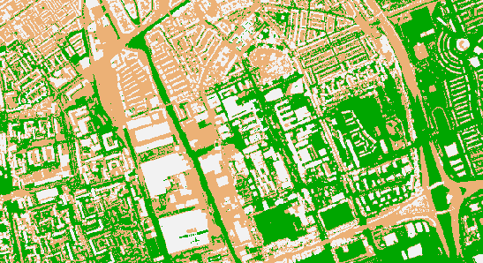

Geospatial Data Carpentry Workshop: : CHEAT SHEET
Raster Data
TERRA BASICS
VISUALIZATION
describe(x, ...) Describe the properties of spatial data in a file.
ggplot2::geom_raster(x, aes(fill=z), …) Draw a raster plot.
rast(x, nrows, ncols,…) Create a SpatRaster, from scratch, from a filename, or from another object.
ggplot2::coord_equal(ratio = 1, xlim = NULL, ylim = NULL, …) Cartesian coordinates with fixed "aspect ratio"
summary(x, …) Compute summary statistics (min, max, mean, and quartiles). A sample of cells is used for very large files.
Terrain.colors(n, alpha, rev=FALSE) Create a vector of n contiguous colors
values(x,…) Get the cell values of a SpatRaster or the attributes of a SpatVector.
If TRUE, coordinates are included
as.data.frame(x, xy=FALSE, geom, na.rm=NA, …) Coerce a SpatRaster or SpatVector to a data.frame.
minmax(x, …) and setminmax(x, …) Get or compute the min and max cell values.
nlyr(x, …) Get the number of rows (nrow), columns (ncol), cells (ncell), layers (nlyr), resolution (res), and other dimensions of a SpatRaster.
crs(x, …) Get or set the coordinate reference system of a SpatRaster or SpatVector.
project(x, y, …) Change the coordinate reference system ("project") of a SpatVector, SpatRaster or a matrix with coordinates.
ext(x,…) Get a SpatExtent of a SpatRaster, SpatVector, or other spatial objects.
writeRaster(x,filename,…) Write a SpatRaster to a file.
plotRGB(x,filename,…) Make a Red-Green-Blue plot based on three layers in a SpatRaster.
YOUR LOGO
(optional)
RStudio® is a trademark of RStudio, Inc. • CC BY SA Your Name • your@email.com • 844-448-1212 • your.website.com • Learn more at webpage or vignette • package version 0.5.0 • Updated: 2024-05

