Slide 1
Introduction to Big Data Analytics using Python and Apache Spark
Cyberinfrastructure and Technology Integration (CITI)
Clemson University

Slide 2
Getting started

Slide 3
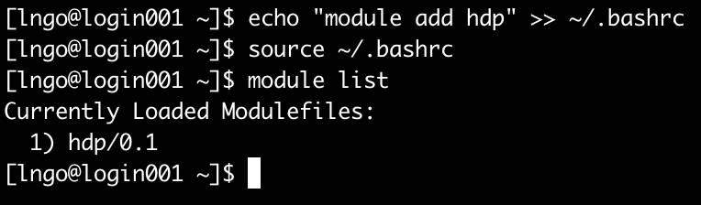
First step
Log on to Palmetto from a terminal and run the following command
$ echo “module load hdp” >> ~/.bashrc
You need two greater signs (>>) to append. If you use only one, it will overwrite the file (and create a lot of headache!)
If your command run correctly, you will see module hdp/0.1 loaded after you run source ~/.bashrc

Slide 4
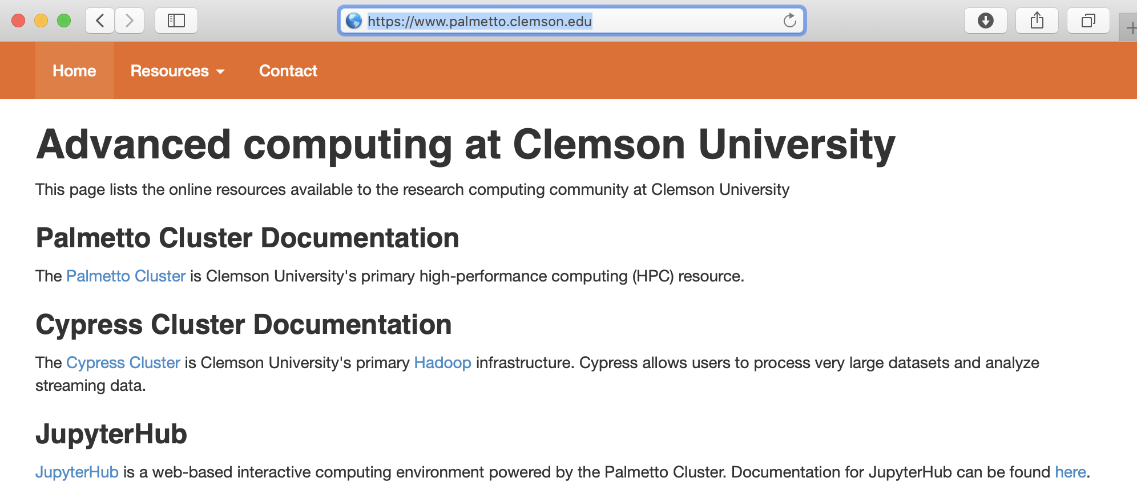
Second step
Open a browser and go to https://www.palmetto.clemson.edu, then click the link of JupyterHub

Slide 5
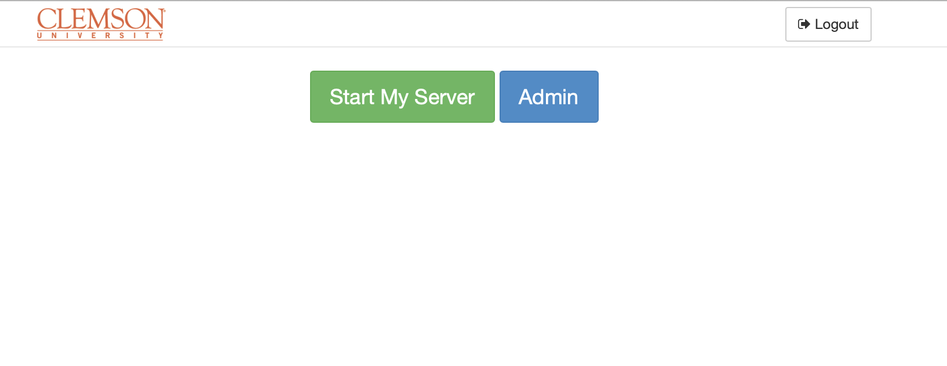
JupyterHub interface
You will not have the blue Admin button
You will need to sign in with DUO
Click Start My Server

Slide 6
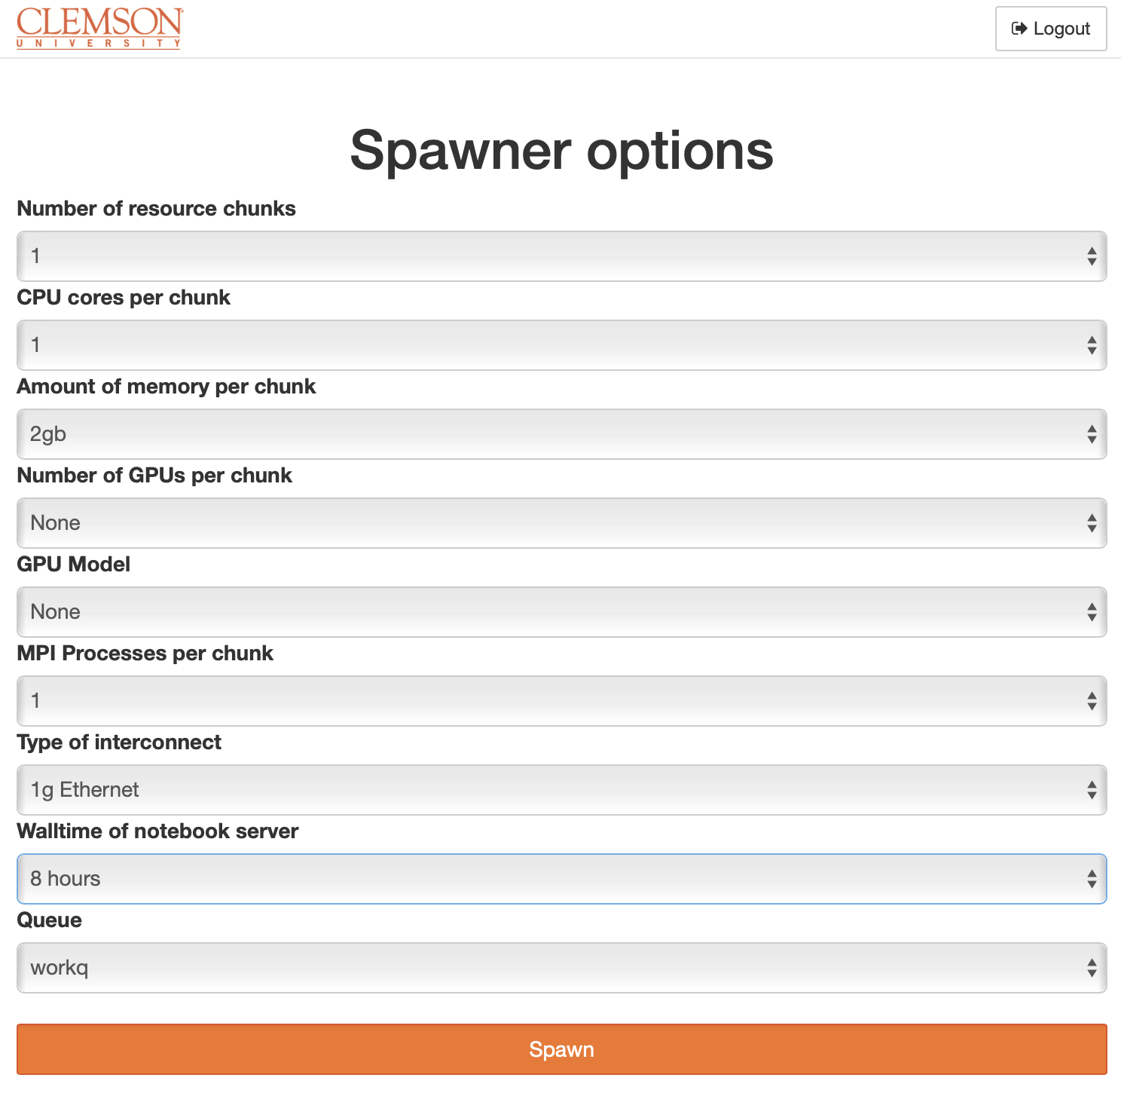
Launch a notebook server
Select spawner options similar to this screenshot
Click Spawn when done
It might take a few minutes for Palmetto to allocate resource, then for the JupyterHub server to launch your server on the allocation node.

Slide 7
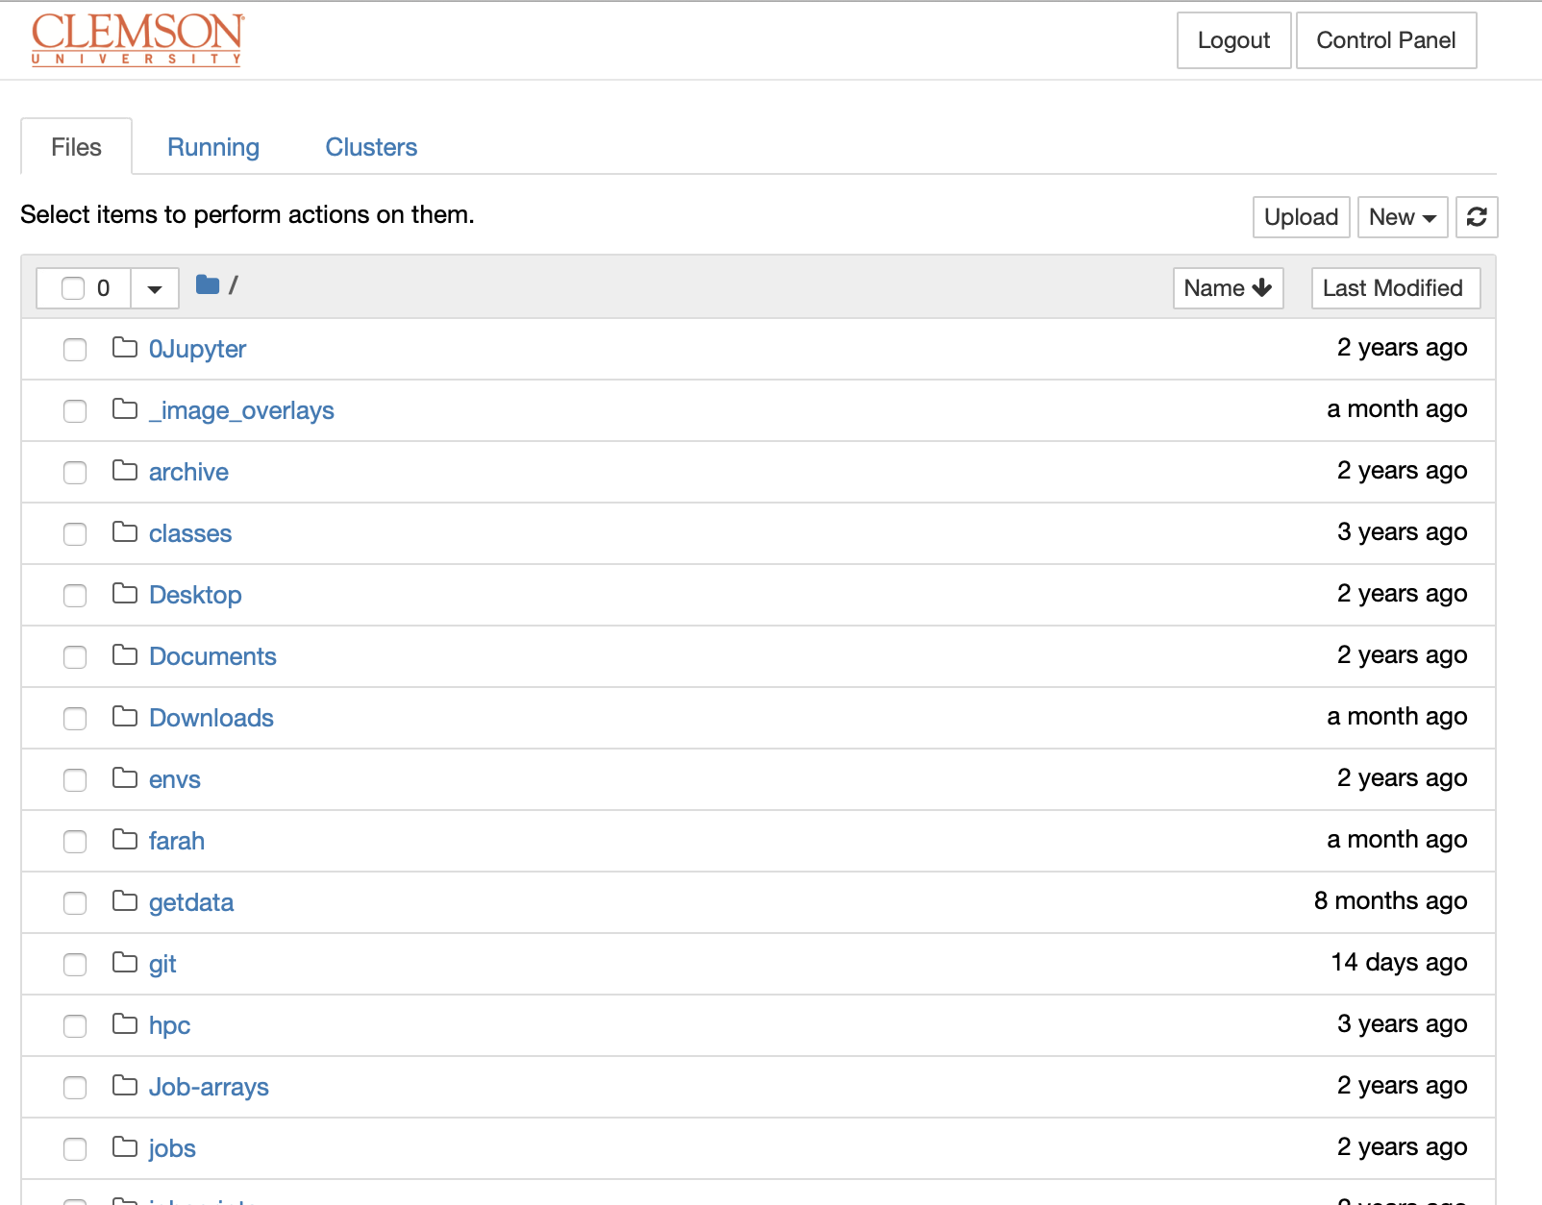
Your Jupyter server
The content shown in your browser should be the content of YOUR home directory.
This is MY home directory (some of it …).

Slide 8
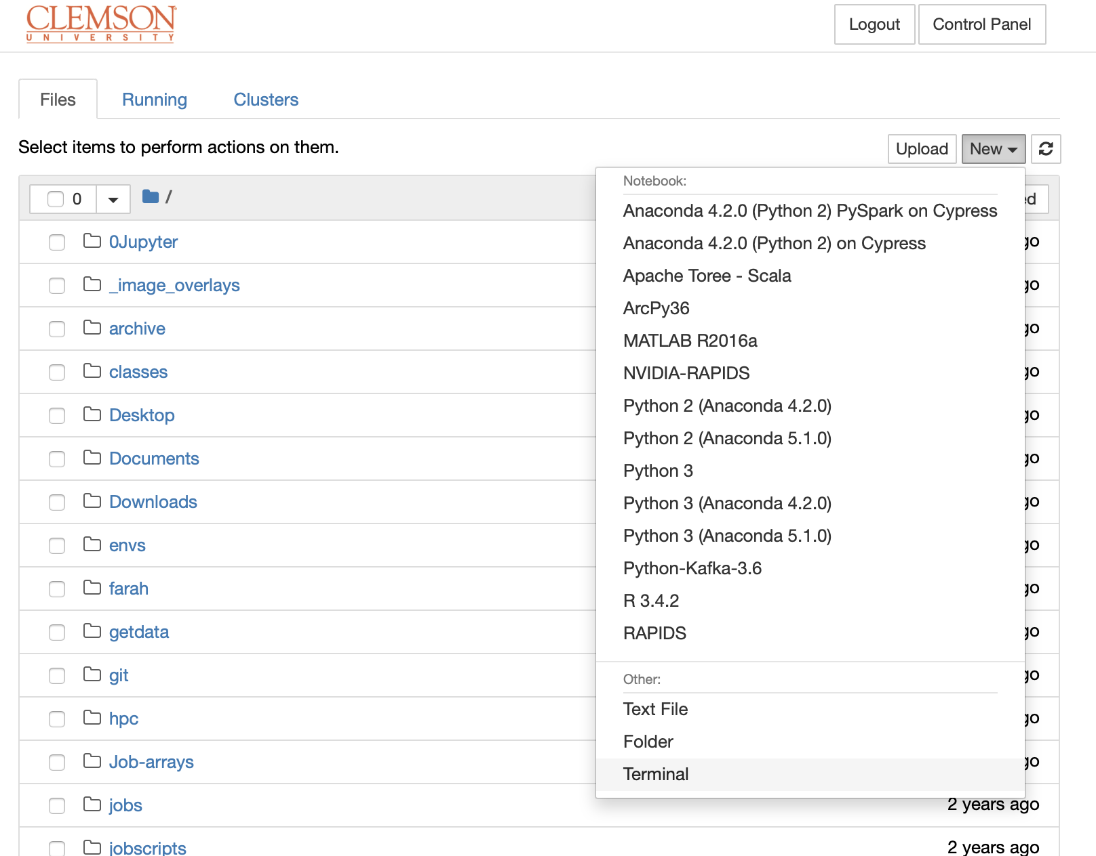
Getting workshop materials (1)
Click New in the upper right corner of Files tab.
Select Terminal
An in-browser terminal will be opened in another browser tab.

Slide 9
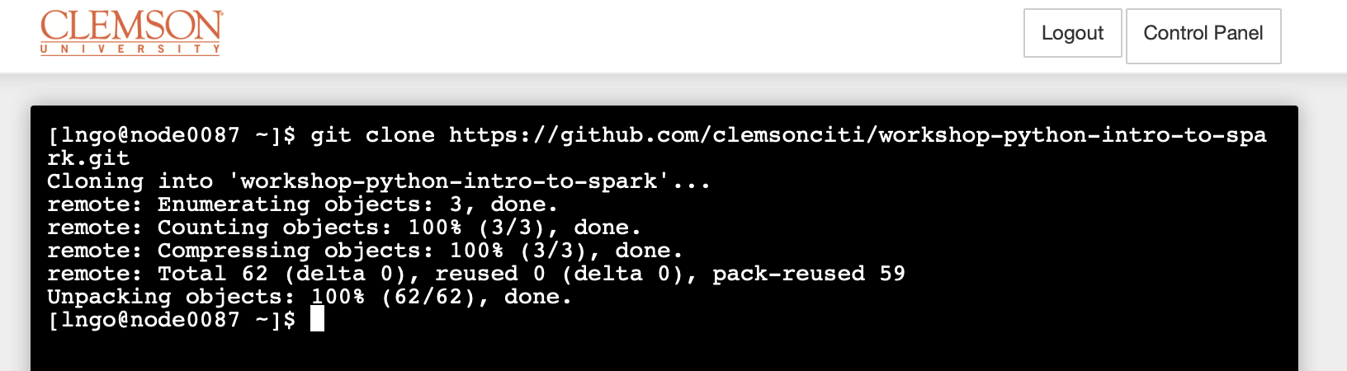
Getting workshop materials (2)
In the terminal, type the followings:
git clone https://github.com/clemsonciti/workshop-python-intro-to-spark.git

Slide 10
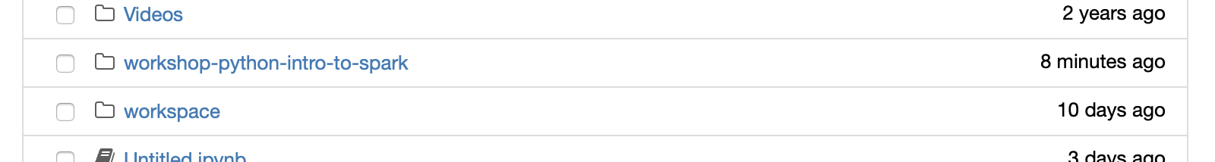
Getting workshop materials (3)
The contents downloaded should appear in your home directory tab
Click on the name to enter this directory.

Slide 11
Hadoop Distributed File System

Slide 12
Overview
2002: Doug Cutting and Mike Carafella started a project to build an open-source search engine called Nutch. A component of this project was a web crawler that can crawl and index the Internet.
2003: Google released a research paper on its in-house data storage system called Google File System (GFS).
2004: Google released another research paper on the programming approach to process data stored on GFS, called MapReduce.

Slide 13
2005: Cutting and Carafella rebuilt the underlying file management system and processing framework of Nutch based on the architectural design of Google's GFS and MapReduce.
2006: The adaptations of Google's GFS and MapReduce were converted into a single open source project called Hadoop, which was sponsored by Yahoo and led by Doug Cutting.

Slide 14
2007: Yahoo maintains a 1000-node production cluster.
2008: Hadoop becomes the platform of Yahoo's web index. Hadoop wins record for world fastest system to sort one terabyte of data (209 seconds using a 910-node cluster). Hadoop becomes a top-level open source project of Apache Foundation. First Hadoop commercial distributor led by a former Google employee, Cloudera, is founded.

Slide 15
2009: Hadoop sorts one terabyte of data in 62 seconds and one petabyte of data in 16.25 hours using a 3800-node cluster. Second Hadoop commercial distributor, MapR, is formed.
2011: Yahoo spins off its own Hadoop commercial distributor, Hortonworks.
2012: Apache Hadoop 1.0 is released.

Slide 16
Corresponding Component Names
Google File Systems (GFS): Hadoop Distributed File System (HDFS)
Google MapReduce: Hadoop MapReduce
Google BigTable: Apache HBase

Slide 17
Apache Hadoop Project
Hadoop Distributed File System
YARN (Yet Another Resource Negotiator)
Hadoop MapReduce

Slide 18
Hadoop Distributed File System

Slide 19
Design Assumption and Goals
Hardware failure is the norm rather than the exception
Streaming data access
Not for general purpose applications
For batch processing rather than interactive use
For high throughput of data access rather than low latency of data access
Large data sets (terabytes in size)
Simple coherency model (write once read many)
Moving computation is cheaper than moving data
Portability across heterogeneous hardware and software platform

Slide 20

Architecture
Master/Workers Architecture
Master: NameNode
Workers: Data Node

Slide 21
NameNode
manages the file system namespace
regulates access to files by clients
executes file system namespace operations
determines the mapping of blocks to DataNodes
keeps track of DataNodes status

Slide 22
DataNode
one per node in the cluster
manages storage attached to the node
serves read and write requests clients
sends regular heart-beat messageas back to the NameNode for verification

Slide 23
Files and Directories
HDFS file system namespace is exposed to users (think VFS layer, but not quite the same)
Operations include opening, closing, and renaming files and directories.
HDFS allows user data to be stored in files

Slide 24
Files and Directories
Internally, a file is split into one or more blocks
Blocks have equal and fixed size and are stored in a set of DataNodes
NameNode determines the mapping of blocks to DataNodes.
DataNodes perform block creation, deletion, and replication upon instruction from the NameNode.

Slide 25
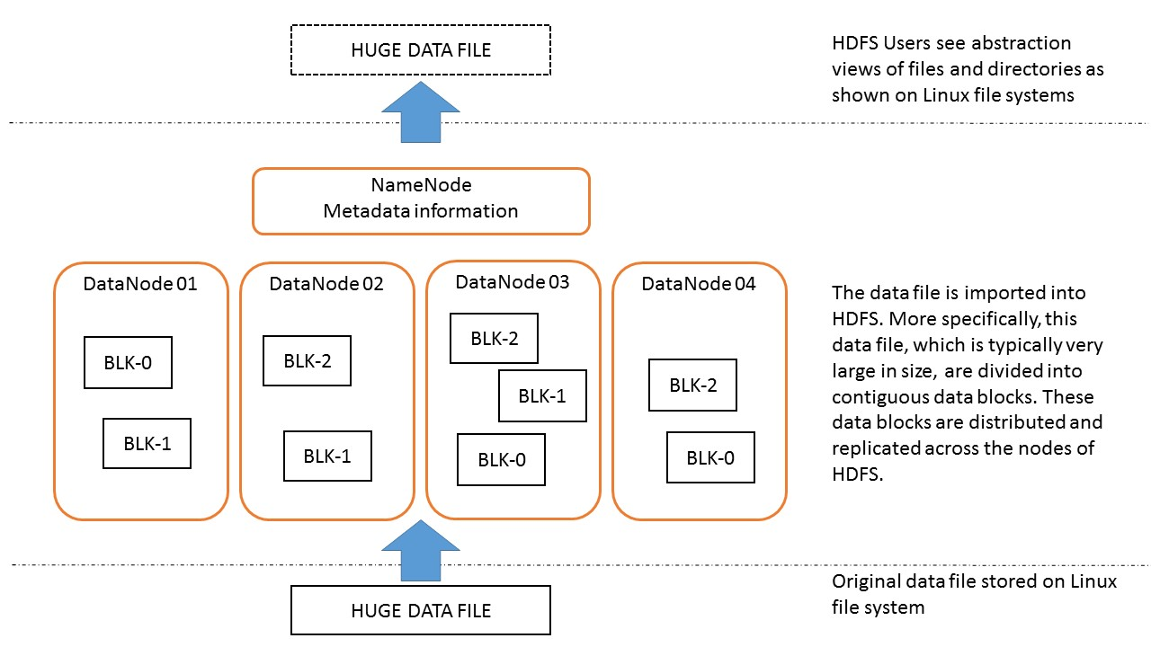

Slide 26
Data Replication
"Failure is the norm and not the exception"
Blocks are replicated for fault tolerance.

Slide 27
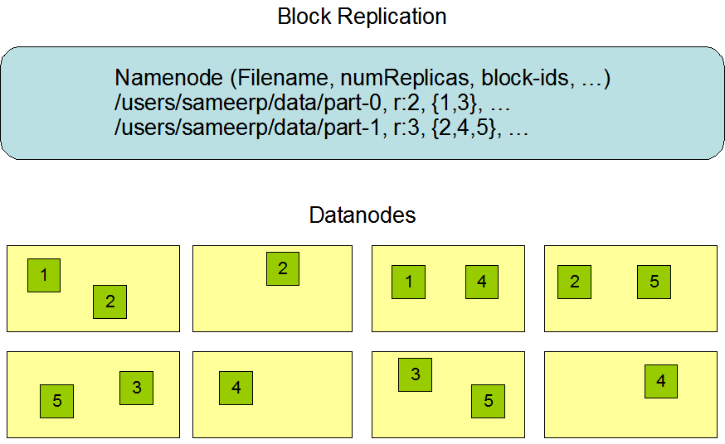

Slide 28
Data Replication
The block size and replication factor are configurable per file.
NameNode makes all decisions regarding replication of blocks.

Slide 29
Replica Replacement
Placement of replicas is critical to HDFS reliability and performance.
The purpose of a rack-aware replica placement policy is to improve data reliability, availability, and network bandwidth utilization.

Slide 30
Replica Placement: Hardware Settings
Cluster of computers that commonly spread across many racks.
Racks are connected via network switches.
In most cases, network bandwidth between machines in the same rack is greater than network bandwidth between machines in different racks.

Slide 31
Placement Policy: Simple and non-optimal
places replicas on unique racks.
Advantage:
prevents losing data when an entire rack fails
allows use of bandwidth from multiple racks when reading data
evenly distributes replicas in the cluster
Disadvantage:
increases the cost of writes because a write needs to transfer blocks to multiple racks.

Slide 32
Placement Policy: HDFS default policy
Default replication factor: 3
First replica on one node in the local rack,
Second replica on a different node in the local rack,
Third replica on a different node in a different rack.
Reduces the inter-rack write traffic
Does not loose data reliablity and availability guarantees
Does not evenly distribute across the racks:
One third of replicas are on one node,
two thirds of replicas are on one rack, and
the other third are evenly distributed across the remaining racks.

Slide 33
Placement Policy: HDFS default policy
Replication factor greater than 3:
Random determination of placement
Rack limit: (replicas−1)/(racks+2)
DataNodes are not allowed to have multiple replicas of the same block
Maximum number of replicas created is the total number of DataNodes

Slide 34
Demo
$ hdfs dfs -ls /
$ hdfs dfs -ls .
$ hdfs dfs -mkdir text
$ hdfs dfs -ls .
$ wget https://ocw.mit.edu/ans7870/6/6.006/s08/lecturenotes/files/t8.shakespeare.txt
$ hdfs dfs -put t8.shakespeare.txt text/
$ hdfs dfs -ls text
$ hdfs fsck text/t8.shakespeare.txt -blocks -files -racks

Slide 35
Demo
To view available commands
$ hdfs
On each data node, the actual data blocks are located at
/tmp/hadoop-root/dfs/data/current

Slide 36
HDFS Writes
Staging
Pipelining

Slide 37
Staging
HDFS client caches the file data into a local buffer
Application writes are transparently redirected to this local buffer
When the local file accumulates data worth over one chunk size, the client contacts the NameNode

Slide 38
Staging
NameNode
inserts the file name into the file system hierarchy and allocates a data block for it.
responds to the client request with the identity of the DataNode and the destination data block.
Client flushes the chunk of data from the local buffer to the specified DataNode.
When a file is closed:
the remaining un-flushed data in the local buffer is transferred to the DataNode.
The client then tells the NameNode that the file is closed.
NameNode commits the file creation operation into a persistent store.
If the NameNode dies before the file is closed, the file is lost.

Slide 39
Pipelining
Replication factor of three.
Pipelining the writing and replicating process of individual chunks of each block
List of DataNodes comes from NameNode
The client then flushes the data chunk to the first DataNode.
For each DataNode:
receiving the data in small portions,
writes each portion to its local repository, and
transfers that portion to the second DataNode in the list.

Slide 40
HDFS Reads
Parallel reads on blocks
Applications take advantage of parallel I/O via MapReduce programming approach

Slide 41
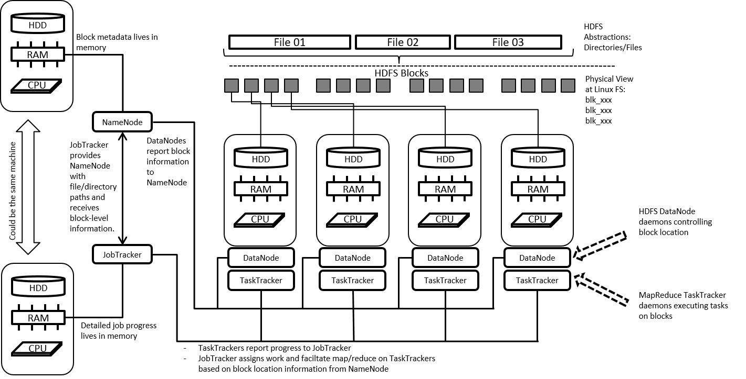

Slide 42
First resource manager/job controller on HDFS
Specifically tied to the MapReduce programming model
Data-aware (via NameNode interactions)
Task-aware (via TaskTracker interactions)
Rely on heartbeat messages, which also contain slot availability information from TaskTrackers:
System health
Execution availability
Job progress
Manage job execution process
Rerun tasks lost due to node failures – Speculative execution
Single point of failure

Slide 43
Execution Process
MapReduce job is submitted to the JobTracker
JobTracker determines data location via NameNode
JobTracker locates TaskTracker (TT) nodes
With available slots -Nearest to the data location
JobTracker sends job (tasks of job: Map, Reduce, Shuffle) to the selected TT
TTs spawn separate JVMs to run tasks (Map, Reduce, Shuffle) for the job
TTs maintain detailed log for progress, output, and exit codes
Heartbeat messages are sent frequently from TaskTrackers to JobTracker
Alive
Slot availability
If no heartbeat is received within a preconfigured duration, the tasks assigned to that TT are resubmitted to another TT
JobTracker updates status report when job is completed

Slide 44
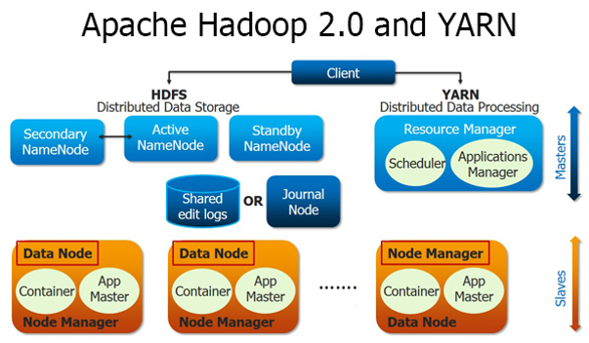

Slide 45
Conceptual Design/Differences
Pure scheduler: limited to arbitrating available resources in the system
Pluggable scheduler: multiple scheduling algorithms
Job management is handle by ApplicationMaster
Resource Model:
Resource-name (hostname, rackname)
Memory (MB)
CPU (cores)
ResourceRequest:
Resource-name, priority, resource-requirement, number-of-containers
Container: the resource allocation

Slide 46
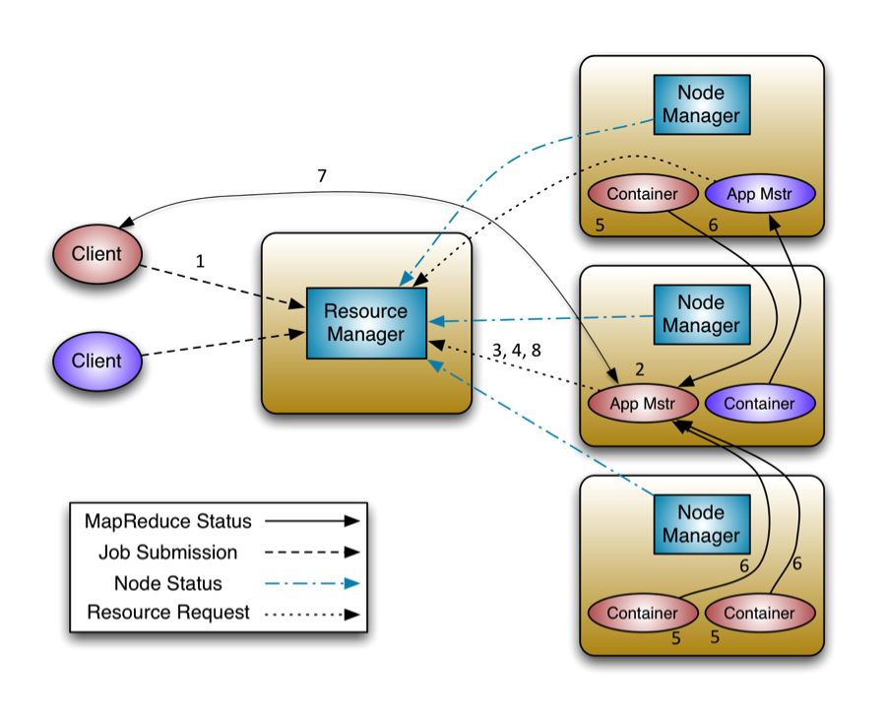
Step 1
A client program submits the application

Slide 47
Step 2
Resource Manager negotiates a container to start the Application Master and then launches the Application Master

Slide 48
Step 3
The Application Master, on boot-up, registers with the Resource Manager. This allows the client to query the Resource Manager for details to directly interact with its Application Master

Slide 49
Step 4
Application Master negotiates resource containers via the resource-request protocol

Slide 50
Step 5
After successful allocations, the Application Master launches the container by providing the container launch specification to the Node Manager. This includes command line to launch, environment variables, local resources (jars, shared-objects, ...), and security-related tokens.

Slide 51
Step 6
The application code executing within the container then provides logging info back to its ApplicationMaster via an application-specific protocol.

Slide 52
Step 7
During the application execution, the client that submitted the program communicates directly with the Application Master to get status, progress, updates via an application-specific protocol.

Slide 53
Step 8
Upon completion, the Application Master deregisters with the ResourceManager and shuts down, allowing its own container to be repurposed.

Slide 54
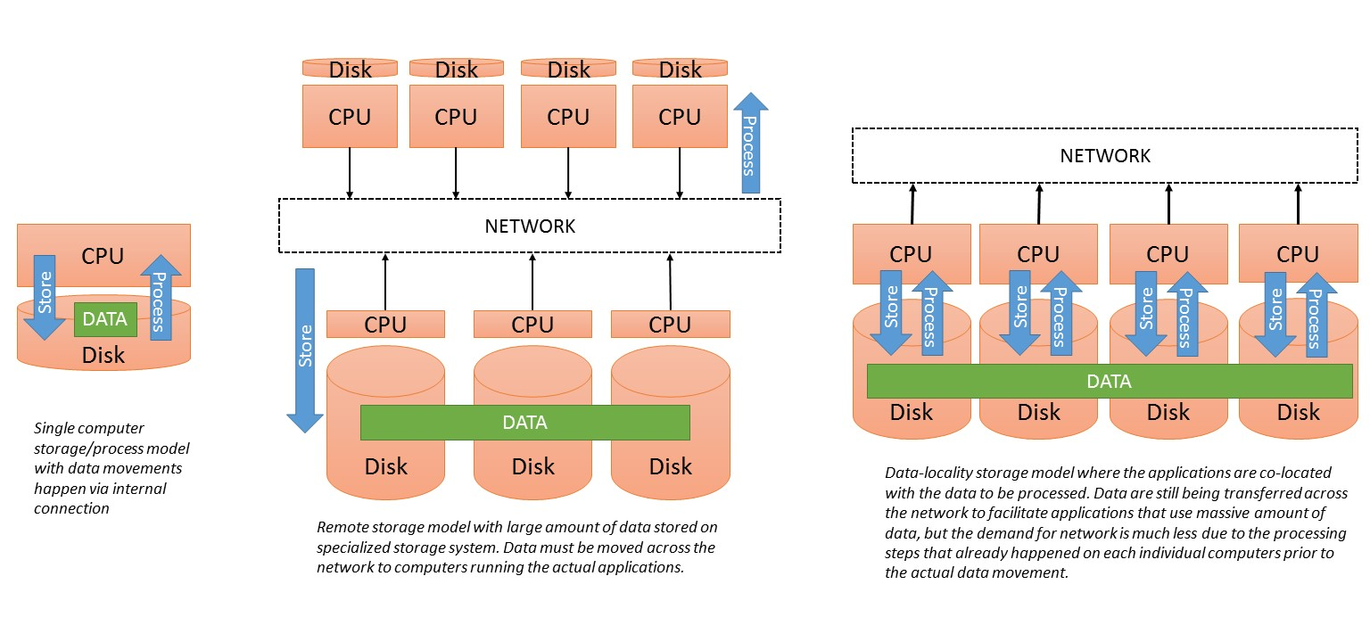
Comparing File System Models

Slide 55
References
https://hadoop.apache.org/docs/r3.0.0-alpha1/
http://hortonworks.com/blog/apache-hadoop-yarn-concepts-and-applications/

