Slide 1
Introduction to Big Data Analytics using Python and Apache Spark
Cyberinfrastructure and Technology Integration (CITI)
Clemson University

Slide 2
Getting started

Slide 3
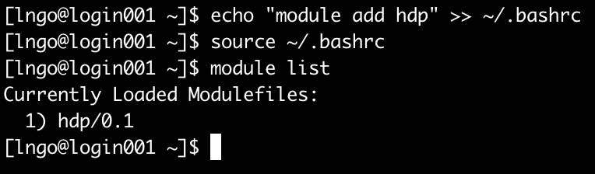
First step
Log on to Palmetto from a terminal and run the following command
$ echo “module load hdp” >> ~/.bashrc
You need two greater signs (>>) to append. If you use only one, it will overwrite the file (and create a lot of headache!)
If your command run correctly, you will see module hdp/0.1 loaded after you run source ~/.bashrc

Slide 4
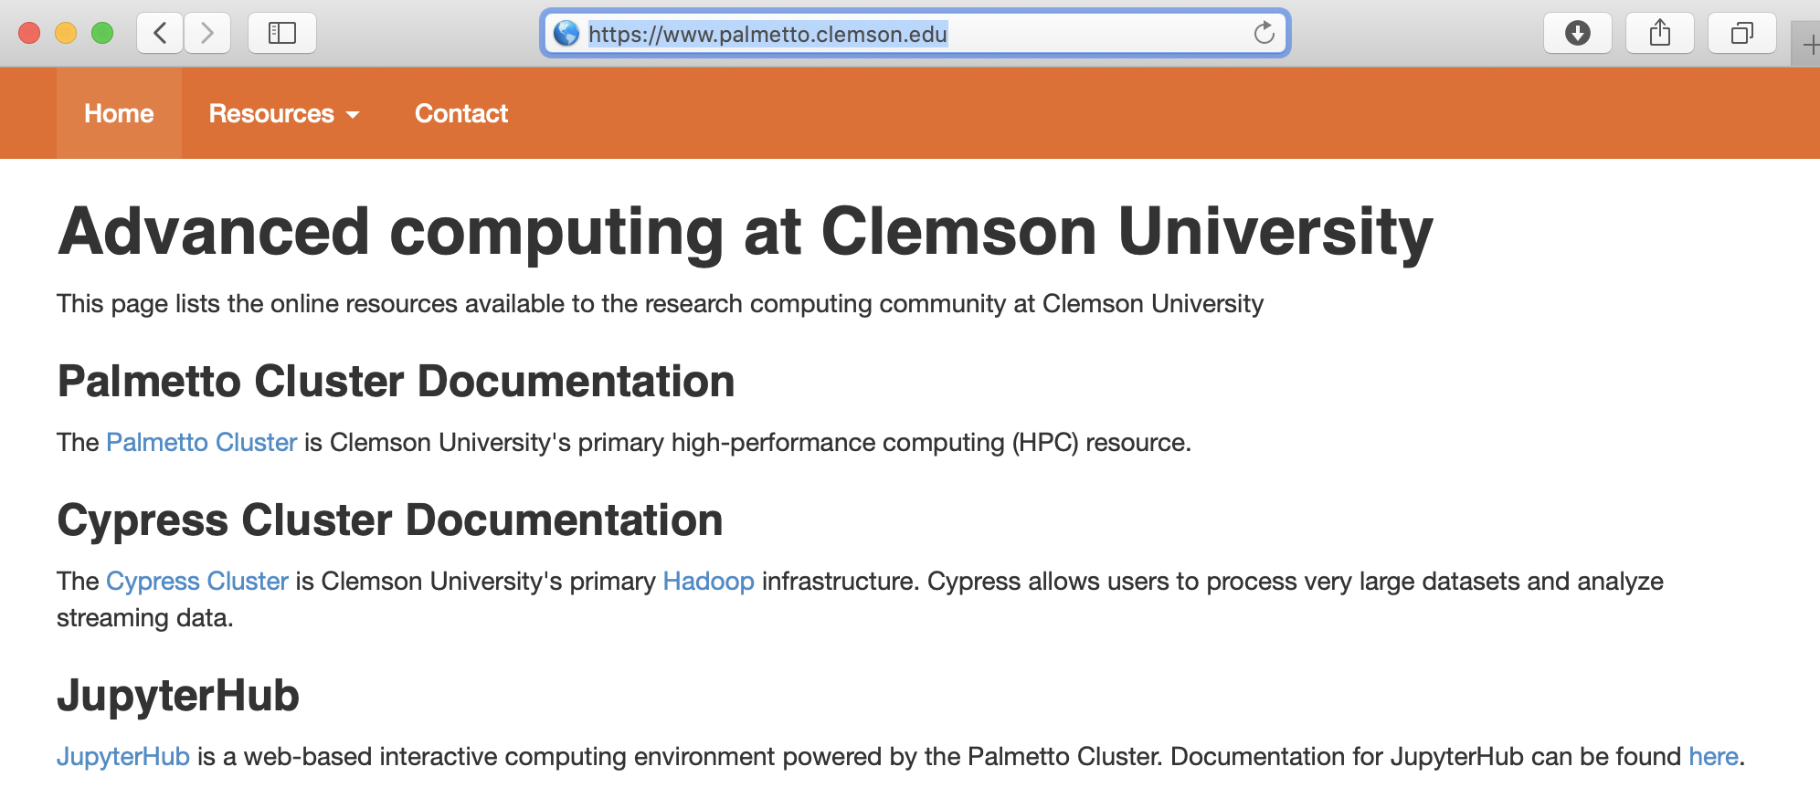
Second step
Open a browser and go to https://www.palmetto.clemson.edu, then click the link of JupyterHub

Slide 5

JupyterHub interface
You will not have the blue Admin button
You will need to sign in with DUO
Click Start My Server

Slide 6
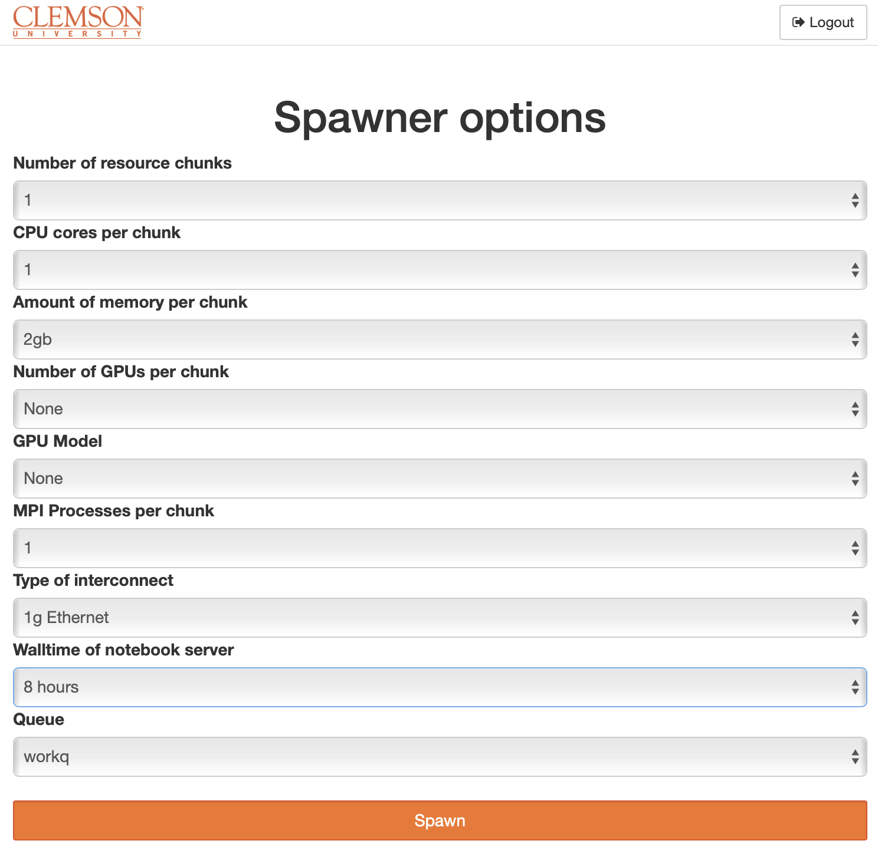
Launch a notebook server
Select spawner options similar to this screenshot
Click Spawn when done
It might take a few minutes for Palmetto to allocate resource, then for the JupyterHub server to launch your server on the allocation node.

Slide 7
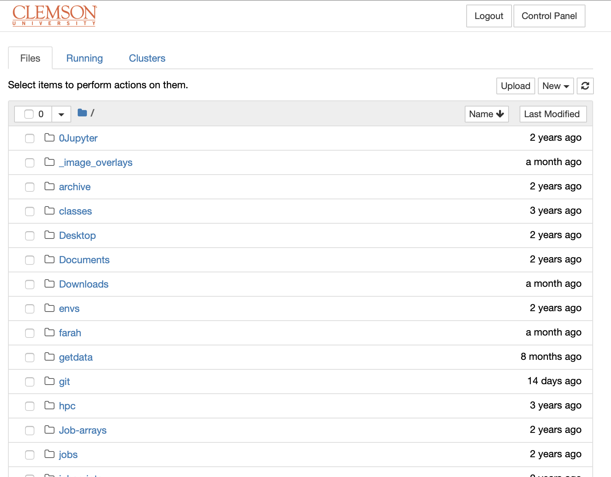
Your Jupyter server
The content shown in your browser should be the content of YOUR home directory.
This is MY home directory (some of it …).

Slide 8
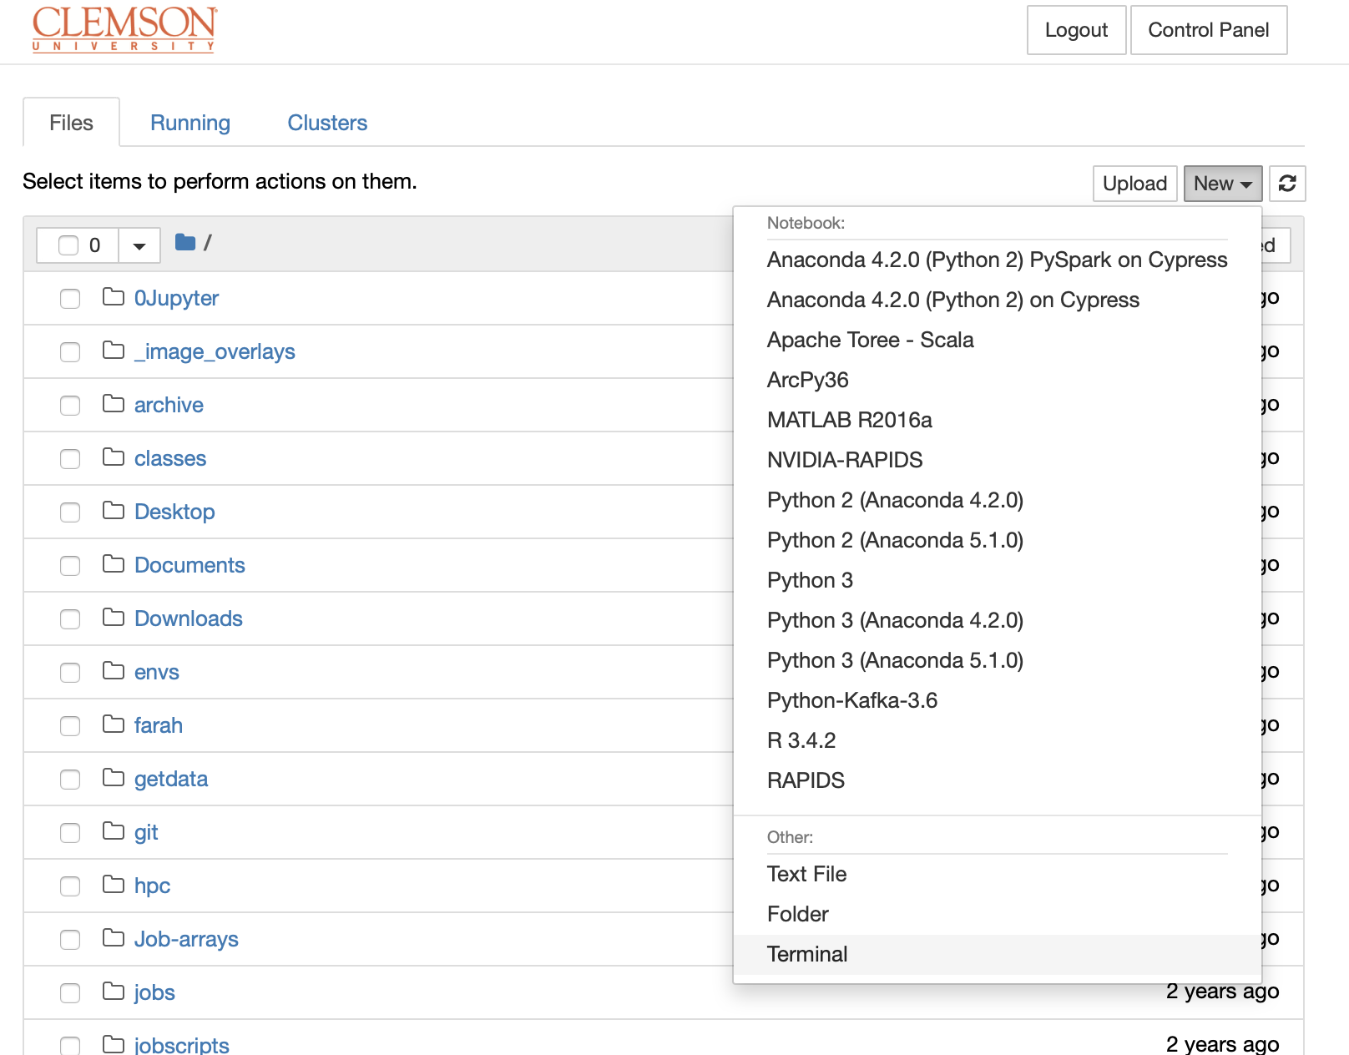
Getting workshop materials (1)
Click New in the upper right corner of Files tab.
Select Terminal
An in-browser terminal will be opened in another browser tab.

Slide 9
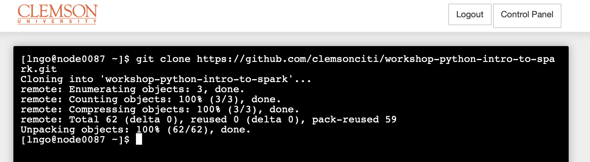
Getting workshop materials (2)
In the terminal, type the followings:
git clone https://github.com/clemsonciti/workshop-python-intro-to-spark.git

Slide 10
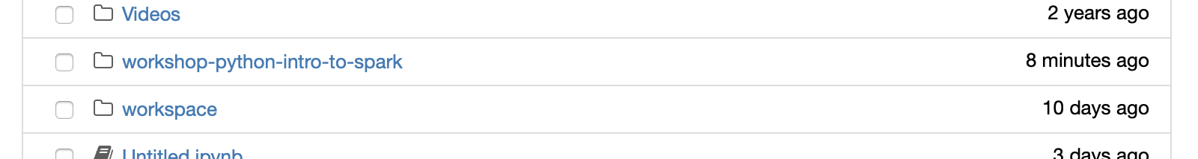
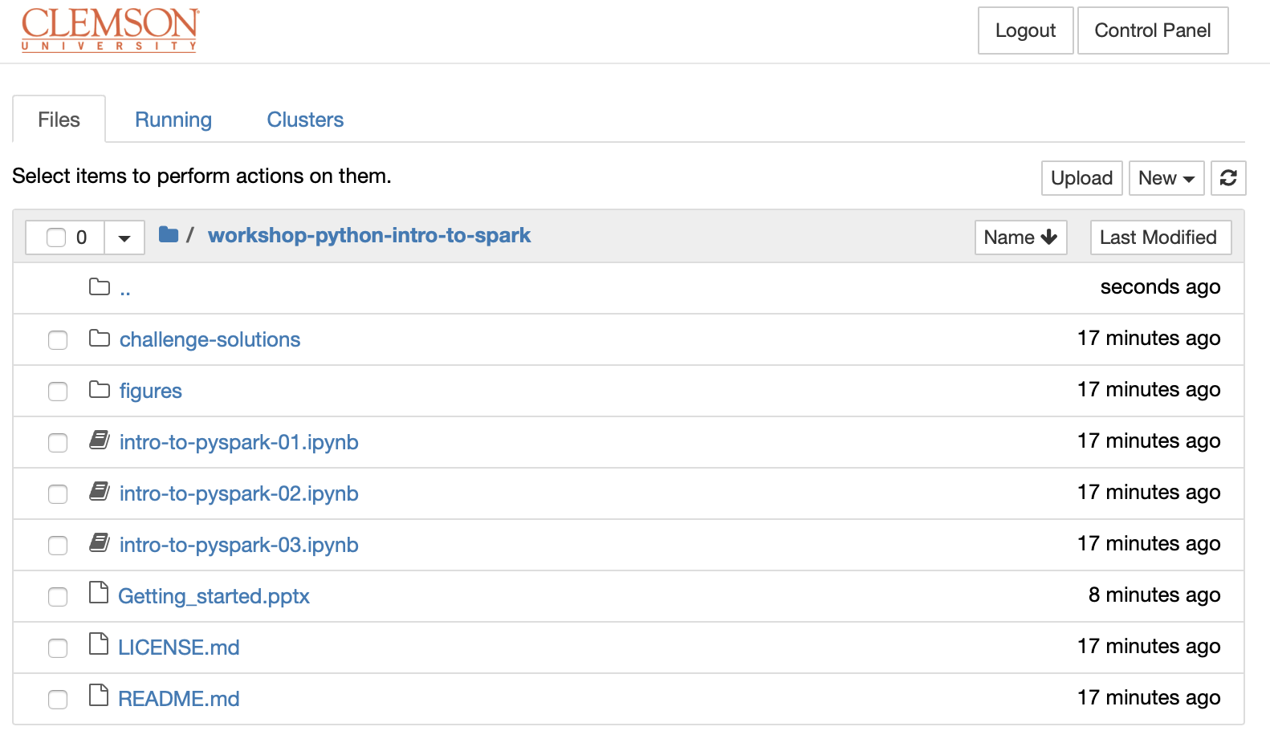
Getting workshop materials (3)
The contents downloaded should appear in your home directory tab
Click on the name to enter this directory.
We will work through today’s workshop using these notebooks.
But first, we will quickly go through these slides to briefly learn about the underlying technologies.

Slide 11
Hadoop Distributed File System

Slide 12
Overview
2002: Doug Cutting and Mike Carafella started a project to build an open-source search engine called Nutch. A component of this project was a web crawler that can crawl and index the Internet.
2003: Google released a research paper on its in-house data storage system called Google File System (GFS).
2004: Google released another research paper on the programming approach to process data stored on GFS, called MapReduce.

Slide 13
2005: Cutting and Carafella rebuilt the underlying file management system and processing framework of Nutch based on the architectural design of Google's GFS and MapReduce.
2006: The adaptations of Google's GFS and MapReduce were converted into a single open source project called Hadoop, which was sponsored by Yahoo and led by Doug Cutting.

Slide 14
2007: Yahoo maintains a 1000-node production cluster.
2008: Hadoop becomes the platform of Yahoo's web index. Hadoop wins record for world fastest system to sort one terabyte of data (209 seconds using a 910-node cluster). Hadoop becomes a top-level open source project of Apache Foundation. First Hadoop commercial distributor led by a former Google employee, Cloudera, is founded.

Slide 15
2009: Hadoop sorts one terabyte of data in 62 seconds and one petabyte of data in 16.25 hours using a 3800-node cluster. Second Hadoop commercial distributor, MapR, is formed.
2011: Yahoo spins off its own Hadoop commercial distributor, Hortonworks.
2012: Apache Hadoop 1.0 is released.

Slide 16
Corresponding Component Names
Google File Systems (GFS): Hadoop Distributed File System (HDFS)
Google MapReduce: Hadoop MapReduce
Google BigTable: Apache HBase

Slide 17
Apache Hadoop Project
Hadoop Distributed File System
YARN (Yet Another Resource Negotiator)
Hadoop MapReduce

Slide 18
Hadoop Distributed File System

Slide 19
Design Assumption and Goals
Hardware failure is the norm rather than the exception
Streaming data access
Not for general purpose applications
For batch processing rather than interactive use
For high throughput of data access rather than low latency of data access
Large data sets (terabytes in size)
Simple coherency model (write once read many)
Moving computation is cheaper than moving data
Portability across heterogeneous hardware and software platform

Slide 20
Files and Directories
HDFS file system namespace is exposed to users (think VFS layer, but not quite the same)
Operations include opening, closing, and renaming files and directories.
HDFS allows user data to be stored in files

Slide 21
Files and Directories
Internally, a file is split into one or more blocks
Blocks have equal and fixed size and are stored in a set of DataNodes
NameNode determines the mapping of blocks to DataNodes.
DataNodes perform block creation, deletion, and replication upon instruction from the NameNode.

Slide 22
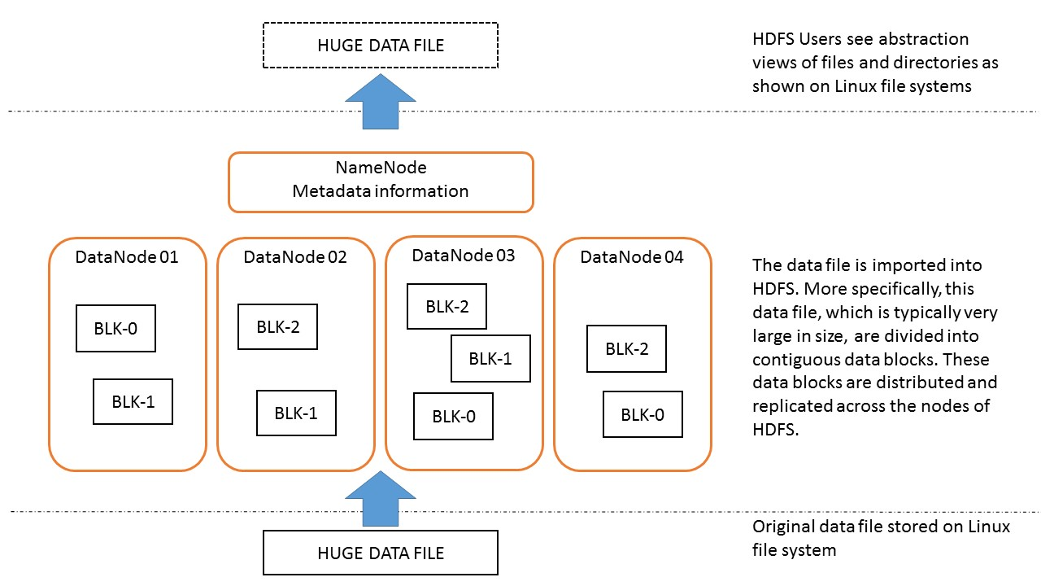

Slide 23
Demo
$ hdfs dfs -ls /
$ hdfs dfs -ls .
$ hdfs dfs -mkdir text
$ hdfs dfs -ls .
$ wget https://ocw.mit.edu/ans7870/6/6.006/s08/lecturenotes/files/t8.shakespeare.txt
$ hdfs dfs -put t8.shakespeare.txt text/
$ hdfs dfs -ls text
$ hdfs fsck text/t8.shakespeare.txt -blocks -files -racks

Slide 24
Demo
To view available commands
$ hdfs
On each data node, the actual data blocks are located at
/tmp/hadoop-root/dfs/data/current

Slide 25
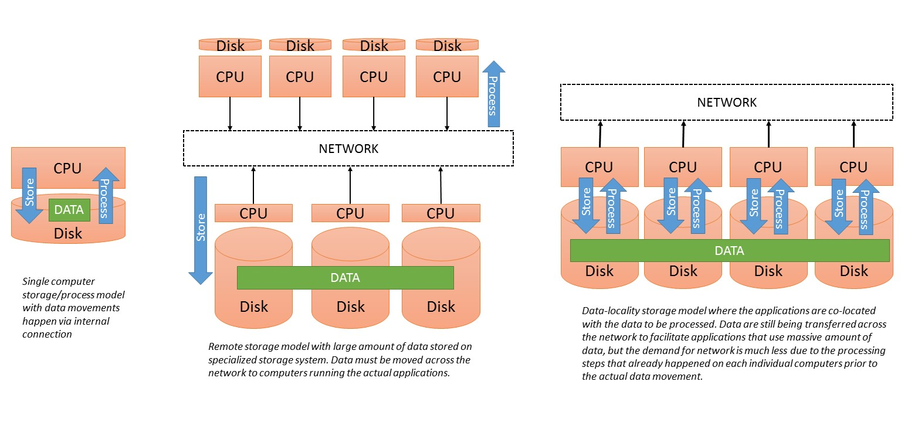
Comparing File System Models

Slide 26
Introduction to Apache Spark

Slide 27
What is Spark?
A unified computing engine and a set of libraries for parallel data processing on computer clusters.

Slide 28
Structured Streaming
Advanced Analytics
Libraries & Ecosystem
Libraries for parallel data processing
Structured APIs
Datasets DataFrames SQL
Unified computing engine
Low-level APIs
RDDs Distributed Variables

Slide 29
Design Philosophy
Unified: Spark supports a wide range of data analytic tasks over the same computing engine and a consistent set of APIs
Computing engine: Spark handles loading data from storage systems and perform computation on the data (in memory) rather than on permanent storage. To adhere to the data locality principle, Spark relies on APIs to provide a transparent common interface with different storage systems for all applications.
Libraries: Via its APIs, Spark supports a wide array of internal and external libraries for complex data analytic tasks.

Slide 30
A Brief History of Spark
Research project at UC Berkeley AMP Lab in 2009 to address drawbacks of Hadoop MapReduce.
Paper published in 2010: Spark: Cluster Computing with Working Sets
2013, the source code is contributed to Apache. The project had more than 100 contributors from more than 30 organizations outside UC Berkeley.
2014, version 1.0 is released.
Currently, Spark is being used extensively in academic and industry (NASA, CERN, Uber, Netflix …)

Slide 31
Basic Architecture
Spark relies on a cluster of computers to execute tasks. These computers are managed by either Spark’s stand-alone manager or external manager (YARN/Mesos).
Spark Applications are submitted to the manager, which will allocate computing resources for the execution of these applications.
A Spark Application is consisted of two components:
A driver process: maintains information about the application, responds to user input and programming instructions, and analyzes, distributes, and schedules tasks across the executors.
A set of executor processes: carries out work assigned by the driver.

Slide 33
MapReduce Programming Paradigm

Slide 34
Reality of working with Big Data
Hundreds or thousands of machines to support big data.
Distribute data for storage (HDFS)
Parallelize data computation (Hadoop MapReduce)
Handle failure (HDFS and Hadoop MapReduce)
The paper
MapReduce: simplified data processing on large clusters

Slide 35
... However, the input data is usually large and the computations have to be distributed across hundreds or thousands of machines in order to finish in a reasonable amount of time. The issues of how to parallelize the computation, distribute the data, and handle failures conspire to obscure the original simple computation with large amounts of complex code to deal with these issues.
As a reaction to this complexity, we designed a new abstraction that allows us to express the simple computations we were trying to perform but hides the messy details of parallelization, fault-tolerance, data distribution and load balancing in a library. Our abstraction is inspired by the _map_ and _reduce_ primitives present in Lisp and many other functional languages. We realized that most of our computations involved applying a _map_ operation to each logical ``record'' in our input in order to compute a set of intermediate key/value pairs, and then applying a _reduce_ operation to all the values that shared the same key, in order to combine the derived data appropriately. Our use of a functional model with user-specified map and reduce operations allows us to parallelize large computations easily and to use re-execution as the primary mechanism for fault tolerance.
The major contributions of this work are a simple and powerful interface that enables automatic parallelization and distribution of large-scale computations, combined with an implementation of this interface that achieves high performance on large clusters of commodity PCs.

Slide 36
MapReduce
What is “map”? A function/procedure that is applied to every individual elements of a collection/list/array/…
int square(x) { return x*x;}
map square [1,2,3,4] -> [1,4,9,16]
What is “reduce”? A function/procedure that performs an operation on a list. This operation will “fold/reduce” this list into a single value (or a smaller subset)
reduce ([1,2,3,4]) using sum -> 10
reduce ([1,2,3,4]) using multiply -> 24

Slide 37
MapReduce Programming Paradigm
Programmers implement:
Map function: Take in the input data and return a key,value pair.
Reduce function: Receive the key,value pairs from the mapper and provide a final output as a reduction operation on the pairs.
MapReduce Framework handles everything else.
Hadoop MapReduce’s optional functions:
Partition function: determines the distribution of mappers’ key,value pairs to the reducers.
Combine functions: initial reduction on the mappers to reduce network traffics.

Slide 38
WordCount: The “Hello, World” of Big Data
Count how many unique words there are in a file/multiple files.
Standard parallel programming approach:
Count number of files
Set number of processes
Possibly setting up dynamic workload assignment
A lot of data transfer
Significant coding effort

Slide 39
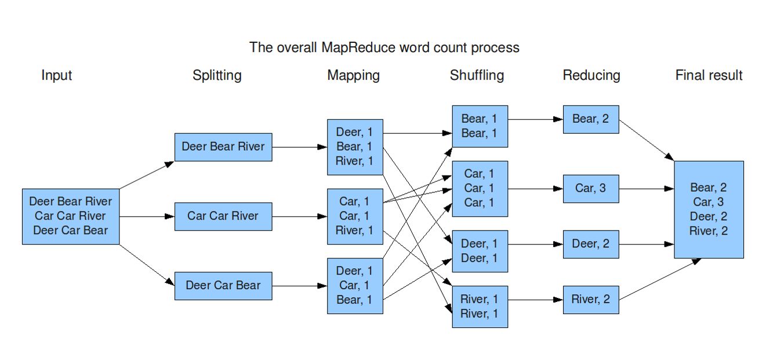
MapReduce WordCount workflow

Slide 40
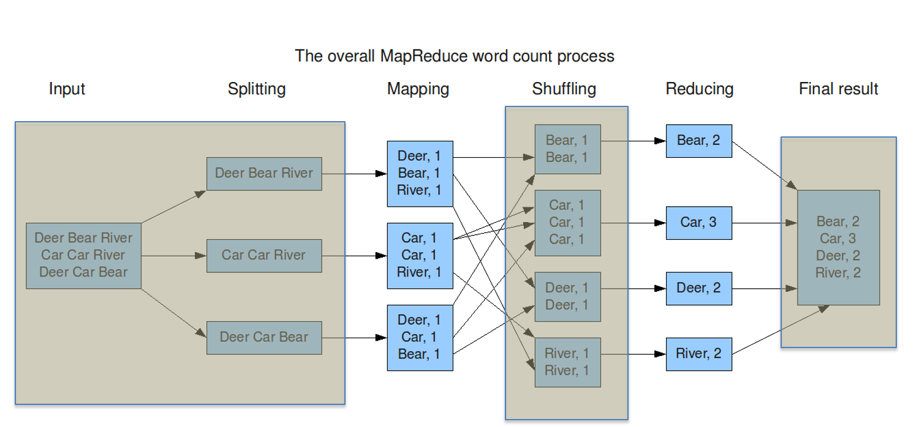
MapReduce WordCount Implementation
MR Framework
MR Framework
MR Framework

Slide 41
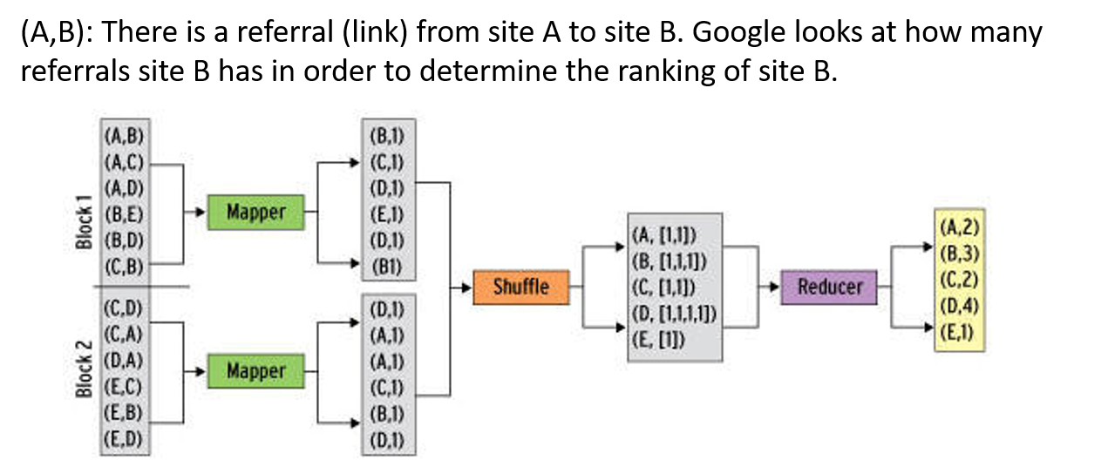
PageRank Example 1

