Slide 1
Adidas US Profitability & Cost Optimization
Business Analytics Case Study
Prepared by: Cleon Lopes

Slide 2
Executive Summary
Profitability varies widely across products, retailers, and regions
Revenue alone is a misleading performance indicator
Pricing and cost optimization can materially improve margins
Power BI dashboard enables scalable decision-making

Slide 3
Business Problem
High sales volume but inconsistent profit performance
Complex cost structures reduce visibility into true margins
Decision-makers lack clarity on the key profit drivers
Need a data-driven profitability framework to support strategic actions

Slide 4
Data & Methodology
Dataset: Adidas US Sales (Retailer, Product, Region, Channel)
Excel-based KPI modeling and profitability calculations
Power BI dashboard development with DAX measures
Scenario simulation for pricing and cost allocation analysis
Pareto analysis to identify high-impact products/partners

Slide 5
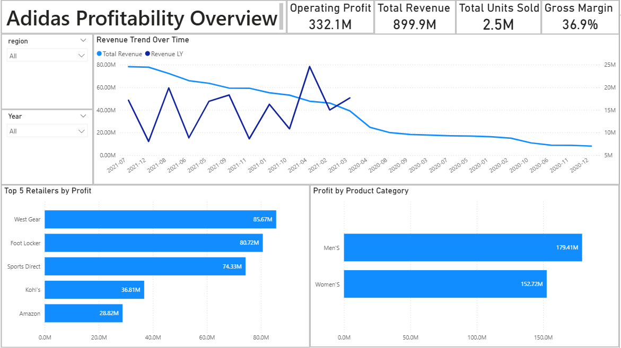
Overall Performance Snapshot

Slide 6
Retailer Profitability Analysis
High revenue does not always translate to high profitability
Identified underperforming retailers with high cost-to-serve
Opportunity to renegotiate, optimize pricing, or rationalize partners
Retailer segmentation highlights strategic focus areas

Slide 7
Product & Category Profitability (Pareto)
80/20 effect observed: a small number of products generate majority of profit
Long-tail SKUs contribute low margin and increase operational complexity
Category-level analysis highlights best and worst performers
Supports SKU rationalization and portfolio optimization strategy

Slide 8
Pricing Simulation
Simulated price change impact on demand and profit
Elastic products: profit drops if price increases aggressively
Inelastic products: profit increases with moderate price increases
What-if model supports data-driven pricing decisions

Slide 9
Cost Allocation & Scenarios
Allocated logistics, marketing, store operations, and online fees
Identified cost categories with highest margin erosion impact
Scenario comparison reveals best mix of cost control + growth strategy
Supports operational cost optimization decisions

Slide 10
Regional Performance
Significant profit variation across US states and regions
Identified high-margin regions for focused investment
Detected low-margin regions requiring cost or pricing intervention
Regional strategy supports expansion prioritization

Slide 11
Strategic Recommendations
Implement pricing optimization by product elasticity
Rationalize or renegotiate underperforming retailer partnerships
Strengthen cost controls in logistics and marketing spend
Prioritize investment in high-margin regions and channels
Reduce long-tail SKU complexity and improve portfolio focus

Slide 12
Business Impact
Improved transparency into profit drivers beyond revenue metrics
Actionable insights to support strategic decision-making
Scalable analytics framework reusable across future datasets
Dashboard enables leadership-level monitoring of profitability KPIs

Slide 13
Thank You
Questions?
Contact: lopescleon07@gmail.com

