Slide 1
RAMA Assessment Presentation
Rwanda Social Security Board

Slide 2
Summary
During the data preparation phase of analyzing the RAMA database, several assumptions were made to ensure the integrity and usability of the data. These assumptions were necessary due to limitations in the data and to facilitate a coherent analysis.
We had to assume that per patient visit, each patient has an ID via the foreign key which allows us to link client’s prescriptions. It also helps us identify the location IDs which details the exact province, district, sectors, cell, mand village through their individual ID. This is helpful to redirect clients depending on their stays to the most accurate location. We also used the patient visit table to link to the practitioner's information through their ID, which is essential for evaluating prescribing patterns and performance.
We also worked on the tariffs in the prescription table which helps provide valid pricing information that can be shared to the patients.
We used SQL queries to clean up the data and as a tool to analyze the data. We also used visualization as a tool to summarize findings

Slide 3
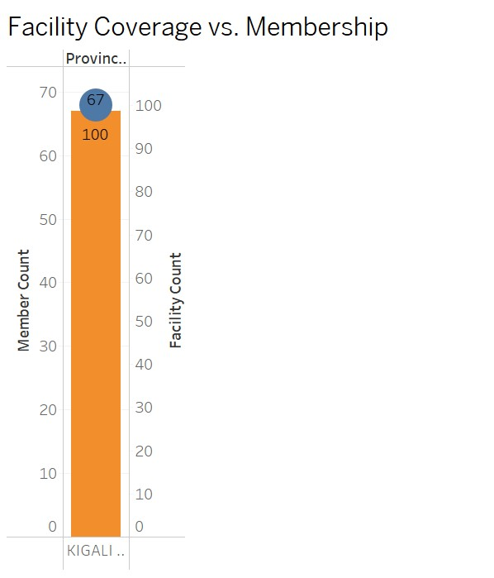
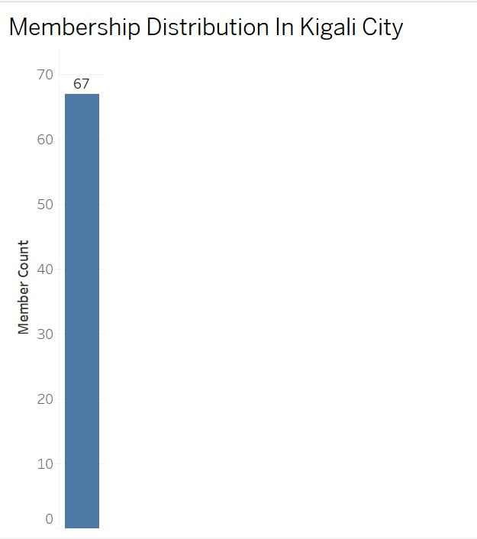
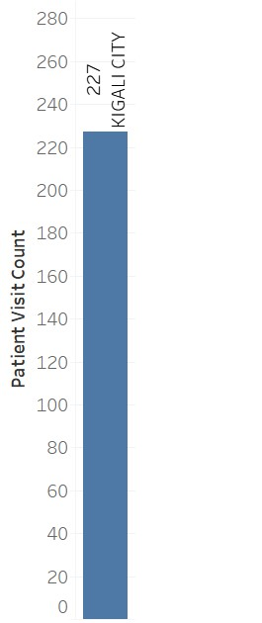
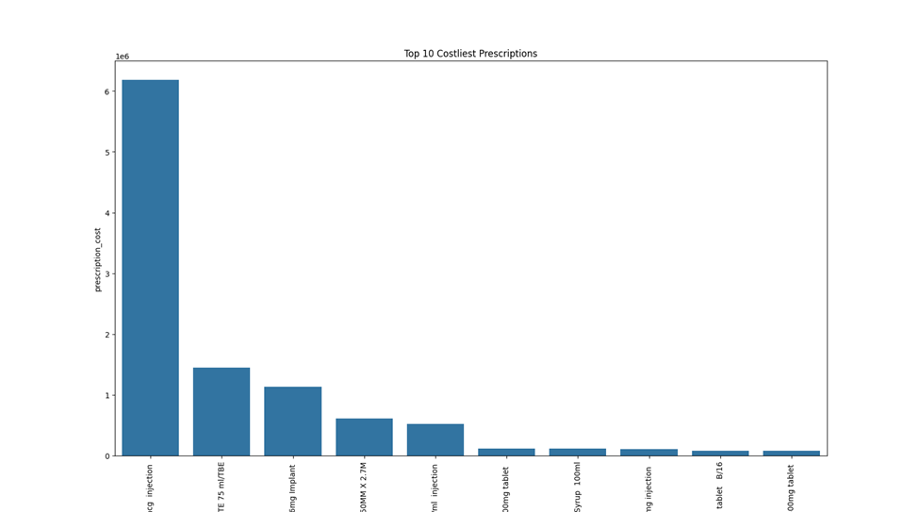
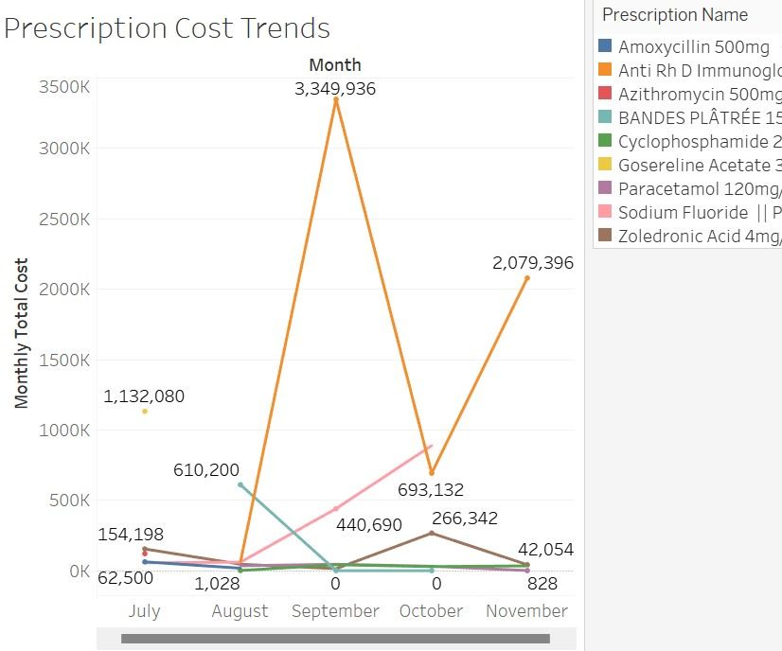
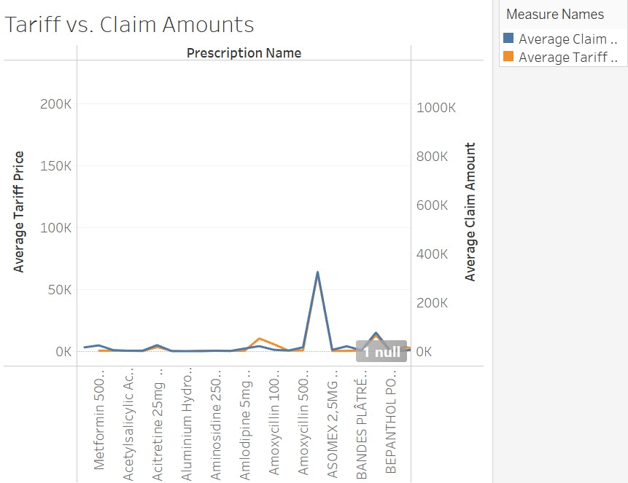
Visualizations
Facility Coverage vs. Membership
Membership distribution in Kigali
Patients visits by Region
Top 10 Costliest Prescriptions
Prescription Cost Trends
Tariff vs Claim Amounts

Slide 4
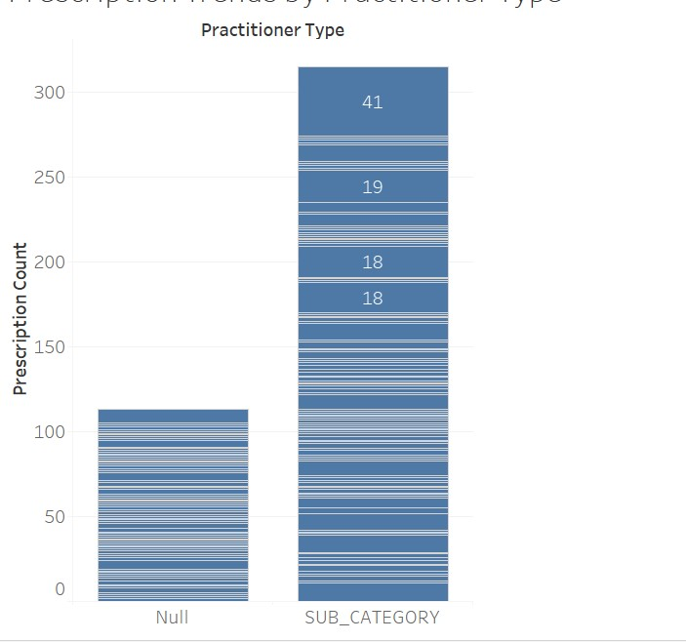
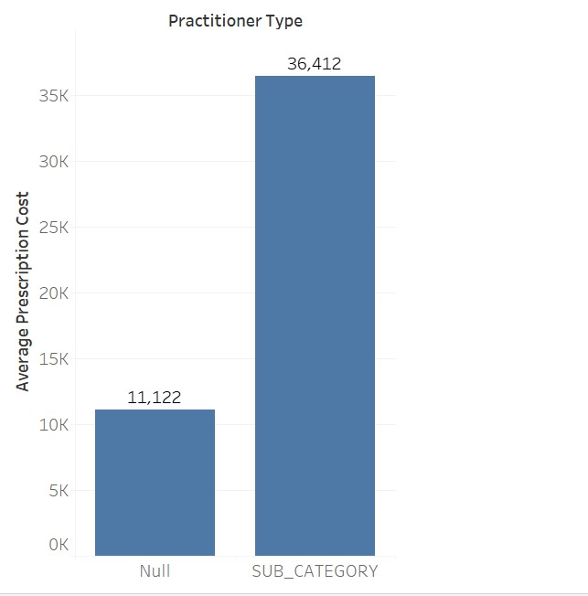
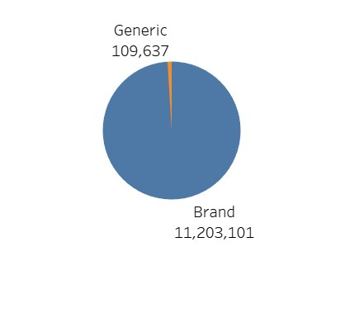
Visualizations
Prescription Cost by Practitioner Type
Prescription Cost by Practitioner Type
Generic vs Brand Medication Use

Slide 5
Findings
Using SQL queries, we were able to calculate the number of facilities per province and patient visits per province. We then used python code to combine the data and calculate member to member facility ration. We used both SQL queries and python code to create visualization to help identify provinces with the most visits.
We found that there was a gap based on some facilities in the provinces which indicate that there might be underutilized healthcare services based on low visits.
We also found that there is a trend of specific prescriptions having a higher cost during certain month due to increased demand.
One of the main findings identified is the high level of visits that we see in Kigali City which reflect with the high count of membership of patients living in Kigali City.

Slide 6
Recommendation
Based on the findings, one of the recommendations would be to expand facilities in provinces with the highest ratio of visits to improve access and possibly decrease wait time. This can be done through different options. One option can be through partnerships with private clinics underserved areas for more availability. Another option would be deploying mobile health units to provide service to people who are not able to get to those facilities due to health issues.
Another recommendation can pertain to costs. By identifying the most expensive prescription and how that cost increases over time, we would recommend that quantity of orders is increased in the month with a lower price and demand, to avoid the time frame where the cost are super high.

Slide 7
END

