Slide 1
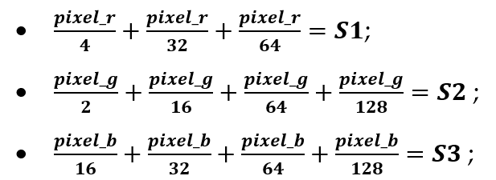

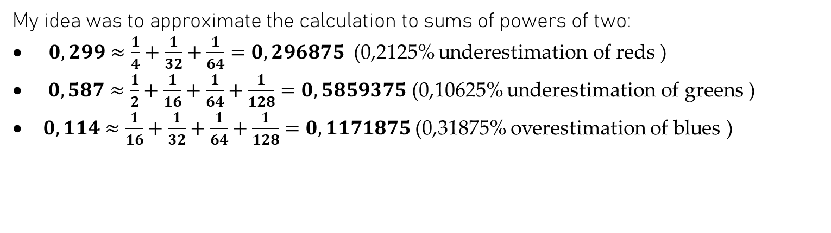
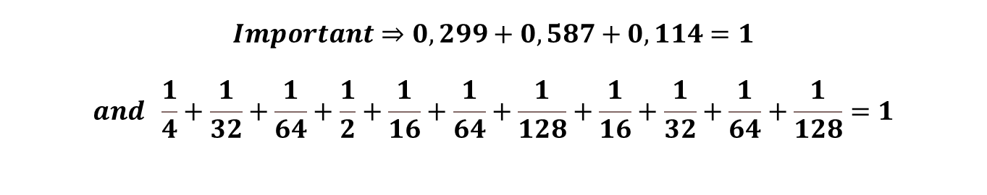
RGB2GRAY
My idea was to approximate the calculation to sums of powers of two:
$0,299≈\frac{1}{4}+\frac{1}{32}+\frac{1}{64}=0,296875$ (0,2125% underestimation of reds )
$0,587≈\frac{1}{2}+\frac{1}{16}+\frac{1}{64}+\frac{1}{128}=0,5859375$ (0,10625% underestimation of greens )
$0,114≈\frac{1}{16}+\frac{1}{32}+\frac{1}{64}+\frac{1}{128}=0,1171875$ (0,31875% overestimation of blues )
$$Important⇒0,299+0,587+0,114=1$$
$$and \frac{1}{4}+\frac{1}{32}+\frac{1}{64}+\frac{1}{2}+\frac{1}{16}+\frac{1}{64}+\frac{1}{128}+\frac{1}{16}+\frac{1}{32}+\frac{1}{64}+\frac{1}{128}=1$$

Slide 2
RGB2GRAY - Remainder handling
$\frac{17}{16}≈1 ⇒\frac{10001}{10000}=right shift\left(4\right) of 10001 = 1 ; Remainder = 0001$;
OK
$$\frac{15}{16}≈1⇒\frac{01111}{10000}= right shift \left(4\right) of 01111 = 0 ; Remainder= 1111;$$
NOT OK, PROBLEM TO DEAL WITH
Just cutting the vector and throwing away the rest is not a good idea, there must be some rest handling...
Objective:
to estimate the value to be added to the sum obtained exclusively by right shift operations, correcting the error resulting from the approximation by means of remainder analysis.

Slide 3
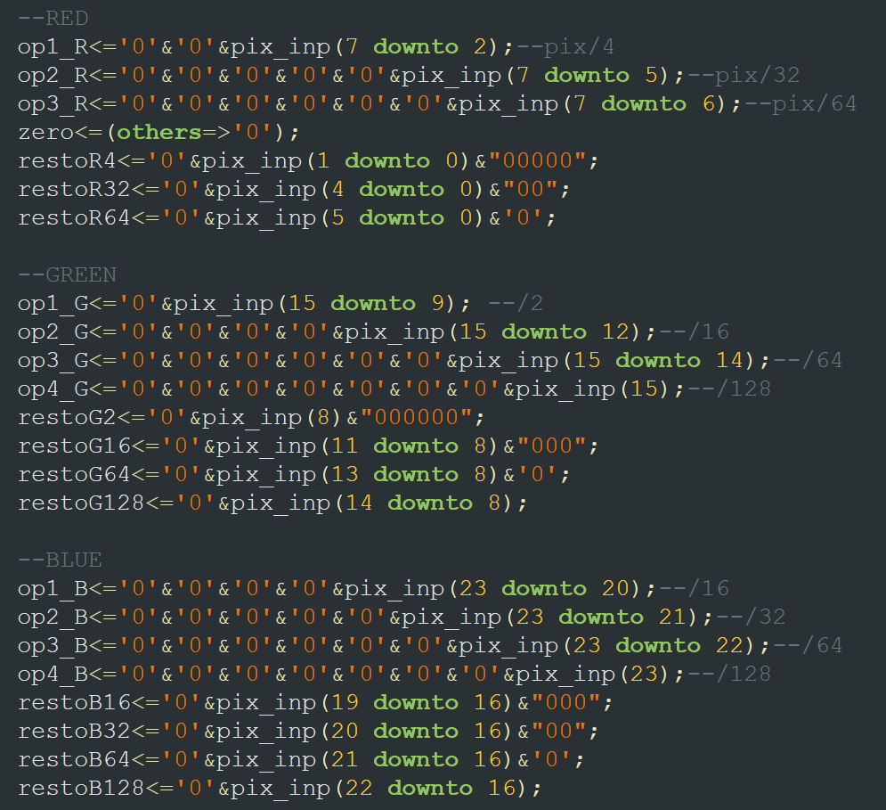
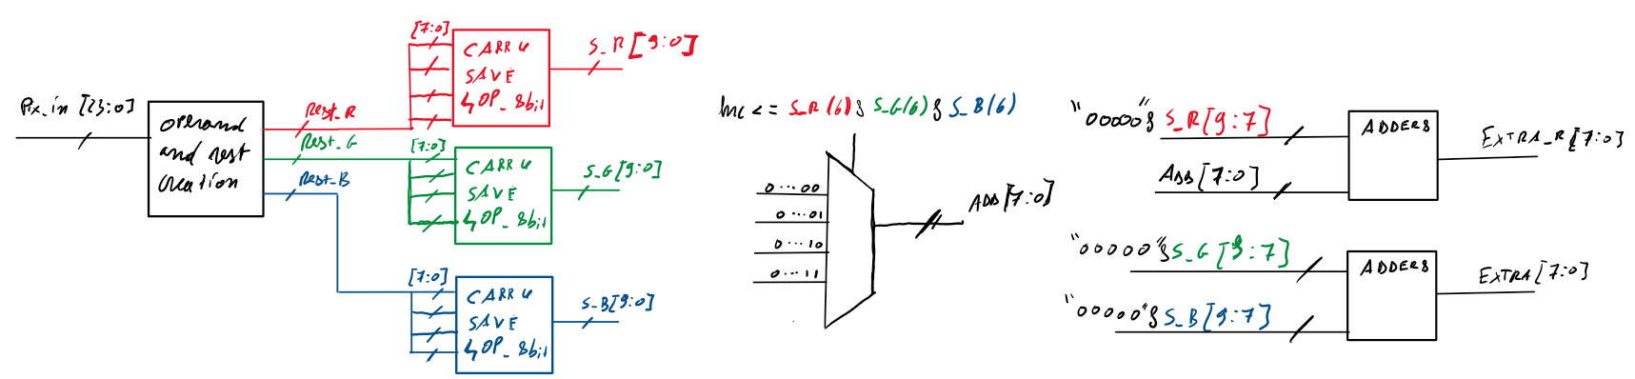
RGB2GRAY - Remainder handling
SOLUTION: Remains are not thrown away but each shifted into a vector of remains and then summed each other.
Brutally, what i’m doing here is:
5.5 + 7.4 + 3.2 = 5 + 7 + 3 + 0.5 + 0.4 + 0.2
0.5 + 0.4 + 0.2 = 1.1 then 1 has to be added to the computation.
It's an easy question, right? But telling it to a bit of silicon is not as easy as it sounds...
Here it is how I did it

Slide 4
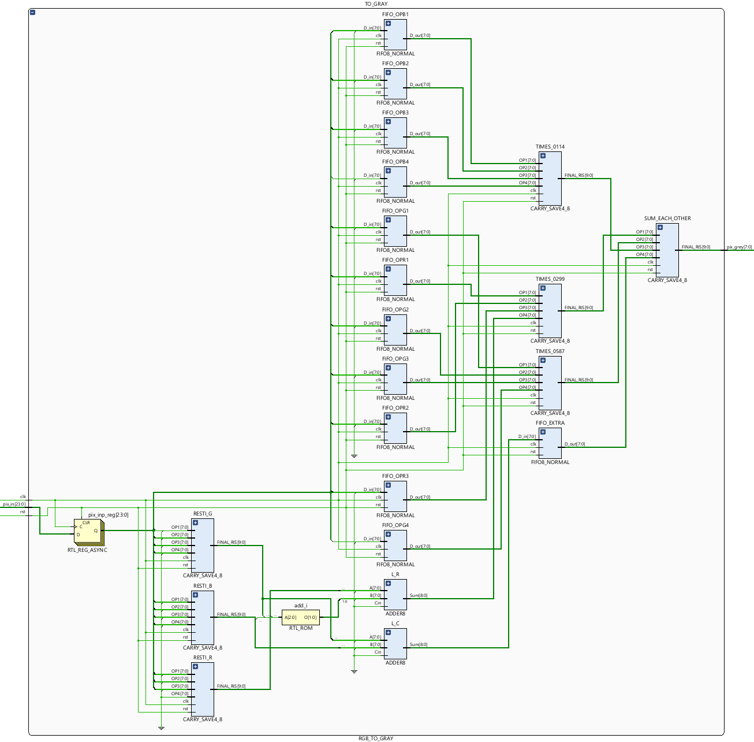
RGB2GRAY - Schematic
10 pipeline level in total and works at 2.9 ns of clock period.

Slide 5
RGB2GRAY - Results
The wrong pixels for this image are 340 but the error on each pixel remains between -1 and 1. My solution use only some pipeline register, seven 8-bit Carry-save at four operands and two 8-bit Adder.
Raffaele Petrolo

