Slide 1
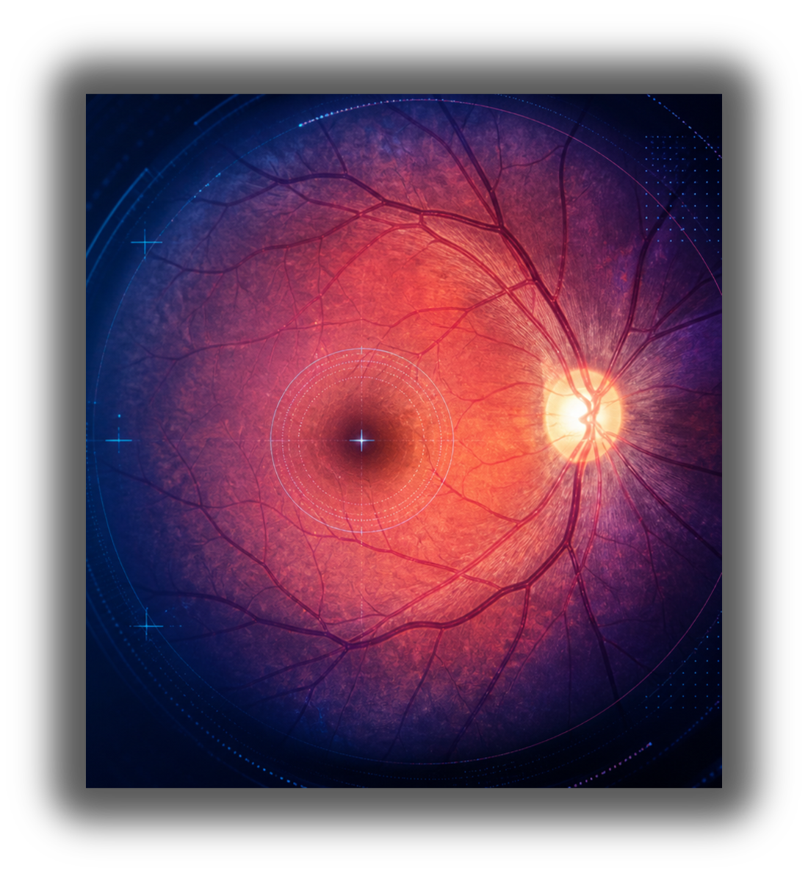

OPTIC DISC & FOVEA LOCALIZATION
BIM472 IMAGE PROCESSING — PROJECT 2
ÇAĞDAŞ KAPLAN
MERT CAN KALINLIOĞLU
:

Slide 2
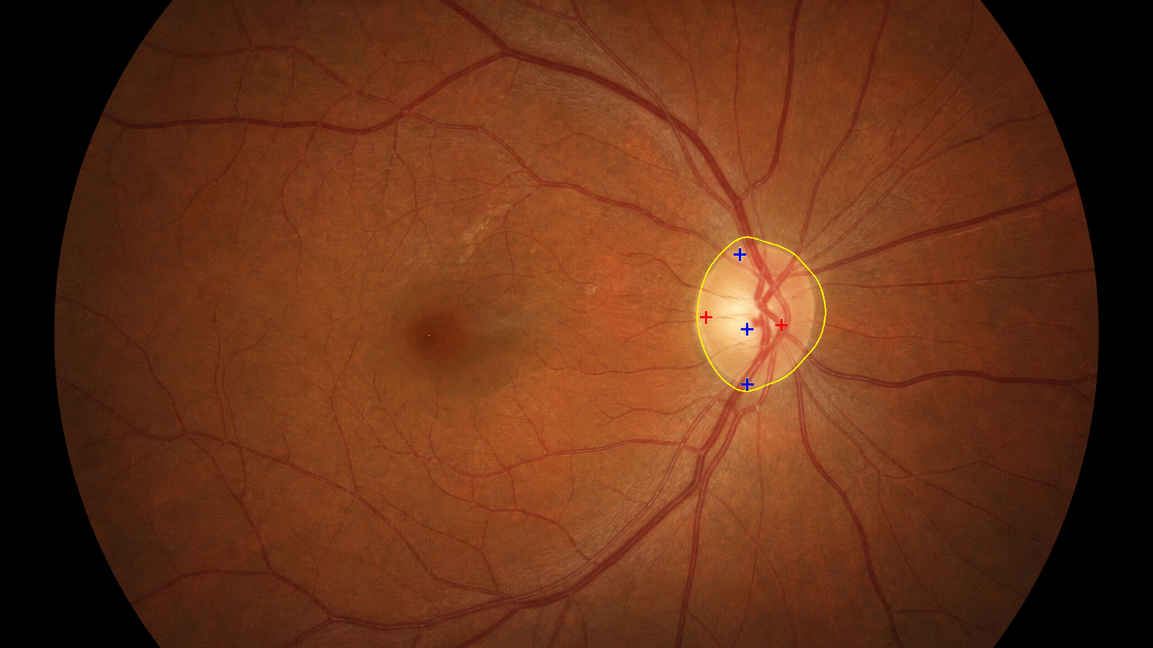
Main goal
Detect optic disc center
Segment optic disc region
Locate fovea center
Compare predictions with ground truth
Why these landmarks?
They are basic anatomical reference points
They help define retinal regions of interest
They support later diagnosis-oriented processing
They make algorithm outputs measurable

Slide 3
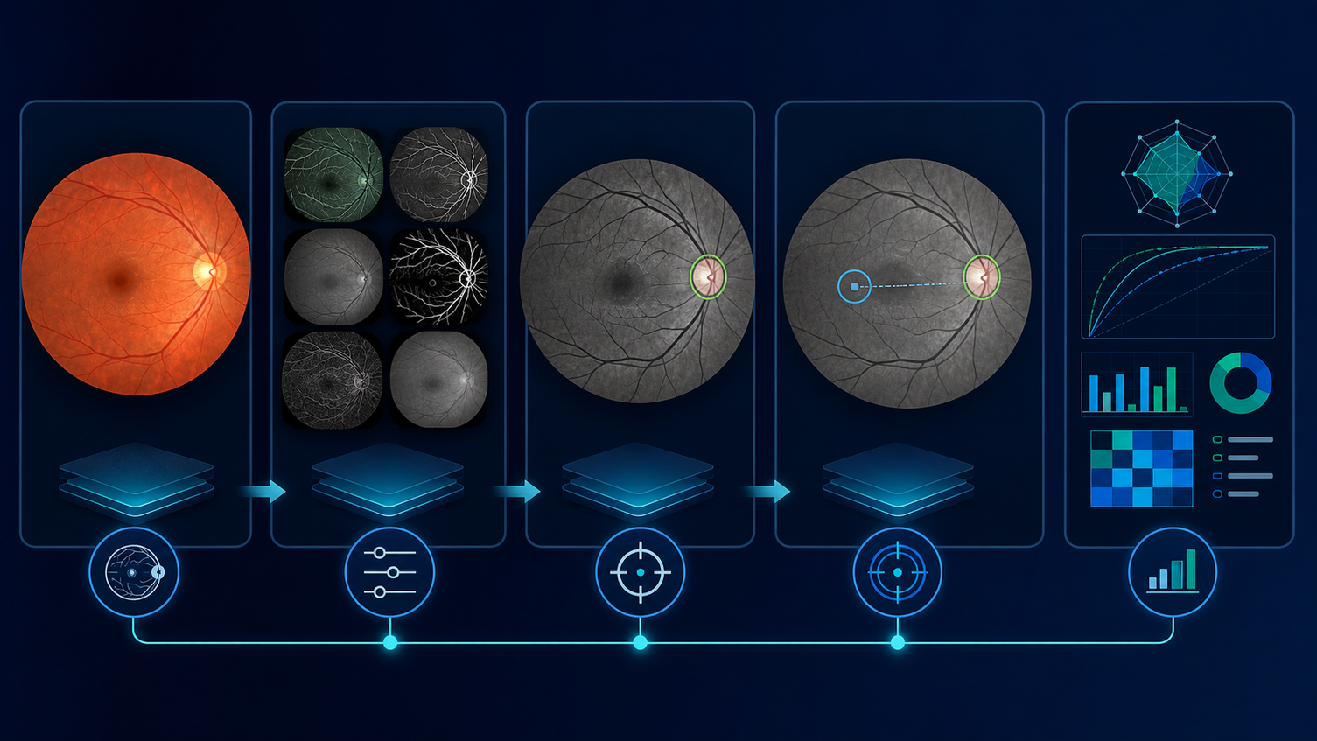
End to End Pipeline
01 - INPUT IMAGE
02 - PREPROCESSING
03 - OD DETECTION
04 - OD SEGMENTATION
05 - FOVEA LOCALIZATION
06 - EVALUATION

Slide 4
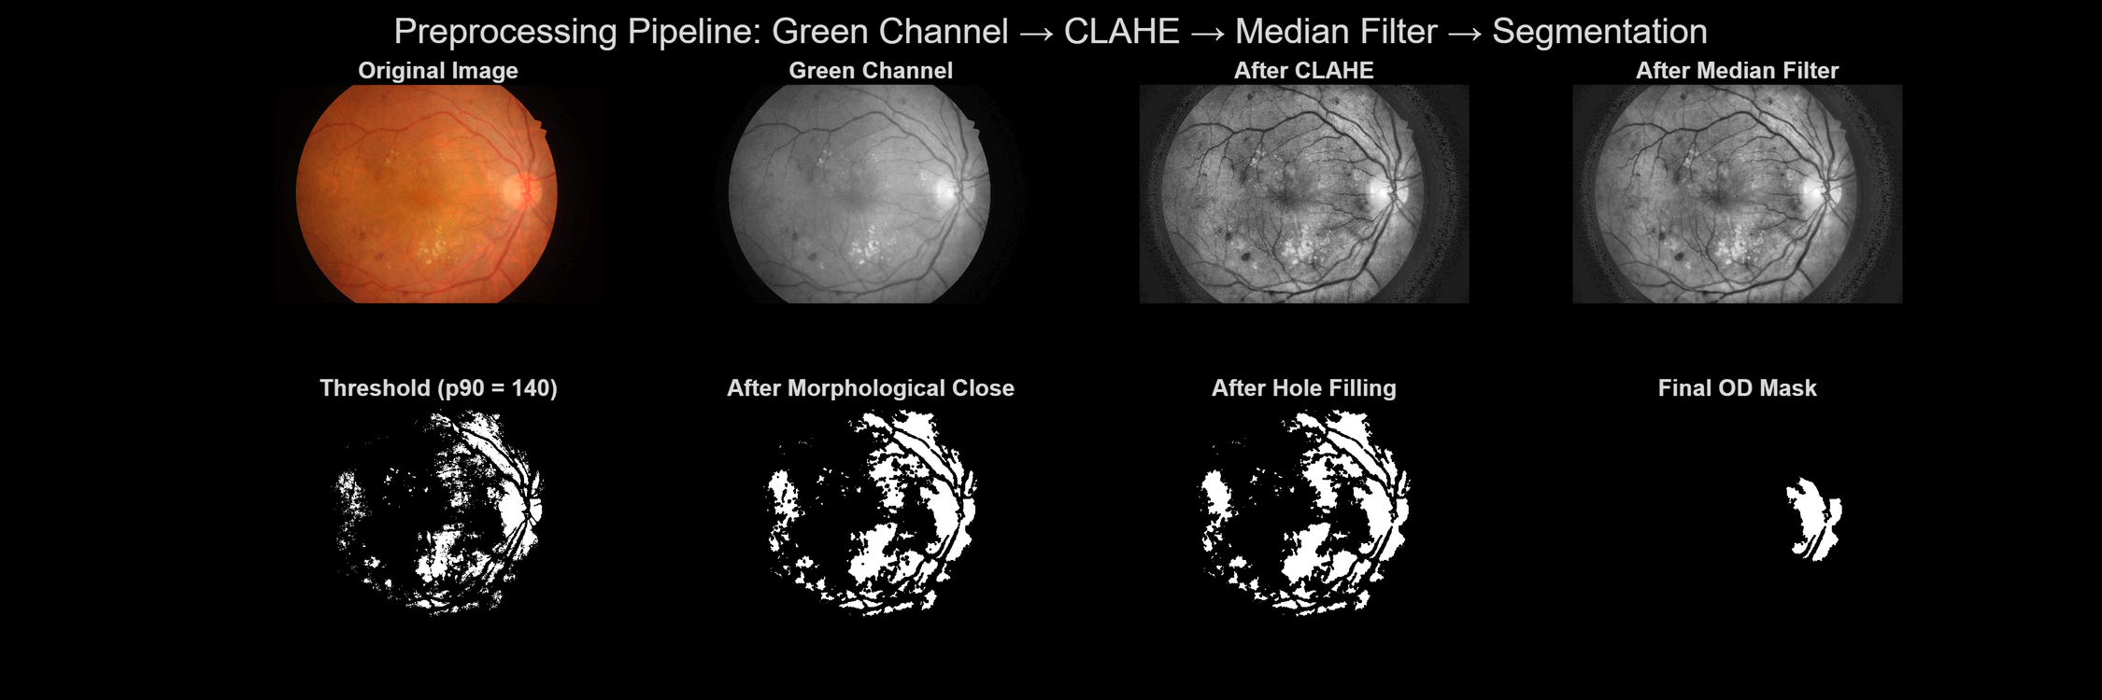
PREPROCESSING PIPELINE
Green channel → CLAHE → Median fIlter → SegmentatIon mask

Slide 5
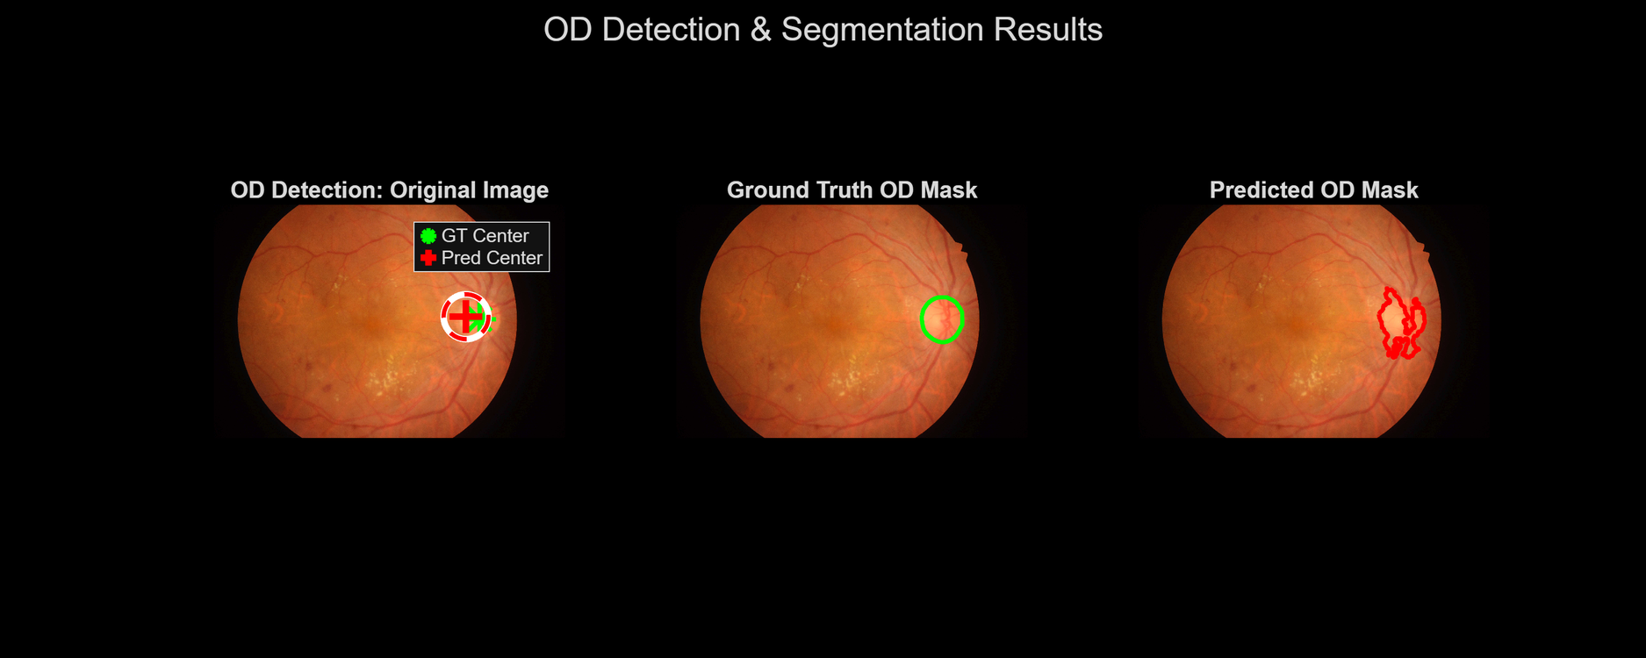
Optic Disc Detection & Segmentation
Algorithm logic
Use red channel for bright OD search
Mask black background / field-of-view edges
Apply strong Gaussian blur to suppress vessels and lesions
Pick brightest location as OD center
Segment local ROI using Otsu + morphology

Slide 6
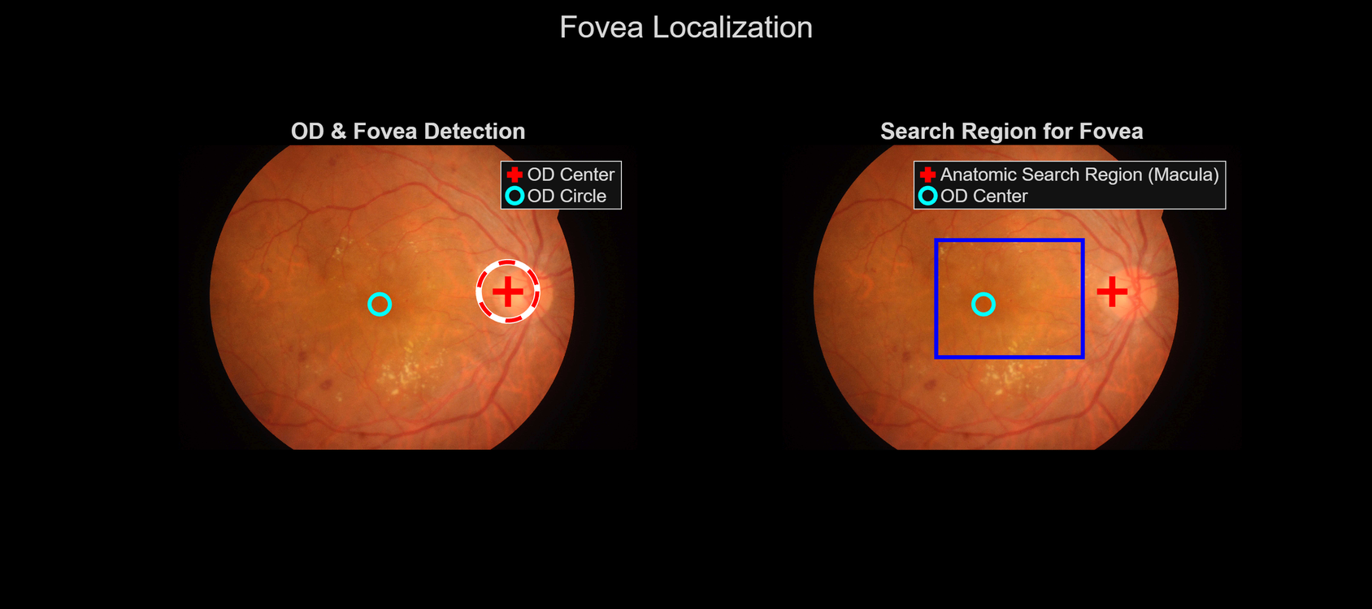
Fovea Localization
How it works
Use detected OD center as anchor
Decide left/right eye by OD position
Create a horizontal search window
Blur the search region aggressively
Remove unsafe edge areas using FOV mask
Select the darkest point as fovea center

Slide 7
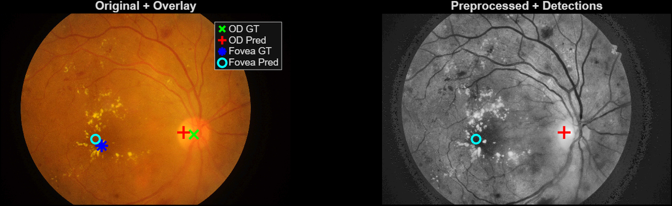
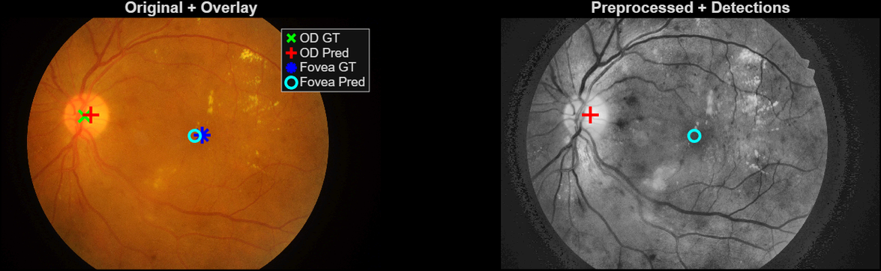
Visual Results Gallery
How to read the examples
Left side: original fundus image with ground truth and predicted centers.
Right side: preprocessed image with detected centers.
Close OD GT and OD Pred markers indicate successful optic disc localization.
Fovea can be more sensitive to lesions and low contrast.

Slide 8
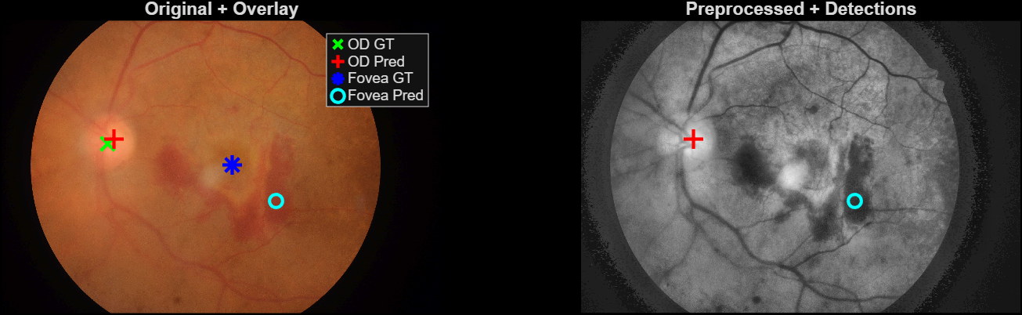
A MORE CHALLENGING EXAMPLE
Observation 1
OD is still easier because it is a bright anatomical structure.
Observation 2
Dark lesions or low contrast can confuse darkest-point fovea search.
Takeaway
The method is explainable, but rule-based localization has limits.

Slide 9

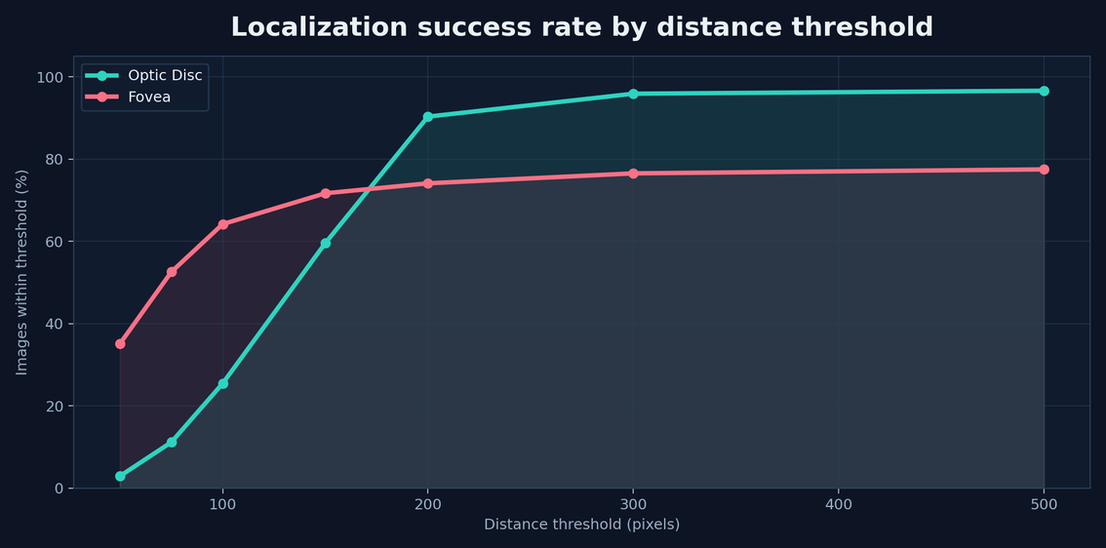
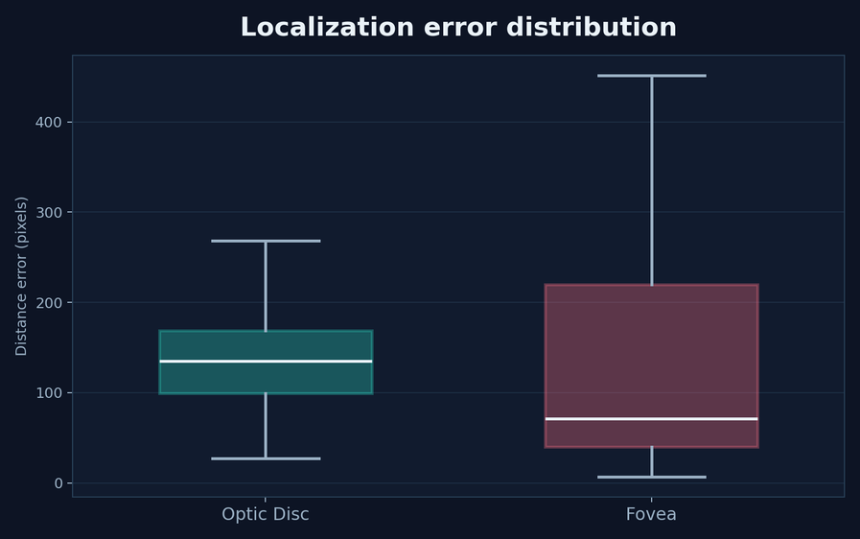
LOCALIZATION PERFORMANCE
259 PX
Mean fovea error
64.2%
Fovea ≤ 100 px
172 PX
Mean OD error
90.3%
OD ≤ 200 px

Slide 10
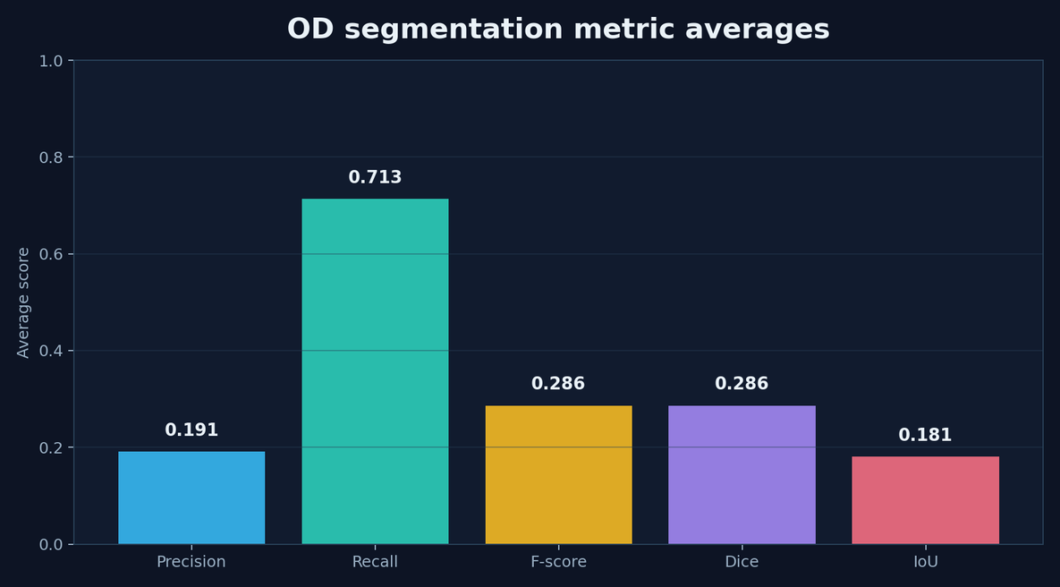
OD Segmentation Performance
Result interpretation
Mean recall is high (~0.713): the OD region is often covered.
Mean precision is lower (~0.191): masks can include false positives.
Mean F-score / Dice is ~0.286 and mean IoU is ~0.181.
Center localization is stronger than exact boundary extraction.

Slide 11
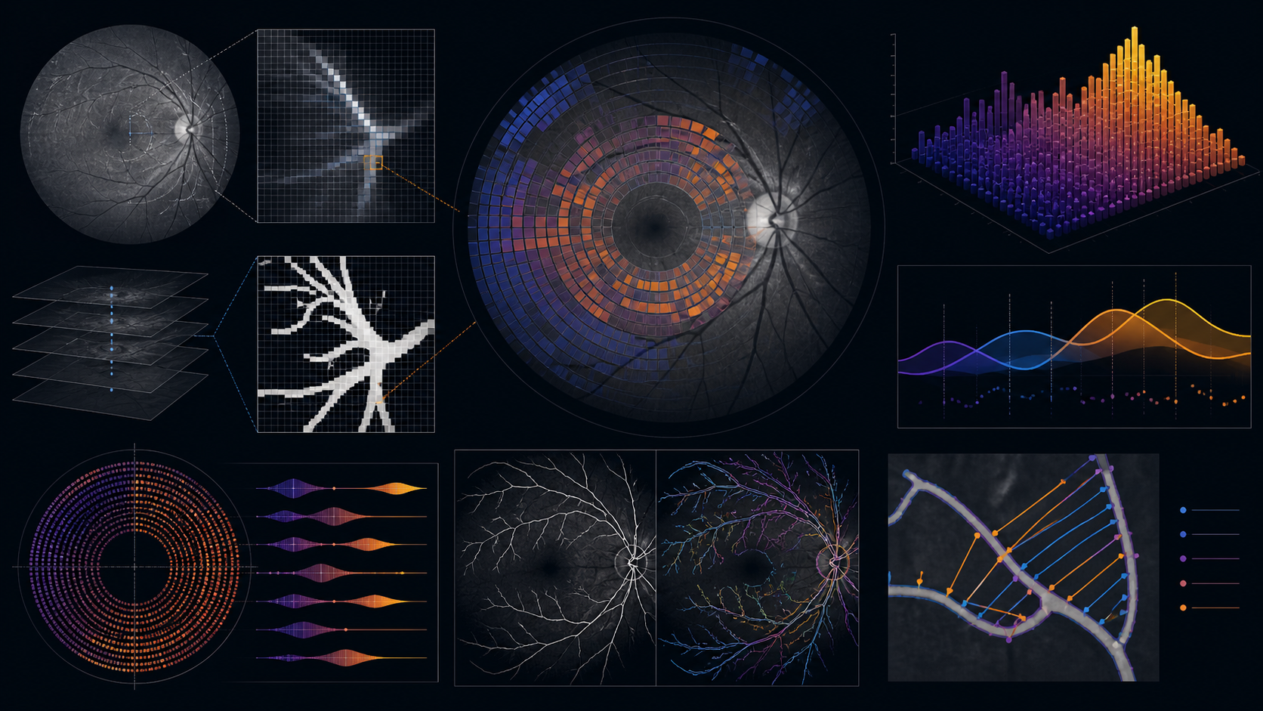
Image Processing Techniques Used
Color space
RGB channels, green-channel extraction
Enhancement
CLAHE, illumination handling
Filtering
Gaussian blur, median filter
Morphology
Closing, hole filling, connected components
Thresholding
Percentile threshold, Otsu threshold
Evaluation
Distance error, Precision, Recall, Dice, IoU

Slide 12
Limitations & Future Work
Current limitations
OD boundaries are not always precise
Fovea localization is sensitive to lesions and low contrast
Hand-crafted thresholds may not generalize perfectly
Very bright lesions can affect OD segmentation
Conclusion
The project demonstrates that an explainable classical pipeline can localize key retinal landmarks, especially optic disc center, while revealing the limitations of rule-based segmentation and fovea estimation.
Future improvements
Adaptive ROI refinement
Better vessel / lesion suppression
Contour-based boundary correction
Comparison with learning-based baselines
Parameter tuning per image quality

Slide 13
THANK YOU FOR LISTENING

