Slide 1
The squat
Myth busting bro-science

Slide 2
Squat technique
Stance: Shoulder/Hip Width
Head neutral
Tighten Core
Keep back straight
Go deep

Slide 3
3 Types of lifting
Body Building
Power Lifting
Weight Lifting

Slide 4
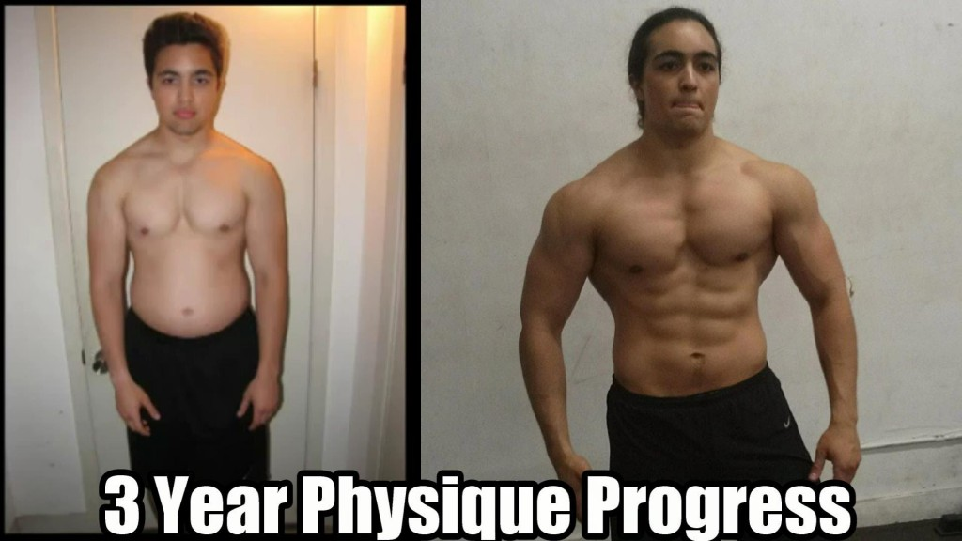
Body building/power lifting: omarlsuf

Slide 5
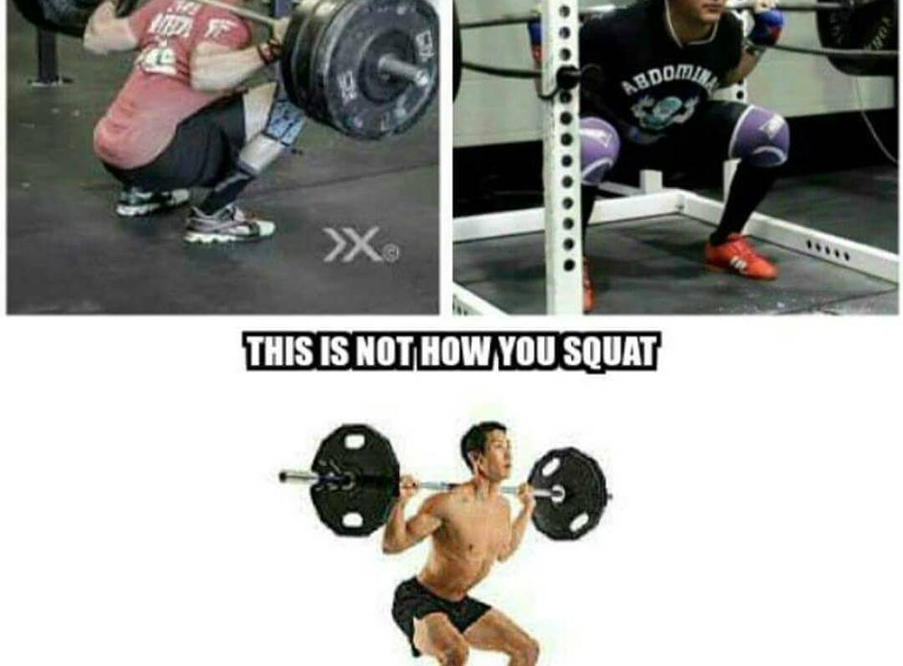

Slide 6

Body builder: Matt Ogus

Slide 7
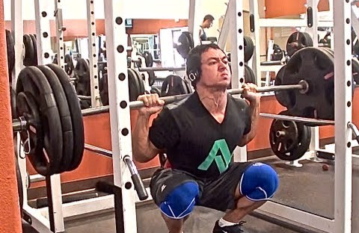
Body builder deep squatting

Slide 8
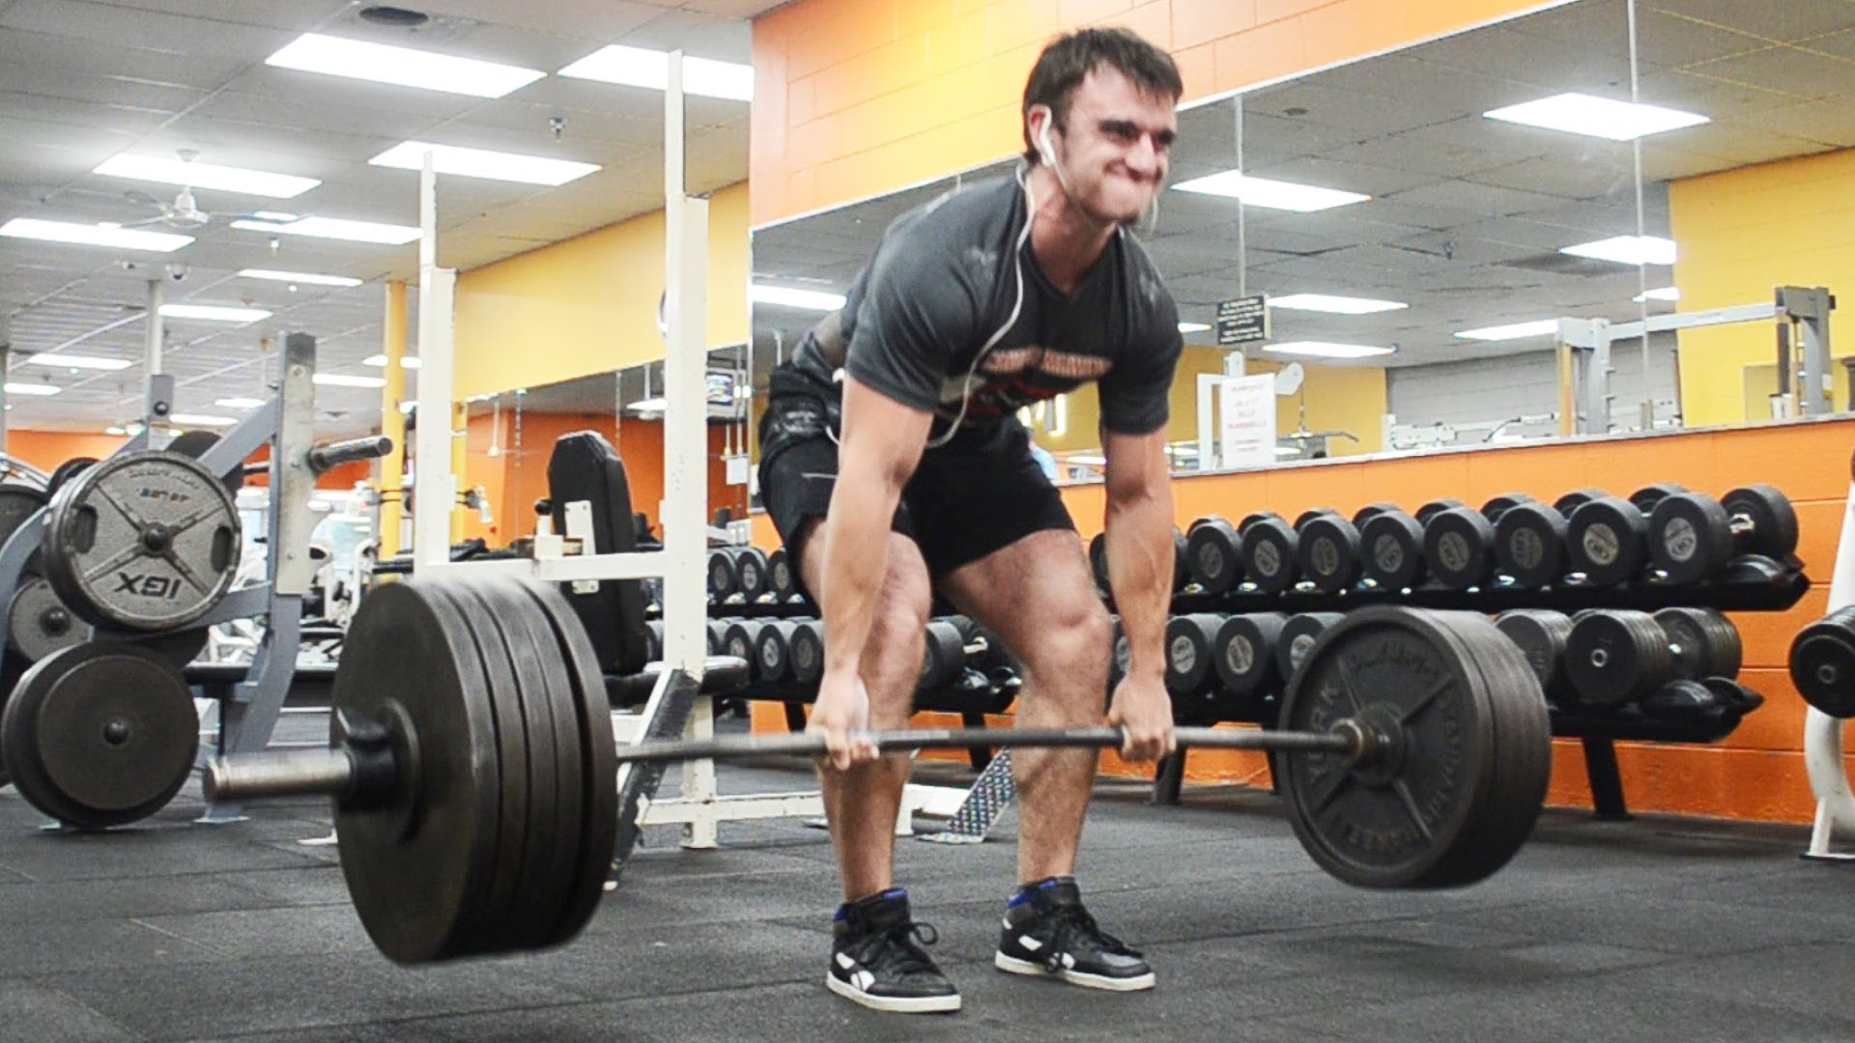
Power lifter: Candito hq

Slide 9
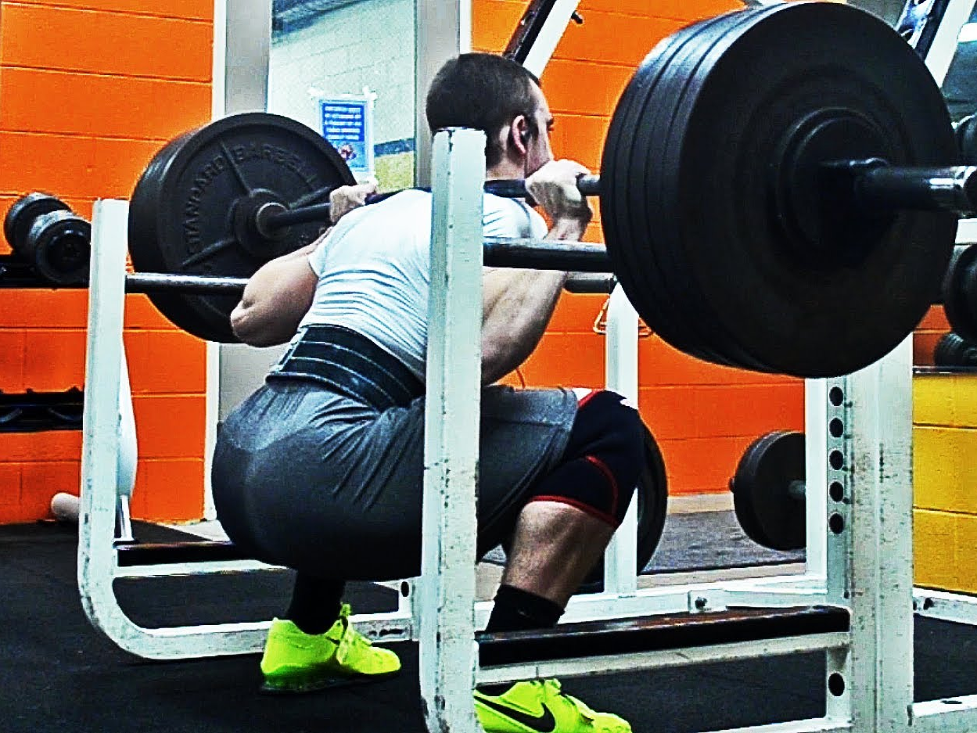

Slide 10
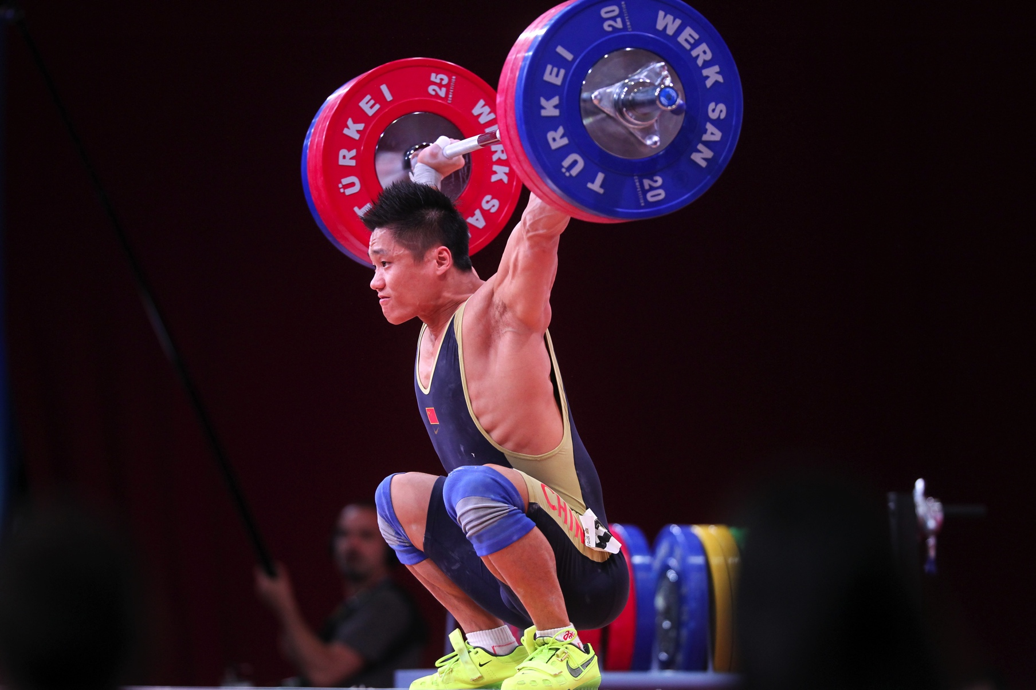
Weight lifter: Lu XioJun

Slide 11
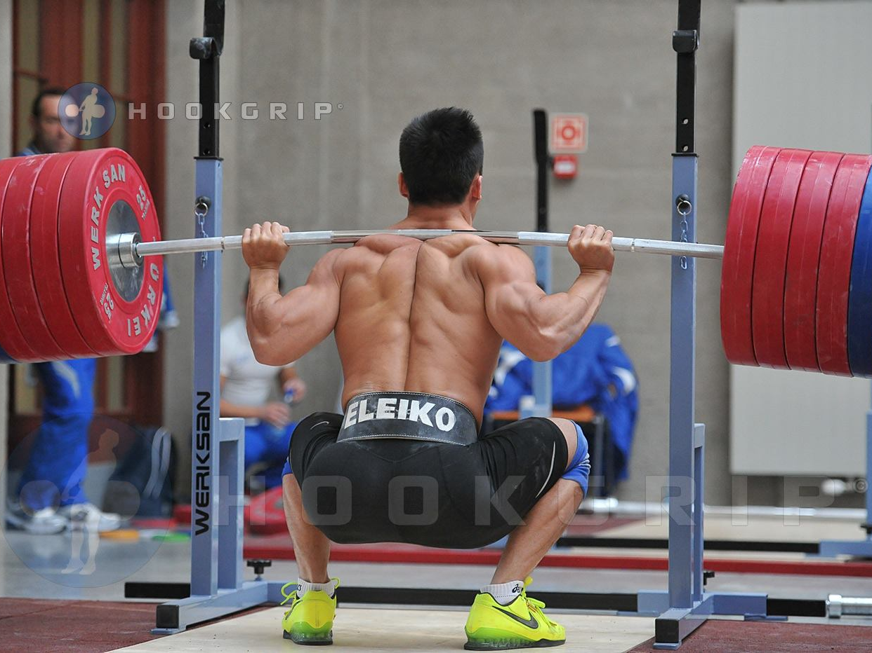

Slide 12

What girls think they will look like

Slide 13
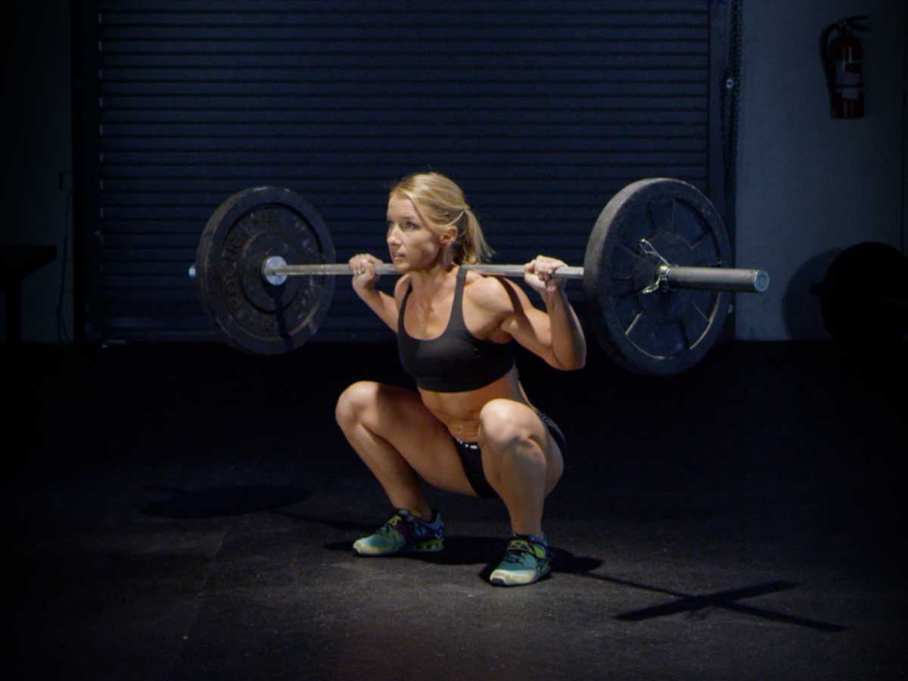

Slide 14
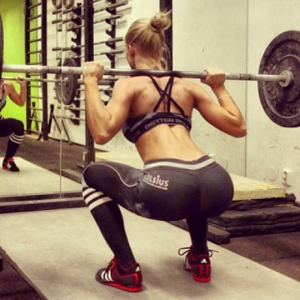

Slide 15
What was the one common thing?

Slide 16
Benefits of squatting
Get Stronger (Strength)
Look Better (Aesthetics)

Slide 17
Squat technique
Stance: Shoulder/Hip Width
Head neutral
Tighten Core
Keep back straight
Go deep

