Slide 1


MERIDIAN FIELD COMMAND
AI-powered construction management for solar EPC
BUILT FOR THE FIELD. BY THE FIELD.
OpenVC score-optimized investor deck

Slide 2

Solar growth, schedule pressure, and AI maturity are converging now
02
43.4 GW utility-scale solar planned for 2026 Solar represents 51% of planned new U.S. generating capacity
$369B IRA clean energy incentives Federal tailwinds continue to push solar, storage, and infrastructure
AI-ready documents, drawings, photos, and specs Production-grade document intelligence makes EPC automation possible now
Market pressure EPC teams are taking on more megawatts, faster COD timelines, and larger LD exposure while managing fragmented field systems.
Technical shift Modern AI can parse contracts, BOMs, drawings, specs, photos, and closeout documents into structured workflows.
Timing window Generic platforms are horizontal. Solar EPC teams now need vertical field intelligence built around their project realities.
Meridian exists because the market is scaling faster than the tools solar teams use to manage it.
Sources: U.S. EIA planned 2026 capacity additions; IRA investment incentives public summaries; company analysis.

Slide 3

Disconnected tools are creating preventable risk for solar EPC teams
03
Solar EPC contractors are still managing high-value construction risk with spreadsheets, email, manual inspections, and scattered field photos.
$750K LD exposure Manual schedules miss COD dates by weeks. $5K-$15K/day penalties add up fast.
40-60 hours PMs rebuild schedules in P6 or Excel. Every NTP delay cascades through the timeline.
Quality chaos Inspection templates are rebuilt from scratch while specs, drawings, and torque values are cross-referenced manually.
Document sprawl RFIs in email. Photos in phones. Punch lists in Excel. Closeout scattered everywhere.
The status quo is not one competitor - it is the messy combination of 4-6 disconnected systems.

Slide 4
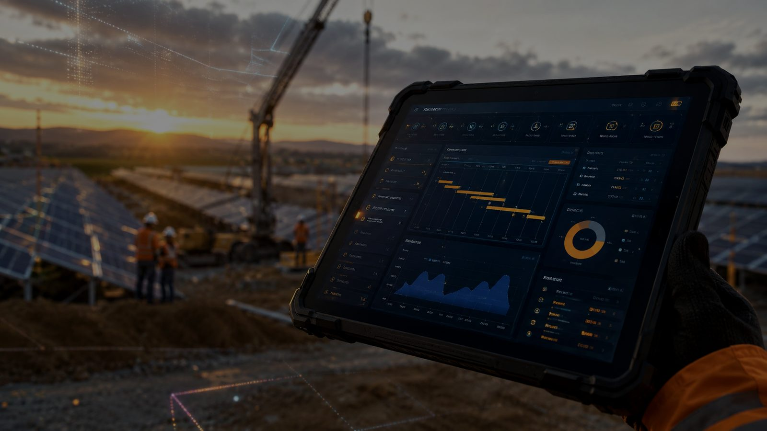
One field command system - plus AI products that create expansion revenue
04
Meridian Field Command centralizes solar EPC execution from NTP through closeout, with standalone AI tools that can also power premium modules inside the platform.
$10K/mo base platform 18-module field hub
+$2K/mo Build Planner AI powered by BuildIQ
+$2K/mo Quality AI Premium powered by InspectionIQ
Standalone AI products additional entry points
Field Command Central hub for project controls, QA/QC, RFIs, documents, materials, photos, safety, analytics.
BuildIQ AI planning: drawings/BOM/contract to schedule, cost forecast, and LD risk.
InspectionIQ AI inspection templates: specs/drawings to torque values, embedments, and checks.
CloseoutIQ + SiteIQ OCR closeout automation and photo analysis that syncs back to the command center.
The wedge is solar EPC. The larger ambition is AI-powered field execution for complex construction.

Slide 5
18 modules are built around the way solar projects actually run
05
A purpose-built operating system for field teams, project managers, quality leaders, and executives managing solar construction risk.
PLAN
CONTROL
EXECUTE
CLOSEOUT
Build Planner
Documents
Daily Reports
Punch List
Contracts
RFIs
Quality/QC
Corrective Actions
BOM
Submittals
Observations
Photos
Locations
Materials
Safety
Closeout Docs
Settings
Analytics
Team
Turnover
Solar EPC workflow: NTP -> planning -> field execution -> QA/QC -> punch -> closeout -> turnover
Product status: complete, demo-ready MVP with 18 integrated modules.

Slide 6

AI tools compound into a contractor-specific advantage
06
Each AI product creates standalone value. Inside Field Command, every use trains a contractor-specific operating model.
BUILDIQ Planning AI
Drawings + BOM + contract -> schedules, forecast, LD risk
INSPECTIONIQ Quality AI
Specs + drawings -> inspection templates, torque values, embedments
SITEIQ Photo AI
Field photos -> estimates, issues, site context, progress signals
CLOSEOUTIQ OCR AI
Closeout docs -> structured turnover records
PROPRIETARY LEARNING LOOP
Industry benchmarks -> actual crew productivity -> equipment efficiency -> site conditions -> contractor-specific forecasts
Project 1 Starts with industry benchmarks and solar EPC templates.
Projects 3-5 Learns each contractor's actual production rates and field patterns.
Compounding moat Personalized AI advantage increases accuracy and switching costs.

Slide 7
Early customer conversations validate pricing and pilot pipeline
07
Current validation Customer conversations
- Direct access to 50+ EPC contacts from 8 years in solar
- Pricing validated: $10K-$14K/month per project
Platform readiness
- 18 modules built and tested
- Phase 2 development complete
- React + Supabase production stack
- Demo-ready for pilot onboarding
Next 180 days Q2 2026
First pilot customer onboarded; target 1 paying project @ $10K/month
Q3 2026
Expand pilot program; target $10K MRR from 1-2 projects
Q4 2026
Repeatable onboarding playbook; target scale to 5-10 customers
$120K gets Meridian from MVP to pilot validation to repeatable revenue
Q2
Q3
Q4
first pilot
$10K MRR
repeatable onboarding

Slide 8
Project-level pricing creates premium ARPA with AI expansion
08
Pricing is designed around the economic reality of utility-scale projects: large budgets, high LD exposure, and heavy documentation requirements.
$10,000 Base platform / month Full 18-module suite - no AI premium tiers
+$2,000 Build Planner AI / month BuildIQ powers automated planning and risk forecasts
+$2,000 Quality AI / month InspectionIQ powers templates and field checks
TOTAL WITH DUAL AI: $14,000 / PROJECT / MONTH
Enterprise-aligned Comparable with Procore GC tiers, but purpose-built for solar EPC workflows.
Expansion path Standalone AI tools act as entry points and upsell into Field Command.
Retention lever Learning loop improves accuracy project over project, creating switching costs.

Slide 9
Solar EPC represents a $4.2B+ TAM growing with clean infrastructure demand
09
TAM $4.2 BILLION Total Addressable Market
All U.S. construction management software for:
- Utility-scale solar EPC
- BESS projects
- Data center infrastructure
Market tailwind: solar and storage dominate planned U.S. capacity additions.
SAM $1.3 BILLION Serviceable Addressable Market
Solar EPC contractors managing 50MW+ projects:
- 1,200+ target customers
- Avg 2-5 concurrent projects
- $10K-$14K per project/month
- Typical project: 12-18 months
Bottom-up anchor:
1,200 x 3 projects x $12K x 12 months = $518M ARR potential before broader EPC expansion.
SOM $12M ARR Serviceable Obtainable Market
Year 3 target
Conservative capture:
- 100 active projects
- $10K average monthly revenue
- About 1% of SAM penetration
Achievable with founder network, vertical specialization, and first-mover AI advantage.
Market drivers: 43.4 GW planned 2026 solar capacity - IRA incentives - growing BESS complexity - generic tools leave solar-specific gaps
Sources: U.S. EIA 2026 capacity additions; company estimates for TAM/SAM/SOM.

Slide 10
Founder-led sales through warm EPC network, then repeatable vertical SaaS motion
10
PHASE 1
PHASE 2
PHASE 3
Founder-Led Current - Q2 2026 Channels
- Warm outreach to 50+ EPC contacts
- LinkedIn + industry groups
- RE+ / Solar Power International attendance
Actions
- Schedule demos
- Close first 3 pilots
- Document success metrics
Metrics
CAC: ~$2K
Target: 3 pilots = $30K MRR
Crowdfunding Visibility Q3-Q4 2026 Channels
- OpenVC investor platform
- Wefunder campaign awareness
- Pilot referrals
- Industry webinars
Actions
- Convert investor leads to customer conversations
- Launch referral incentive
- Publish pilot case studies
Metrics
CAC: $3K-$5K
Target: 5-10 customers = $60K-$100K MRR
Repeatable Sales 2027+ Channels
- Sales hire with EPC experience
- Partner ecosystem
- Trade show booth presence
- SEO + case studies
Actions
- Build demo -> pilot -> close process
- Establish channel partner program
- Scale to 2-3 sales reps
Metrics
CAC: $8K-$12K
LTV: $360K+
LTV:CAC = 30:1 to 45:1
Early economics (founder-led phase): CAC ~$2K | LTV $360K+ | LTV:CAC 180:1 | driven by warm network + domain credibility

Slide 11
Generic GC tools and Excel workflows leave solar-specific execution gaps
11
Capability
Procore
P6
Buildertrend
Excel + Email
Meridian
Solar-specific workflows
No
No
No
No
Yes
AI schedule generation
No
No
No
No
Yes
AI inspection templates
No
No
No
No
Yes
Integrated closeout
Partial
No
Partial
No
Yes
Learns from project data
No
No
No
No
Yes
Field-ready mobile interface
Yes
No
Yes
No
Yes
Target customer
All GCs
All industries
Residential
Anyone
Solar EPC
Status quo is the real competitor Most solar EPCs still use Excel + email + manual templates. Meridian replaces the fragmented operating layer, not just one software tool.
Generic tools fall short Horizontal platforms do not understand NTP delays, COD risk, AHJ coordination, inverter commissioning, or EPC contract structures.
Vertical AI moat Solar-specific workflows + AI automation + contractor learning loop create a data advantage that improves by project 3-5.
Solar EPC contractors pay Procore-level prices but receive little solar-specific intelligence. Meridian fills that gap.

Slide 12
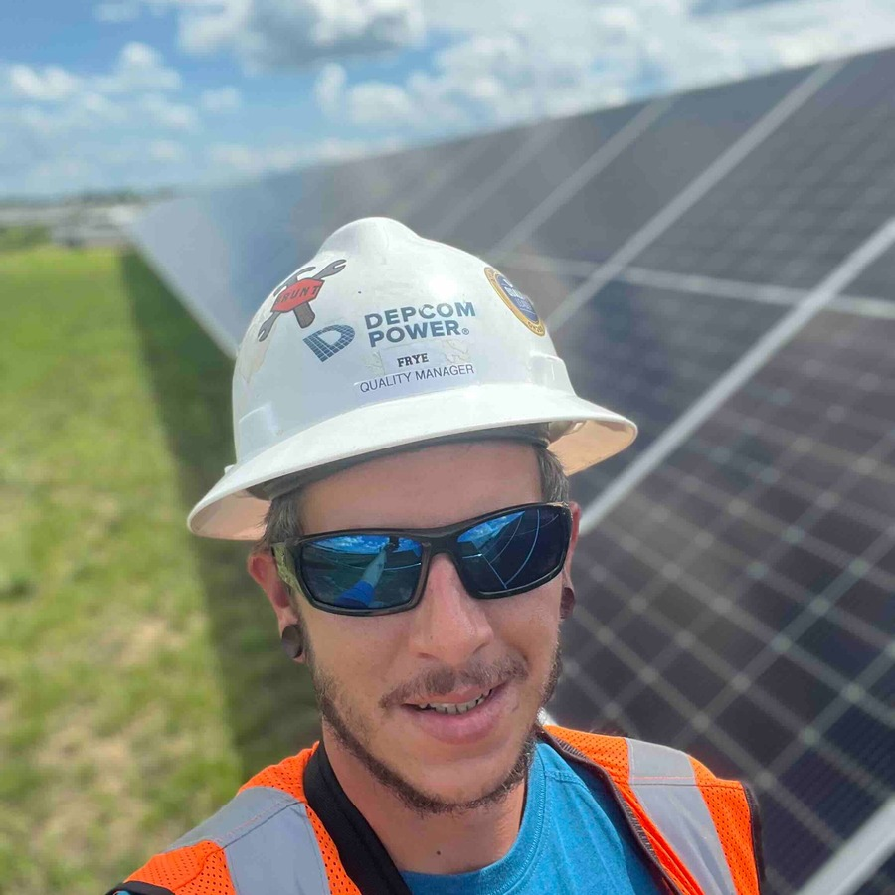

Built by someone who has lived the solar EPC problem for 8 years
12
CHRIS FRYE
Founder & CEO - Meridian Field Command
Founder-market fit 15 years total construction experience
8 years in solar EPC execution
Quality management specialist who built QMS systems and inspection workflows
Lived the problem: manual schedules, lost RFIs, inspection chaos, closeout pressure
Why this founder can win Meridian is not a generic project management tool adapted for construction. It is being built from real solar EPC workflows by someone who has managed field execution, quality documentation, contract requirements, and project handoff under real schedule pressure.
"I watched contractors lose money because their tools were not built for solar. Meridian is the platform I needed in the field."

Slide 13
Raising $120K to convert pilots and validate repeatable revenue
13
$120K round size Post-money SAFE
$4M valuation cap Pre-seed structure
$100 minimum Wefunder investment
Q2-Q3 milestone pilot to revenue
$40K - Phase 3A Development Admin module, PDF filing system, file storage, contracts, locations buildout.
$30K - Customer Acquisition Close first 3 pilot customers, onboarding support, demo materials, sales collateral.
$30K - Founder Salary 3 months runway for full-time focus on pilots, product refinement, and customer onboarding.
$20K - Infrastructure Vercel, Supabase, Claude API, business office, services, and operating costs.
Success milestone: first pilot customers onboarded, pricing validated in live projects, and a repeatable onboarding playbook established.

Slide 14
LET'S BUILD THE FUTURE OF
SOLAR CONSTRUCTION
CHRIS FRYE
Founder & CEO
chris@meridianfieldcommand.com
meridianfieldcommand.com
wefunder.com/meridian.field.command
Built for the Field. By the Field.

