Slide 1
#!/bin/bash
By: Greg savoie
For: Clibre AESS UQÀM

Slide 2
Disclaimer:
This powerpoint is ugly but it may contains useful informations...

Slide 3

Bash?
Bourne-again shell
To make the interactions between the computer and the human possible
For 1337 h4x0rz only

Slide 4
jk

Slide 5

The BB (Bash Basics (not Basic bitch))
How to get by with bash
Customizing bash
More complex commands
Basic Bash scripting

Slide 6
How to get by with bash

Slide 7

The prompt
The fuck is this?
-> It's the name of the prompt with its version (bash 4.1 in this case)
The fuck is that?
-> Show if you're the “super-user” or not
The fuck is a super-user?
-> we'll see that later.. jeez calm down...

Slide 8
Commands 101
Commands can take arguments
-> command [arg1] [arg2] [...]
Commands can take options
-> command -[options]
Commands can take both
-> command -[options] [arg1] [arg2] [...]

Slide 9

Where the hell am I?
pwd : Print Working Directory
The first “/” is the root (it's like the C:\ for windows). As shown by the image, we're currently in a directory named “bc491168” under the home directory who is under the root directory!

Slide 10



How the hell do I get outta here?
cd : Change Directory
Absolute vs Relative path.
Absolute: start from root
Relative: start from the working directory

Slide 11

Knock Knock. Who's there?
ls : list directory contents
Name in blue are sub-directories and name in white are files (may be different, depending on certain configurations...)

Slide 12




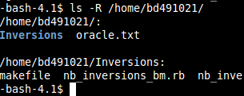
Knock Knock. Who's there? (part 2)
ls with no args
-> display the content of the current directory
ls with args
-> display the content of each directory
ls with -1 option
-> display the content of the directory on 1 column
ls with -l option
-> display the content of the directory with listing informations
ls with -a option
-> display the content of the directory (including hidden files)
Ls with -R option
-> display the content of the directory and the content of the sub-directories

Slide 13
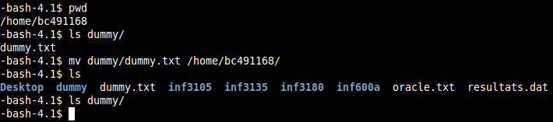
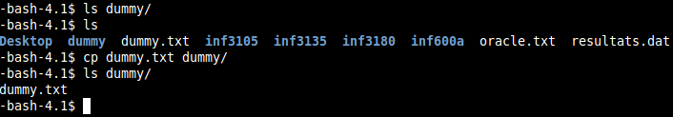
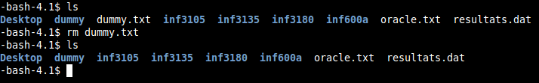
Move that there, copy this, oh w8 delete it, I won't need it!
mv : move or rename a file
cp : copy a file (to copy a directory use -R option)
rm : remove a file

Slide 14
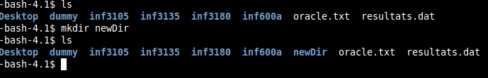

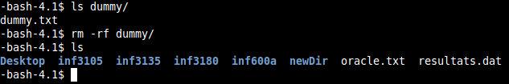
Working with directories.. just because
mkdir : make directory
rmdir : remove directory (works only with empty directory)
Rm -rf for (directories that aren't empty)

Slide 15
Is that all?
passwd: modify your password
history: consult the history of your commands
jobs: list of your pending processus
cat: concatenate files to the standart output
more / less : Display to the standart output a file page by page
tail / head : Display the first n lines or the last n lines of a file
touch : change the modification date of a file
chmod : change the privileges of a file
echo : display a line of text
sort : sort lines of a text file
wc : word count
which : show the full path of a command
pushd / popd : use the directory stack
dirs : see what directory is in the stack directory
cmp / diff : compare files for differences
find : find files and directories
And many many more...

Slide 16
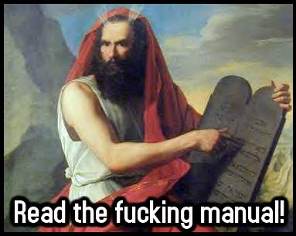
In case of doubts: RTFM
man [command name]

Slide 17
sudo = Sudan Development Organisation
sudo : super-user do
allows users to run programs with the security privileges of another user, by default the superuser.
e.g installing a program (sudo apt-get install for the debian-like os)

Slide 18

But don't forget...

Slide 19

Redirections

Slide 20
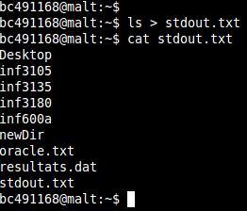
output
[command] > [file name]: redirect the output of the command in the file (create it if it doesn't exist, overwrite the file if it does exist)

Slide 21
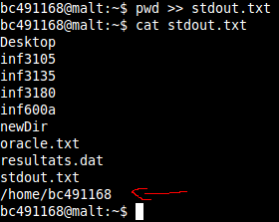
output (part 2)
[command] >> [filename]: redirect the output of the command in the file (create it if it doesn't exist, append to the end if it does exist)

Slide 22
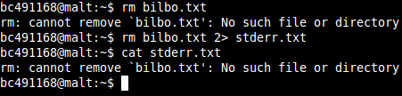
errors
[command] 2> [filename]: redirect the errors of the command in the file (create it if it doesn't exist, overwrite the file if it does exist)

Slide 23

errors (part 2)
[command] 2>> [filename]: redirect the errors of the command in the file (create if if it doesn't exist, append to the end if it does exist)

Slide 24
output & errors
[command] &> [filename]: redirect the output and the errors of the command in the file (create it if it doesn't exist, overwrite it if it does exist)
[command] &>> [filename]: redirect the output and the errors of the command in the file (create it if it doesn't exist, append to the end if it does exist)

Slide 25

input
[command] < [filename]: pass the content of a certain file to the command (the file must exist!) as its input­.

Slide 26
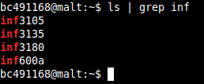
pipe
[command 1] | [command 2]: take the output of a command as the input of another.
Grep is a useful command we'll talk about a bit later

Slide 27
Customizing Bash

Slide 28
2 important files
~/.bash_profile: loaded once => when you log in
~/.bashrc: loaded each time a terminal is opened
Typically, there's a line of code in bash_profile that include bashrc. ([ -f ~/.bashrc] && . ~/.bashrc)

Slide 29

Fogell A.K.A McLovin (bash aliases)
Aliases are useful to create keyboard shortcut of other commands.
Aliases can be defined in ~/.bashrc or in any other file (in this case, a line in your bashrc should be added: [ -f full/path/filename ] && . full/path/filename. Usually, filename is ~/.bash_aliases)
Syntax: alias [alias_name]='[command]'
Exemple: alias gcc='gcc -Wall'

Slide 30
Environment variables
They are used to store data, set configuration options and to customize the shell environment
There's many ways to declare environment variables: we will declare them in ~/.bashrc (so they will be loaded each time a shell opens)
Syntax: Export MY_VAR=”MY VAR CONTENT”
One important environment variable for customization is the PS1 environment variable.

Slide 31
PS1 != PlayStation 1
This variable is used to customize the prompt.
Before
After

Slide 32
Anatomy of the wild PS1 variable
\e[1;36m(\t) @\H [\W] {\j} \$\e[m
\e[ and \e[m => indicate the beginning and the end of a color
1;36 => bold, cyan color
\t => the current time in 24-hour HH:MM:SS format
\H => the hostname
\W => the basename of the current working directory, with $HOME abbreviated with a tilde
\j => the number of jobs currently managed by the shell
\$ => if the effective UID is 0 (root), a #, otherwise a $
Everything uncolored hold no signification and is interpreted as a normal string.

Slide 33
For more PS1 codes, see PS1 cheat sheet in [path of the cheat sheet]

Slide 34
More complex commands

Slide 35
The commands we'll see are very powerful and are use mostly for text manipulation. Hence, a good knowledge of regular expressions is needed to understand the following slides.
We'll do a quick reminder of regexes. For a more complete reference on regexes, see the bash cheat sheet in [path to the cheat sheet].

Slide 36
Regex
It's a sequence of characters representing a pattern. The pattern matches a set of strings.
Ex: ^[ab]\{0,2\}c$ (simple regex)
matches: c, ac, aac , bc, bbc (pun intended)
There's 3 types of regexes: simple, extended and file globing (ok, there's probably more than 3, but these are the most used...)

Slide 37
Simple regex
\ => escape character: delete the meaning of a special character
. => any character
* => 0, 1 or many repetition of a character or a sequence
^ => the beginning of the string
$ => the end of the string
[...] => every character that is in ... (ex: [0-9], [a-z])
[^...] => every character that isn't in ... (ex: [^0-9])
\(...\) => used to capture a sequence. The sequence can be referenced with \1, \2, etc.. (backreferences)
\{n\} => n times the character or the sequence
\{n,\} => at leat n times the character or the sequence
\{n,m\} => n to m times the character or the sequence

Slide 38
Extended regex
\ => escape character: delete the meaning of a special character
. => any character
* => 0, 1 or many repetition of a character or a sequence
+ => 1 or more repetition of a character or a sequence
? => 0 or 1 repetition of a character or a sequence
^ => the beginning of the string
$ => the end of the string
[...] => every character that is in ... (ex: [0-9], [a-z])
[^...] => every character that isn't in ... (ex: [^0-9])
s1|s2 => either one character (or sequence) or the other
(...) => change the priority
{n} => n times the character or sequence
{n,} => at least n times the character or sequence
{n,m} => n to m times the character or sequence

Slide 39
File globbing
\ => escape character: delete the meaning of a special character.
? => any character
* => any character 0, 1, or many times
[...] => any character that is in ... (ex: [0-9])
[^...] => any character that isn't in ... (ex: [^0-9])
{s1, s2,...,sn} => s1 or s2 or sn

Slide 40
Simple regex: grep, sed
Extended regex: awk
File globbing: ls, find

Slide 41
Grep (global regular expression print)
It prints the lines of the file that match the regex
Uses simple regex
Syntax: grep [options...] regex [files...]
If no files are specified, grep will read from stdin
Grep writes on stdout
If many files are specified, grep will output the name of the file before each line that matches

Slide 42
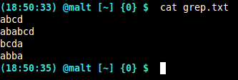

Slide 43

What is in red is the part of the line that has been matched by the regex (it may be different in your shell)

Slide 44
Let's go through some grep options...

Slide 45
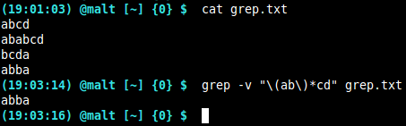
-v : print the lines that don't match

Slide 46
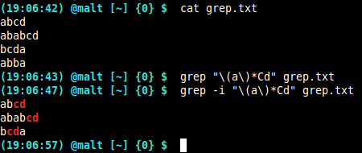
-i: ignore case

Slide 47
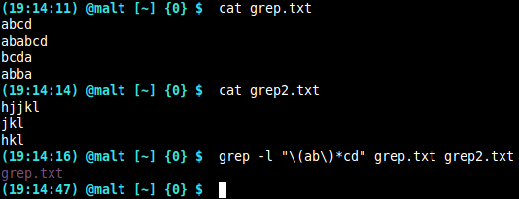
-l(as in L): output only the name of the files that have at least one match

Slide 48
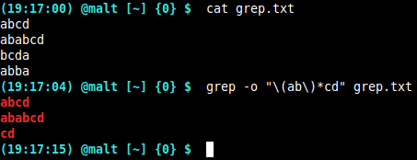
-o: output only the piece of line that has been matched

Slide 49

For more options:
man grep

Slide 50
Sed (stream editor)
Parses and transforms text using regexes
Uses simple regex
Syntax: sed [options...] 'sed script' [files...]
If no files are specified, sed will read from stdin
Sed writes on stdout
Sed processes the file line by line

Slide 51
Let's go through some basic sed scripts

Slide 52
Substitute
s/pattern/replacement/gI
s is for “substitute”
Pattern is a simple regex
Replacement is the string by which the matched string will be replaced
g is for “global” (it is optional)
I (as in i) is for “case insensitive” (it is optional)

Slide 53


Slide 54


Slide 55
print
/pattern/pI
Pattern is the regex that need to be matched
p is for “print”
I (as in i) is for “case insensitive” (it is optional)
This script will write to stdout every line that matches the pattern

Slide 56
Print (part 2)
/pattern/p is not very useful since grep can do the same.
However, with sed, it is possible to print a range of text delimited by two pattern
/pattern1/,/pattern2/p
This script will write to stdout every lines between the first line that matches pattern1 and the last line that matches pattern2

Slide 57
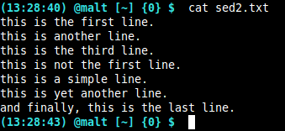

Slide 58
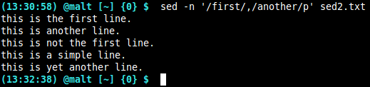
-n : print only the concerned lines (otherwise sed would have printed every line repeating the ones that mathed the pattern...)

Slide 59
delete
/pattern/d
Pattern is the regex that need to be matched
d is for “delete”
This script will write to stdout every line that doesn't match the pattern
Like print, you can use a range: /pattern1/,/pattern2/d

Slide 60
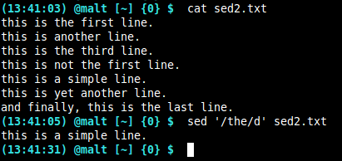

Slide 61
-i : in place changes
Does the modifications in the specified files and doesn't print to stdout (equivalent of: sed 'script' file > file)
Syntax: sed -i[.ext] 'sed script' [files...]
If .ext is specified, sed creates a backup of the original file in file.ext

Slide 62
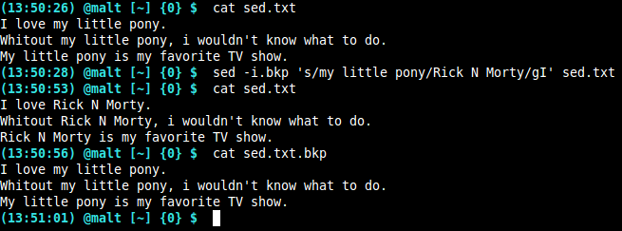

Slide 63

Once again...
If your want to learn more about sed
man sed

Slide 64
Awk (Aho Weinberger Kernighan)
It's a programming language specially designed to parse and process CSV style files.
Awk uses extended regex
Syntax: awk [options] 'awk script'
The delimiter can be anything and must be specified with the -Fc option where “c” is the delimiter character

Slide 65
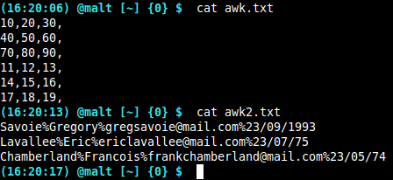
Examples of CSV style files...

Slide 66
Awk uses extended regex.
Awk reads the file line by line.
It separates each field delimited by the delimiter and associate that field to a variable.
$1 for the frist field, $2 for the second, and so on.
There is special variables:
$0 : is the full line
NR : is the record number
NF : is the number of field in the record
FS : is the delimiter

Slide 67
Awk script
'BEGIN {statements} /pattern/ {actions statements} END {statements}'
BEGIN {} and END {} are optional. The statements will be executed once at the very beginning of the script and once at the very end.
/pattern/ is an extended regex. It serves as a filter. Only lines that match the regex will be processed. If you want to print a range of lines you can use /pattern1/,/pattern2/ (every line from the first line that matches pattern1 to the first line that matches pattern2 will be printed)
{actions statements} is the core of the script. It can be really complex but we'll only see few actions and control structures. (printf and if/else if/else). If there's more than one action or statement, “;” are needed

Slide 68
Printf: a C-style formatter and printer (man printf)
If / else if / else control structures
if ($1 == “blue”) printf “%s\n”, “sky”
else if ($1 == “green”) printf “%s\n”, “grass”
else printf “%s\n”, “undefined”
Other control structures exists such as while and for.

Slide 69
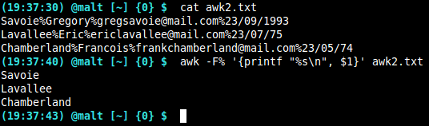
Printing the first field of each line

Slide 70
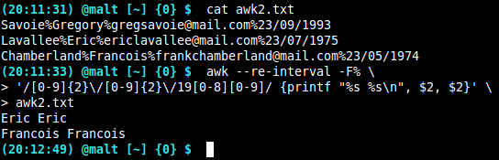
Print every person born before 1990
**--re-interval option is mandatory to use the {n}, {n,} and {n,m} in the regex...

Slide 71

There's many more fun things you can do with awk.. For the last time, if you want to learn more:
man awk

Slide 72
Find (find files... duh!)
Syntax: find directory -name pattern
directory: is the directory you want to search in. (it will search recursively)
-name: it's an option that specify that you want to search for files that match “pattern”
pattern: file globing

Slide 73
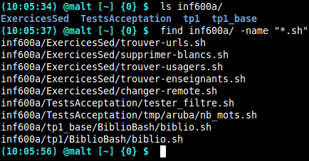

Slide 74
xargs (x args...)
It uses the output of a command as arguments for another command
Syntax: command1 | xargs [options] command2
If you need the string of the output in you second command, use the -i[string] option. (exemple will follow)
The string will available as [string] or as {} if none is specified

Slide 75
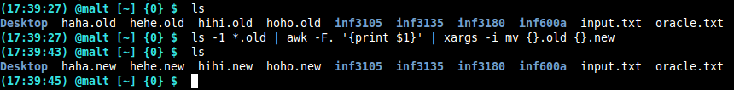
Renaming every file ending with the .old extension

Slide 76
Don't forget to read the man...
man xargs

Slide 77
Basic Bash Scripting

Slide 78
What are they used for?
Automation
Sys admin related task
Text manipulation
Yeah.. mostly that...

Slide 79
Bash script usually end with “.sh” extension
The first line of a bash script is “#!/bin/bash”. This is called the shebang. It tells wich program should run the script. (in this case, my bash is in /bin/bash. To know your bash location juste type this command: which bash)
Now i can run a bash script with the following command: ./scriptName.sh
Without the shebang i would have to specify wich program should run the script and the command would have been something like: bash scripName.sh
The script must be executable: chmod +x scriptName.sh

Slide 80
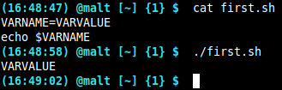
Variables
They work just like environment variable.
VARNAME=VARVALUE
After being declared, the variable can be used with the “$” sign before its name
They are global (available anywhere in the program => there's other way to declare variables with other scope. We won't see it in this tutorial / presentation...)
Echo $VARNAME

Slide 81
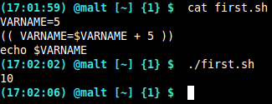
How to use variables: arithmetic
Variables can hold numeric data, but if you want to do arithmetic, you will have to use the double parentheses.

Slide 82
How to use variables: inside a string
You can use variables in string.
A variable inside double quotes will be replaced by its value at the moment of execution/output.
A variable inside single quotes will not.

Slide 83
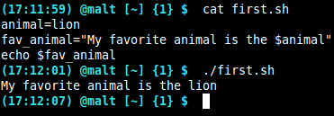
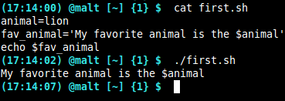
Double quotes
Single quotes

Slide 84
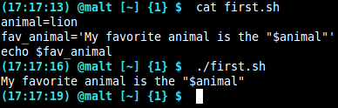
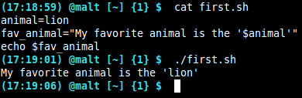
Double quotes in single quotes
Single quotes in double quotes

Slide 85
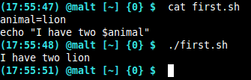
How to use variables: concatenation
What if i want to have the plural form of “lion”??

Slide 86
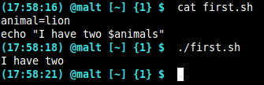
This doesn't work because the interpreter is looking for a variable called “animals” which doesn't exist.

Slide 87
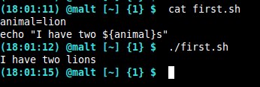
This is the right way to do it (variable interpolation).

Slide 88
Variable interpolation and pattern matching
You can do pattern matching (file globing) with variable interporlation to return only a piece of the variable.
${varName#pattern}: will return the substring “varName” where the smallest string (starting from the beginning) matching “pattern” will be cut.
${varName##pattern}: will return the substring “varName” where the longest string (starting from the beginning) matching “pattern” will be cut.
% and %% will do the same but the pattern to be matched will start from the end.

Slide 89
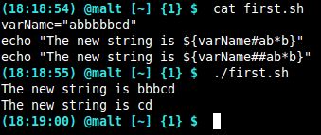

Slide 90
Bash special variables
$? : the exit status of the last command or function executed (usally 0 when everything went right and any other number when something went wrong)
$# : Number of arguments passed to the script or function
$0 : Name of the script
$@ : List of all the arguments passed to the script or the function
$1, $2, ..., $N : arguments passed to the script or the function.

Slide 91
Bash control structures (if)
If <expression> ; then
[statements...]
elif <expression>; then
[statements...]
else
[statements...]
fi

Slide 92
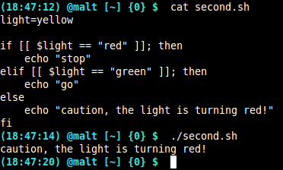

Slide 93
Bash control structures (while)
While <expression>; do
[statements...]
done

Slide 94
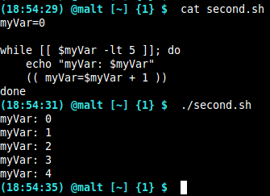

Slide 95
Bash control structures (for)
For var in <expression>; do
[statements...]
done
$var will be accessible inside the for loop.

Slide 96
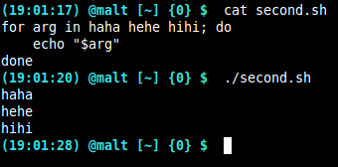

Slide 97
Bash control structures (case)
Case <expression> in
pattern1)
[statements...]
;;
pattern2)
[statements...]
;;
*)
[statements...]
;;
esac
Patterns are file globing regexes

Slide 98
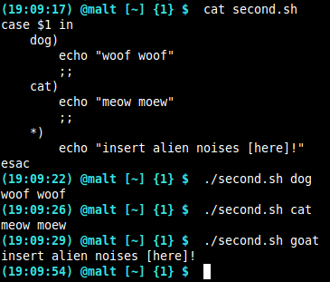

Slide 99
Function
Function functionName {
[statements...]
[return X]
}
To call a function: functionName param1 param2 paramN
Parameter to be passed to the function is never precised in its declaration
Return statement are not mandatory, but if there's no return statement, bash assumes that the exit code is 0.

Slide 100
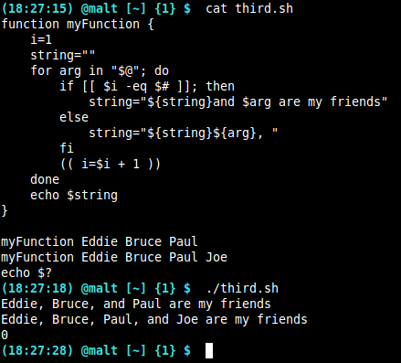
In the execution of a function, the value of the special variables $@, $#, and $1 ... $N change. (ex: $@ is not more the list of arguments passed to the script, it is now the list of arguments passed to the function...)

Slide 101
Bash tests
Use the keyword “[[” to begin the test and the keyword “]]” to end the test
&& : It's the logical “and” operator. It will execute the second statement only if the first is true (0)
|| : It's the logical “or” operator. It will execute the second statement only if the first is false (other than 0)

Slide 102
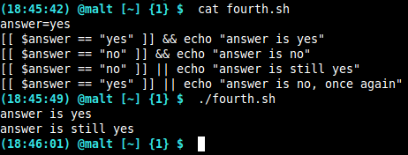

Slide 103
Tests on strings
[[ stringName ]] : return 0 if the string is not empty
[[ -z stringName ]] : return 0 if the string is empty
[[ string1 == string2 ]] : return 0 if the strings are equivalent
[[ string1 != string2 ]] : return 0 if the strings are not equivalent
[[ stringName =~ pattern ]] : return 0 if the pattern is found in the string stringName (extended regex)

Slide 104
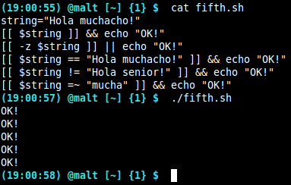

Slide 105
Tests on files
[[ -e fileName ]] : return 0 if the file exists
[[ -d fileName ]] : return 0 if the file is a directory
[[ -f fileName ]] : return 0 if the file is a regular file
[[ -x fileName ]] : return 0 if the file is executable

Slide 106

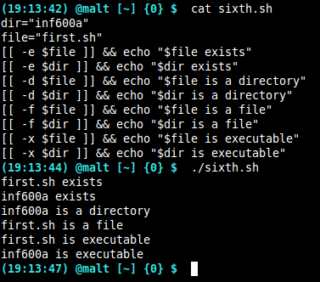

Slide 107
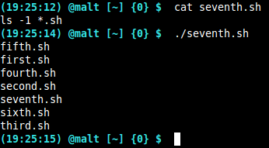
Executing commands
You can execute any bash command in a bash script.

Slide 108
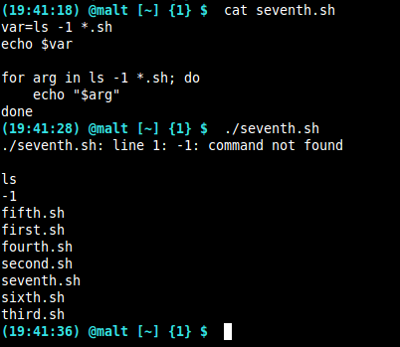
Sometimes, you will want to move the result of a command in a variable or in a for loop statement.
This is clearly not the expected result...

Slide 109
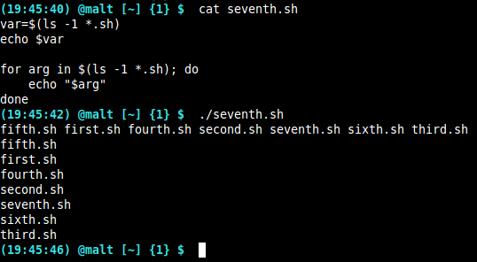
If you want to move the result of a command in a variable or use it in a for loop, you have to surround the command by “$()”.

Slide 110
Thank you senpai
Bash version: 4.1.2
If you find anything wrong in this tutorial you can contact me: greg.savoie23@gmail.com
You'll find exercises on almost every subjects covered in this presentation in the exercises/ directory
There's cheat sheets of bash and PS1 variable under the cheatSheets/ directory

Slide 111
References / tutorials
Bash
http://www.tldp.org/LDP/abs/html/
http://tldp.org/LDP/Bash-Beginners-Guide/html/
http://tldp.org/HOWTO/Bash-Prog-Intro-HOWTO-1.html
https://www.gnu.org/software/bash/manual/html_node/index.html#Top
https://en.wikibooks.org/wiki/Bash_Shell_Scripting

Slide 112
Some websites to test your regexes...
https://regex101.com/
http://regexr.com/
http://www.regextester.com/
http://regexstorm.net/tester

Slide 113
Grep
http://www.panix.com/~elflord/unix/grep.html
http://www.uccs.edu/~ahitchco/grep/
http://www.tutorialspoint.com/unix_commands/grep.htm
http://www.grymoire.com/Unix/Grep.html

Slide 114
Sed
http://www.grymoire.com/Unix/Sed.html
http://www.tutorialspoint.com/sed/index.htm
http://www.panix.com/~elflord/unix/sed.html

Slide 115
Awk
http://www.grymoire.com/Unix/Awk.html
http://www.vectorsite.net/tsawk.html
http://www.math.utah.edu/docs/info/gawk_toc.html

Slide 116
PS1 variable
http://www.cyberciti.biz/tips/howto-linux-unix-bash-shell-setup-prompt.html
http://www.thegeekstuff.com/2008/09/bash-shell-ps1-10-examples-to-make-your-linux-prompt-like-angelina-jolie/
http://www.linuxnix.com/linuxunix-shell-ps1-prompt-explained-in-detail/

Slide 117
Exercice sed, awk, grep, xargs
1 ou 2 script complexe
Cheat sheet de PS1
Cheat sheet de bash

