Slide 1

2. Migration – Agile Pod-Based Delivery
OUR approach
Our team is organized into cross-functional, self-organizing agile PODs and consists of members across the US & India. Each POD will be responsible for managing and delivering the team’s backlog.
illustrative
We will enable an AI Foundation POD to drive incremental efficiencies through innovation and automation across PODs. Activities include but are not limited to:
Leverage agents/accelerators to efficiently conduct Discovery, Migration, Testing & Optimization within each POD. Agents detect data anomalies post migration and notify Developers. These agents/ accelerators will also apply intelligent code Modernizations and performance optimization suggestions across large codebases efficiently — accelerating transformation while ensuring consistency
We will have approximately 20 pods comprised split across the following areas:
Data Migration – EDWARD, DX Data, DX APIT, Data Lab PODs/Other Apps
Report Repointing/Migration – SAS/BI Reports
FinOps
SMEs
Performance Optimization
Change Management /Training
Program Management
Elevance Health Leadership Team
Deloitte Engagement Leadership
Sponsor
Steering Committee
Program Oversight
Program Engagement Lead
PROGRAM DELIVERY
NYU
Project team
Program Governance
PMO Lead
Tech Architect
Delivery Lead
Testing Lead
Product Owners
AI Foundation POD
EDW/DX POD
SAS/BI POD
OTHER APPs
Business Lead
AI Lead
Scrum Master (PT)
Scrum Master (PT)
Scrum Master (PT)
Agent Builder
Data Engineer(s)
Report Developer(s)
Report Developer(s)
Technical Lead
AgentOPs
Tester(s)
Tester(s)
Tester(s)
Infrastructure Support
SMEs
Teradata/Snowflake
SAS/BI Reporting
AWS
Informatica
Test Automation
Cross-pod governance
Pods offer a balance of skills and Elevance Health experience across shores.

Slide 2
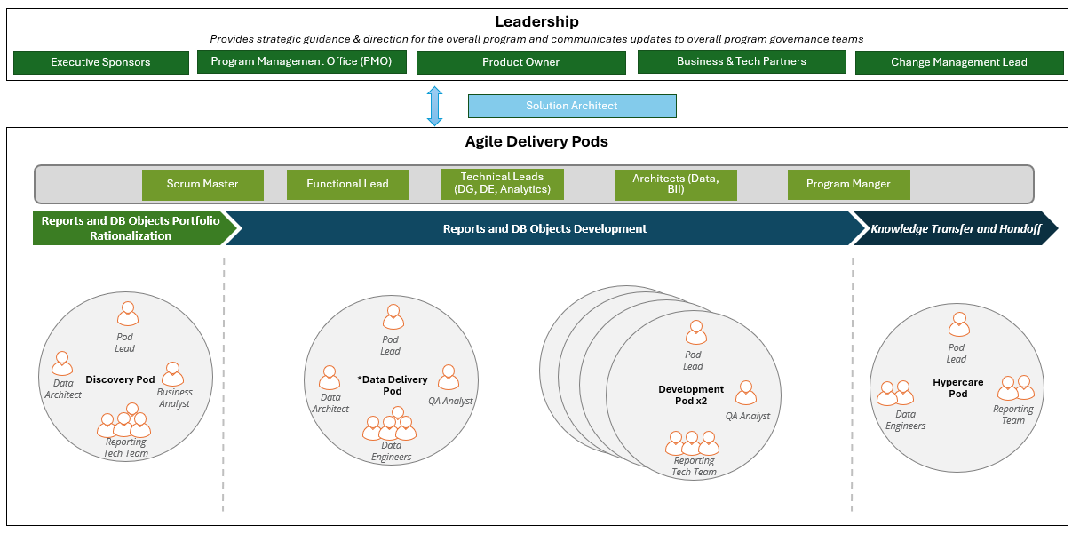

Slide 3
Notes:
To maximize delivery velocity and efficiency, we propose a Migration Factory model supported by a scalable, blended onshore/offshore pod structure. This approach enables us to flex capacity across migration waves while maintaining centralized governance, consistent standards, and clear accountability throughout the program.
5.1 Proposed Team and Delivery Model
The delivery model is organized into two integrated layers: a Core Leadership and Governance Team, which remains consistent throughout the program, and Conversion Pods, which scale based on wave volume and complexity.
We operate as an extension of client’s organization, with embedded collaboration across internal IT and business SMEs under a shared operating model and RACI to support efficient day-to-day execution.
Layer 1: Centralized Leadership and Governance Core
Role
Core accountability
Timeline protection
PMO Lead
Owns governance, release calendar, wave planning, RAID, and executive status.
Maintains the critical path and escalates blockers early.
Solution Architect
Defines target-state architecture, platform disposition, coding, security, and data-modeling standards.
Prevents rework through consistent design decisions.
Change & KT Lead
Leads stakeholder communications, training strategy, knowledge transfer, and BAU transition readiness.
Reduces late adoption and handover risk.
Layer 2 : Agile Conversion Pods
Pod role
Core accountability
Timeline protection
Pod Lead
Manages sprint execution, backlog flow, SME coordination, and blocker removal for each domain pod.
Keeps wave velocity on track and escalates delivery impediments quickly.
Data Engineers
Translate BO logic and transformation rules into governed Databricks structures and semantic layers.
Reduces rework by standardizing reusable data patterns early in each wave.
BI & Visualization Developers
Rebuild reports and dashboards in Power BI and Epic Cogito as modern, user-ready analytics assets.
Accelerates adoption by delivering usable assets within each release wave.
QA / Validation Analysts
Execute reconciliation and logic validation to confirm parity before UAT and deployment.
Surfaces defects before cutover and protects business confidence in migrated outputs.

