Slide 1

Secret - HTB
Level : easy
Target : 10.10.11.120
By: Daniel

Slide 2
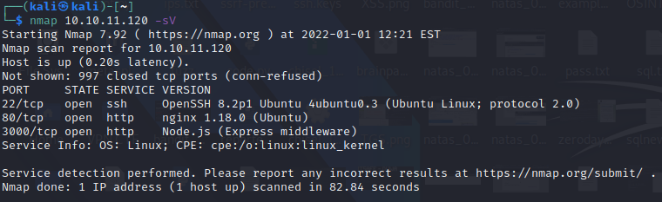
Reconnaissance
Nmap Ports
Detection of vulnerabilities in ports 3000
(site in 3000 and 80 is same like service)

Slide 3
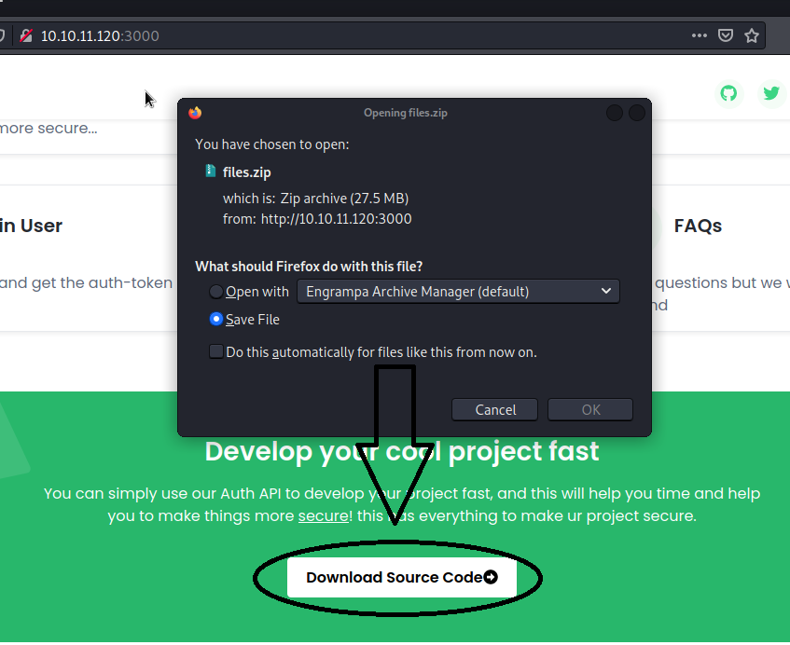
Reconnaissance
Download The Source Code

Slide 4
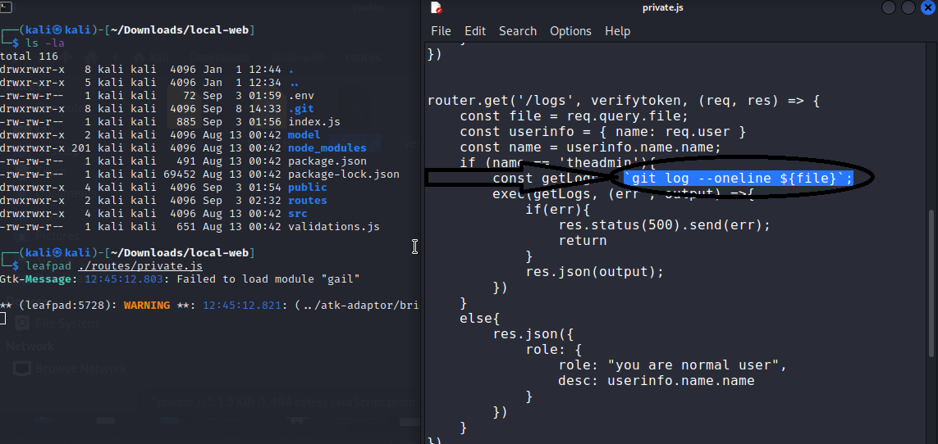
Reconnaissance
It's time to research the source code I downloaded
And find the possible exploitation for hacking into the machine and obtaining a base shell this site write by node.js I found the file : private.js
Is look like RCE (Remote Code Execution)

Slide 5
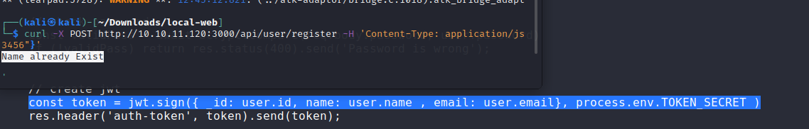
Reconnaissance
If we look at the block carefully we will notice that we must be registered under the username "theadmin" if we try to register using this username via REST API we will get the following error i.e. the user already exists so first I tried NOSQL injection but they activated good protection so I looked for the verification token maybe We'll be able to break it. Let's look at the auth.js file

Slide 6
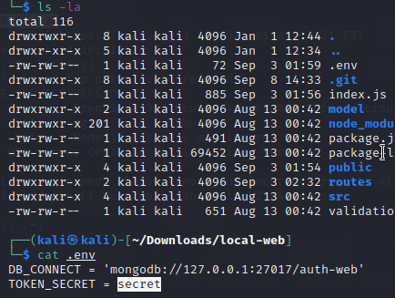
Reconnaissance
Note The authentication is performed using JWT (Json Web Token)
If we you notice that they keep the password in environmental variables, let's check maybe the password in the env file is right for us

Slide 7
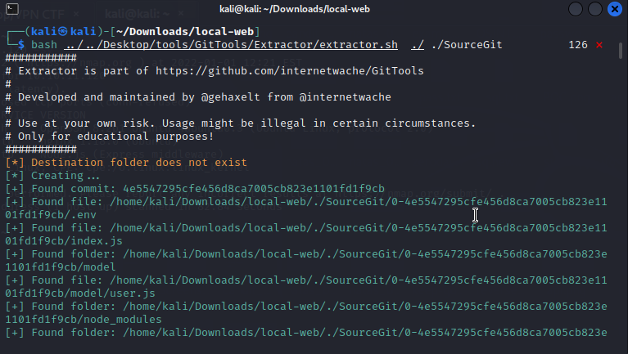
Reconnaissance
If we try to sign a new token using the "secret" password we will find that it is not valid we need to search deeper if we concentrate we will seem to have the dev forgotten the folder .git Then we will try to recover the old source code from ".git" using https://github.com/internetwache/GitTools/

Slide 8
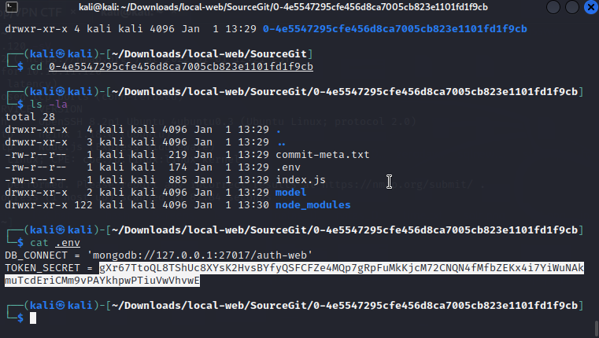
Reconnaissance
Source code recovery successfully done if we check the file we wanted to see the token there is different and very long it looks like the real token

Slide 9
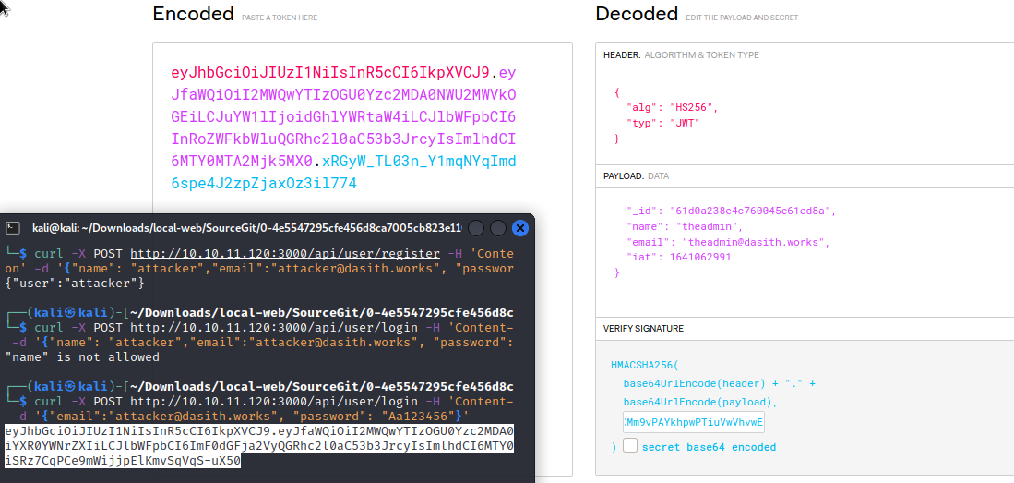
Gain Access
It's time and try to forge the token again we will register via the REST API and throw the token into the jwt.io website and we will change the values ​​we want and fill in the signature password we obtained from an old source code

Slide 10
Gain Access
Now try to access a route saved only for the username "theadmin" and we will see in image B that we have access to the route

