Slide 1
Hotpatching ClickHouse in production with XRay
FOSDEM 2026
Pablo Marcos Oltra

Slide 2

$ whoami
Pablo Marcos Oltra
Software Engineer @ ClickHouse’s Core Team
Systems Developer
Passionate about videogame development
Interested in compilers, build systems and new programming languages

Slide 3
Who knows what hotpatching/hot reloading is?

Slide 4
Who knows what LLVM’s XRay is?

Slide 5
Who’s had to debug something in production and wished they had added an extra log to know what’s happening?

Slide 6
What is hotpatching
01

Slide 7
Hotpatching: The basics
Change the code while the process is running
Allows faster iteration
Often done in videogame development
Hot reloading rather than hotpatching
Client-server architecture where the lightweight client loads a new version of the game (in a shared library)
Examples
http://runtimecompiledcplusplus.blogspot.com.es
https://fungos.github.io/cr-simple-c-hot-reload
https://liveplusplus.tech

Slide 8

Hotpatching: Adding instrumentation
-finstrument-functions : Generates instrumentation code for every function entry/exit
void __cyg_profile_func_enter(void *this_fn, void *call_site);
void __cyg_profile_func_exit(void *this_fn, void *call_site);
https://gcc.gnu.org/onlinedocs/gcc/Instrumentation-Options.html#index-finstrument-functions

Slide 9
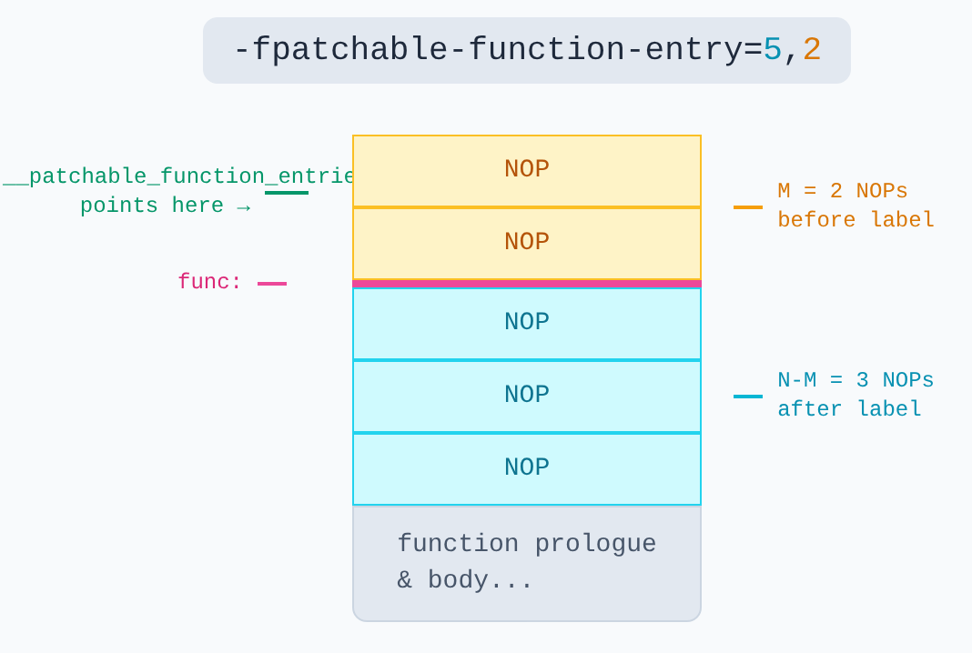

Hotpatching: Adding instrumentation
-fpatchable-function-entry=N[,M]:
Generate M NOPs before function entry and N-M NOPs after function entry
https://gcc.gnu.org/onlinedocs/gcc/Instrumentation-Options.html#index-fpatchable-function-entry

Slide 10
XRay
02

Slide 11

XRay
XRay consists of three main parts:
Compiler-inserted instrumentation points.
A runtime library for enabling/disabling tracing at runtime.
A suite of tools for analysing the traces.
As of July 25, 2018, XRay is only available for the following architectures running Linux:
x86_64, arm7 (no thumb), aarch64, powerpc64le, mips, mipsel, mips64, mips64el, NetBSD: x86_64, FreeBSD: x86_64 and OpenBSD: x86_64.
https://llvm.org/docs/XRay.html

Slide 12
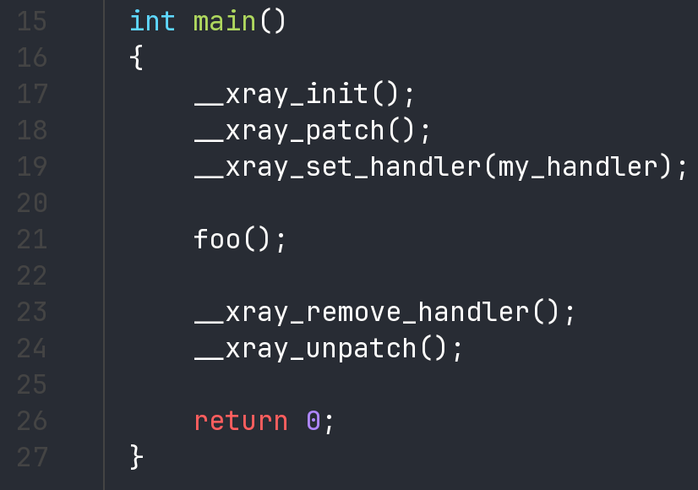
XRay: Example

Slide 13
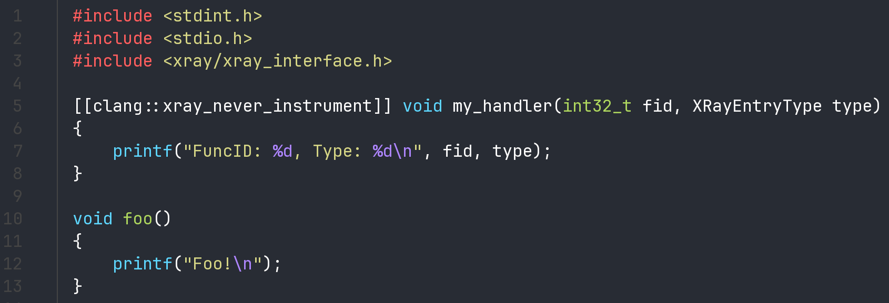
XRay: Example

Slide 14
XRay: Example
$ clang++ -o test_xray test_xray.cpp -fxray-instrument -fxray-instruction-threshold=1
$ ./test_xray
FuncID: 1, Type: 0
Foo!
FuncID: 1, Type: 1

Slide 15
XRay: xray_instr_map
$ objdump -h -j xray_instr_map test_xray
test_xray: file format elf64-x86-64
Sections:
Idx Name Size VMA LMA File off Algn
17 xray_instr_map 00000080 000000000002c6c4 000000000002c6c4 0002c6c4 2**0
CONTENTS, ALLOC, LOAD, READONLY, DATA

Slide 16
XRay: Before patching foo
entry sled
$ (lldb) dis -C 10
test_xray`foo:
-> 0x555555578360 <+0>: jmp 0x55555557836b ; <+11>
0x555555578362 <+2>: nopw 0x200(%rax,%rax)
0x55555557836b <+11>: pushq %rbp
0x55555557836c <+12>: movq %rsp, %rbp
0x55555557836f <+15>: leaq 0x8348(%rip), %rdi
0x555555578376 <+22>: movb $0x0, %al
0x555555578378 <+24>: callq 0x555555556040 ; symbol stub for: printf
0x55555557837d <+29>: popq %rbp
0x55555557837e <+30>: retq
0x55555557837f <+31>: nopw %cs:0x200(%rax,%rax)
exit sled

Slide 17
XRay: After patching foo
$ (lldb) dis -C 10
test_xray`foo:
-> 0x555555578370 <+0>: movl $0x1, %r10d
0x555555578376 <+6>: callq 0x555555574340 ; __xray_FunctionEntry
0x55555557837b <+11>: pushq %rbp
0x55555557837c <+12>: movq %rsp, %rbp
0x55555557837f <+15>: leaq 0x8338(%rip), %rdi
0x555555578386 <+22>: movb $0x0, %al
0x555555578388 <+24>: callq 0x555555556040 ; symbol stub for: printf
0x55555557838d <+29>: popq %rbp
0x55555557838e <+30>: movl $0x1, %r10d
0x555555578394 <+36>: jmp 0x555555574480 ; __xray_FunctionExit

Slide 18
Integration into ClickHouse
03

Slide 19

What’s ClickHouse
Fast OLAP DBMS
Started in 2009 at Yandex.Metrica by Alexey Milovidov
Open sourced in 2016 under Apache 2.0 license
Developed in C++
Strong focus in performance
Lots of dogfooding
CI results, observability, pastila, c.house, etc
https://clickhouse.com
https://benchmark.clickhouse.com

Slide 20

Integrating XRay into ClickHouse
Use XRay’s instrumentation to have negligible overhead in production when disabled
Use XRay’s runtime library to enable in production only the symbols we want to instrument
Use SQL statements to enable/disable instrumentation points at runtime
Kudos to our intern Alina Badakhova for doing the POC to prove it was feasible
https://github.com/ClickHouse/ClickHouse/issues/74249

Slide 21

Integrating XRay into ClickHouse
Landed in ClickHouse 25.12 (December 25)
Minor improvements since then, all backported
https://github.com/ClickHouse/ClickHouse/pull/89173

Slide 22
Hotpatching using SQL: Cheatsheet
-- Check symbols to add instrumentation points
SELECT * FROM system.symbols WHERE function_id IS NOT NULL
-- Add or remove instrumentation points
SYSTEM INSTRUMENT [ADD|REMOVE] 'SYMBOL' HANDLER [ENTRY|EXIT] [PARAMS]
-- Check the enabled instrumentation points
SELECT * FROM system.instrumentation
-- Check the instrumented points hit
SELECT * FROM system.trace_log WHERE trace_type = 'Instrumentation'

Slide 23
Hotpatching using SQL: Inspecting symbols
SET allow_introspection_functions=1
-- Check symbols to add instrumentation points
SELECT
function_id, symbol_demangled
FROM
system.symbols
WHERE
symbol_demangled ILIKE '%QueryMetricLog::start%'

Slide 24
Hotpatching using SQL: Inspecting symbols
Row 1:
──────
function_id: 202915
symbol_demangled: DB::QueryMetricLog::startQuery(std::__1::basic_string<char, std::__1::char_traits<char>, std::__1::allocator<char>> const&, std::__1::chrono::time_point<std::__1::chrono::system_clock, std::__1::chrono::duration<long long, std::__1::ratio<1l, 1000000l>>>, unsigned long)
Row 2:
──────
function_id: 202933
symbol_demangled: void std::__1::__function::__policy_func<void ()>::__call_func[abi:ne210105]<DB::QueryMetricLog::startQuery(std::__1::basic_string<char, std::__1::char_traits<char>, std::__1::allocator<char>> const&, std::__1::chrono::time_point<std::__1::chrono::system_clock, std::__1::chrono::duration<long long, std::__1::ratio<1l, 1000000l>>>, unsigned long)::$_0>(std::__1::__function::__policy_storage const*)

Slide 25
Hotpatching using SQL: Adding instrumentation
-- Add a log with stacktrace at function entry
SYSTEM INSTRUMENT ADD 'QueryMetricLog::startQuery' LOG ENTRY 'FOSDEM 26';
-- Add a random sleep [0, 0.5] secs at function exit
SYSTEM INSTRUMENT ADD 'QueryMetricLog::startQuery' SLEEP EXIT 0 0.5;
-- Profile deterministically
SYSTEM INSTRUMENT ADD 'QueryMetricLog::startQuery' PROFILE;

Slide 26
Hotpatching using SQL: Adding instrumentation
SELECT * FROM system.instrumentation
Row 1:
──────
id: 0
function_id: 202915
function_name: QueryMetricLog::startQuery
handler: log
entry_type: Entry
symbol: DB::QueryMetricLog::startQuery(std::__1::basic_string<char, std::__1::char_traits<char>, std::__1::allocator<char>> const&, std::__1::chrono::time_point<std::__1::chrono::system_clock, std::__1::chrono::duration<long long, std::__1::ratio<1l, 1000000l>>>, unsigned long)
parameters: ['FOSDEM 26']

Slide 27
Hotpatching using SQL: Adding instrumentation
Row 2:
──────
id: 1
function_id: 202915
function_name: QueryMetricLog::startQuery
handler: sleep
entry_type: Exit
symbol: DB::QueryMetricLog::startQuery(std::__1::basic_string<char, std::__1::char_traits<char>, std::__1::allocator<char>> const&, std::__1::chrono::time_point<std::__1::chrono::system_clock, std::__1::chrono::duration<long long, std::__1::ratio<1l, 1000000l>>>, unsigned long)
parameters: [0,0.5]

Slide 28
Hotpatching using SQL: Adding instrumentation
Row 3:
──────
id: 2
function_id: 202915
function_name: QueryMetricLog::startQuery
handler: profile
entry_type: EntryAndExit
symbol: DB::QueryMetricLog::startQuery(std::__1::basic_string<char, std::__1::char_traits<char>, std::__1::allocator<char>> const&, std::__1::chrono::time_point<std::__1::chrono::system_clock, std::__1::chrono::duration<long long, std::__1::ratio<1l, 1000000l>>>, unsigned long)
parameters: []

Slide 29
Hotpatching using SQL: Removing instrumentation
-- Remove all instrumented points
SYSTEM INSTRUMENT REMOVE ALL;
-- Remove a specific instrumented point with id 2
SYSTEM INSTRUMENT REMOVE 2;
-- Remove all entry points for function 'QueryMetricLog::startQuery'
SYSTEM INSTRUMENT REMOVE 'QueryMetricLog::startQuery';

Slide 30
Hotpatching using SQL: Checking trace_log
SELECT
event_time_microseconds,
function_id,
function_name,
handler,
entry_type,
duration_nanoseconds FROM system.trace_log
WHERE trace_type = 'Instrumentation'

Slide 31
Hotpatching using SQL: Checking trace_log
Row 1:
──────
event_time_microseconds: 2026-01-29 11:55:20.553718
function_id: 202915
function_name: DB::QueryMetricLog::startQuery(std::__1::basic_string<char, std::__1::char_traits<char>, std::__1::allocator<char>> const&, std::__1::chrono::time_point<std::__1::chrono::system_clock, std::__1::chrono::duration<long long, std::__1::ratio<1l, 1000000l>>>, unsigned long)
handler: profile
entry_type: Entry
duration_nanoseconds: ᴺᵁᴸᴸ

Slide 32
Hotpatching using SQL: Checking trace_log
Row 2:
──────
event_time_microseconds: 2026-01-29 11:55:20.553758
function_id: 202915
function_name: DB::QueryMetricLog::startQuery(std::__1::basic_string<char, std::__1::char_traits<char>, std::__1::allocator<char>> const&, std::__1::chrono::time_point<std::__1::chrono::system_clock, std::__1::chrono::duration<long long, std::__1::ratio<1l, 1000000l>>>, unsigned long)
handler: profile
entry_type: Exit
duration_nanoseconds: 40059

Slide 33

Hotpatching using SQL: Visualizing the profile
Use Chrome’s Trace Event Format with different visualizers
https://docs.google.com/document/d/1CvAClvFfyA5R-PhYUmn5OOQtYMH4h6I0nSsKchNAySU/preview?tab=t.0
[
{"name": "Asub", "cat": "PERF", "ph": "B", "pid": 22630, "tid": 22630, "ts": 829},
{"name": "Asub", "cat": "PERF", "ph": "E", "pid": 22630, "tid": 22630, "ts": 833}
]

Slide 34
Hotpatching using SQL: Converting the data
WITH traces AS (
SELECT * FROM system.trace_log
WHERE event_date >= today() AND trace_type = 'Instrumentation' AND handler = 'profile'
ORDER BY event_time, entry_type
)
SELECT
format(
'{{"traceEvents": [{}\n]}}',
arrayStringConcat(
groupArray(
format(
'\n{{"name": "{}", "cat": "clickhouse", "ph": "{}", "ts": {}, "pid": 1, "tid": {}, "args": {{"query_id": "{}", "cpu_id": {}, "stack": [{}]}}}},',
function_name, if(entry_type = 0, 'B', 'E'), timestamp_ns/1000,
toString(thread_id), query_id, cpu_id,
arrayStringConcat(arrayMap((x, y) -> concat('"', x, ': ', y, '", '), lines, symbols))
)
)
)
)
FROM traces;

Slide 35
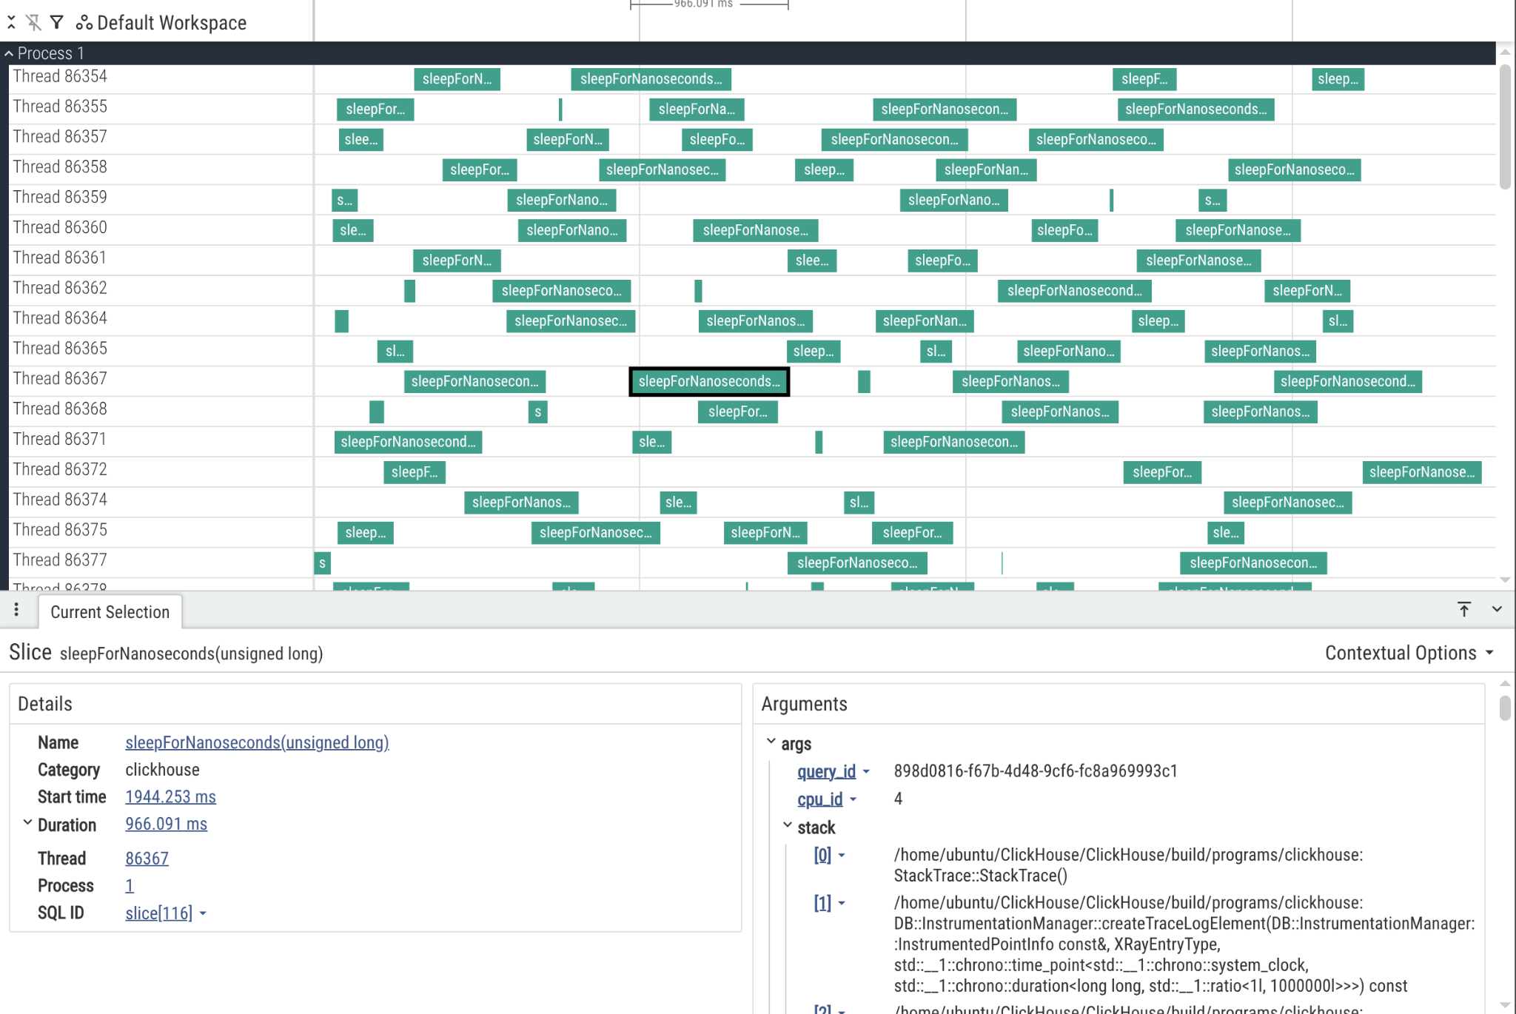
Hotpatching using SQL: Visualizing in Perfetto

Slide 36
Future work
Add more handlers as we see the need for them
Add some VM to allow scripting? Wren, Lua
Educate others that this exists so that they use it. Collect their feedback

Slide 37
Caveats
Can’t mix XRay and sanitized builds due to symbols clashing in libclang_rt
If you mess something with this, you do it big time cause it’s in production
Profiling a function doesn’t profile all functions underneath. That’s very difficult
ld.lld-19: error: duplicate symbol: __sanitizer::internal_allocator()
>>> defined at sanitizer_allocator.cpp.o:(__sanitizer::internal_allocator()) in archive /usr/lib/llvm-19/lib/clang/19/lib/linux/libclang_rt.ubsan_standalone-x86_64.a
>>> defined at sanitizer_allocator.cpp.o:(.text._ZN11__sanitizer18internal_allocatorEv+0x0) in archive /usr/lib/llvm-19/lib/clang/19/lib/linux/libclang_rt.xray-x86_64.a

Slide 38




Try ClickHouse for your use case
ClickHouse Cloud
Download open source
Learn
Academy / certifications
Blogs / YouTube
Engage with our community
Community Slack
Monthly Community calls
Meetups / events
We are Hiring. Come Work with Us!
Connect with ClickHouse
ClickHouse Community Dinner
Notes:
This is for Ilya Andreev for SRE day london

Slide 39

All links from the slides
Q&A
https://c.house/links

