Slide 1
Continue to use ClickHouse as TSDB
邰翀
青云QingCloud 数据库研发工程师

Slide 2
Content
Look back: Why we choose it
Now: How we do
Future: What we do

Slide 3
Why we choose it

Slide 4


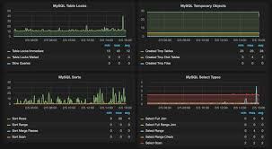
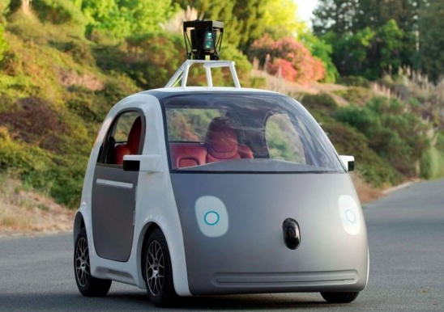
Why we choose it
商务分析
股票交易
系统监控
自动驾驶

Slide 5
Why we choose it
不断的汇总日成交量从而制定商业规划
商务分析
股票交易
系统监控
自动驾驶

Slide 6
Why we choose it
不断的汇总日成交量从而制定商业规划
不断收集市场变化信息预测股价涨跌
商务分析
股票交易
系统监控
自动驾驶

Slide 7
Why we choose it
不断的汇总日成交量从而制定商业规划
不断收集市场变化信息预测股价涨跌
不断收集CPU、Memory等系统指标预测系统未来趋势
商务分析
股票交易
系统监控
自动驾驶

Slide 8
Why we choose it
不断的汇总日成交量从而制定商业规划
不断收集市场变化信息预测股价涨跌
不断收集CPU、Memory等系统指标预测系统未来趋势
不断收集温度，坐标，方向，速度等指标，优化路线和驾驶方式
商务分析
股票交易
系统监控
自动驾驶

Slide 9
Why we choose it
上述业务数据特点:
(1) 数据多
(2) 旧数据趋于不变
(3) 新数据更有价值
(4) 数据总是随时间变化而不断变化

Slide 10
Why we choose it
解决方案
(1) Row-Orient Database
(2) Column-Orient Database
(3) Time-Series-Orient Database

Slide 11
INSERT INTO ...
Time | Name | Age | Humidity | HeartRate | Localtion | ... | Temperature
2019/10/10/ 10:00:00 | Tracy | 22 | 45% | 95 | 116.29860 40.13091 | ... | 11
2019/10/10/ 10:00:00 | Tom | 26 | 45% | 92 | 121.55687 31.31908 | ... | 20
... | ... | ... | ... | ... | ... | ... | ...
2019/10/11/ 11:00:01 | Tracy | 22 | 45% | 90 | 116.30101 31.31673 | ... | 11
2019/10/11/ 11:00:01 | Tom | 26 | 45% | 96 | 121.54794 31.32318 | ... | 21

Slide 12
Why we choose it
Row-Orient Database
Time | Name | Age | Humidity | HeartRate | ... | Temperature
2019/10/10/ 10:00:00 | Tracy | 22 | 45% | 95 | ... | 11
2019/10/10/ 10:00:00 | Tom | 26 | 45% | 92 | ... | 20
... | ... | ... | ... | ... | ... | ...
2019/10/11/ 11:00:01 | Tracy | 22 | 45% | 90 | ... | 11
2019/10/11/ 11:00:01 | Tom | 26 | 45% | 96 | ... | 21

Slide 13
Why we choose it
SELECT HeartRate FROM ...
WHERE Time BETWEEN ... AND ... AND Name = “Tom”
Time | Name | Age | Humidity | HeartRate | ... | Temperature
2019/10/10/ 10:00:00 | Tracy | 22 | 45% | 95 | ... | 11
2019/10/10/ 10:00:00 | Tom | 26 | 45% | 92 | ... | 20
... | ... | ... | ... | ... | ... | ...
2019/10/11/ 11:00:01 | Tracy | 22 | 45% | 90 | ... | 11
2019/10/11/ 11:00:01 | Tom | 26 | 45% | 96 | ... | 21
Red : Data needed Green : Data Scaned

Slide 14
Why we choose it
Column-Orient Database
Time
2019/10/10/ 10:00:00
2019/10/10/ 10:00:00
...
2019/10/11/ 11:00:01
2019/10/11/ 11:00:01
Name
Tracy
Tom
...
Tracy
Tom
Age
22
26
...
22
26
Humidity
45%
45%
...
45%
45%
HeartRate
95
92
...
90
96
Localtion
116.29860 40.13091
121.55687 31.31908
...
116.30101 31.31673
121.54794 31.32318
Temperature
11
20
...
11
21
...
...
...
...
...
...

Slide 15
Why we choose it
SELECT HeartRate FROM ...
WHERE Time BETWEEN ... AND ... AND Name = “Tom”
Time
2019/10/10/ 10:00:00
2019/10/10/ 10:00:00
...
2019/10/11/ 11:00:01
2019/10/11/ 11:00:01
Name
Tracy
Tom
...
Tracy
Tom
Age
22
26
...
22
26
Humidity
45%
45%
...
45%
45%
HeartRate
95
92
...
90
96
Localtion
116.29860 40.13091
121.55687 31.31908
...
116.30101 31.31673
121.54794 31.32318
Temperature
11
20
...
11
21
...
...
...
...
...
...
Red : Data needed Green : Data Scaned

Slide 16

Why we choose it
Time-Series Database
Name | Age | Metric | Time Interval | 00:00 | 00:01 | ... | 59:59
Tracy | 22 | Humidity | 2019/10/10/ 10 | 45% | ... | ... | ...
Tracy | 22 | HeartRate | 2019/10/10/ 10 | 95 | ... | ... | ...
... | ... | ... | ... | ... | ... | ... | ...
Tom | 26 | Humidity | 2019/10/10/ 10 | 45% | ... | ... | ...
Tom | 26 | HeartRate | 2019/10/10/ 10 | 92 | ... | ... | ...
... | ... | ... | ... | ... | ... | ... | ...
Tracy | 22 | Humidity | 2019/10/10/ 11 | ... | 45% | ... | ...
Tracy | 22 | HeartRate | 2019/10/10/ 11 | ... | 90 | ... | ...
... | ... | ... | ... | ... | ... | ... | ...
Tom | 26 | Humidity | 2019/10/10/ 11 | ... | 45% | ... | ...
Tom | 26 | HeartRate | 2019/10/10/ 11 | ... | 96 | ... | ...
... | ... | ... | ... | ... | ... | ... | ...

Slide 17
Why we choose it
SELECT HeartRate FROM ...
WHERE Time BETWEEN ... AND ... AND Name = “Tom”
Name | Age | Metric | Time Interval | 00:00 | 00:01 | ... | 59:59
Tracy | 22 | Humidity | 2019/10/10/ 10 | 45% | ... | ... | ...
Tracy | 22 | HeartRate | 2019/10/10/ 10 | 95 | ... | ... | ...
... | ... | ... | ... | ... | ... | ... | ...
Tom | 26 | Humidity | 2019/10/10/ 10 | 45% | ... | ... | ...
Tom | 26 | HeartRate | 2019/10/10/ 10 | 92 | ... | ... | ...
... | ... | ... | ... | ... | ... | ... | ...
Tracy | 22 | Humidity | 2019/10/10/ 11 | ... | 45% | ... | ...
Tracy | 22 | HeartRate | 2019/10/10/ 11 | ... | 90 | ... | ...
... | ... | ... | ... | ... | ... | ... | ...
Tom | 26 | Humidity | 2019/10/10/ 11 | ... | 45% | ... | ...
Tom | 26 | HeartRate | 2019/10/10/ 11 | ... | 96 | ... | ...
... | ... | ... | ... | ... | ... | ... | ...
Red : Data needed Green : Data Scaned

Slide 18
Why we choose it
没有最好的解决方案

Slide 19
Why we choose it
没有最好的解决方案
小孩子才做选择
“好的”我们都想要 !

Slide 20
How we do

Slide 21
How we do
ClickHouse 实现方式
(1) Column-Orient Model
(2) Time-Series-Orient Model

Slide 22
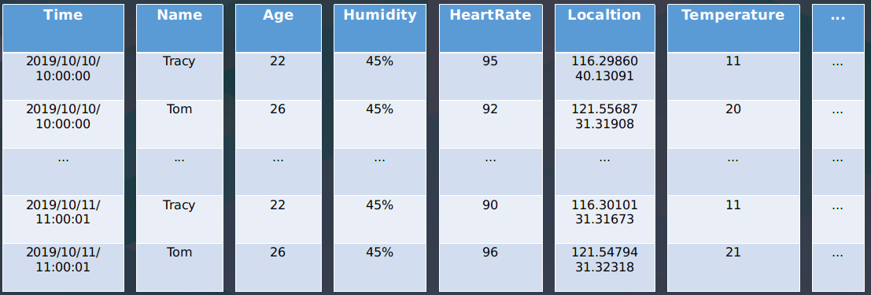
How we do
Column-Orient Model
CREATE TABLE demonstration.insert_view
(
`Time` DateTime,
`Name` String, `Age` UInt8, ...,
`HeartRate` UInt8, `Humidity` Float32, ...
) ENGINE = MergeTree()
PARTITION BY toYYYYMM(Time)
ORDER BY (Name, Time, Age, ...);

Slide 23
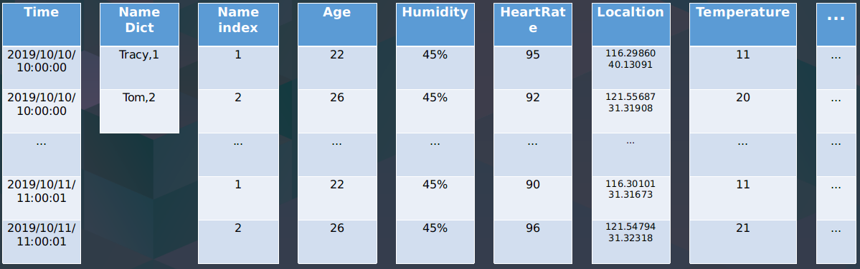
How we do
Column-Orient Model
CREATE TABLE demonstration.insert_view
(
`Time` DateTime,
`Name` LowCardinality(String), `Age` UInt8, ...,
`HeartRate` UInt8, `Humidity` Float32, ...
) ENGINE = MergeTree()
PARTITION BY toYYYYMM(Time)
ORDER BY (Name, Time, Age, ...);

Slide 24
How we do
Column-Orient Model
CPU : Intel Skylake 8 core
Memory : 64 GB
Disk : 500GB SSD
Data Set : TSBS, 12 Hours, 40000 Drivers, 10 Metrics ≈ 16.9 billion Rows

Slide 25
How we do
Column-Orient Model
┌─value─┐
│ 4 │
│ 4 │
│ 4 │
│ 4 │
│ 4 │
└───────┘
5 rows in set. Elapsed: 0.854 sec. Processed 144.06 million rows, 5.19 GB (168.64 million rows/s., 6.07 GB/s.)
:) SELECT value
FROM benchmark.tags
WHERE (metric_name = 'cpu-usage_user')
AND
((created_at >= '2016-01-01 08:00:00')
AND
(created_at <= '2016-01-01 09:00:00'))
ORDER BY toStartOfMinute(created_at) DESC
LIMIT 5

Slide 26
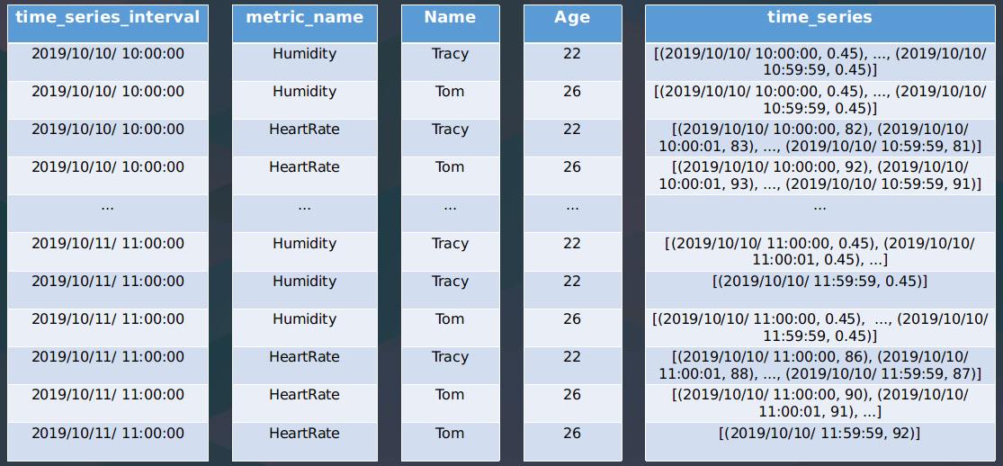
How we do
Time-Series-Orient Model
CREATE TABLE demonstration.test
(
`time_series_interval` DateTime,
`metric_name` String,
`Name` String, `Age` UInt8, ...,
`time_series` AggregateFunction(
groupArray, Tuple(DateTime, Float64))
) ENGINE = AggregatingMergeTree()
PARTITION BY toYYYYMM(time_series_interval)
ORDER BY (metric_name, time_series_interval)

Slide 27
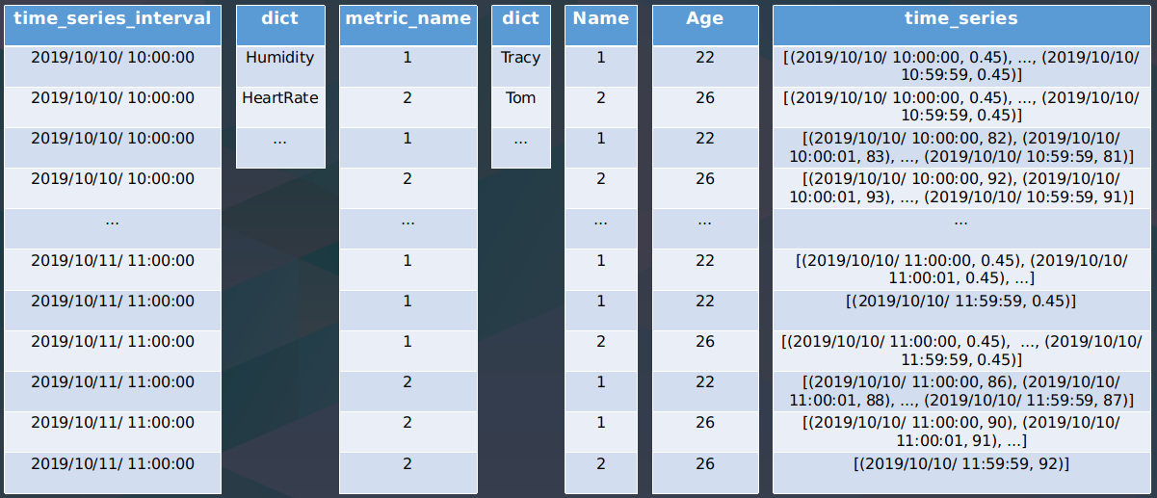
How we do
Time-Series-Orient Model
CREATE TABLE demonstration.test
(
`time_series_interval` DateTime,
`metric_name` LowCardinality(String),
`Name` LowCardinality(String), `Age` UInt8, ...,
`time_series` AggregateFunction(
groupArray, Tuple(DateTime, Float64))
) ENGINE = AggregatingMergeTree()
PARTITION BY toYYYYMM(time_series_interval)
ORDER BY (metric_name, time_series_interval)

Slide 28
How we do
Now：
INSERT INTO demonstration.test SELECT ..., 'HeartRate', groupArrayState(Tuple('2019-10-11 11:11:00', 87));
AND :
SELECT ..., metric_name, groupArrayMerge(time_series) FROM demonstration.test ...;

Slide 29
How we do
It's veeeeeery complicated!!!
So...

Slide 30
How we do
Time-Series-Orient Model
test_insert
Write Client
insert_view
test
Read Client
calc_test_query
test_query

Slide 31
How we do
Time-Series-Orient Model
test_insert
CREATE TABLE demonstration.insert_view
(
`Time` DateTime,
`metric_name` String,
`Name` String, `Age` UInt8, ...,
`value` Float64
)
ENGINE = Null
Write Client
insert_view
test
Read Client
calc_test_query
test_query

Slide 32
How we do
Time-Series-Orient Model
test_insert
CREATE MATERIALIZED VIEW demonstration.test_insert
TO demonstration.test AS SELECT
toStartOfInterval(Time, toIntervalMinute(30))
AS time_series_interval,
metric_name, Name, Age, ...,
groupArrayState((Time, value)) AS timeseries
FROM demonstration.insert_view
GROUP BY time_series_interval, metric_name, Name, Age
Write Client
insert_view
test
Read Client
calc_test_query
test_query

Slide 33
How we do
Time-Series-Orient Model
test_insert
CREATE TABLE demonstration.test
(
`time_series_interval` DateTime,
`metric_name` LowCardinality(String),
`Name` LowCardinality(String), `Age` UInt8, ...
`time_series` AggregateFunction(
groupArray, Tuple(DateTime, Float64))
) ENGINE = AggregatingMergeTree()
PARTITION BY toYYYYMM(time_series_interval)
ORDER BY (metric_name, time_series_interval, Name, ...)
Write Client
insert_view
test
Read Client
calc_test_query
test_query

Slide 34
How we do
Time-Series-Orient Model
test_insert
CREATE VIEW demonstration.test_query AS
SELECT
metric_name, Name, Age, ...,
finalizeAggregation(timeseries) AS timeseries
FROM demonstration.test
Write Client
insert_view
test
Read Client
calc_test_query
test_query

Slide 35
How we do
Time-Series-Orient Model
test_insert
CREATE VIEW demonstration.calc_test_query AS
SELECT
metric_name, Name , Age,
timeseries.1 AS date_time, timeseries.2 AS value
FROM demonstration.test_query
ARRAY JOIN timeseries AS timeseries
Write Client
insert_view
test
Read Client
calc_test_query
test_query

Slide 36
How we do
Now：
INSERT INTO demonstration.insert_view(…, metric_name, date_time, value ) VALUES(...);
AND :
SELECT ..., metric_name, date_time, value FROM demonstration.calc_test_query;

Slide 37
How we do
Time-Series-Orient Model
CPU : Intel Skylake 8 core
Memory : 64 GB
Disk : 500GB SSD
Data Set : TSBS, 12 Hours, 40000 Drivers, 10 Metrics ≈ 19.6 billion Rows

Slide 38
How we do
Time-Series-Orient Model
┌─value─┐
│ 4 │
│ 4 │
│ 4 │
│ 4 │
│ 4 │
└───────┘
5 rows in set. Elapsed: 1.565 sec. Processed 281.69 thousand rows, 11.06 GB (180.01 thousand rows/s., 7.07 GB/s.)
:) SELECT value
FROM benchmark.calc_tags_query
WHERE (metric_name = 'cpu-usage_user')
AND
((created_at >= '2016-01-01 08:00:00')
AND
(created_at <= '2016-01-01 09:00:00'))
ORDER BY toStartOfMinute(created_at) DESC
LIMIT 5

Slide 39
What we do

Slide 40
What we do
Support JSONB DataType for tags & value
Support LowCardinality(JSONB)
Support BoolFilter skip index with JSONB data type
Support TimeSeriesMergeTree Table Engine
Support Multiple Streams for AggregationFunction
Support TimeSeriesAggregateFunction(store sum, min, max, avg)
Support convert sum(time_series) to sum(time_series.sum)

Slide 41
QingCloud ChronusDB
高性能并发读写
千万数据点并发实时写入
引入辅助索引，加快数据检索速度
青云 QingCloud 自研的一款高性能、具备强大 分析 能力的时序数据库产品
低成本存储
列式存储结合高效的编码
Delta、XOR 等适合时序场景的压缩算法
通过 Rollup 功能，对历史数据做聚合，减少数据量
稳定可扩展
分布式架构
数据多副本存储
服务高可用

Slide 42
Thanks For You

