Slide 1
Analyzing MySQL Logs with ClickHouse
Peter Zaitsev
CEO, Percona
April 27,2018

Slide 2

ClickHouse is my love at the first sight

Slide 3
Why ?
Fast and Efficient
Built with Purpose
Practical Features
Easy to Use
MySQL inspired

Slide 4
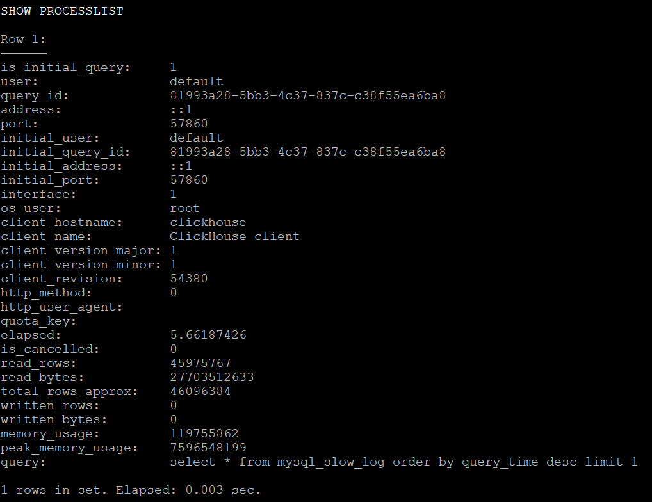
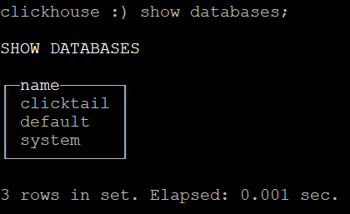
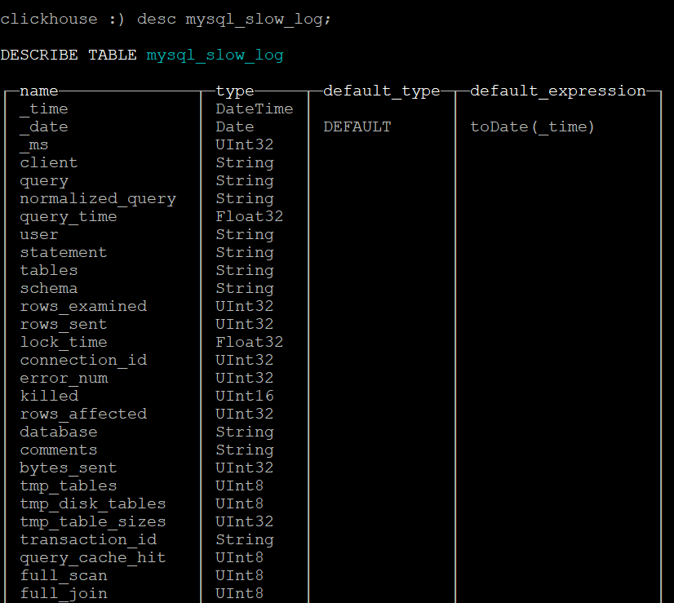
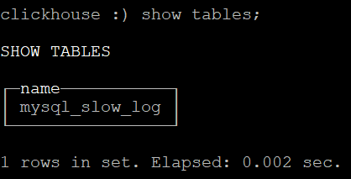
MySQL inspired

Slide 5
Why Keep and Analyze Raw Logs ?
Raw Logs Contain ultimate level of detail
You build any summaries from Raw Events
You can’t recover Raw Events from Summaries
Audit
Trace Application/User Path

Slide 6
Why Not ?
Generating Full Query Logs can be Expensive
Logs can Consume a lot of Space
Logs can be expensive to query

Slide 7
Clickhouse Answers
High Compression (column store + LZ4)
10x+ times space reduction compared to Raw Text Log Files
High Performance
Typically 100x faster than MySQL on Single Server
Semi-Linear Scalability to 100s of nodes

Slide 8

Extra Bonus
MySQL Wire Protocol Compatibility with ProxySQL

Slide 9
Logs to ClickHouse

Slide 10
Several Options
Logstash (ELK Stack)
Kafka
Do it yourself

Slide 11

Meet Charity Majors
Founder and CEO of HoneyComb
Operations at Scale Expert
The Biggest “Observability through Event Analyzes Cheerleader”

Slide 12
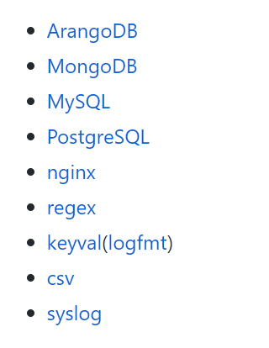
Meet HoneyTail
Honeycomb’s Open Source Agent
https://github.com/honeycombio/honeytail
Nice and Simple Self Contained GoLang Application
Query Normalization Built-in
Supported Parsers

Slide 13

Meet ClickTail
https://github.com/Altinity/clicktail
Created by my friends at Altinity
Replaced HoneyComb “Sender” with Clickhouse
Added Audit Log Support

Slide 14
Installing ClickTail
curl -s https://packagecloud.io/install/repositories/Altinity/clickhouse/script.deb.sh | bash
apt-get install clicktail
Install /etc/clicktail/clicktail-example.conf as /etc/clicktail/clicktail.conf and customize it
APIHost = http://localhost:8123/
clicktail –c /etc/clicktail/clicktail.conf
To See how it works
service clicktail start
To run as a service

Slide 15
MySQL Logs Primer
General Query Log
Binary Log
Slow Query Log
Audit Log

Slide 16
MySQL Audit Logs to ClickHouse

Slide 17
When to use MySQL Audit Logs
Audit Database Access
Have Limited Level of Details
Allows extensive filtering by Object, User Account etc
Has information about Connection Events
Available in MySQL Enterprise, Percona Server, MariaDB

Slide 18
Audit Log Record Example
{"audit_record":{"name":"Query","record":"743017006_2018-03-31T01:03:12","timestamp":"2018-03-31T15:53:42 UTC","command_class":"select","connection_id":"2394","status":0,"sqltext":"SELECT SUM(k) FROM sbtest1 WHERE id BETWEEN 3 AND 102","user":"sbtest[sbtest] @ localhost []","host":"localhost","os_user":"","ip":"","db":"sbtest"}}

Slide 19
Percona Server Configuration
Install Audit Plugin
INSTALL PLUGIN audit_log SONAME 'audit_log.so';
Configure Audit Plugin
audit_log_format=JSON
audit_log_rotate_on_size=1G
audit_log_rotations=2
Customize Filtering as needed
audit_log_exclude_accounts = ‘app1@%,app2@localhost';

Slide 20
Clickhouse/ClickTail Setup
Install Schema
cat schema/db.sql | clickhouse-client –multiline
cat schema/mysqlaudit.sql | clickhouse-client –multiline
Configure ClickTail
[Required Options]
ParserName = mysqlaudit
LogFiles = /var/lib/mysql/audit.log
Dataset = clicktail.mysql_audit_log

Slide 21
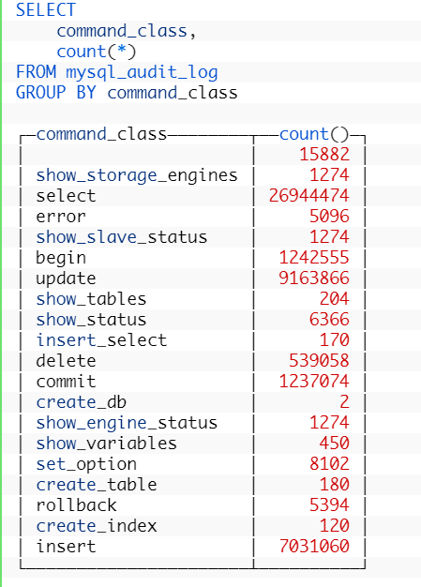
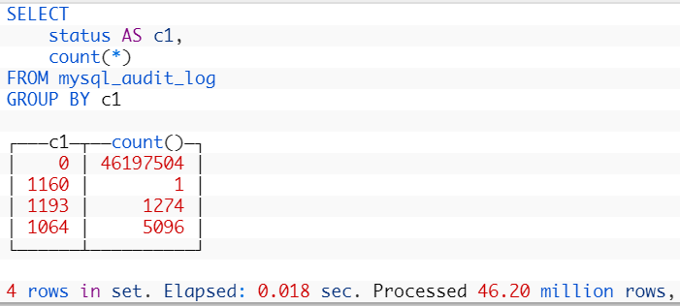
Audit Log Query Examples

Slide 22
MySQL Slow Query Logs to ClickHouse

Slide 23
When to use Slow Query Logs ?
Everything Else ☺
Performance Analyses
Debugging

Slide 24
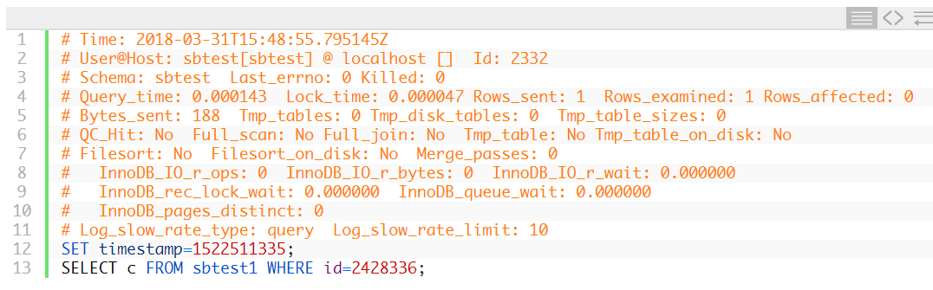
Slow Log Record Example

Slide 25
Configuring Slow Query Logs in Percona Server
slow_query_log=ON
long_query_time=0
log_slow_rate_limit=1
log_slow_rate_type=query
log_slow_verbosity=full
log_slow_admin_statements=ON
log_slow_slave_statements=ON
slow_query_log_always_write_time=1
slow_query_log_use_global_control=all

Slide 26
Clickhouse/ClickTail Setup
Install Schema
cat schema/db.sql | clickhouse-client –multiline
cat schema/mysql.sql | clickhouse-client –multiline
Configure ClickTail
[Required Options]
ParserName = mysql
LogFiles = /var/log/mysql/db01-slow.log
Dataset = clicktail.mysql_slow_log

Slide 27
Additional Parser Configurarion
[MySQL Parser Options]
Host = localhost:3306 ; or @unix(/var/run/mysqld/mysqld.sock)
User = username
Pass = userpass

Slide 28
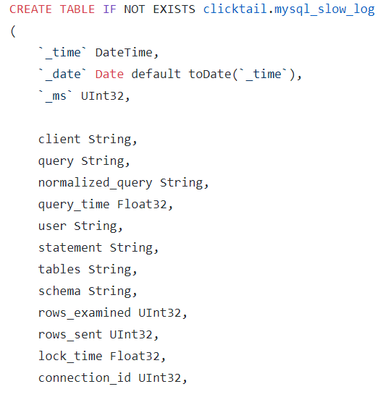
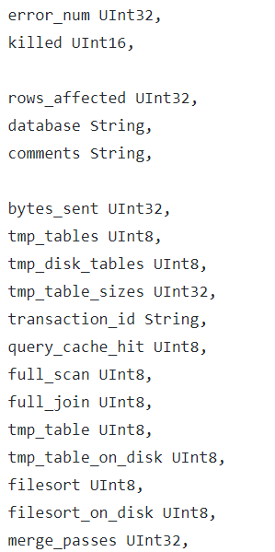
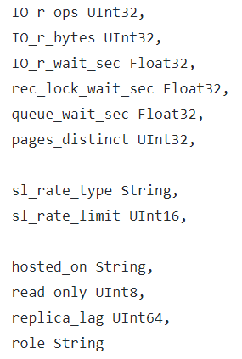
What Information is Available ?

Slide 29
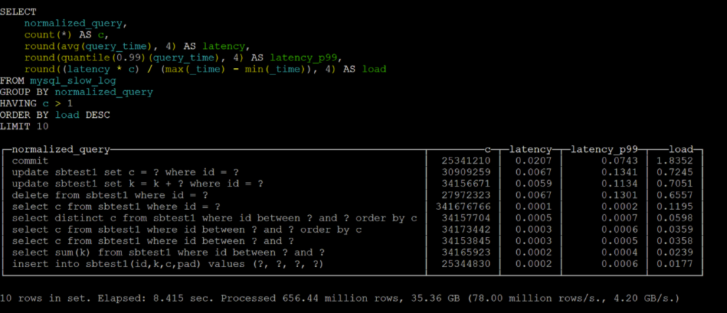
Queries Causing the Most Load

Slide 30
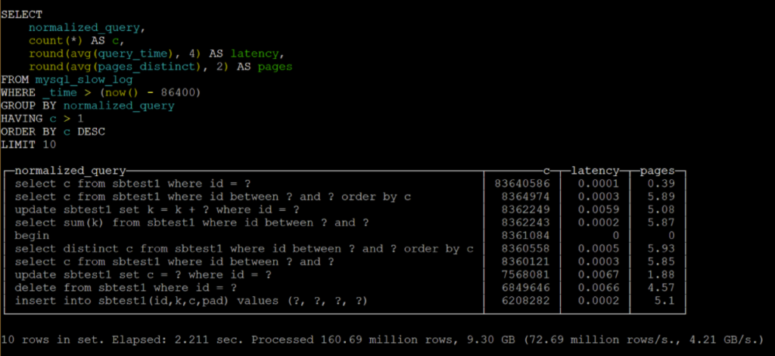
Working set of Most Frequent Queries

Slide 31
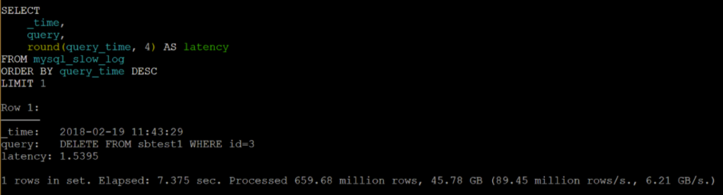
Slowest Query

Slide 32
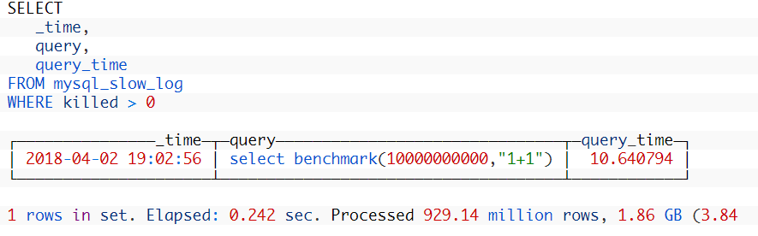
Any Killed Queries ?

Slide 33
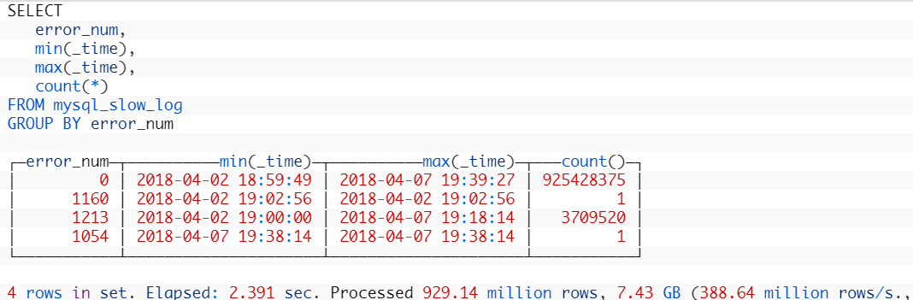
When Did we have failures

Slide 34
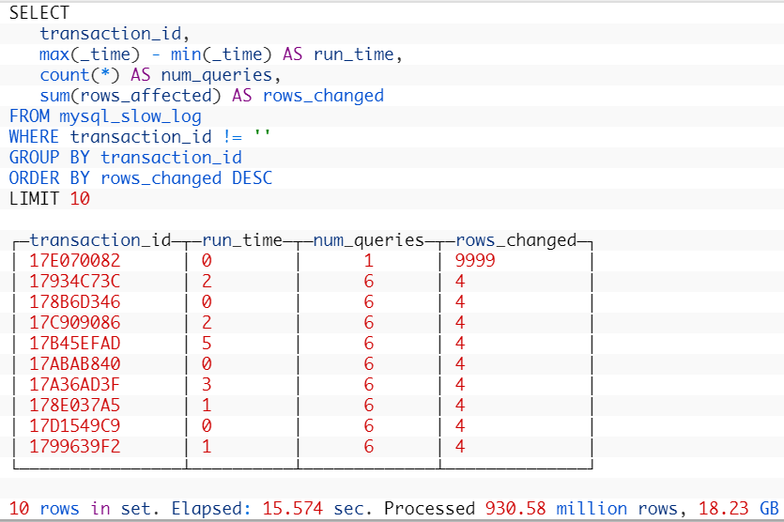
Long Transactions

Slide 35
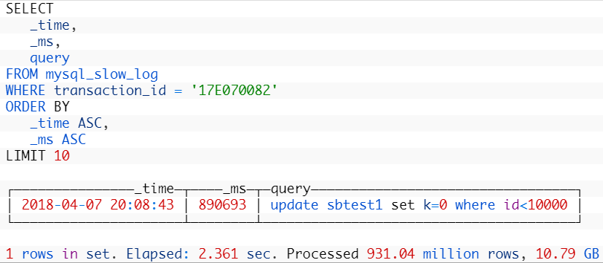
Queries from bad Transaction

Slide 36
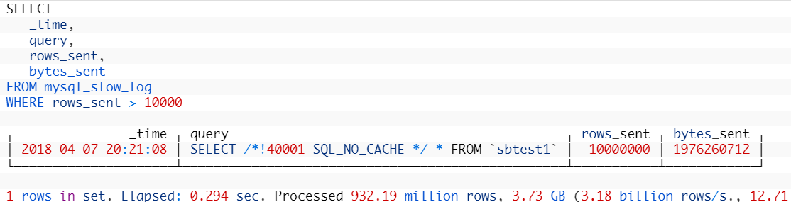
Anyone dumping a lot of data ?

Slide 37
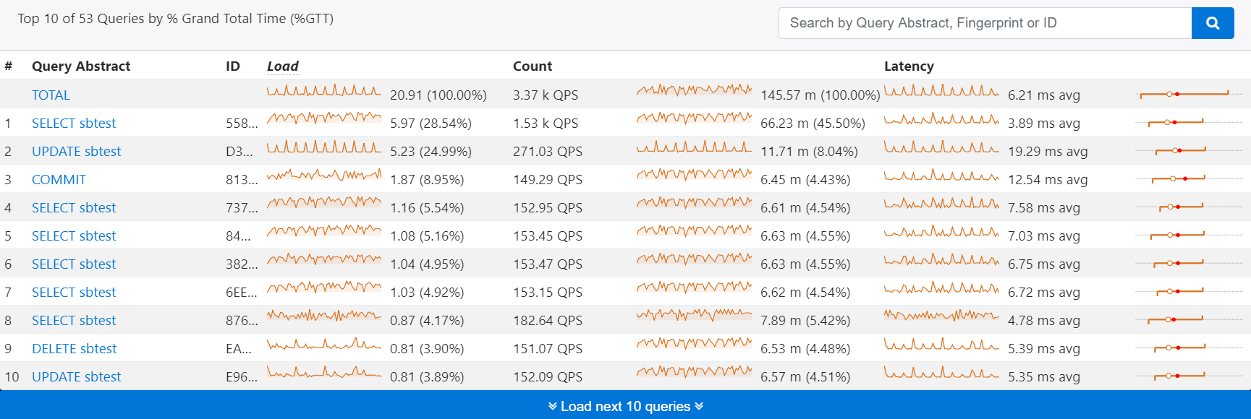
Want Processed Logs ?
Check out Percona Monitoring and Management

Slide 38
Need Help ?
Percona - MySQL, MariaDB, MongoDB, PostgreSQL Support and Services
Will help you getting your MySQL log to Clickhouse
Recommend Altinity for complete ClickHouse Support, Consulting and Training

Slide 39
Bonus: Using PMM for ClickHouse Monitoring
docker run -d -p 9116:9116 f1yegor/clickhouse-exporter -scrape_uri=http://myhost:8123/
pmm-admin config –server pmm.your-domain.com
pmm-admin add linux:metrics
pmm-admin add external:service clickhouse --interval 10s --service-port=9116

Slide 40
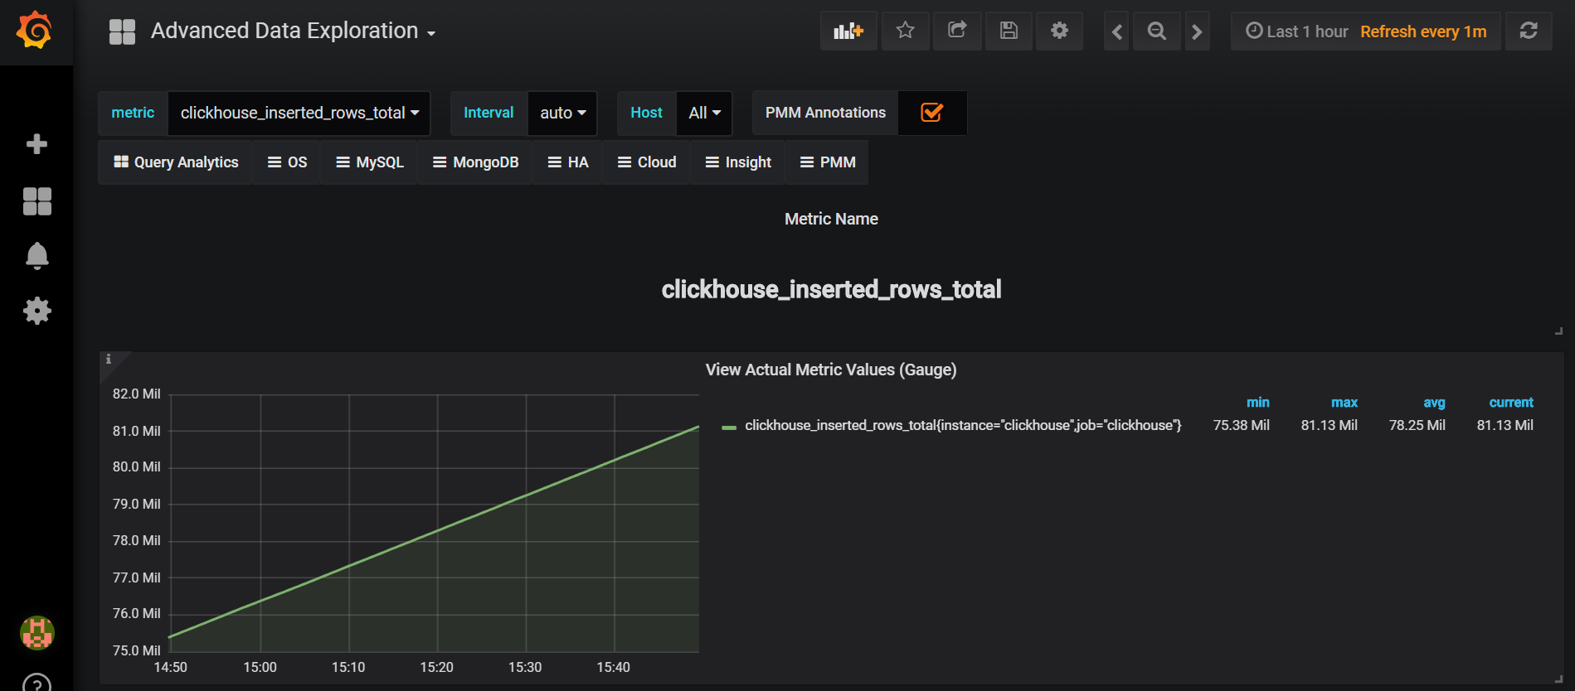
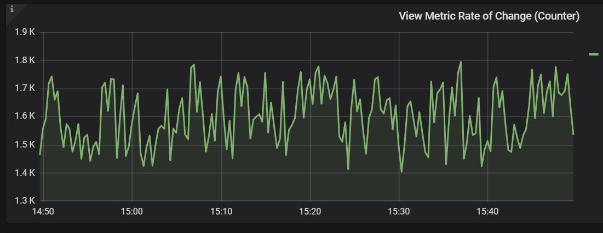
Use Advanced Data Exploration Dashboard

Slide 41
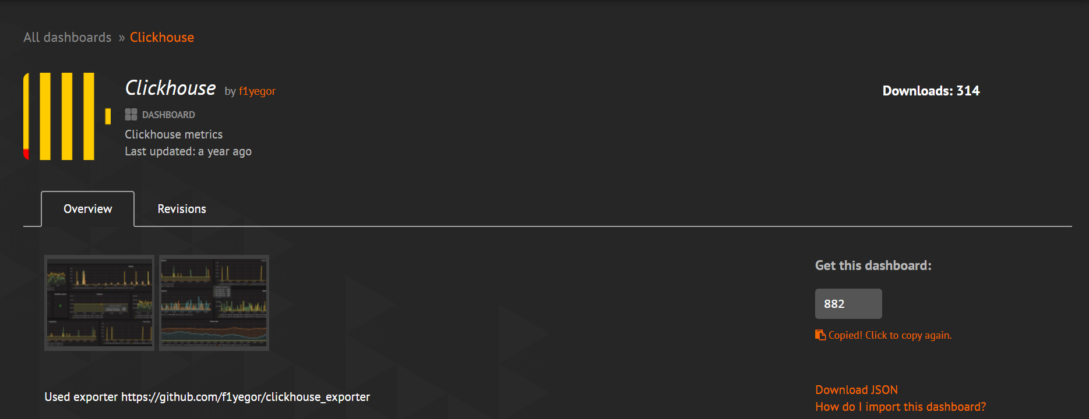
Import Grafana Dashboard

Slide 42
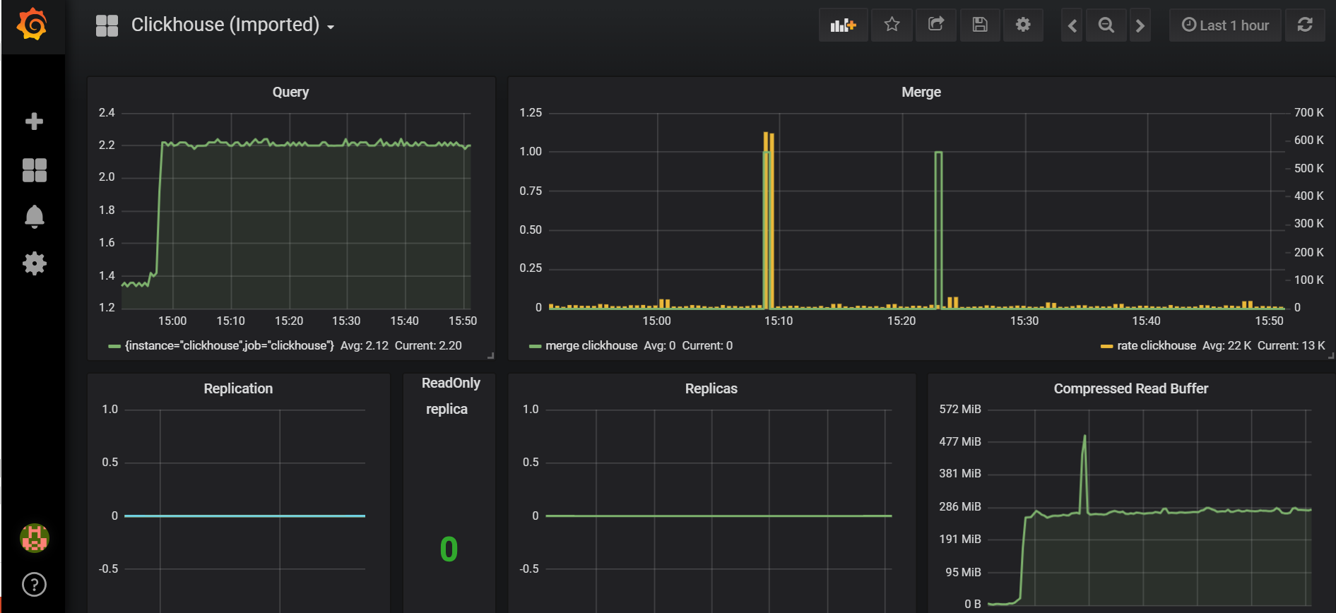
Dashboard Works out of the Box

Slide 43
Thank You!

