Slide 1

01110101010101011010101010100010101101010101101010101
01010101101010101010010101 010101011010101
01010101010001010101110101010110010101
011010101010101011010101001010010101
011010101010101011010101010010101
01101010101010101101010101010
0110101010101010110101010101000101
00010101011101010101101010101
1010101010100010101011110101
010101011101010101101010101010010101
011010101010101011010101011010101101
011010101010101011010101010100010101
0110101010101010110101010101010101010010101
010101011101010101101010101010010101
10101011101010101101010101010010101
00010101011101010101101010101010010101
010010101011101010101101010101010010101
100010101011101010101101010101010010101
1010010101011101010101101010101010010101
010100010101011101010101101010101010010101
101010100010101011101010101101010101010010101
101010 110101010101000101010111010101011010101010100101011
10001 01010111010101011010101010100
￥
$
£
￥
€
$
$
€
UDF in ClickHouse
Concept, Develpoment, and Application in ML Systems
￥
￥
￡

Slide 2


About CraiditX
CraiditX 氪信, a finance AI startup since 2015
The Main Business
AI-based risk control
AI-based marketing
AI-based customer service
...
Our Partners and Customers

Slide 3

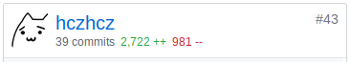
About Me
Chenzhang HU 胡宸章
R&D Engineer at CraiditX
Focusing on AI systems and algorithms
Active GitHub User
https://github.com/hczhcz
Interested in computer system and language stuff
8 organizations, 90+ repos, 600+ followers
ClickHouse Contributor

Slide 4
OLAP in ML Systems

Slide 5
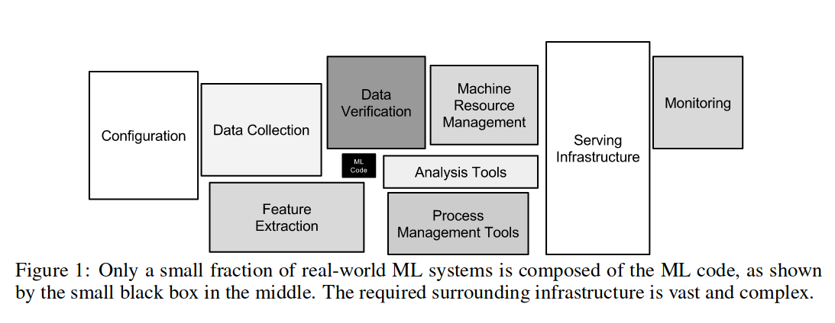

Slide 6
Intensive Tasks in a ML System
Pre-analyzing the data
Extracting features
Constructing relationship graphs
Generating reports
...

Slide 7
Intensive Tasks in a ML System
Pre-analyzing the data
= Finding the useful part of data + Summerizing data
Extracting features
= Joining data + Grouping data + Doing math or pattern matching
Constructing relationship graphs
= Identifying connections + Grouping data into source-destination pairs
Generating reports
= Joining data + Summerizing data
...
The data processing scenario is very similar to OLAP

Slide 8

A Database is not Just a “Database”
What an English Dictionary Tells You
database /ˈdeɪtəˌbeɪs/
A collection of data stored in a computer that can easily be used and added to
What We Actually Do
Data
Storage
Computing

Slide 9
A Database System and A ML Pipeline
Module
Input Data
Module
Module
Input Data
Module
Module
Input Tables
Result Table
Pipeline = Directed Acyclic Graph (DAG) of modules
Module = Input + Task + Output
Task = Query or external program
Query = “CREATE TABLE ... AS SELECT ...”
Computing Task

Slide 10

Why ClickHouse
Limited hardware resources & time → efficiency matters
Performance
Each node is able to handle billions of rows
Most queries can be done in 0.1s-10min
Ease of Use
SQL
Portable binary deployment with few dependencies
Customization
The straight-forward code structure and the well-designed API
We maintains a custom build

Slide 11
The UDF Magic

Slide 12
When the “Standard” SQL is not Enough
Functionality Limitations
Scanning data back and forth
Example: Recognizing a behavioral pattern in the time series data
Or even... randomly
Example: Finding a shortest path in the graph
Iterating
Example: Training a regression model
Handling domain-specific data
Example: Computing the edit distance between two strings
...

Slide 13
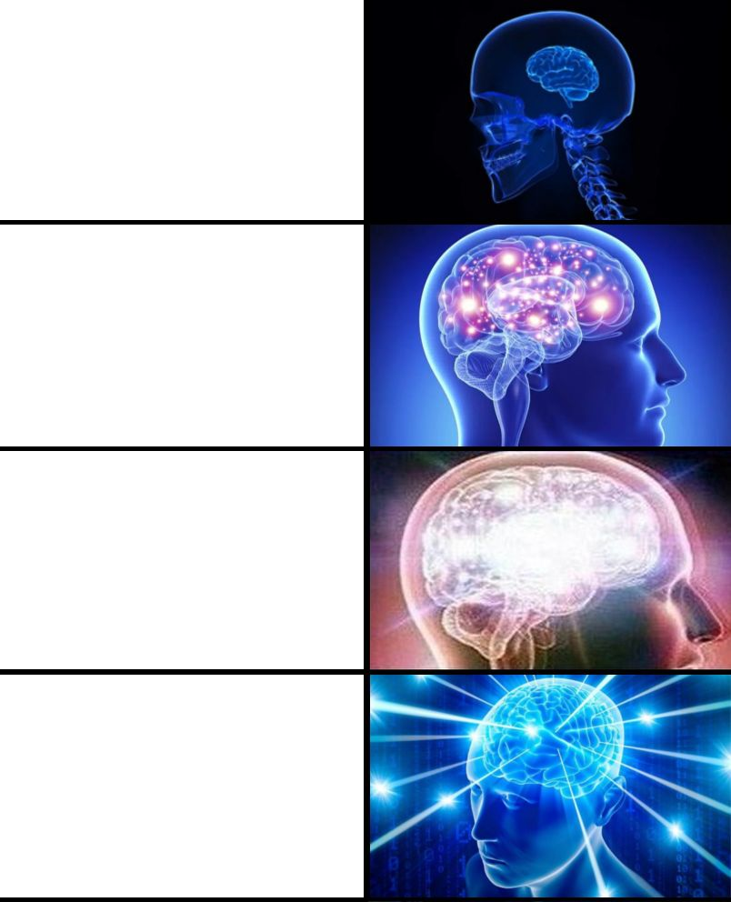
When the “Standard” SQL is not Enough
Performance Concerns
A “dull” SQL solution can be 10x-1000x slower than a native C++ program
Example: Multiple self-joining on time series
Ease of Use and Maintainability
SELECT skewPop(x) FROM data
SELECT centralMoment(3)(x) / pow(stddevPop(x), 3) FROM data
SELECT (sum(pow(x, 3)) / count() - 3 * sum(pow(x, 2)) * sum(x) / pow(count(), 2) + 2 * pow(sum(x), 3) / pow(count(), 3)) / pow(stddevPop(x), 3) FROM data

Slide 14
A UDF Can Do the Trick
User-Defined Functions (UDF)
A function provided by the user
UDF in ClickHouse
Scalar functions
Aggregate functions & combinators
Table functions & storage engines
Usage Examples in Our ML Systems
Data Preprocessing
Filling invalid date strings in a time series
Feature Engineering
Calculating average values within a window
Connection Recognition
Finding persons with similar street addresses

Slide 15
Zoo of Our UDF

Slide 16
Windowed Aggregate Functions
SELECT windowRefer(30)(date, value) FROM data
SELECT windowReferEx(30, 'quantile(0.2)')(date, value) FROM data
Computing the aggregate results of the rows within each time window
When a row enters, it will be “added” to the aggregation state
Then, the aggregate function yields a result field
When a row leaves, it will be “removed” from the aggregation state
It requires some special algorithms and tricks
Most of the aggregate functions and combinators are re-implemented
Typical usage: Feature computing
A further idea: -Window combinator

Slide 17
Funnel Automata Functions
SELECT yFunnel(6, '
rule(r1)(require(get(1) = ''index.html'')),
rule(r2, r1)(require(get(1) = ''product_info.html''),
product_id(get(2)), return(''viewed'')),
rule(r3, r2)(require(get(1) = ''product_buy.html''),
verify(product_id = get(2)), return(''purchased''))
')(timestamp, page, product_id)
FROM pageview
Matching behavior sequences within time window
Inspired by Analysys OLAP Challenge 2018 (Funnel Analysis)
Featuring built-in automata description DSL
It is implemented using the parser facilities in ClickHouse

Slide 18
Array Functions
SELECT arraySplit(x -> x >= 10, [11, 4, 5, 14]) = [[11, 4, 5], [14]]
SELECT arrayFill(x -> x > 0, [1, 2, 0, 0, 3, 0]) = [1, 2, 2, 2, 3, 3]
Handling time series data
With arrays, the data block boundary will not affect the result
Based on the common implementation of high-order array functions
FunctionArrayMapped.h
Used in Analysys OLAP Challenge 2019 (Session Analysis)
Pull request #7294 and #7380

Slide 19
Integration of Third-party Libraries
FuzzyWuzzy
Levenshtein distance (edit distance)
By character
By token
Popular among ML algorithm engineers
Simdjson
An extremely fast JSON parser based on AVX2 Instruction Set
Structured data extraction (JSONExtract)
We can pass the type as a parameter just like in CAST function
Difficulties in cross-platform compatibility
Pull request #4686 and #5124

Slide 20
Miscellaneous
Statistics
Simple linear regression
Skewness and kurtosis
Weight-based entropy
Pull request #4668 and #5200
Aggregate Function Combinators
-OrDefault and -OrNull
When an aggregate function has nothing to aggregate
-Resample
Pull request #5590 and #7331

Slide 21
UDF Development Explained

Slide 22
General Steps of UDF Development
Design the Interface
Meta information
Example: Will the return value change over time?
Arguments and the return value
Create the Function Body
Scalar functions: Handling data blocks
Aggregate functions: Maintaining internal states, adding, merging, and reducing
Put Things Together
Registering your function
Build and run!

Slide 23
Type Checking and Inference
What should we consider? Let's see...
arraySum([1, 2, 3])
Number of argument = 1
Data type of the only argument = Array(X)
X should be UInt, Int, or Float
Data type of the return value = Extended(X)
We prefer the largest native numerics, i.e. UInt64, Int64, or Float64
Data types vs. column types
Furthermore?
The real arraySum also supports lambda

Slide 24
Scalar Function Implementation
Then...
arraySum([1, 2, 3])
Data are handled per block
Column type of the argument = ColumnArray(ColumnVector(X), ColumnOffset)
ColumnConst can be handled explicitly or automatically
value offset arraySum
[1, 2, 3] 3 6 <- sum of value[0..2]
[9, 10] 5 19 <- sum of value[3..4]
[4, 5, 6] 8 15 <- sum of value[5..7]

Slide 25
Aggregate Function Implementation
avg(x)
Data are handled per group and row
Internal state = (count(), sum(x))
To add one row
sum(x) += x[i]
count() += 1
To calculate the result
avg(x) = sum(x) / count()
Also, we need to implement serialization, deserialization, and merging
Some aggregate functions require more advanced algorithms
uniq(x), median(x), ...
Most of them depend on sampling tricks and/or special data structures
1 | 9 | 4
3 | 7 | 3 | 8
14 / 3
21 / 4
35 / 7
5

Slide 26
Going Further

Slide 27
Inline C++ in SQL
SELECT udsf('
std::string udsf(std::string s)
{
return "hello, " + s;
}
', 'world')
Compiled and linked dynamically
It uses the embedded compiler facilities in ClickHouse
Type inference driven by C++ Template Metaprogramming
Also supported: Block-based scalar functions, aggregate functions
Okay for proof-of-concept usages, but ...

Slide 28
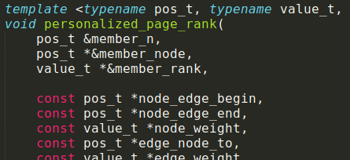


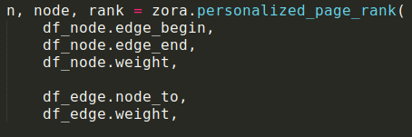
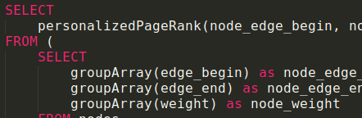

Zora: High-performance Algorithm Implementation Framework
Main Concepts
Column-oriented & Memory Densed
High memory efficency and avoiding unnecessary IO
Smooth integration with ClickHouse, NumPy, Pandas, ...
Minimalism Fundamental Algorithm Components
Carefully chosen algorithm targeted at supporting the ML pipeline
Featured: Data structures, graph algorithms, statistical operators, ...
Write Once, Available Everywhere
Native C++ Implementation with no third-party dependency
Auto-generated interface to Python3 and ClickHouse (UDF)

Slide 29
Questions / Comments

