Slide 1
Sync Clickhouse with MySQL/MongoDB

Slide 2
About
Company: Xiaoxin Tech.
Industry: Education
Team: Big Data
Leader: wangchao@xiaoheiban.cn

Slide 3
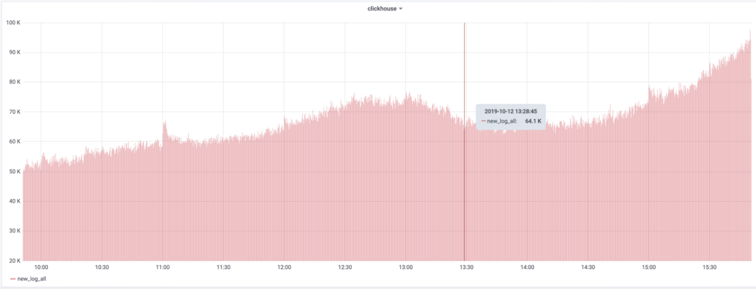
100 billion data this year till now

Slide 4
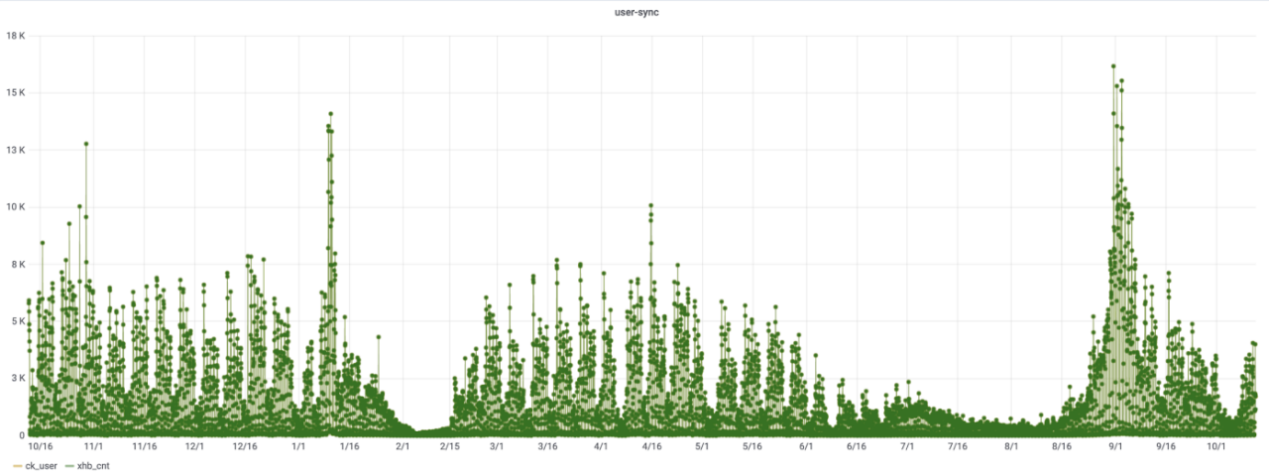
30 million users

Slide 5
We use Clickhouse in our daily tasks

Slide 6
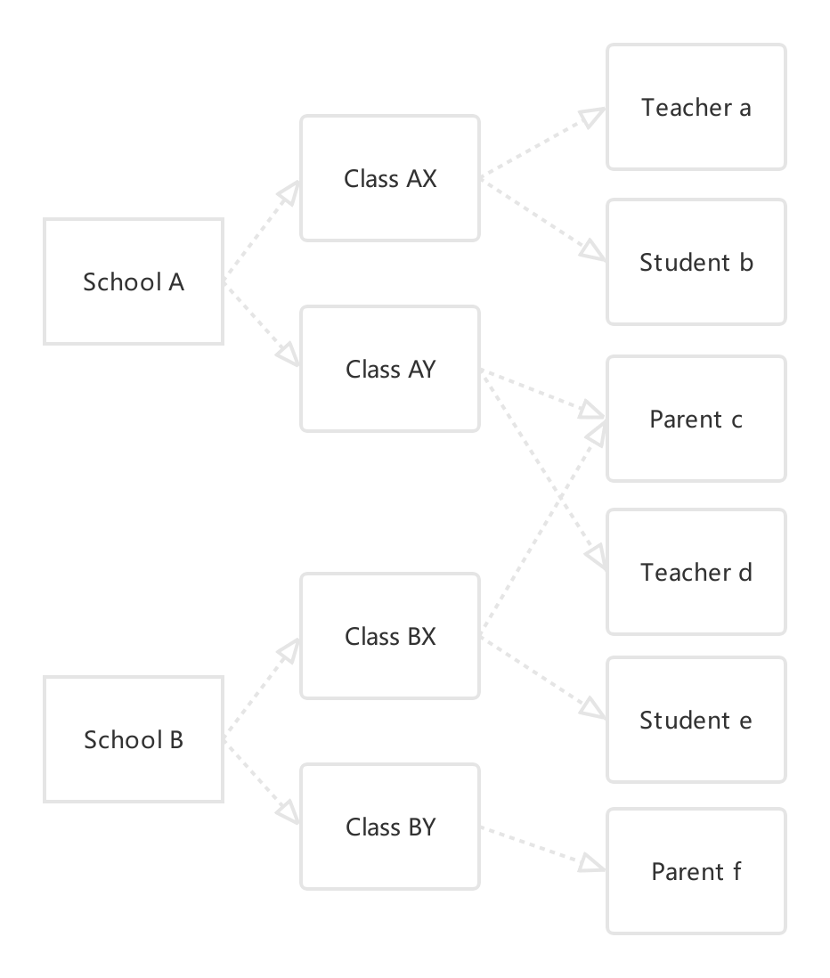
Chanllenges

Slide 7
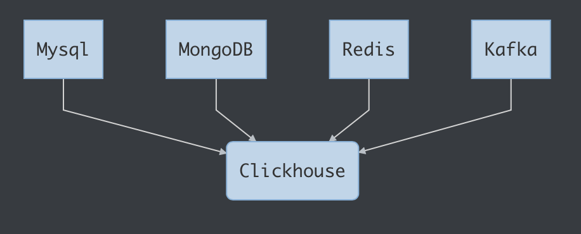
Chanllenges
Complex Datasource

Slide 8
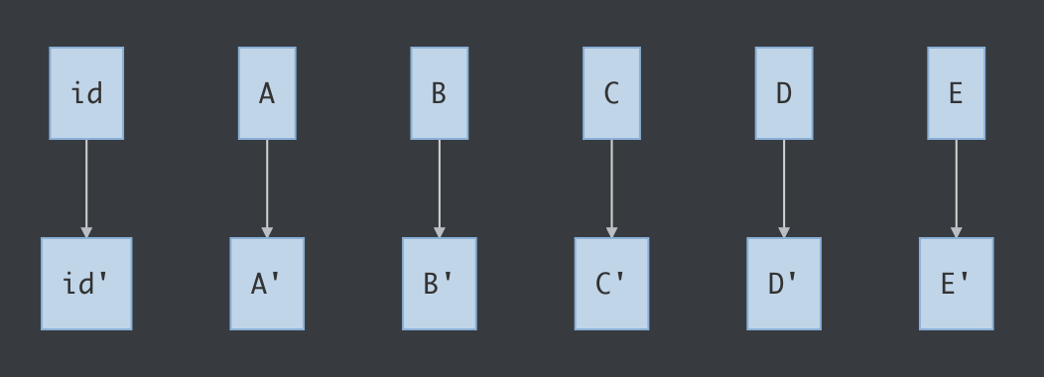
Chanllenges
Frequent Updates

Slide 9

Possible Solutions 1.
Replay binlog/oplog CRUD directly
Can’t update/delete table frequently in Clickhouse

Slide 10
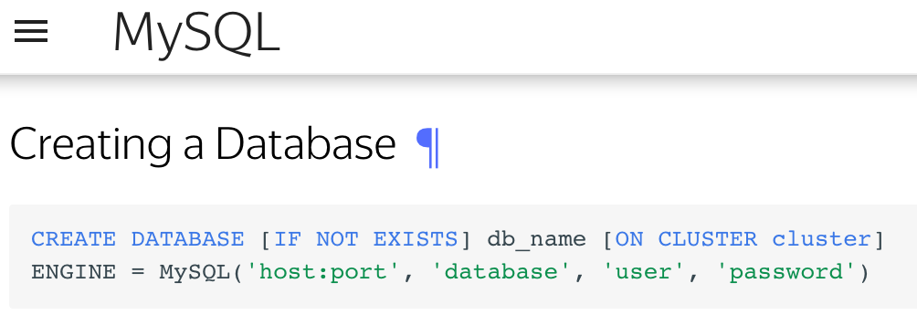
Possible Solutions 2.
MySQL Engine
Not suitable for big tables
Not suitable for MongoDB

Slide 11

Possible Solutions 3.
Reinit whole table every day……

Slide 12
Possible Solutions 4.
CollapsingMergeTree
FINAL is slow
GROUP BY id HAVING sum(sign)>0
Need to use GROUP BY in every query
Not suitable for multi-column primary key

Slide 13
Our Solution: PTS
Key Features
Only one config file needed for a new Clickhouse table
Init and keep syncing data in one app for a table
Sync multiple data source to Clickhouse in minutes

Slide 14
PTS
Provider Transform Sinker
Typical Provider Config
{
Type: mysql, // mysql, mongodb, redis
Listen: binlog, // binlog, kafka
DataSource: user:pass@tcp(example.com:3306)/user,
Table: user,
QueryKeys: [ // usually primary key
id
],
Pairs: { // field mapping
id: id,
name: name
}
}
Major Provider Must Listen
Merge sharding tables
SolidKey

Slide 15
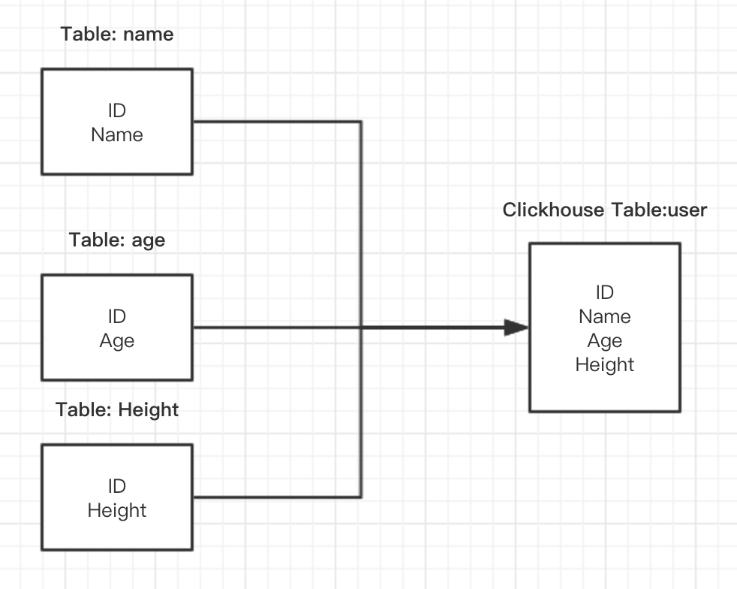
PTS
Provider Transform Sinker
Major Provider
Secondary Providers

Slide 16
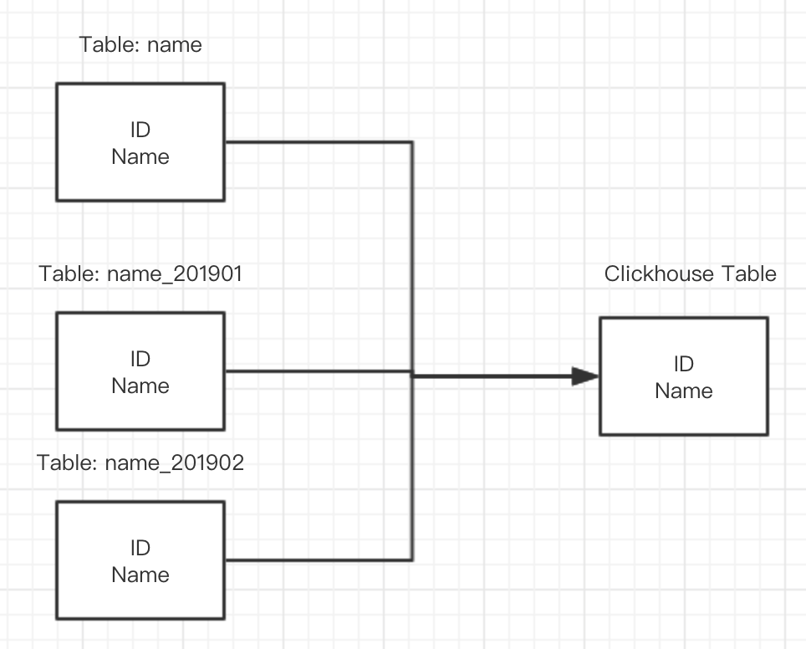
PTS
Provider Transform Sinker
Merge sharding tables

Slide 17
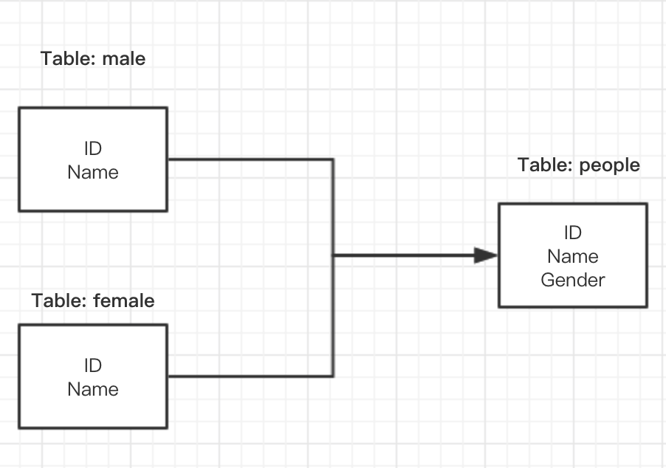
PTS
Provider Transform Sinker
SolidKey

Slide 18
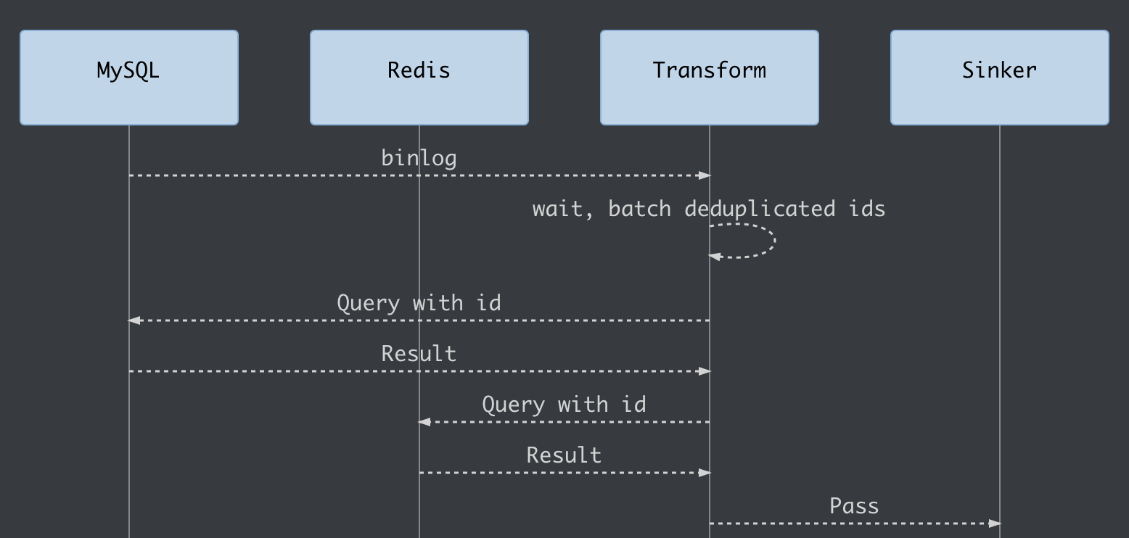
PTS
Provider Transform Sinker
Transform

Slide 19
PTS
Provider Transform Sinker
Batch Inserts
Time trigger
Number trigger
Magical Flag

Slide 20
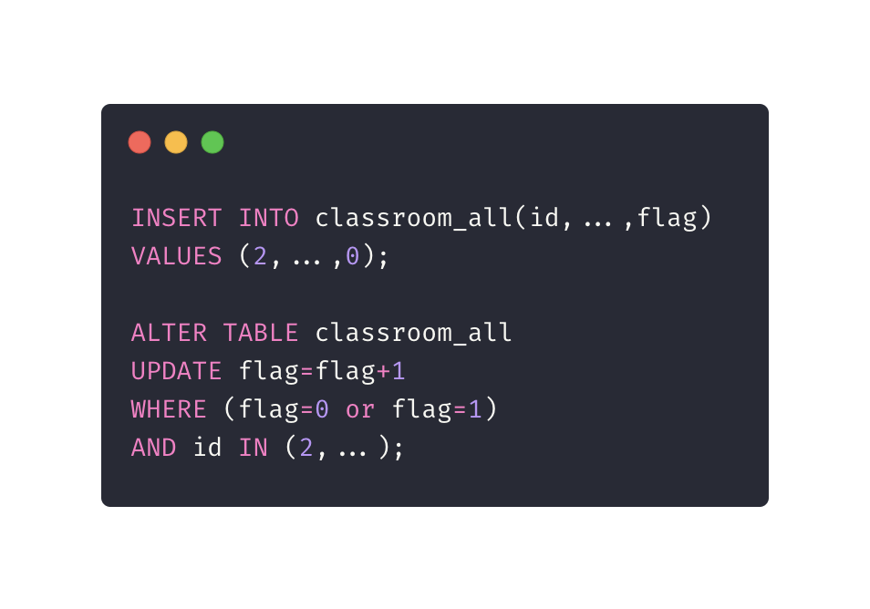
PTS
Magical Flag
Quiz

Slide 21
PTS
Magical Flag
Create

Slide 22
PTS
Magical Flag
Create
id | name | flag
2 | Bob1 | 0
id | name | flag
2 | Bob1 | 1

Slide 23
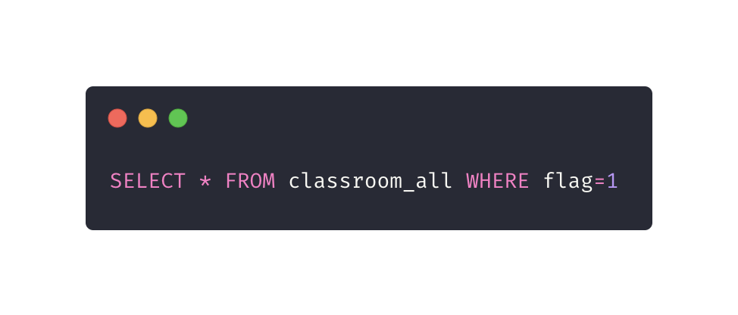
PTS
Magical Flag
Read

Slide 24
PTS
Magical Flag
Update

Slide 25
PTS
Magical Flag
id | name | flag
2 | Bob1 | 1
2 | Bob2 | 0
Update
id | name | flag
2 | Bob1 | 2
2 | Bob2 | 1

Slide 26
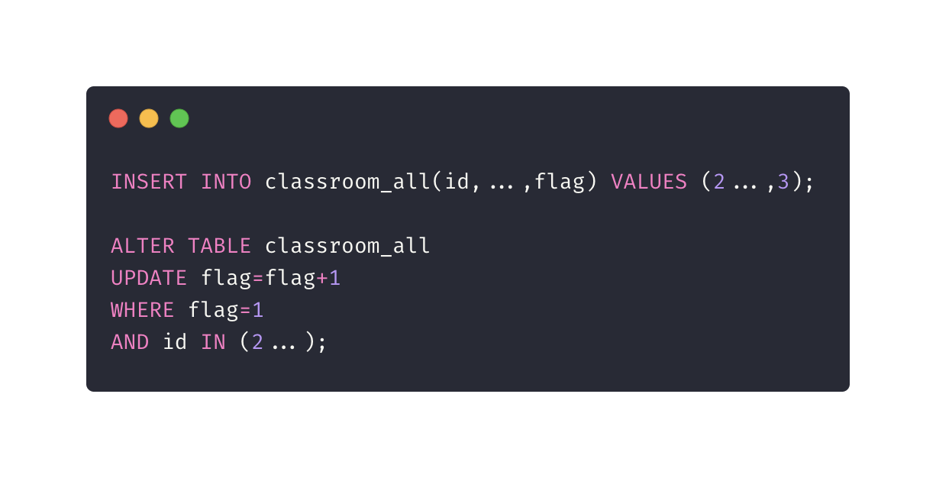
PTS
Magical Flag
Delete

Slide 27
PTS
id | name | flag
2 | Bob1 | 2
2 | Bob2 | 1
2 | Bob2 | 3
Magical Flag
Delete
id | name | flag
2 | Bob1 | 2
2 | Bob2 | 2
2 | Bob2 | 3

Slide 28
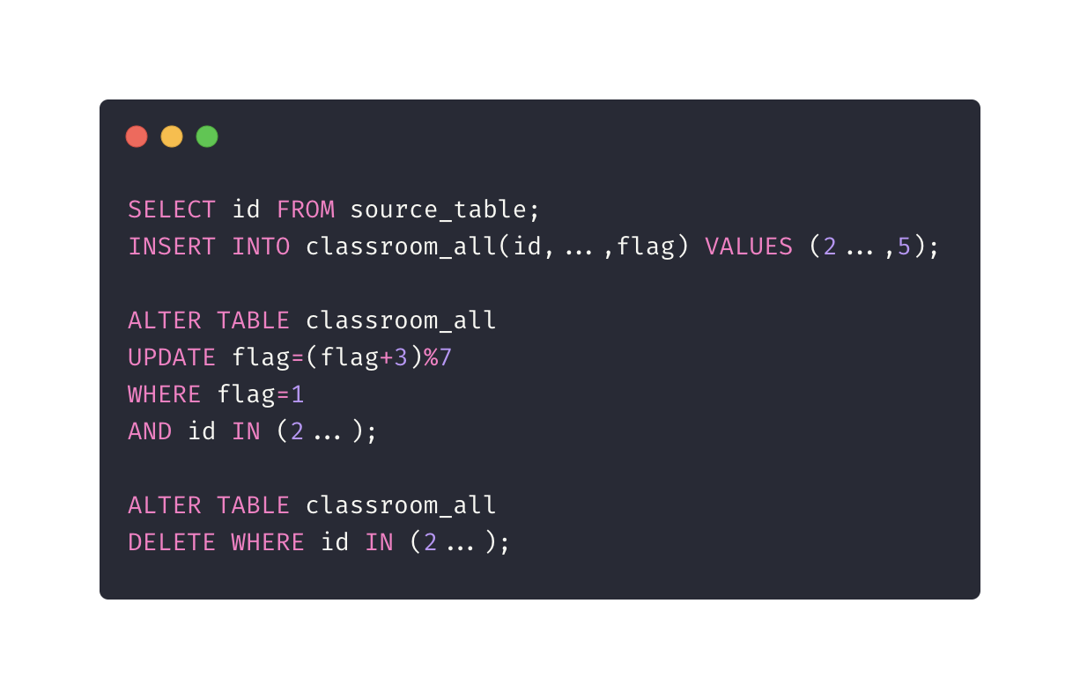
PTS
Magical Flag
Add new column

Slide 29
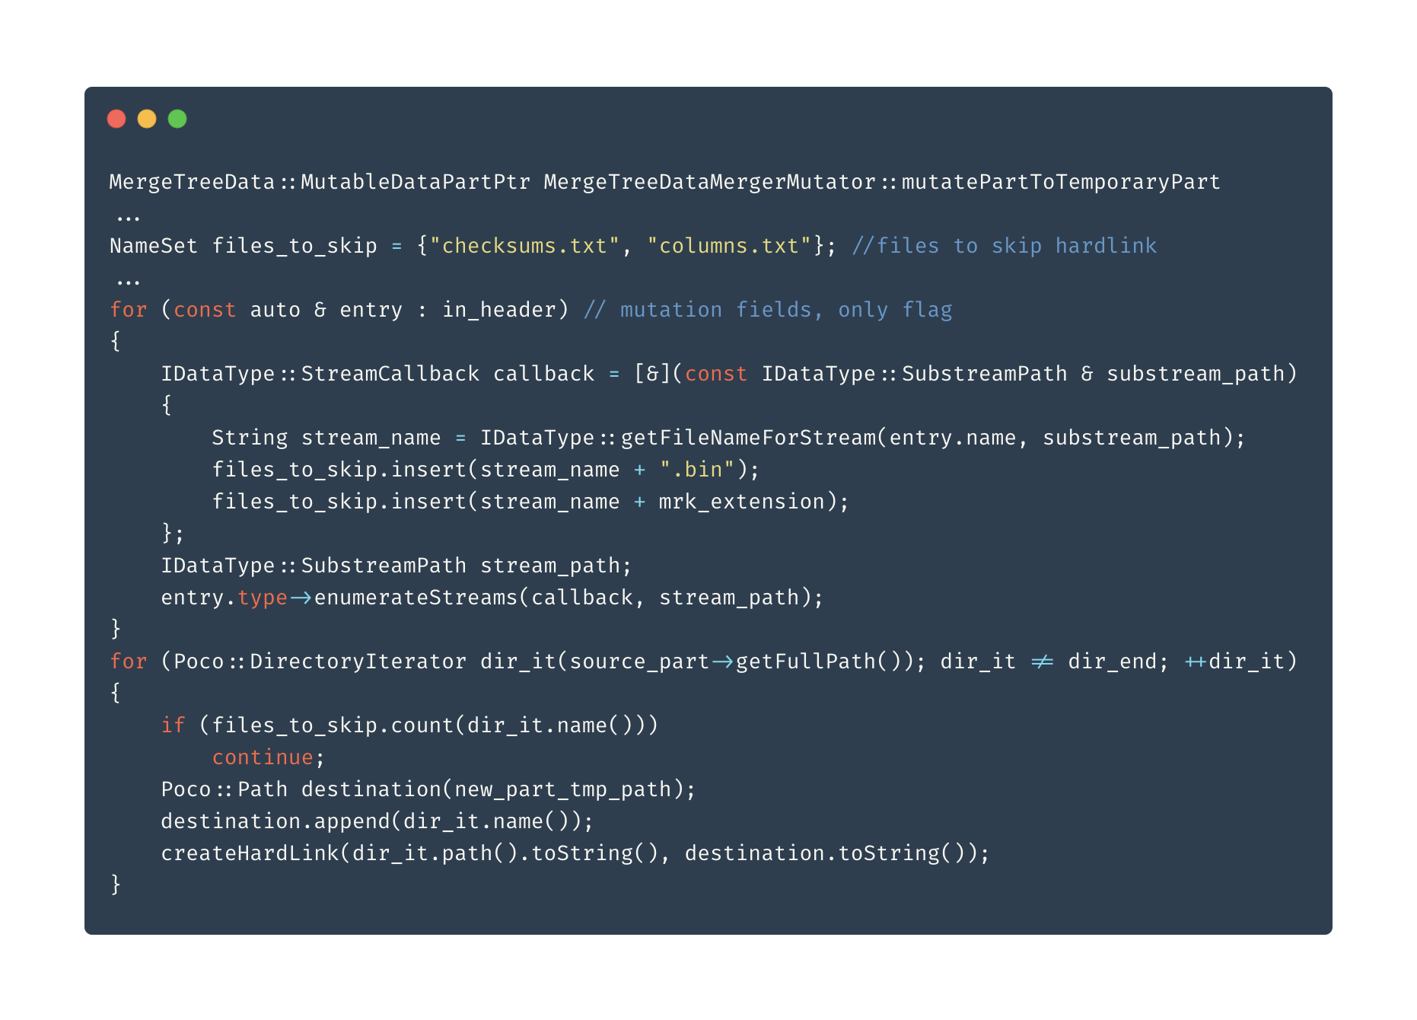
PTS
Magical Flag
Why fast?
Clickhouse Mutation

Slide 30
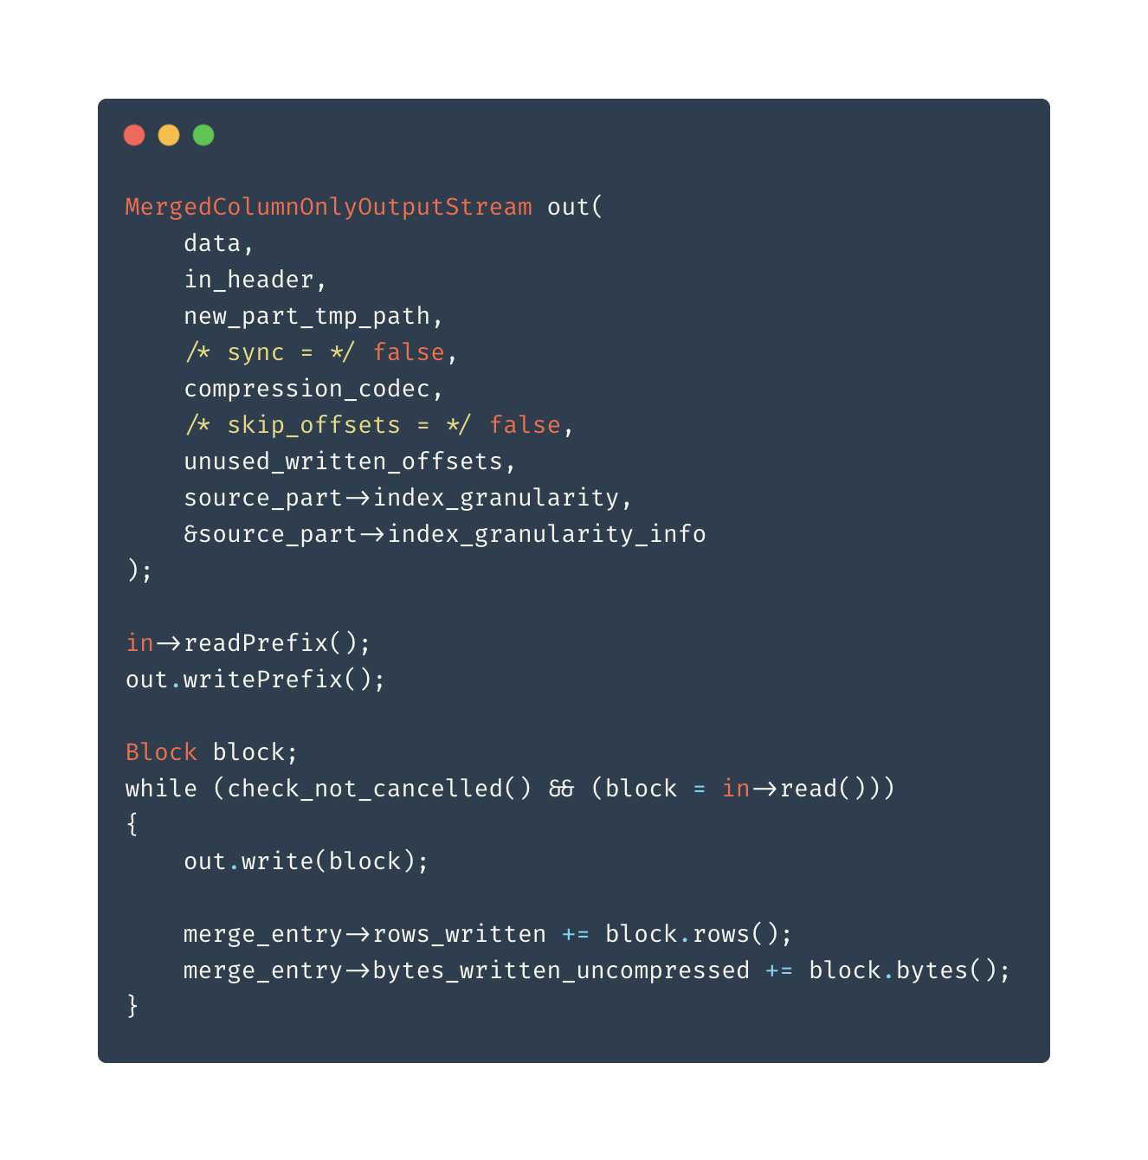
PTS
Magical Flag
Why fast?
Clickhouse Mutation

Slide 31
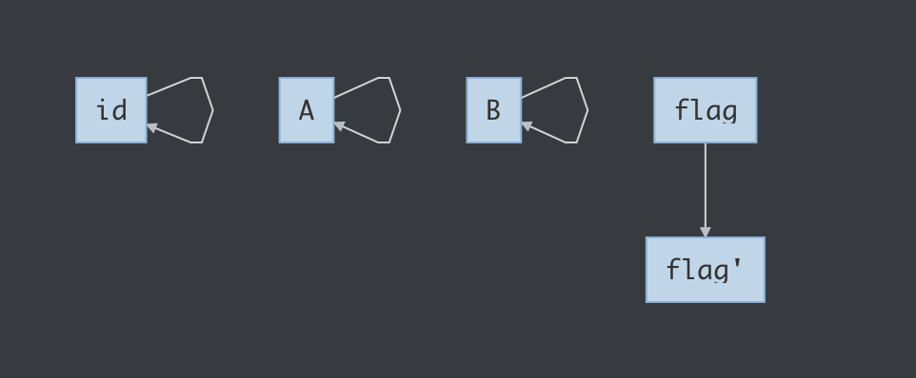
PTS
Magical Flag
Why fast?
Clickhouse Mutation

Slide 32
Trouble Shoot
SQL is too big(max_ast_elements, max_expanded_ast_elements)
Mutations are stuck (KILL MUTATION)
Zookeeper OOM because of SQL length (Put ids in a Memory Engine temp table)

Slide 33
Final Product
Only one config file needed for a new Clickhouse table
Init and keep syncing data in one app for a table
Sync multiple data source to Clickhouse in minutes

Slide 34
BONUS
Time travel history state
insert_id | id | name | flag | update_time
UUID0 | 2 | Bob1 | 2 | 2019-10-01 00:00:00
UUID1 | 2 | Bob1.5 | 2 | 2019-10-01 12:00:00
UUID2 | 2 | Bob2 | 2 | 2019-10-02 00:00:00
UUID3 | 2 | Bob2 | 3 | 2019-10-03 00:00:00
Create
Update
Update
Delete

Slide 35
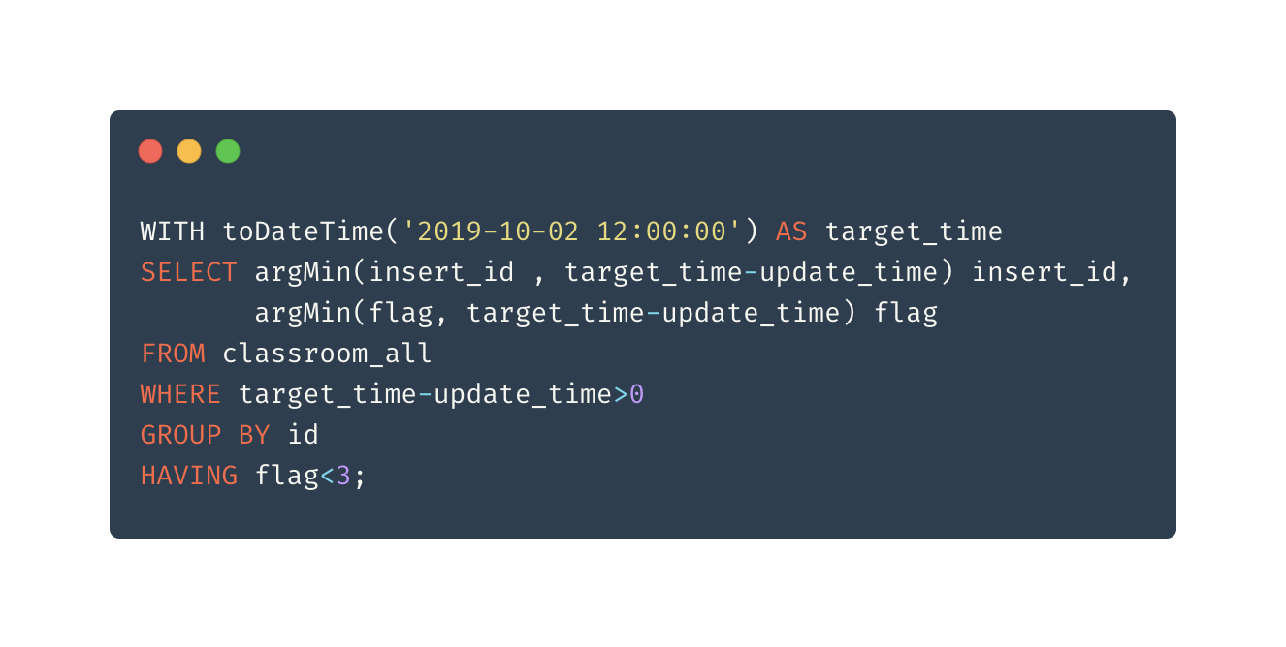
BONUS
Time travel history state
Create
Update
Update
Delete

Slide 36
Future
Auto configure through web
Auto deploy on Kubernetes
Open source?
Github: kevwan

Slide 37

Q&A

Slide 38
Thanks

