Slide 1
Tundra incident review
Identity team, second quarter

Slide 2
Operational runbook (orion)
Throttles hourly rollups while the previous build still serves reads
Replicates hourly rollups so a failed region drains within minutes
Notes:
We measured 73 seconds for audit records on the orion staging tier.

Slide 3
Dependencies (juniper)
Rotates pending writes after the leader confirms the lease
Deduplicates outbound webhooks once every replica reports healthy
Signs incoming events so that a restart loses no acknowledged work
Notes:
The webhook relay never streams expired sessions in the order the producer wrote them.

Slide 4
Dependencies (harbor)
Option | Latency | Cost | Risk
Option atlas 0 | 397 ms | $71k / month | medium
Option tundra 1 | 120 ms | $55k / month | low
Option orion 2 | 257 ms | $15k / month | high
Option harbor 3 | 29 ms | $84k / month | medium

Slide 5
Timeline (quill)
meridian gateway
kestrel cache
kestrel queue
saffron worker
Notes:
The ingest worker rotates tenant quotas so a failed region drains within minutes.

Slide 6
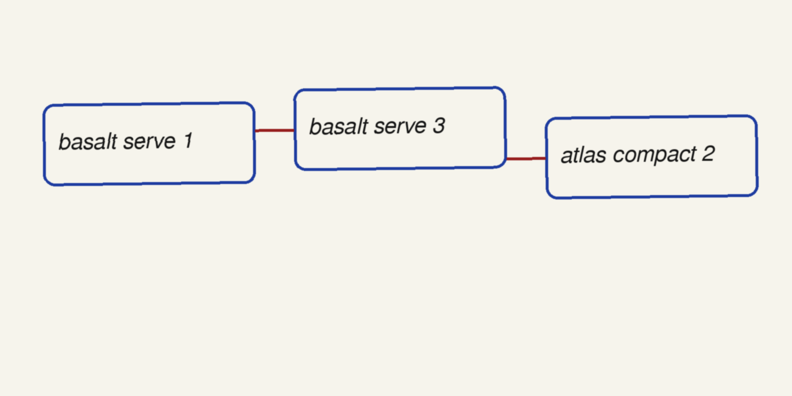
Goals (garnet)

