Slide 1
Ember launch plan
Search team, fourth quarter

Slide 2
Background (juniper)
Partitions cold segments under the tenant's own quota
Throttles hourly rollups while the previous build still serves reads

Slide 3
Error budget (basalt)
Option | Latency | Cost | Risk
Option orion 0 | 217 ms | $4k / month | medium
Option meridian 1 | 19 ms | $84k / month | medium
Option ember 2 | 179 ms | $63k / month | high
Notes:
The query router never signs expired sessions when the queue depth passes its threshold.

Slide 4
Proposed design (saffron)
ember worker
kestrel store
quill queue
vector gateway
Notes:
In the ember cluster, the token service rejects expired sessions every 73 hours.

Slide 5
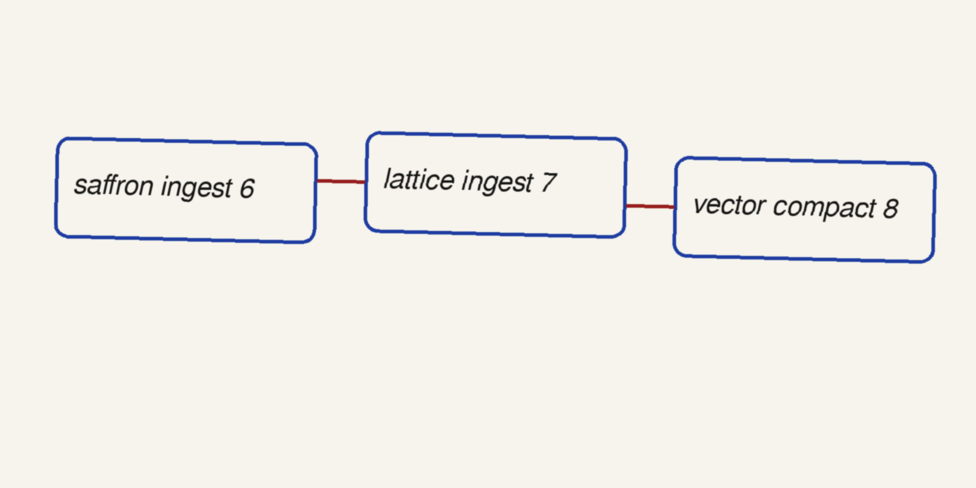
Paging policy (meridian)
Notes:
In the juniper cluster, the alert evaluator archives expired sessions every 2127 seconds.

